Slide 1


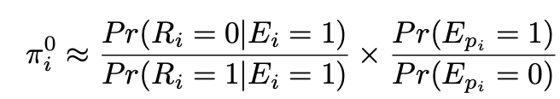


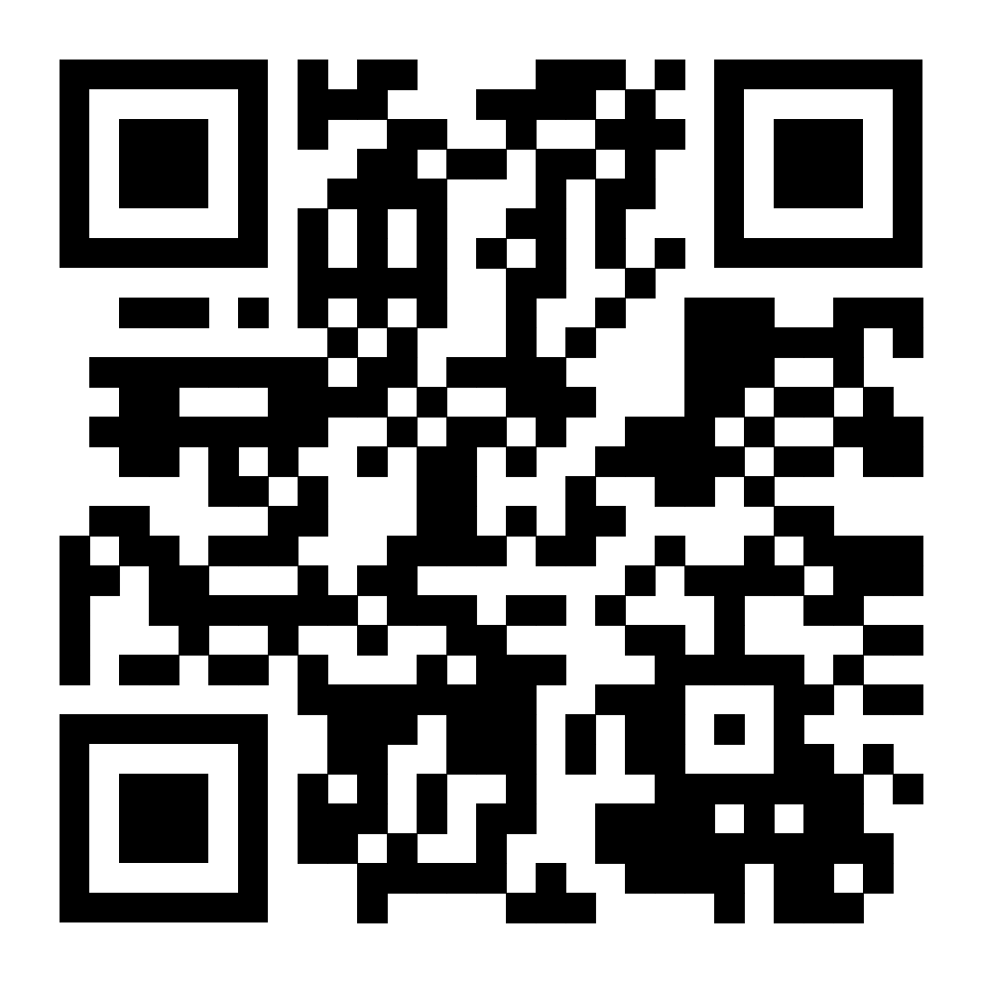


A two-step approach for improved prevalence estimation among hard-to-reach populations
Christoffer Dharma ¹, Peter Smith ^{1,2}, Travis Salway ³, Dionne Gesink ¹, Michael Escobar ¹, Victoria Landsman ^{1,2}
1. University of Toronto; 2. Institute for Work and Health; 3. Simon Fraser University
Population-based vs non-probability data
Multiple Imputation Formula
Illustrative Example
 | Population-based data | Non-probability based data
Examples | Canadian Community Health Survey (CCHS), NHANES (National Health and Nutrition Examination Survey) | Venue based samples, snowball sampling, community-based survey
Advantages | Theoretically more representative; well-calibrated survey weights | Easier to reach hard to reach populations (e.g., sexual minorities)
Drawbacks | Misclassification biases for stigmatized behaviours (e.g.,: drug users, sexual minorities) | Possibility of selection bias; May only be reaching those who are the most connected,
Generate multiply imputed variables m times for each individual where E_{p} = 0. Using Bayes formula, it can be shown that for the i-th individual, the probability of misclassification can be estimated as:
Goal: to estimate prevalence of mental health and well-being among sexual minority men (SMM) using the 2015-2019 Canadian Community Health Survey (CCHS), a population-based survey from Statistics Canada and the 2019 Sex Now data, a non-probability, community-based survey for SMMs.
Two Step Methods
Results
Step 1 - Multiple Imputation of true status
Step 2 – Estimation of prevalence
Apply ALP on the non-probability community survey
True status will always = 1 when reported status = 1
At the end of both cases: Pool the m estimates into a single estimate using Rubin’s formula.
Case 1 – using population survey
Calculate probability of misclassification for each participant in the population survey using ALP-weighted non-probability survey data
Multiply impute each participants’ true status in the population survey m times by assigning a random binary variable (0/1) with the probability assigned above for cases when E =/= 1 (i.e. reported status are not positive).
Case 2 - using non-probability survey
Calculate m prevalence estimates using participant’s true status for each iteration
At the end of each of the m iterated imputations performed at the end of Step 1, we obtained a new set of individuals whose true status = 1.
Use these new individuals to recalculate new pseudoweights for the non-probability sample; each iteration of the new ALP-weights were used to calculate m prevalence estimates.
Case 1 – From the CCHS | Naive, unweighted (95% CI) ª | Survey-weighted (95% CI) ^{b} | Two-step method (95% CI) ^{c}
Any reported mental health diagnosis | 20.92 (19.31, 22.77) | 19.97 (16.12, 23.80) | 18.69 (14.73, 25.02)
Mental health service use | 14.32 (11.93, 16.08) | 15.83 (10.99, 21.47) | 14.59 (10.37, 21.15)
Self-rated mental health | 13.49 (12.06, 14.65) | 13.40 (10.21, 17.92) | 12.60 (8.87, 17.86)
Perceived life stress ^{e} | 23.53 (21.95, 25.25) | 27.05 (22.76, 32.47) | 26.16 (21.32, 32.50)
Objectives
Using previously established method of Adjusted Logistic Propensity and Multiple Imputation (MI), [1,2] we proposed a generalizable two-step method to synthesize information from the two types of surveys above to create a more informed prevalence estimate that correct for both biases simultaneously.
Adjusted Logistic Propensity (ALP)
Case 2 – From Sex Now | Naive, unweighted (95% CI) ª | ALP-weighted (95% CI) ^{d} | Two-step method (95% CI) ^{c}
Any reported mental health diagnosis | 25.72 (24.78, 26.59) | 21.71 (19.17, 23.89) | 21.59 (19.22, 23.92)
Mental health service use | 26.45 (25.46, 27.57) | 24.54 (22.45, 25.85) | 24.27 (22.41, 26.14)
Self-rated mental health | 27.59 (26.55, 28.77) | 23.68 (21.72, 26.34) | 23.75 (21.14, 26.37)
Loneliness ^{f} | 51.25 (50.23, 52.36) | 46.93 (44.73, 50.59) | 47.11 (44.29, 49.93)
1. Harmonize the variables and concatenate the population survey and community-based datasets (`combined sample’)
2. Define a binary outcome = 1 for community-based participants and 0 for population-based surveys participants
3. Estimate pseudoweight of the i-th participant from the community-based survey to be (1 – p_{i}) / p_{i} . These are the ALP weights that will be applied to the community-based samples in subsequent analyses [3]
Assign weight = population-based survey weights
Assign weight = 1 to community-based participants;
Fit logistic regression with the weights as defined above and estimate the probability of the i-th individual to participate in community based-surveys (as a function of covariates) – denote by p_{i}
a. Naïve, unweighted estimate with no weights from either CCHS or Sex Now; b. Survey weighted estimates using Statistics Canada weights; c. Two step methods proposed in this poster.; d. ALP weighted method only; e. only asked in CCHS; f. only asked in Sex Now. 95% were calculated using the bootstrap
Conclusion
Method can be applied in other similar situations with other hard to reach populations. Point estimates should be reliable under theoretical assumptions of the models which might not be met.
No strong differences between the naive estimates and the ones after the two-step methods were applied, disclosure and mental health might not be as strongly associated as initially expected.
Simulations studies might be required to rule out other sources of errors under no violation of assumptions.
Define Notation
Let E = individual’s true status (e.g., sexual orientation: 1 – sexual minority; 0 – heterosexual)
Let R = 1 if an individual is willing to report their true status E if they were selected in a population survey; 0 – otherwise
Let E_{p} be an observed (reported) status variable in a population survey. True status variable E takes value 1 for those who reported E_{p} = 1, but the value of E is missing for those who reported E_{p} = 0
Acknowledgement
We acknowledge the Community Based Research Center (CBRC) for access to the Sex Now data. The author’s doctoral work is funded by the Vanier Canada Graduate Scholarship. The knowledge translation is funded by the 2SLGBTQ+ Knowledge Generation and Mobilization Awards. Work is currently in review at the American Journal of Epidemiology
Questions? chris.dharma@mail.utoronto.ca
Scan QR code below for GitHub codes
References
Rubin DB. Multiple imputation for nonresponse in surveys. Wiley series in probability and mathematical statistics. New York: Wiley, 1987.
Wang L, Valliant R, and Li Y. Adjusted logistic propensity weighting methods for population inference using nonprobability volunteer-based cohort. Statistics in Medicine 2021;40:5237–50.
Dharma C, Smith P, Escobar M, et al. Improving prevalence estimates of mental health and well-being indicators among Sexual Minority Men: A Propensity Weighting Approach. American Journal of Epidemiology. American Journal of Epidemiology: in press. 2023.

