Slide 1
Care and Caregiving
Dr. Laura Sikstrom
Team Meeting, June 7, 2024

Slide 2
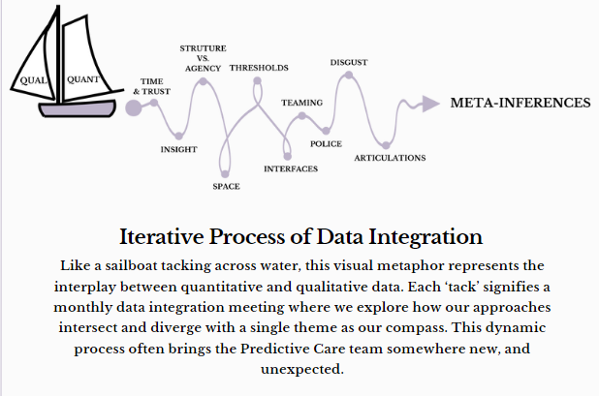

Slide 3
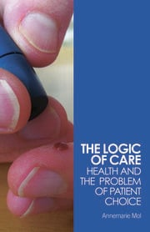
The Anthropology of Care
This project conceptualizes routine risk assessments in the ED as technocratic and embodied care work. By care work, we refer to the range of therapeutic procedures, processes and outcomes that are oriented towards “recovery,” or what anthropologists refer to as “healing”.

Slide 4
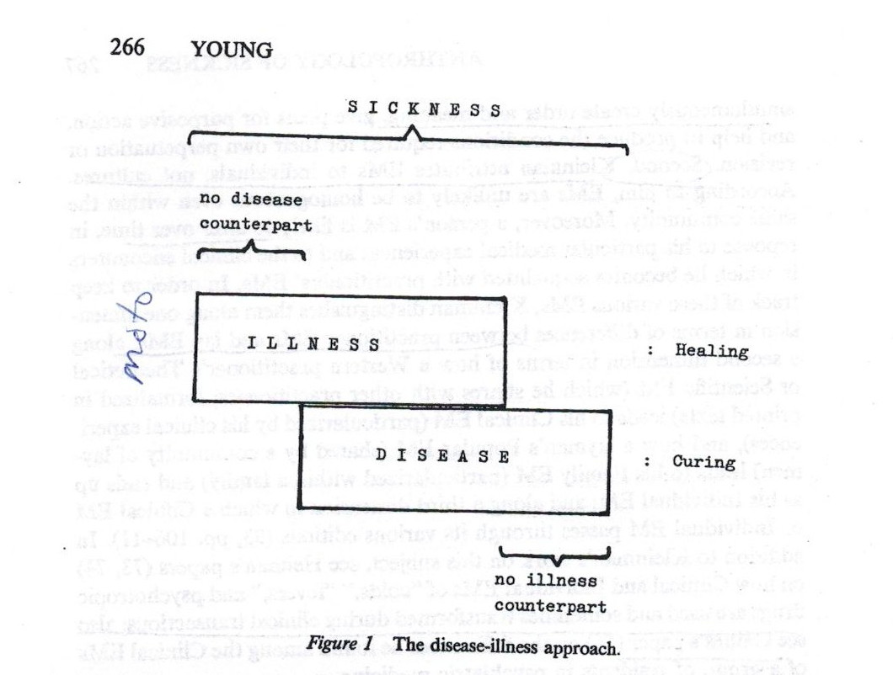
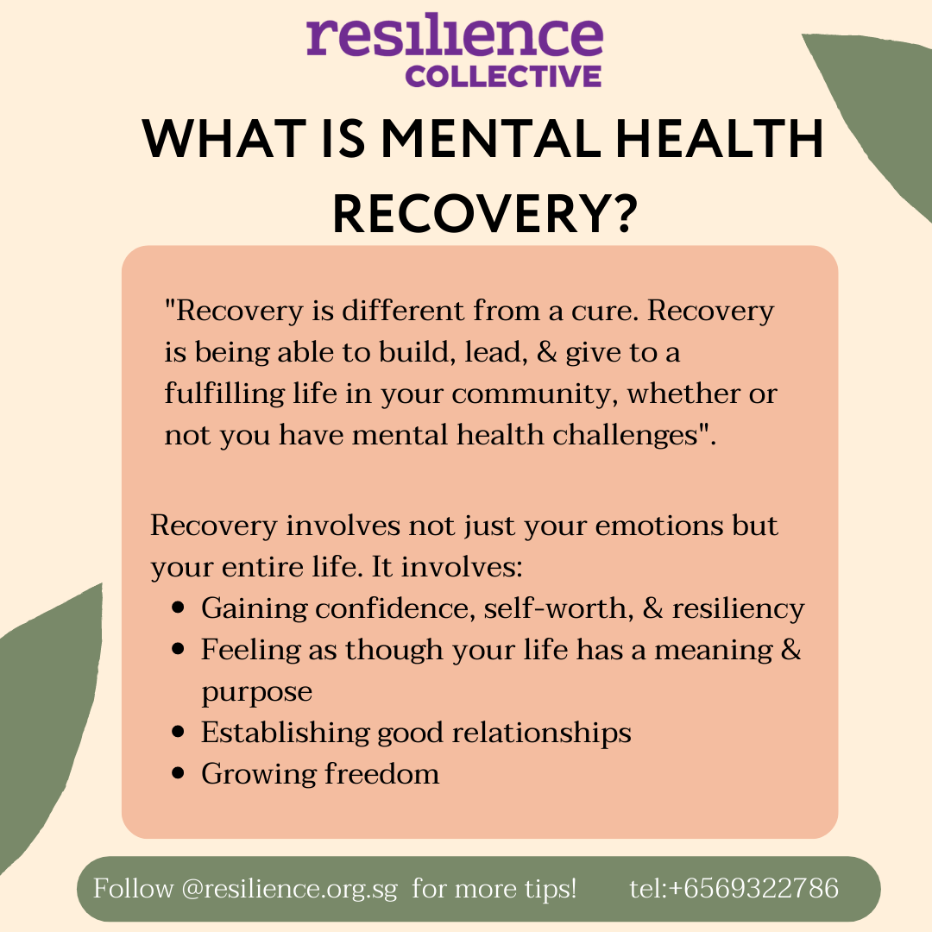
Core Concepts: healing-recovery
Allan Young (1982) The Anthropologies of Illness and Sickness
Neely Myers (2015) Recovery’s Edge: An ethnography of mental health care and moral agency

Slide 5


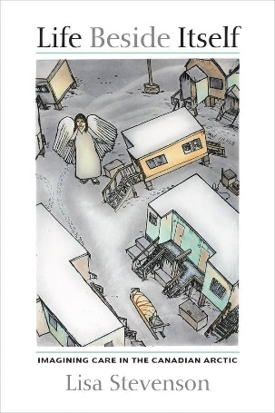
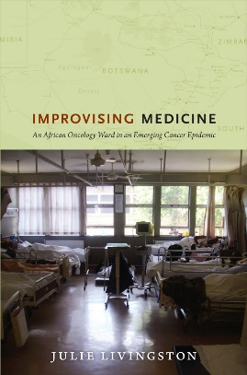

Why “Care”?
Why ‘Care’?
Care as object (or the ways that someone comes to matter). Less about good intentions, positive outcomes or sentimental responses to suffering.(Stevenson).
Gendered and racialized dimensions of care work (e.g., nurses reluctantly taking on interpretative and advocacy work) (Livingston).
Embodied dimensions of learning how to be a ‘good’ doctor (e.g., ‘Are we going to talk about the ethics of this [restraints]?’ (Good, Davenport etc.)
Affective and intersubjective dimensions of care (e.g., touch, cultivating personas, building rapport, therapeutic alliance). (Yates-Doer, Buch etc.)
Medico-legal entanglements (coercion as care) (Garcia, Rhodes)
How AI might reconfigure how we define, conceptualize and problematize care.

Slide 6
What does good care mean to you?
Are there any aspects of your identity that impacted your care (patients) and/or experience with risk assessments (providers)?

Slide 7

Caregiving
Therapy management is a fluid process negotiated among socially embedded persons – a ‘therapy management group.’
Avoids assumptions about who does what and when;
Draws attention to fluid dynamics and competing interests among individuals who actualize health care for the sufferer;
Highlights varying roles of non-family members in caregiving and decision-making and provides opportunity to examine negotiation between and within different interest groups (e.g., authority, decision-making)
Unpacks ideas about decision-making capacity, especially in cases of severe mental illness and/or addiction (e.g., Alberta approach to mandatory addictions treatment)
Caregiving is not just a life affirming gesture reserved only for the healthy towards the sick but is woven into the very practices that may ultimately kill you (e.g., co-patients sharing drugs as forms of care)

Slide 8
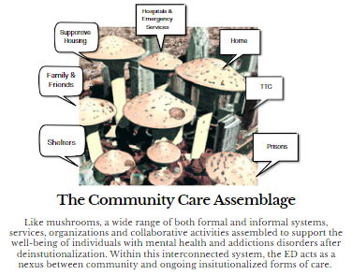
Caregiving & Therapy Networks*
Caregivers | Housing & Employment | Marital Status | Children | Total # Patient Interviews
Police, family, doctors, nurses, social workers, courts, housing facilitators, friends, co-patients + TECHNOLOGY? | “Supportive” (50%) ODSP (majority) | Single (majority) | Mostly none | 26
Alumni Meeting Poster, Feb 2024, Theme 2
* Sikstrom, L. This Disease Ends in Death: Growing up with HIV/AIDS in the Global Health Era.

