Slide 1
De Escalation
History, Trajectory, & Relation to Gender in Acute Care
Hailey Rocha

Slide 2
Table of Contents / Plan
Definition of Term
Timeline
Gender & De Escalation
Discussion
01
02
03
04

Slide 3
De Escalate
De Escalate
Oxford English Dictionary:
Verb. [with object]
reduce the intensity of (a conflict or potentially violent situation)
Cambridge English Dictionary:
Verb.
to (cause to) become less dangerous or difficult

Slide 4
De-Escalation
“De-escalation involves the use of various psychosocial short-term techniques aimed at calming disruptive behaviour and preventing disturbed/violent behaviour from occurring. Every effort is made to avoid confrontation.”
National Collaborating Centre for Nursing and Supportive Care (UK). (2005). Violence: The Short-Term Management of Disturbed/Violent Behaviour in In-Patient Psychiatric Settings and Emergency Departments. Royal College of Nursing (UK).
Notes:
This can include talking to the service user, often known as verbal de-escalation, moving service users to a less confrontational area, or making use of a specially designated space for de-escalation.

Slide 5
Verbal De-Escalation
“A nurse might describe it as "talking the patient down," but it is actually a complex, interactive process in which the patient is redirected toward a calmer personal space. Nursing goals are reduction of anxiety, maintenance of control, and avoidance of violent acting out. These are achieved through effective communication with the patient, using the nurse's training and skills to identify the patient's Stressors and providing the patient with functional alternatives to aggression.”
Stevenson, S. (1991). Heading Off VIOLENCE With Verbal DE-ESCALATION. Journal of Psychosocial Nursing and Mental Health Services, 29 (9), 6-9. doi: 10.3928/0279-3695-19910901-04.

Slide 6
Other Terms Used For De Escalation
In The Literature
“Conflict resolution”
“Conflict management”
“Crisis resolution”
“Talk down”
“Defusing”
“Intervention”
“Violence mitigation”
“Predictive”
Notes:
Although most follow similar principles, there is no single systematic / universally agreed upon definition or model of De-Escalation

Slide 7
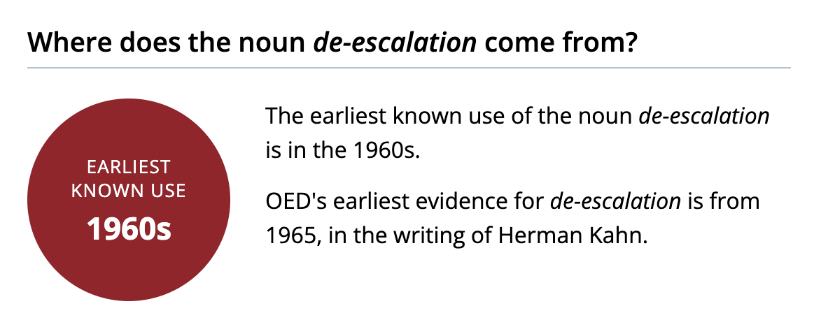
Timeline: Transformation of Term/Concept
Oxford English Dictionary:
Used in relation to warfare and nuclear strategy

Slide 8
Timeline: Transformation of Term/Concept
1970s
1980s
1990s
Related to political unrest & global conflict
Police begin de escalation training in the context of domestic violence intervention
Training programs begin to develop in acute mental health care settings for the management and intervention of violent patients
A strong focus on systemic implementation in acute care
Introduction of "therapeutic communication" and verbal de escalation training as focus
Opting for “Least Restrictive Measures”
The voices of female nurses and acute care staff begin to be more represented in the literature
Gaps in acute care training are identified as workplace violence continues to persist
Specific de escalation training begins to roll out across select parts of North America
Consistency in intervention a key goal
Found most in the pediatric context

Slide 9
Timeline: Transformation of Term/Concept
2000s
2010s
2020s
A more comprehensive approach is being introduced, including the acknowledgement of gender, race, and particular mental health disorders
Space as a form of de escalation is emerging, (noise control, light, colour and access to space)
Internal and external causation at centre of approach
Focuses on the decriminalizing of mental illness when de escalating
Stronger presence of allied health professionals and first responders in treatment process
Clearly stating expectations and limits as a provider
Agitation rather than violence/overt aggression begins to be addressed
Verbal de-escalation and nonverbal communication being used to increase autonomy and choice of patients

Slide 10
Gender & De Escalation
Gender is rarely explicitly discussed as a contributing factor in the ways de escalation is used in practice.
This lack of mention within the literature leaves gaps in care as gender contributes to…
Lived experiences
Medical mistrust and distrust
Positionality of providers and patients
Social determinants of health
Manifestations of violence, aggression, and agitation
Specific needs (eg, menstrual products)
Physical advantages or limitations
Trauma (personal & intergenerational)

Slide 11
Gender & De Escalation
Gender-Informed
Trauma-Informed
Treatment approaches addressing the wide range of women’s needs (eg. physical, social, mental health needs, and biological and social reproductive services)
Aware of gender specific issues, oppression, and systemic factors that fundamentally impact experiences and interactions within society (eg. sexism, misogyny)
Trauma awareness/acknowledgment
Maintaining trust and safety
Promoting choice and collaboration
Maintaining focus on strength/skills building
Attending to cultural, historical, and gender issues (eg. intimate partner violence, intergenerational trauma, sexual violence, etc.)
Quilty L, Agic B, Coombs M, Kristy B, Shakespeare J, Spafford A, Besa R, Dematagoda S, Patel A, Persaud R, Buckley L Benefits of Digital Health Resources for Substance Use Concerns in Women: Scoping Review JMIR Ment Health 2021;8(6):e25952 URL: https://mental.jmir.org/2021/6/e25952 DOI: 10.2196/25952

Slide 12
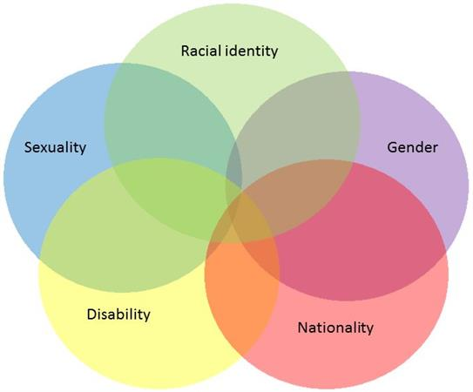
De Escalation with an Intersectional Lens
Boston et al.
Notes:
Kimberlé Williams Crenshaw. It is the study of overlapping or intersecting social identities and related systems of oppression, domination, or discrimination.

Slide 13
Notes:
Literature is yet to be fully clear about exactly what is being addressed/focused on in training modules
Seemingly no actively enforced/regulated standard of care has been developed in relation to de escalation of violence
Good Hearts Law – “when a measure becomes a target, it ceases to be a good measure.”
How do prevention and de escalation differ from one another in practice?

Slide 14
Discussion
Thank you!

