Slide 1


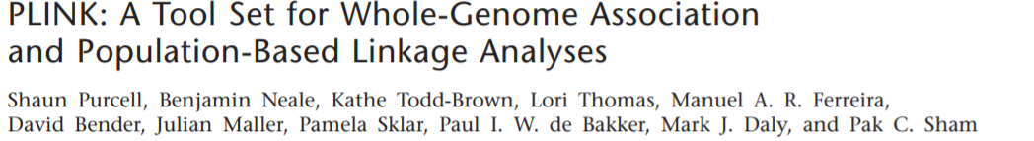
WORKSHOP
Using PLINK for genome-wide association studies
Vanessa Gonçalves, PhD
Arun Tiwari, PhD
Clement Zai, PhD
Victoria Marshe, PhD
Tuesday, September 16th, 2021

Slide 2

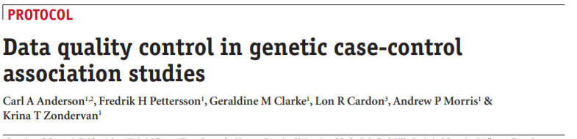
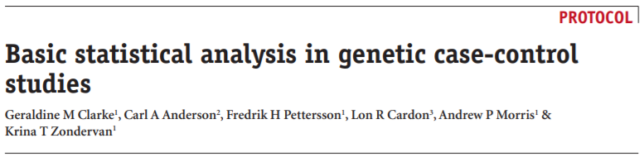
Key References
Anderson CA et al. Data quality control in genetic case-control association studies. Nat Protoc. 2010 Sep;5(9):1564-73.
doi: 10.1038/nprot.2010.116.
Clarke GM et al. Basic statistical analysis in genetic case-control studies. Nat Protocol. 2011 Feb;6(2):121-33.
doi: 10.1038/nprot.2010.182.

Slide 3
Overview
→ Background
→ Quality control (QC) steps
→ Statistical Analysis
→ Next steps and alternative approaches
Notes:
This is the proposed overview

Slide 4
BACKGROUND
Source of DNA
Genotyping platform
Batch effect
Build and strand
Initial Data
SAMPLE QUALITY CONTROL
Call rate
Excess heterozygosity
Population stratification
Familiar relationships
SNP QUALITY CONTROL
Call rate
MAF
HWE
Select good quality SNPs
Select good quality samples
Run association analysis
Adapted from Alonso N, 2008
Notes:
Explain QC steps: what MAF, HWE and Call rare means. We used MAF=1% and allowed for 5% of mising data per genotyoe

Slide 5
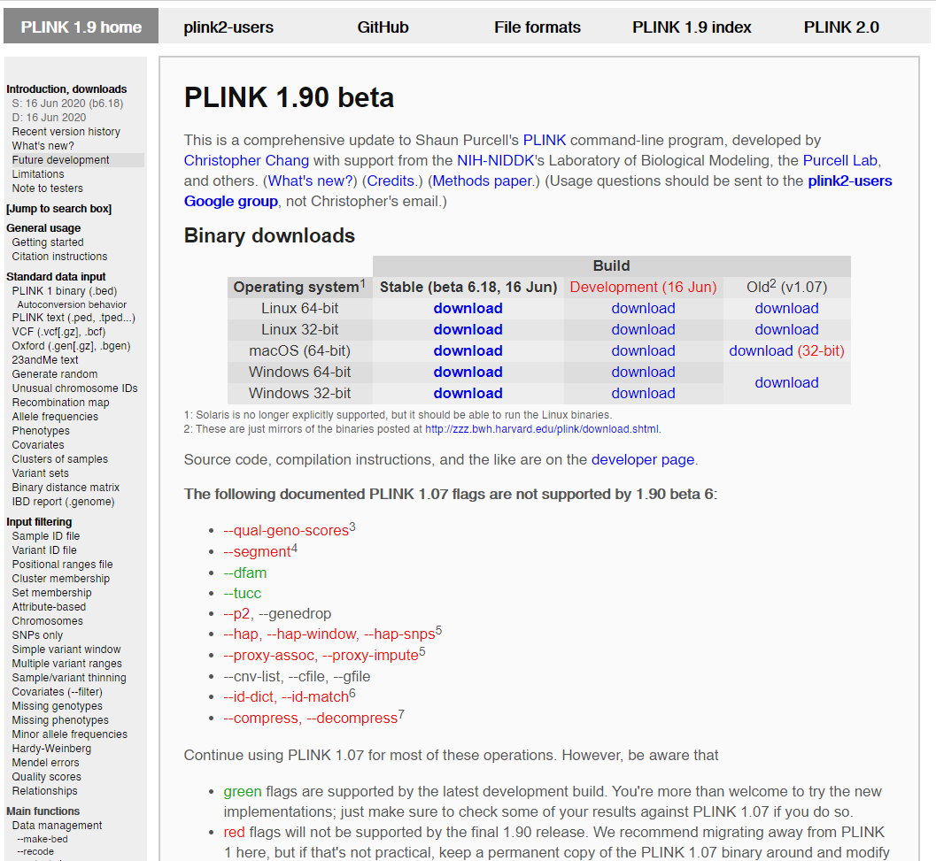
Background: PLINK (Purcell et al., 2007)
PLINK is a free, open-source whole genome association analysis toolset
Designed to perform a range of basic, large-scale analyses in a computationally efficient manner
Command-line program that works on Windows, Mac and Linux
Image retrieved from: https://www.cog-genomics.org/plink2
Notes:
More information can be found in plink web-site. Note, than most steps described in tutorial can be applied to candidate gene studies and GWAS

Slide 6
Quality Control: File Formats
STEP 1. Creating binary files
plink --file raw-GWA-data --make-bed --out raw-GWA-data
→ A PED file is white-space (space/tab) delimited file; the first 6 columns are mandatory:
FID | Family ID
IID | Individual ID
PID | Paternal ID
MID | Maternal ID
Sex | Sex [1 = male (XY); 2 = female (XX); other = unknown]
Phenotype | Phenotype
ped
bed
fam
→ By default, each link of the MAP file describes a single marker and must contain exactly 4 columns:
CHR | Chromosome (1-22, X, Y or 0 if unplaced)
SNP | rs# or SNP identifier
POS | Genetic distance (morgans)
BP | Base-pair position (bp units)
map
bim
NOTE. In the “bed” format, the first 6 columns from ped file are stored in the “fam” file, while genotypes are coded in the binary format. ”Bim” file is the “map” file enriched by information about minor and major allele.
Notes:
Do not open the bed file.

Slide 7
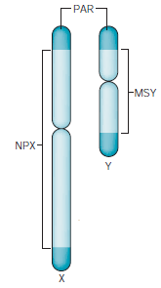
Quality Control for Individuals: Check Sex Info
STEP 2. Check sex information
→ Identify and list individuals with discordant sex information (requires X chromosome information)
plink --bfile raw-GWA-data --check-sex --out sex
Generated file: plink.sexcheck
Sex | NPX Genetic differences (alleles) | F
XX | 2 | F < 0.2
XY | 1 | F > 0.8
NOTE. It calculates to the mean homozygosity rate across X-chromosome markers for each individual in the study.
Notes:
Typically one expects male samples to have a homozygosity rate of 1 (though due to genotyping error there is variation around this) and females to have a homozygosity rate less than 0.2
F is coefficient of inbreeding

Slide 8
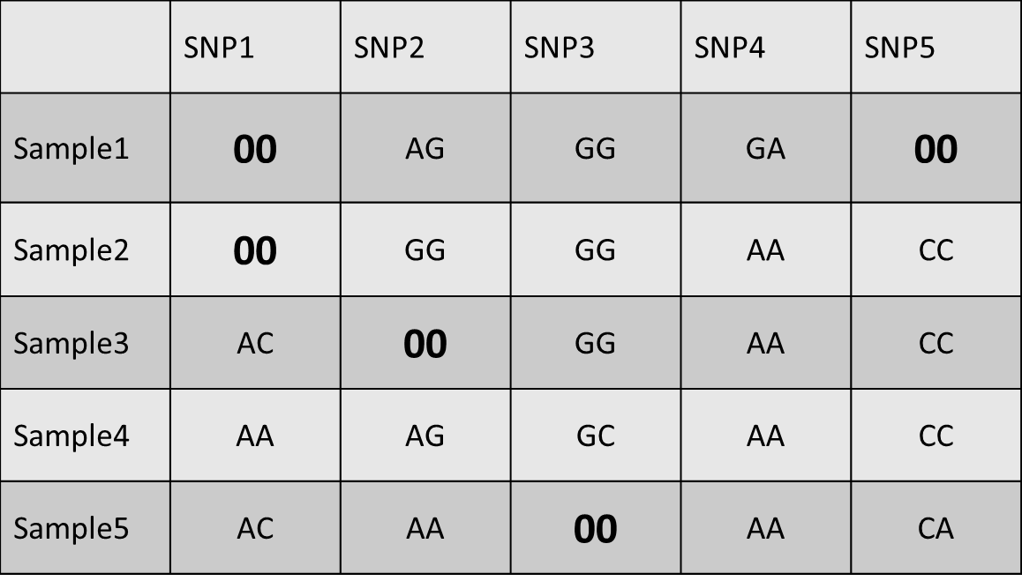
Quality Control for Individuals: Missingness
STEP 3. Check genotyping rate per individual
plink.imiss showing missing genotypes for each subject (%):
plink --bfile raw-GWA-data --missing --out raw-GWA-data
40%
Generated files: plink.imiss, plink.lmiss
20%
20%
 | SNP1 | SNP2 | SNP3 | SNP4 | SNP5 | Individual Missingness (%)
SAMPLE 1 | 00 | AG | GG | GA | 00 | 40%
SAMPLE 2 | 00 | GG | GG | AA | CC | 20%
SAMPLE 3 | AC | 00 | GG | AA | CC | 20%
SAMPLE 4 | AA | AG | GC | AA | CC | 0%
SAMPLE 5 | AC | AA | 00 | AA | CA | 0%
SNP Missingness (%) | 40% | 20% | 20% | 0% | 20%
0%
20%
plink.imiss
plink.lmiss showing
missing genotypes
for each SNP (%): 40% 20% 20% 0% 20%
plink.lmiss
NOTE. In general, 1 to 5% of missing data per individual and SNP are allowed.
Notes:
Missingness plots can be generated in R,

Slide 9
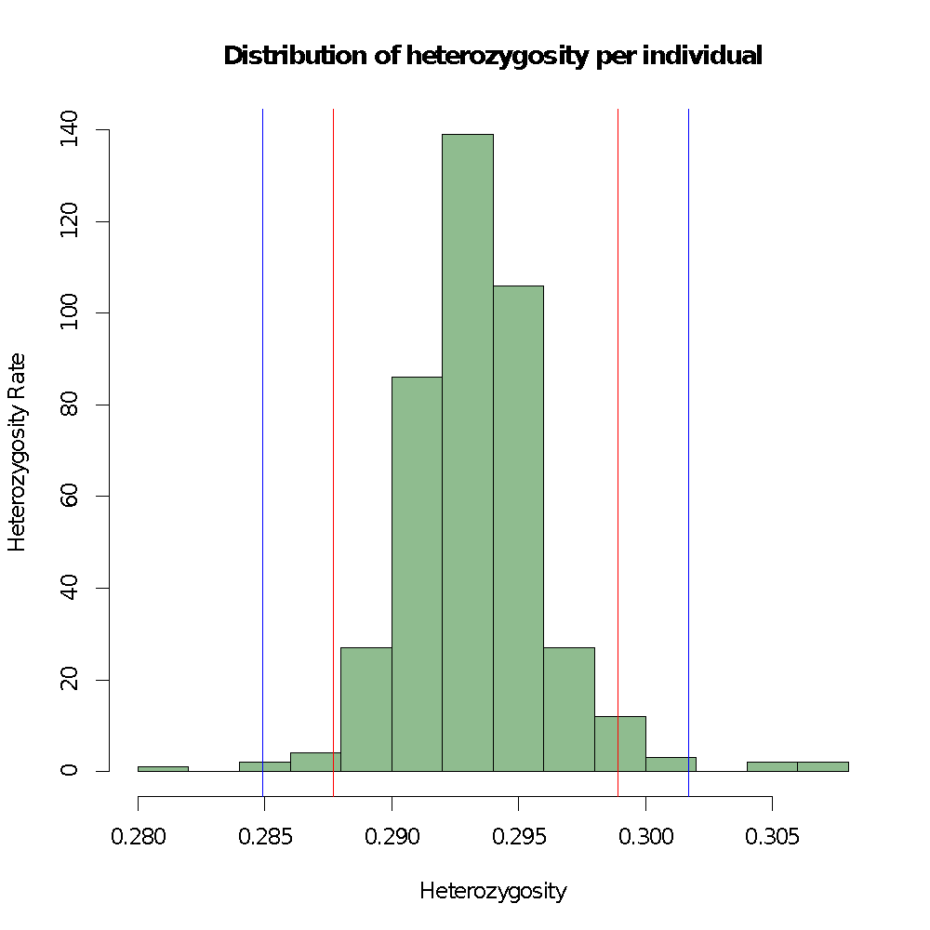
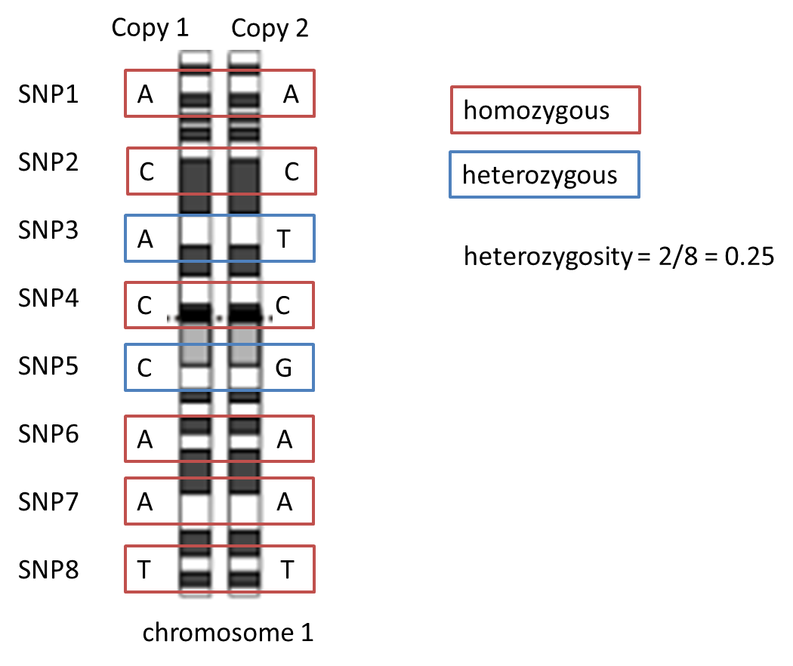
Quality Control for Individuals: Heterozygosity
STEP 4. Check individual heterozygosity rate
plink --bfile raw-GWA-data --het --out raw-GWA-data
Generated file: raw-GWA-data.het
NOTE. To calculate the observed heterozygosity rate per individual: (N(NM) - O(Hom))/N(NM)
Abbreviations.
N(NM): non-missing genotypes
O(Hom): observed number of homozygous genotypes
Notes:
Likewise, the distribution of mean heterozygosity (excluding the sex chromosomes) across all individuals should be inspected to identify individuals with an excessive or reduced proportion of heterozygote genotypes, which may be indicative of DNA sample contamination or inbreeding, respectively.

Slide 10
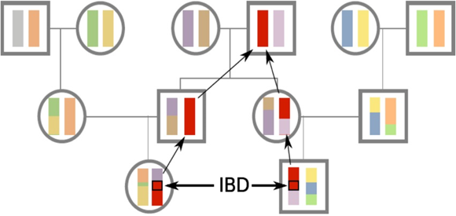
Quality Control for Individuals: Duplicated or Related Individuals
STEP 5. Search for duplicate or related individuals
plink --bfile DATA --exclude high-LD-regions.txt --indep-pairwise
50 5 0.2 --out prune
NOTE. First, decrease number of SNPs for this specific analysis
plink --bfile raw-GWA-data --extract raw-GWA-data.prune.in --genome --out raw-GWA-data
NOTE. Typically, one individual in a pair that achieved an IBD of over 0.1875 is removed.
Relationship category | Relatedness
Monozygotic twins | 1
Parent-Offspring | 0.5
Full siblings | 0.5
Grandparent-grandchild | 0.25
Uncle/Aunt-Nephew/Niece | 0.25
First cousins | 0.125
Unrelated | 0
Table: http://www.icompbio.net/wp-content/uploads/GWAS-Tutorial-Bush1.pdf
Notes:
If duplicates, first- or second- degree relatives are present, a bias may be introduced to the study because the genotypes within families will be over- represented, and thus the sample may no longer be a fair reflection of the allele frequencies of the entire population.
a metric (identity by state, IBS) is calculated for each pair of individuals based on the average proportion of alleles shared in common at genotyped SNPs (excluding the sex chromosomes). The method works best when only independent SNPs are included in the analysis.
Related individuals will share more alleles IBS than expected by chance, with the degree of additional sharing proportional to the degree of relatedness.
For any given pair of individuals with genotype information, identity-by-state (IBS) can be observed at a given locus with three possible outcomes: the individuals have two different alleles (IBS0) or they share one (IBS1) or two (IBS2) alleles in common.

Slide 11
Quality Control for Individuals: Self-reported Ancestry vs. Genetic Ancestry (1)
STEP 6. Search for population stratification
Requires a reference population data set, such as 1000 Genomes
→ Extract independent SNPs from the main data
plink --bfile raw-GWA-data --extract prune.prune.in --make-bed --out raw-GWA-data-pruned
→ Merge reference with your data set
plink --bfile raw-GWA-data-pruned --bmerge 1000G.bed 1000G.bim 1000G.fam --make-bed --out 4Flips
→ Remove SNP with strand issues
plink --bfile raw-GWA-data-pruned --flip 4Flips.missnp --make-bed --out raw-GWA-data_Align
→ Merge data sets again
plink --raw-GWA-data_Align --bmerge 1000G.bed 1000G.bim 1000G.fam --make-bed --make-bed --out raw-GWA-data-1000G
Notes:
It is crucial to confirm self-reported ancestry as presence of uncorrected and undetected population stratification can lead to spurious associations

Slide 12
QC for individuals: self reported ancestry vs genetic ancestry (3)
Quality Control for Individuals: Self-reported Ancestry vs. Genetic Ancestry (2)
→ Generate pairwise IBS estimates
plink --bfile raw-GWA-data-1000G --genome –out IBS
→ Perform Multidimensional Scaling (MDS) or principal component analysis (PCA)
--plink --bfile raw-GWA-data-hapmap --read-genome IBS –cluster --pca --out raw-GWA-data-hapmap-PCA
NOTE. Outliers are defined as ± 6 SD from mean (Price et al., 2006)

Slide 13
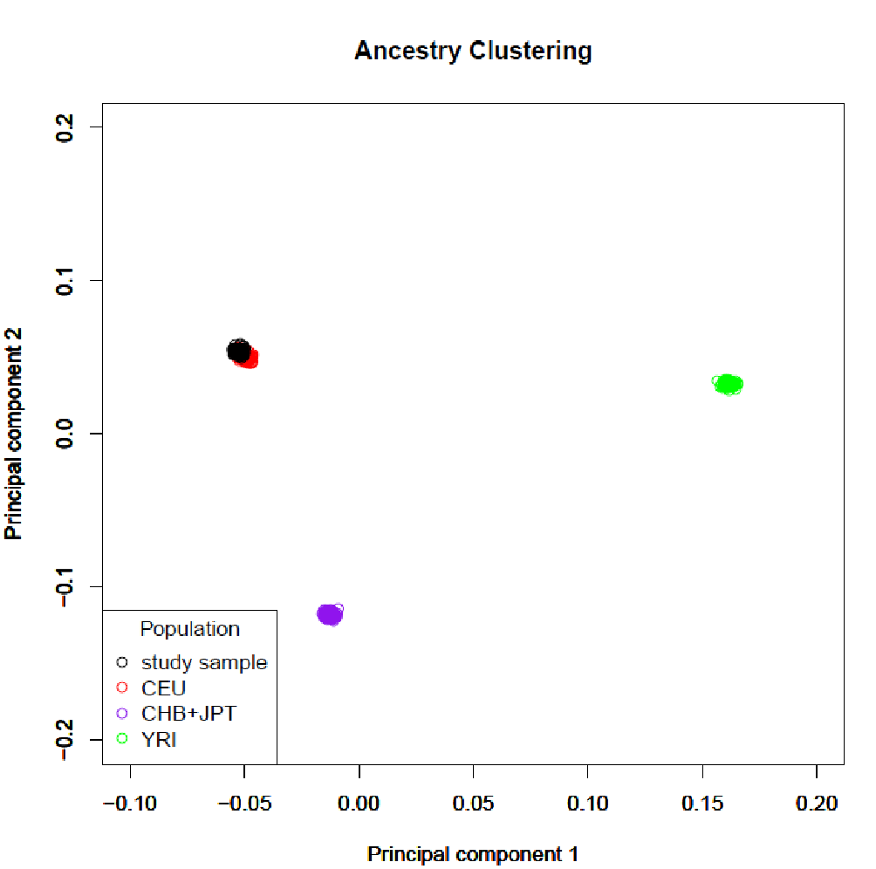
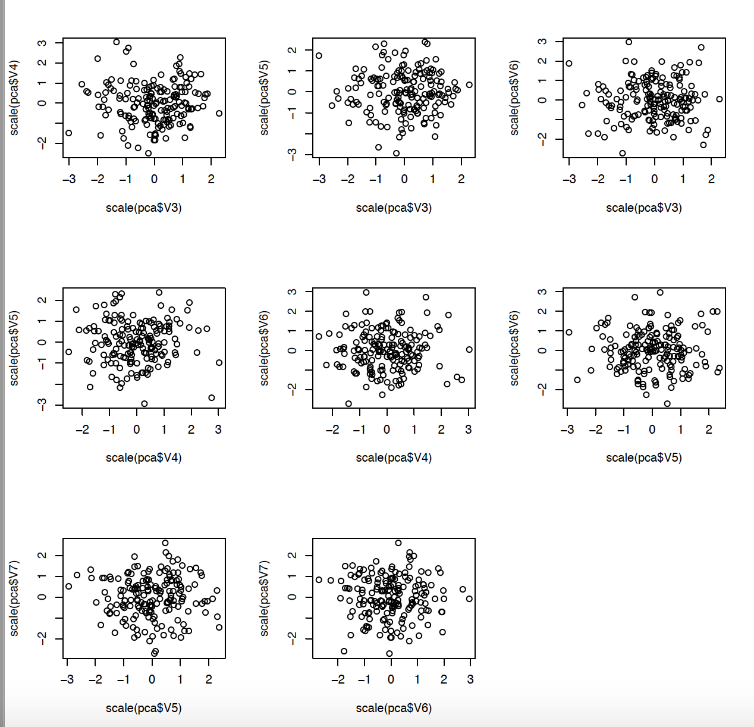
Quality Control for Individuals: Self-reported Ancestry vs. Genetic Ancestry (3)

Slide 14
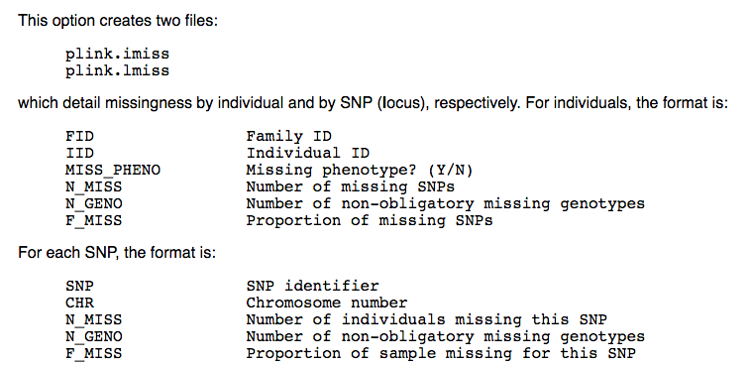
Quality Control for SNPS: Missingness
STEP 7. Identify SNPs with excessive missing data rate
plink --bfile clean-inds-GWA-data --missing --out lmiss
→ For each SNP, the format is:
SNP | SNP identifier
CHT | Chromosome number
N_MISS | Number of individuals missing this SNP
N_GENO | Number of non-obligatory missing genotypes
F_MISS | Proportion of sample missing for this SNP

Slide 15
Quality Control for SNPs: Excluding Poor Quality SNPs
STEP 8. Remove all poor SNPs from association analyses
plink --bfile clean-inds-GWA-data --mind 0.05 --maf 0.01 --geno 0.05 --hwe 0.00001 --make-bed --out clean-GWA-data
Options in effect:
--mind 0.05: allow 5% of missing data per individual (1% is also frequently used)
--maf 0.01: remove SNPs with minor allele frequency lower than 1%
(other frequently used option is 5%)
--geno 0.05: allow 5% of missing data per SNP (1% is also frequently used)
--hwe 0.00001: p-value from chi-squared test for Hardy-Weinberg equilibrium
Notes:
Under Hardy-Weinberg assumptions, allele and genotype frequencies can be estimated. When the ratios of homozygous and heterozygous genotypes significantly differ from the prediction under HWE assumptions, it can indicate genotyping errors, batch effects, population stratification

Slide 16
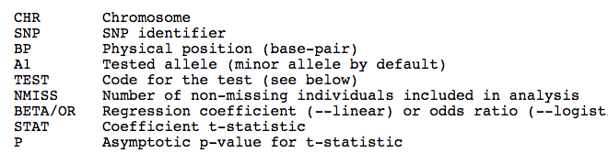
Association Analyses
STEP 9. Association analysis
→ Linear (for quantitative trait) or logistic (for binary trait) regression
plink --bfile clean-GWAS-data --pheno GWA-pheno.txt --pheno-name trait --covar GWA-pheno.txt --covar-name covar1,covar2 --linear --out trait
CHR | Chromosome number
SNP | SNP identifier
BP | Physical position (base-pair)
A1 | Tested allele (minor allele default)
TEST | Code for the test
NMISS | Number of non-missing individuals included in analysis
BETA/OR | Regression coefficient (--linear) or odds ratio (--logistic)
STAT | Coefficient t-statistic
P | Asymptotic p-value for t-test

Slide 17
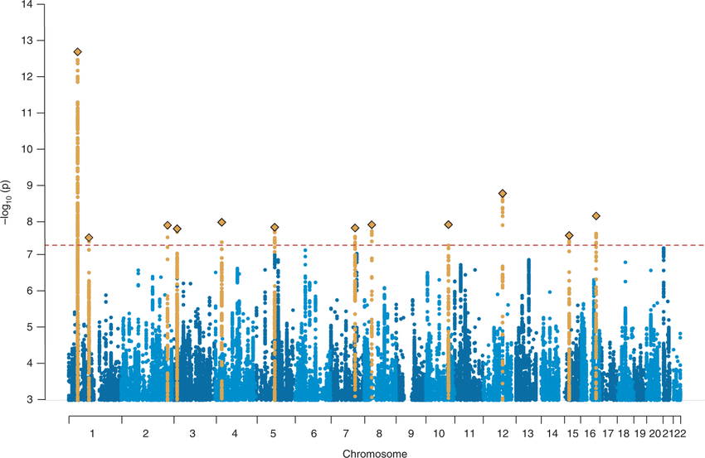
Visualization: Manhattan Plot
Image: Demontis et al. Discovery of the first genome-wide significant risk loci for attention deficit/hyperactivity disorder. Nat Genet. 2019 Jan;51(1):63-75.

Slide 18
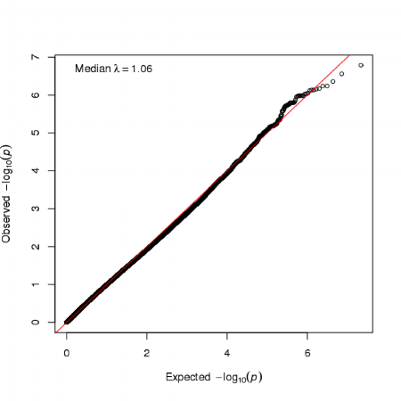
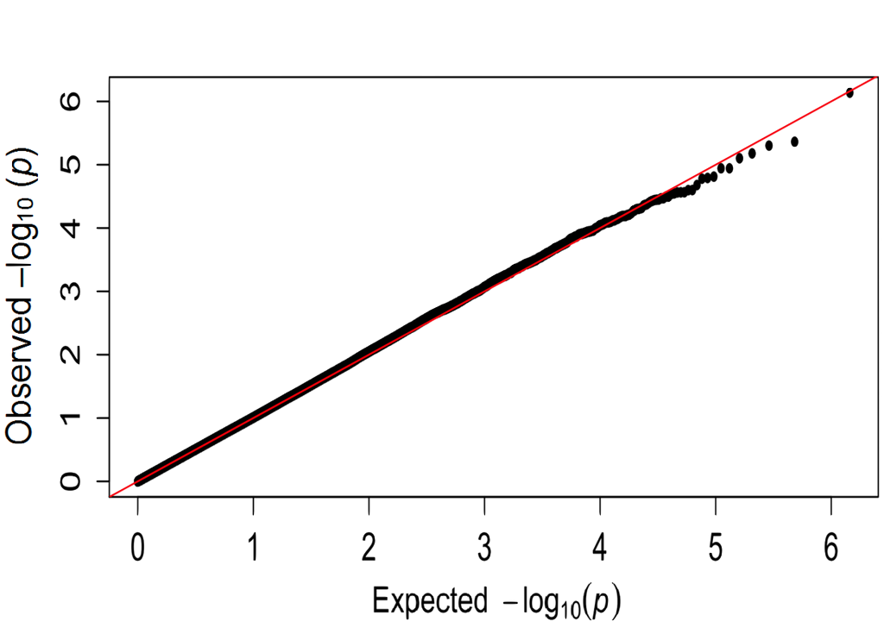
Visualization: QQ-plot for Quality Control
→ This is a quantile-quantile (QQ) plot
→ Dots (representing p-values) are located on the diagonal (null hypothesis)
→ This QQ plot suggests that there is no significant difference between expected and observed p-values.
Image retrieved from http://www.mdpi.com/1422-0067/16/1/2145/htm, Ren H et al Int. J. Mol. Sci. 2015
Source: http://www.nealelab.is/blog/2017/9/11/details-and-considerations-of-the-uk-biobank-gwas

Slide 19
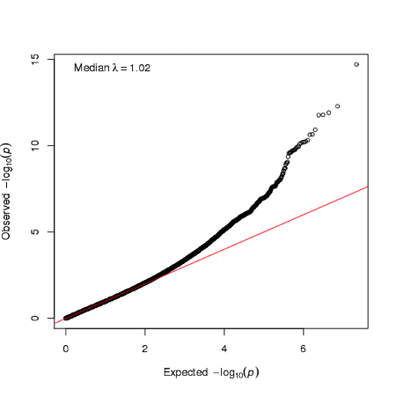
Visualization: QQ-plot for Quality Control
→ This QQ plot suggests that there are significant differences between expected and observed p-values or inflation
Image retrieved from http://www.mdpi.com/1422-0067/16/1/2145/htm, Ren H et al Int. J. Mol. Sci. 2015
Source: http://www.nealelab.is/blog/2017/9/11/details-and-considerations-of-the-uk-biobank-gwas

Slide 20
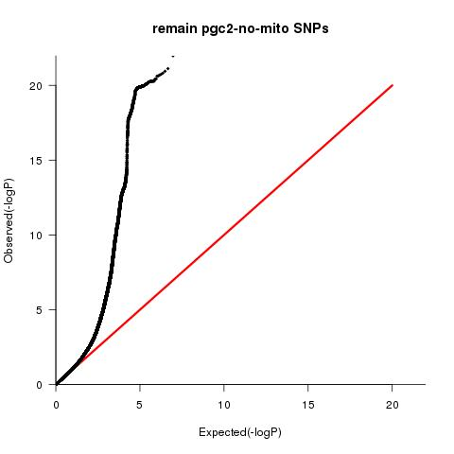
Visualization: QQ-plot for Quality Control

Slide 21
GWAS: Next Steps
→ Replication on independent sample is also required for validation of findings
→ Power analysis is needed
Tools as Quanto (Windows only) or Genetic power calculator (http://pngu.mgh.harvard.edu/~purcell/gpc/) are suitable for such analyses.
→ Biological role: HaploReg, GTEx portal, etc.
→ Pathway? Gene-set analysis: MAGMA statistical tool;
→ Imputation to increase genome-wide coverage

Slide 22
Useful Resources
TUTORIALS
→ http://www.icompbio.net/wp-content/uploads/GWAS-Tutorial-Bush1.pdf
→ http://www.h3abionet.org/component/attachments/download/285
WEBSITE
→ http://www.gettinggeneticsdone.com/
→ http://genometoolbox.blogspot.ca
PUBLICATIONS
→ Anderson, C.A., et al. (2010) Data quality control in genetic case-control association studies. Nat Protoc. 5:1564-1573. doi:10.1038/nprot.2010.116
→ Clarke, G.M., et al. (2011) Basic statistical analysis in genetic case-control studies. Nat Protoc. 6: 121-133. doi:10.1038/nprot.2010.182.
R packages
→ GenABEL, qqman
→ Running GWAS in GenABEL: http://www.genabel.org/sites/default/files/html_for_import/GenABEL_tutorial_html/GenABEL-tutorial.html
→ QC and association in BioConductor: https://www.bioconductor.org/packages/3.3/bioc/vignettes/GWASTools/inst/doc/DataCleaning.pdf
Notes:
R might be better options for Windows usewrs

Slide 23
Thank you!

Slide 24
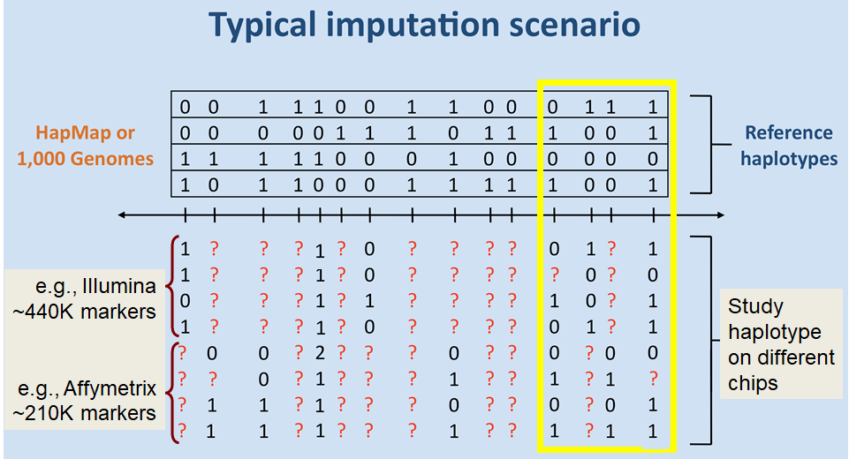
Imputation
Useful Resources
Modified from mathgen.stats.ox.ac.uk

Slide 25
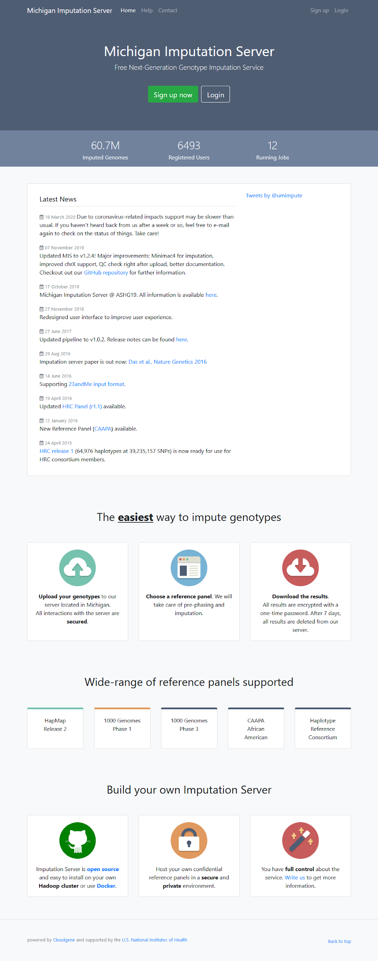
Imputation -- considerations
Imputation
QC, map, and strand
Software:
Minimac4 (Michigan Imputation Server)
Beagle (https://faculty.washington.edu/browning/beagle/beagle.html)
IMPUTE2 (https://mathgen.stats.ox.ac.uk/impute/impute_v2.html#home)
Reference Panel:
1000 Genomes Phase 3
HapMap
Haplotype Reference Consortium (HRC)
Prephasing
Post-imputation QC

Slide 26
Imputation -- MIS
Imputation
plink --bfile sample_b37fwd_cleaned --chr 22 --make-bed --out sample_b37fwd_cleaned_chr22
plink --bfile sample_b37fwd_cleaned_chr22 --recode vcf --out sample_b37fwd_cleaned_v_chr22
vcf-sort sample_b37fwd_cleaned_v_chr22.vcf | bgzip -c > sample_b37fwd_cleaned_v_chr22.vcf.gz
Upload to Michigan Imputation Server
7za e chr22.zip # to get dose.vcf.gz and info files.gz
Filter for Rsq threshold, duplicate SNPs (multiallelic)...
plink --vcf chr22.dose.vcf.gz --extract chr22.info_6.uniqSNPs --make-bed --out chr22.dose
Update sex in PLINK sample file, update SNP IDs
Post-imputation QC: e.g., MAF, missingness, HWE
gzip -cd chr22.info.gz | head -20
SNP REF(0) ALT(1) ALT_Frq MAF AvgCall Rsq Genotyped LooRsq EmpR EmpRsq Dose0 Dose1
22:16050115 G A 0.00639 0.00639 0.99361 0.00000 Imputed - - - - -
22:16050213 C T 0.00759 0.00759 0.99241 0.00000 Imputed - - - - -
22:16050568 C A 0.00040 0.00040 0.99960 0.00000 Imputed - - - - -
22:16050607 G A 0.00100 0.00100 0.99900 0.00000 Imputed - - - - -

Slide 27
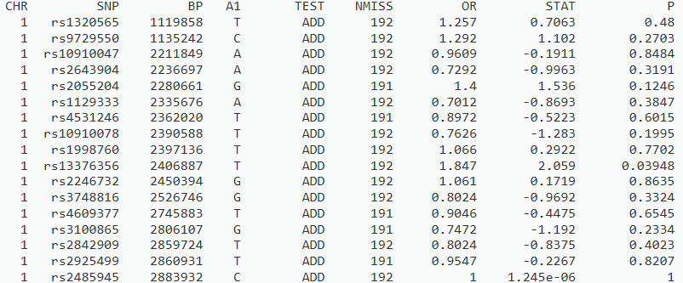
Post-GWAS Analyses: Using Summary Statistics
Association results (e.g., rem.assoc.logistic)

Slide 28
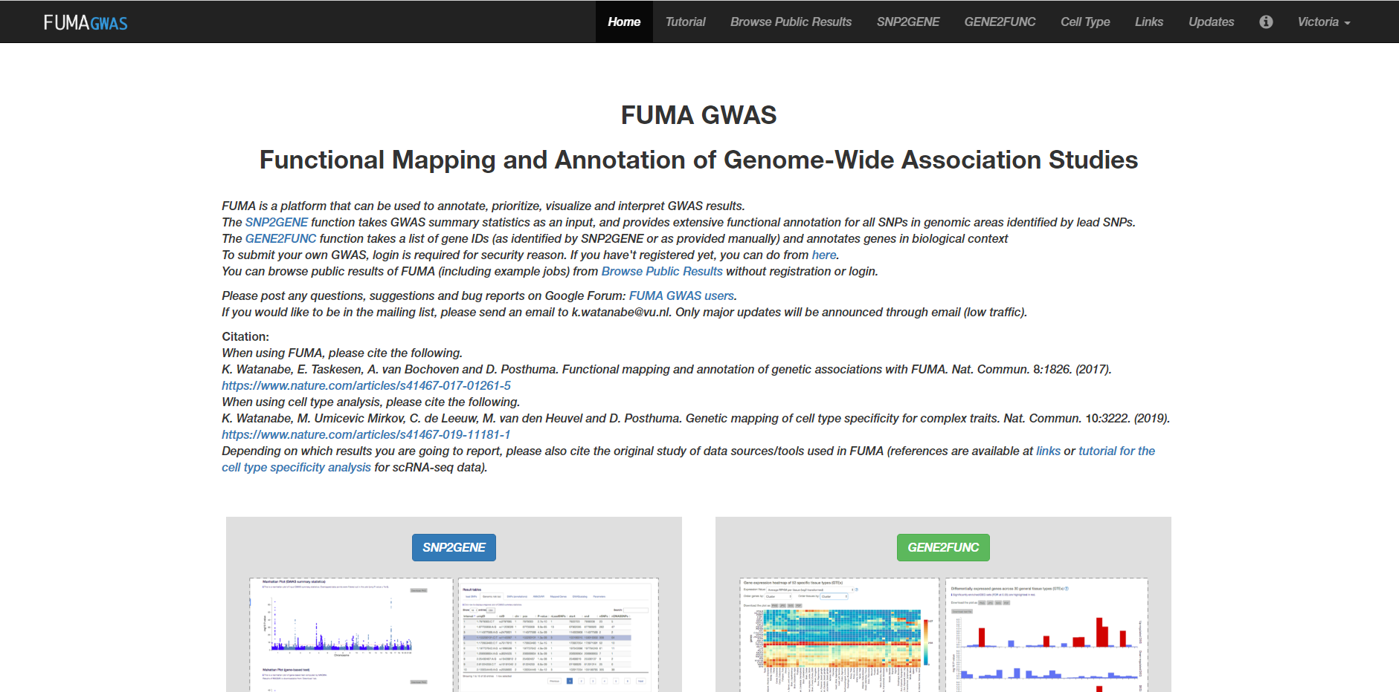
Post-GWAS Analyses: FUMA (Watanabe et al., 2017)
From summary statistics to SNP annotation
From SNP annotation to gene annotation

Slide 29
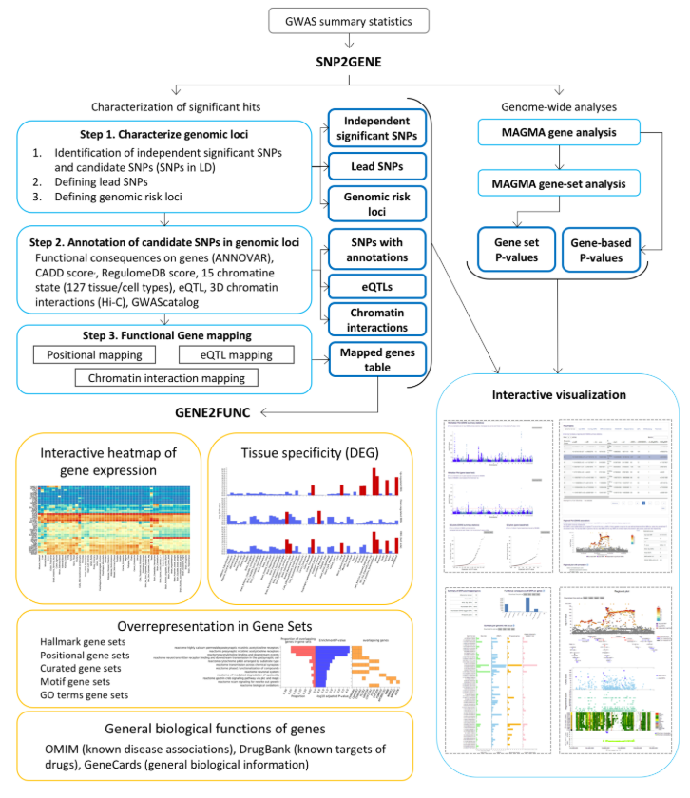
Post-GWAS Analyses: FUMA workflow
SNP ANNOTATION
Experimental function (ANNOVAR)
Predicted function (CADD)
Chromatin states + regulatory elements (RegulomeDB)
Gene mapping (position)
eQTLs (experimental)
GENE ANNOTATION
Expression levels
Differential tissue expression (e.g., GTEx)
Gene-set enrichment (MSigDB)
Functional information (e.g., drug targets: DrugBank)

Slide 30
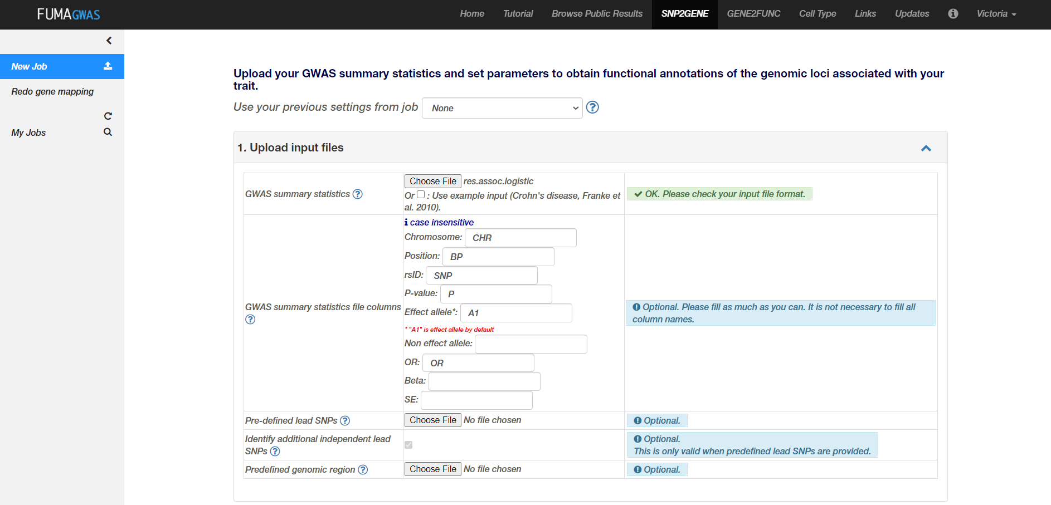
Post-GWAS Analyses: Submitting files to FUMA

Slide 31
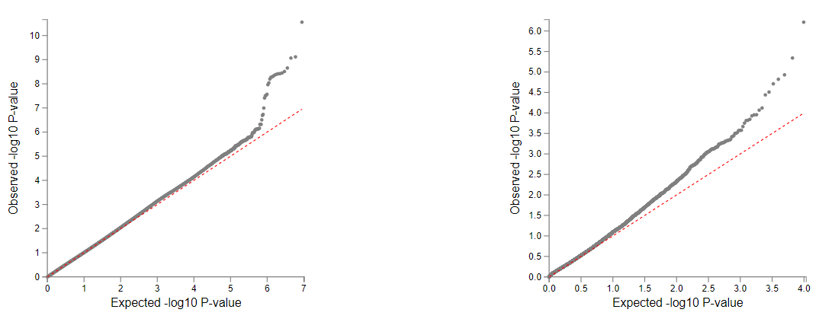
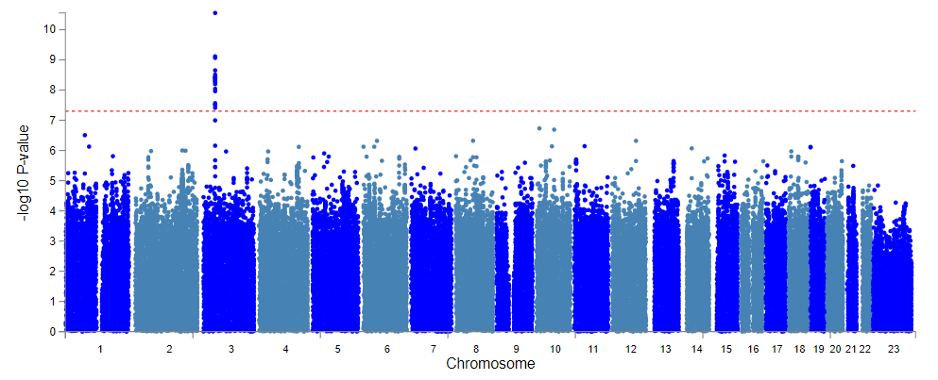
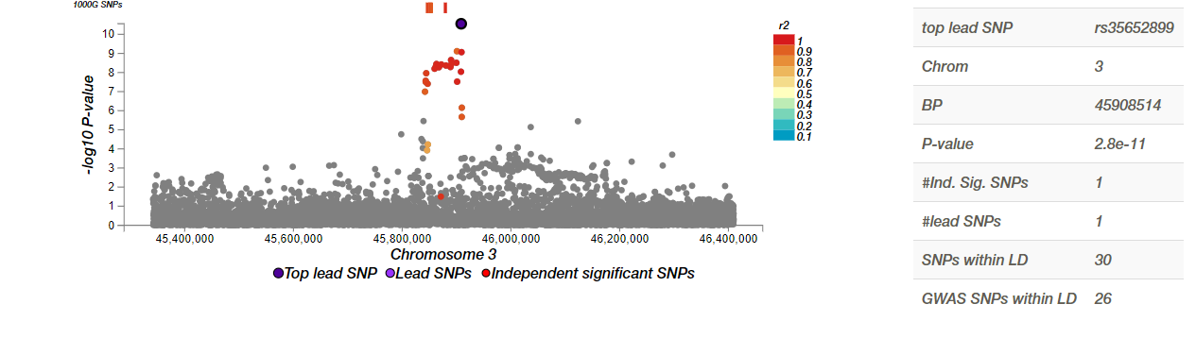
Post-GWAS Analyses: SNP associations
REGIONAL PLOT (i.e., LocusZoom)
Zoom-ed plot of associated SNPs
Integrates linkage disequilibrium (LD)
Can help explore if SNPs are independently associated
May reveal SNPs in LD with function

Slide 32
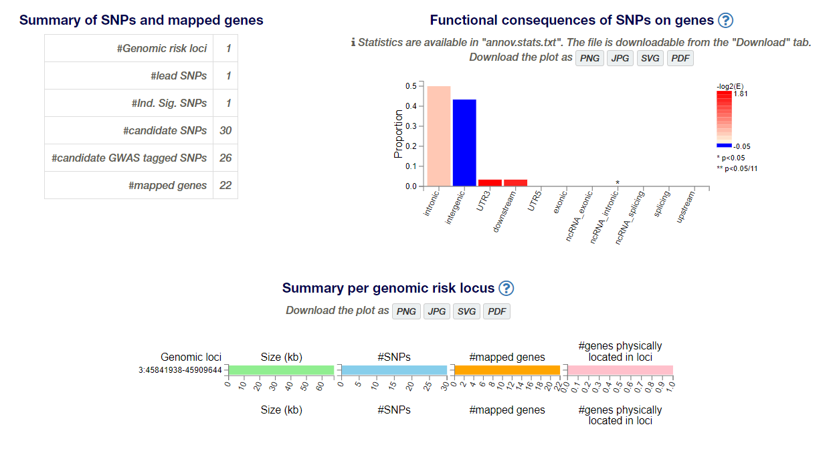
Post-GWAS Analyses: SNP annotation

Slide 33
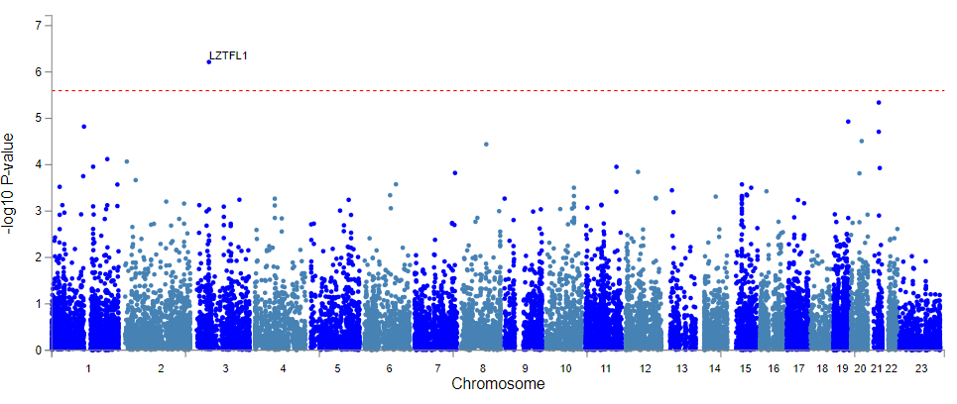
Post-GWAS Analyses: Gene-based analyses
MAGMA (Gene-based GWAS; de Leeuw et al., ‎2015)
Whole-gene associations adjusted for gene length and number of SNPs

Slide 34
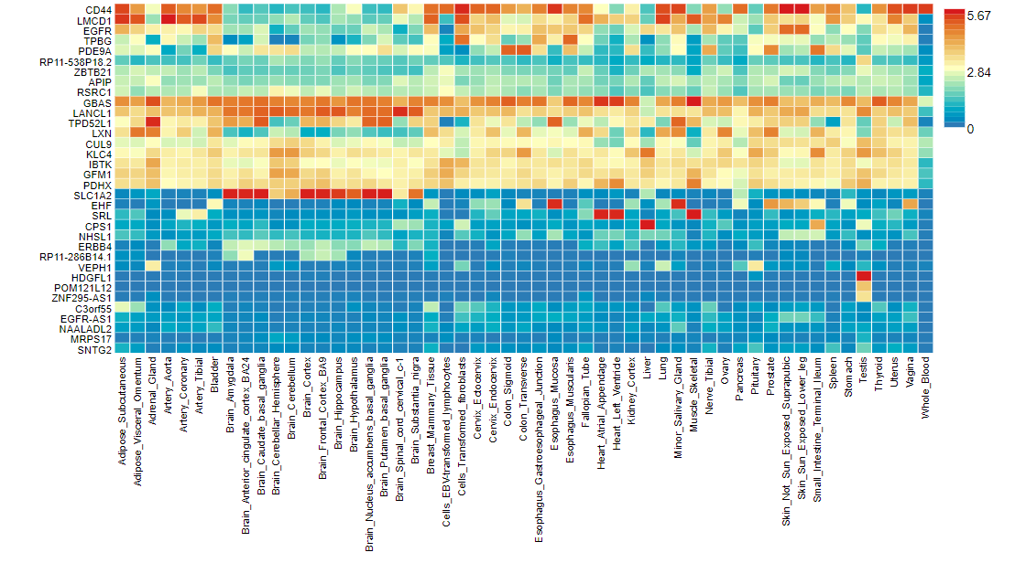
Post-GWAS Analyses: Expression levels
GENE EXPRESSION HEATMAP
GTex tissue expression
Average expression

Slide 35
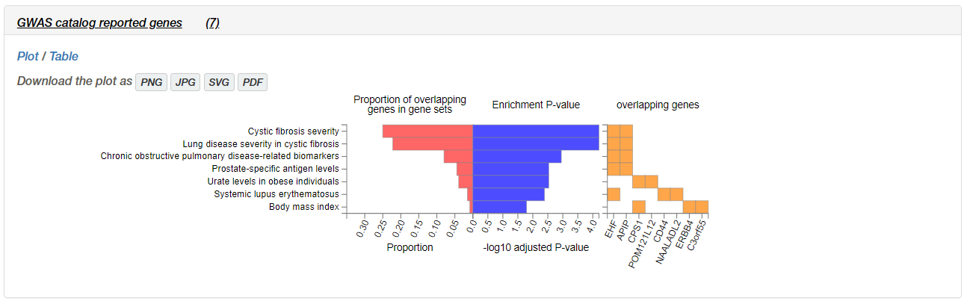
Post-GWAS Analyses: Gene-set analyses

Slide 36
Putty:
Host: teach.scinet.utoronto.ca
Log in name/ password
cp -r scinet/course/ss2019/3/2_plink/participants_folder_2019/participants_folder_2019
module load plink/1.09
module load r/3.4.3-anaconda5.1.0
Test: type:
plink (enter)
R
q()
N

Slide 37
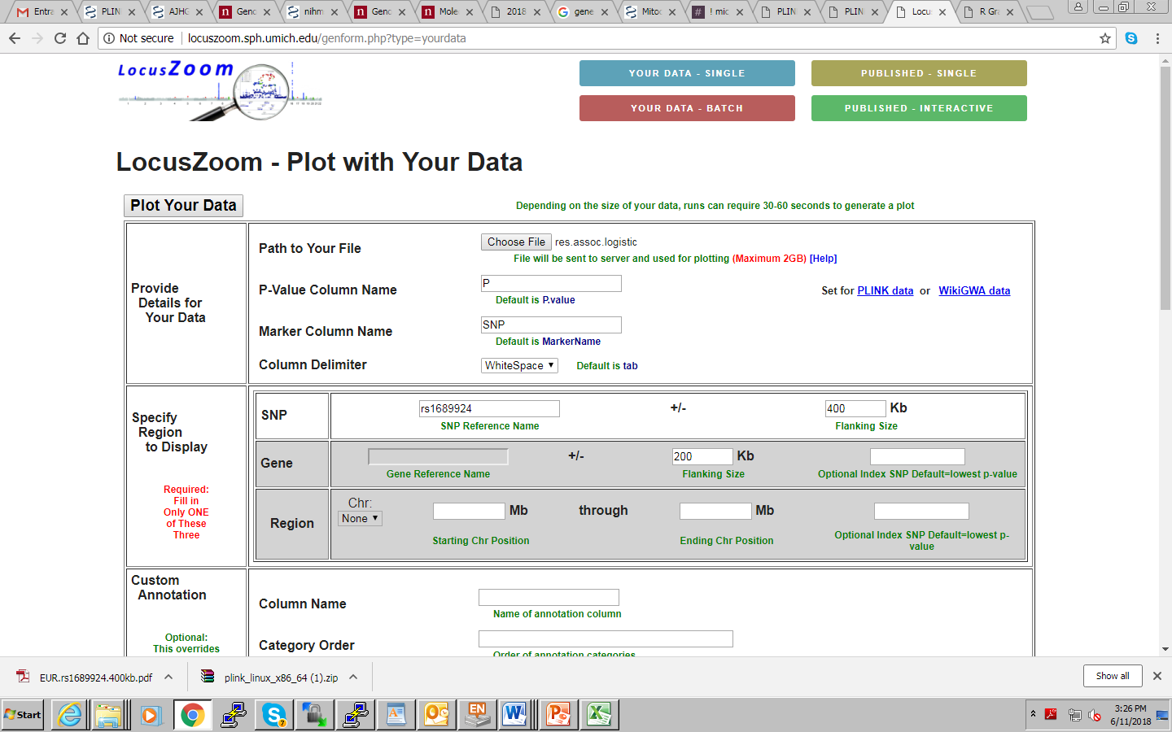

Slide 38
