Slide 1
Biostats Support
Krembil Centre for Neuroinformatics
Project Lifecycle
Grant Application (Study Design, Sample Size, Analysis Plan)
Data Collection
Data Analysis (a fee may apply)
Manuscript Writing
Statistical Consulting
Any question you may have about statistics
Software
How to use software, scripts, interpret outputs.
Education & Training
Workshops and seminars related to statistics and statistical software

Slide 2
Biostatistical Consulting Request Form:
https://edc.camhx.ca/redcap/surveys/?s=EJJKEPWN8N
marcos.sanches@camh.ca
Workshops Schedule (Need CAMH login and password):
https://kcniconfluence.camh.ca/display/ED/Learning#Learning-WorkshopSchedule-2021
Workshop material (Need CAMH login and password):
https://kcniconfluence.camh.ca/display/ED/SPSS+Workshop+Material
Subscribe to Biostatistics Mailing List:
http://info2.camh.net/mailman/listinfo/r
SPSS Mixed Models (Week after the next) Registration link:
https://edc.camhx.ca/redcap/surveys/?s=MDD99HYDDX
SPSS Linear Regression II:
https://edc.camhx.ca/redcap/surveys/?s=M7HHFT4P8E
Workshop Office Hours (Every Wed from 11am to 12am):
https://camh.webex.com/meet/marcos.sanches

Slide 3
Linear Regression Review
For Continuous Outcomes:
If Only ONE Explanatory variable:
Two Levels: t-test
More than two levels: Anova
Continuous: Correlation
Or Linear Regression for all the above!
If MORE THAN ONE variable:
Linear Regression

Slide 4
Linear Regression Review
If Only ONE Explanatory variable:
Does treatment improve pain relief?
If MORE THAN ONE variable:
Does treatment improve pain relief, while controlling for sex and age?
Sometimes you need to control for things because the treatment groups are not randomized/ balanced.

Slide 5
Logistic Regression
For Dichotomous (Binary) Outcomes:
If Only ONE Explanatory variable:
Categorical: crosstab
Continuous: Logistic Regression
If MORE THAN ONE variable:
Logistic Regression

Slide 6
Types of Outcomes
Continuous:
Treatment → Pain Relief
Age → Pain Relief
Linear Regression coefficients indicates how the MEAN of the outcome is affected by the explanatory variable.

Slide 7
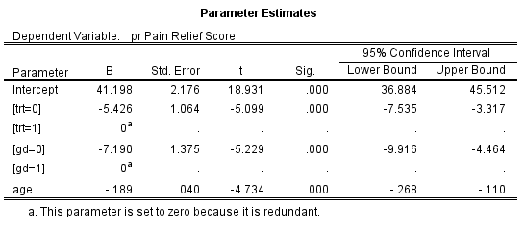
Linear Regression
Continuous outcomes in linear regression – Coefficients are interpreted as difference in means.
Trt = 0 has mean pain relief 5.4 points lower than Trt = 1.
Increasing 1 year in Age, decreases mean pain relief by 0.19

Slide 8
Types of Outcomes
Dichotomous:
Treatment → Good Status (Respiratory Illness)
Age → Good Status (Respiratory Illness)
Logistic Regression coefficients indicates how the ODDS of the outcome is affected by the explanatory variable.

Slide 9
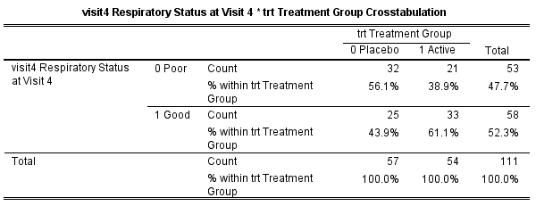
Dichotomous Outcomes
Risk of Good: 44% (Pcb) vs 61% (Act.)
Risk Difference = 61% - 44% = 17%
Relative Risk = 61%/44% = 1.39
Note: Ratio more common than difference!

Slide 10
Odds Ratio!
Odds of Good for Placebo: 44% /(1- 44%) = 0.78
Odds of Good for Active: 61% /(1- 61%) = 1.56
Odds Ratio: 1.56/0.78 = 2.00
Odds of good 2.00 times higher in the active group as compared to placebo group!

Slide 11
Odds Ratio!
Okay, lets do it using Logistic Regression!

