Slide 1
Biostats Support
Krembil Centre for Neuroinformatics
Project Lifecycle
Grant Application (Study Design, Sample Size, Analysis Plan)
Data Collection
Data Analysis (a fee may apply)
Manuscript Writing
Statistical Consulting
Any question you may have about statistics
Software
How to use software, scripts, interpret outputs.
Education & Training
Workshops and seminars related to statistics and statistical software

Slide 2
Biostatistical Consulting Request Form:
https://edc.camhx.ca/redcap/surveys/?s=EJJKEPWN8N
marcos.sanches@camh.ca
Workshops Schedule (Need CAMH login and password):
https://kcniconfluence.camh.ca/display/ED/Learning#Learning-WorkshopSchedule-2021
Workshop material (Need CAMH login and password):
https://kcniconfluence.camh.ca/display/ED/SPSS+Workshop+Material
Subscribe to Biostatistics Mailing List:
http://info2.camh.net/mailman/listinfo/r
SPSS Linear Regression II:
https://edc.camhx.ca/redcap/surveys/?s=M7HHFT4P8E
SPSS Mixed Models II:
https://edc.camhx.ca/redcap/surveys/?s=FK77AARY8X
Workshop Office Hours (Every Wed from 11am to 12am):
https://camh.webex.com/meet/marcos.sanches

Slide 3
Correlated Data
Caused by ‘Clustering’ in the data. 2 types:
  Longitudinal – Clusters are subjects and data is collected over time.
    Sampling Design: Sample Individuals, then time within individuals.
  Clustered Data – Clusters are sampling features like schools, classes within schools, FSAs, Hospitals.
    Sampling Design: Sample Schools, then within schools we sample students.
Clusters induce correlation in the data, which we need to take care of because usual stats models assume uncorrelated data.

Slide 4
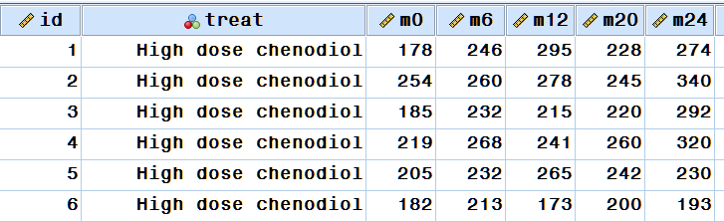
Repeated Measure Anova & Manova
Only for Data in Wide Format.
  rmANOVA – Same measure repeated times.
  MANOVA – Multiple Measures at the same Time.
  rmANOVA can be replaced by MEM which has advantages (handle drop-outs and different covariance structures).

Slide 5
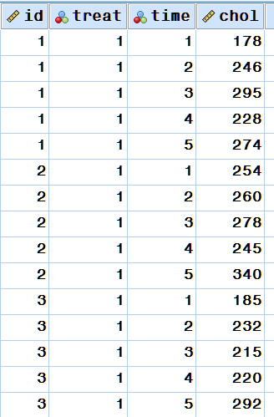
Mixed Effect Models
Data in Long Format.
  Now we only have one dependent variable and we can just use a regression model!
  Well, not so fast… Now we have a problem that the data is not independent. The top 5 lines are a single subject, but regression will think there are 5 subjects.

Slide 6
Correlation = Loss of information
If the second data point is correlated with the first, then the additional information provided by it may be small.
→ 2 points but sample size is not 2.

Slide 7
Data Analysis

Slide 8
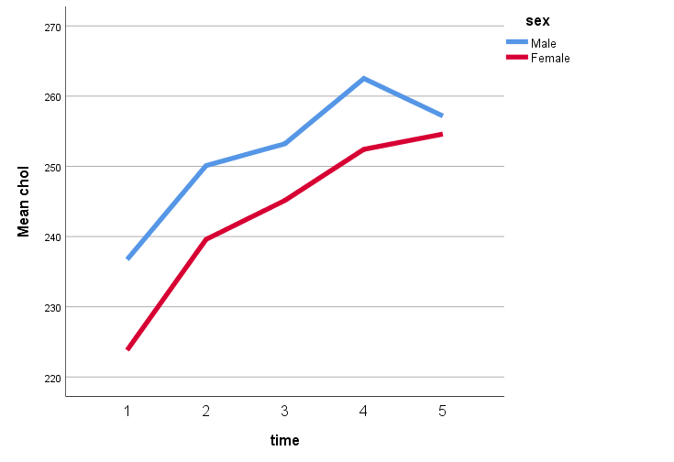
Research Question?
Model must be built to answer the research question.
Are the rate of change (Slopes) different?
Is the outcome different at the last time point?
Is there a difference in trajectory?
Difference Last – Baseline?

Slide 9
Usual Effect – Interaction group by time
Interaction = The effects depend on each other.
Time Effect = How outcome changes overtime (Trajectories).
Group Effect = How outcome differ across groups.
Interaction Effect = How outcome trajectories differ across groups

Slide 10
Let’s see how it works by doing it!

Slide 11
Testing specific hypotheses
Use EMMEANS and TEST command. TEST can only be done through the syntax. Here an example:
MIXED chol BY sex treat months WITH age
/FIXED=sex treat months age treat*months | SSTYPE(3)
/METHOD=REML
/PRINT=SOLUTION TESTCOV
/RANDOM=INTERCEPT | SUBJECT(uniqueid)
/EMMEANS=TABLES(treat*months) with(age = 30) compare (treat) adj(bonferroni)
/test = "24 - 0 at High Dose" months -1 0 0 0 1 treat*months -1 0 0 0 1 0 0 0 0 0
/test = "24 - 0 at Low Dose" months -1 0 0 0 1 treat*months 0 0 0 0 0 -1 0 0 0 1
/test = "24 - 0 at High - 24 - 0 at Low" treat*months -1 0 0 0 1 1 0 0 0 -1
/test = "24 - 0 in general" months -1 0 0 0 1 treat*months -1/2 0 0 0 1/2 -1/2 0 0 0 1/2
/test = "Chol for Male 31yo High Dose at Baseline"
intercept 1 sex 1 0 age 31 treat 1 0 months 1 0 0 0 0 treat*months 1 0 0 0 0 0 0 0 0 0 .

