Slide 1
SARD CoP Meeting,
Dan Nichol
March 19th , 2026

Slide 2
1
What is a DataMart?
2
How to use a DataMart?
3
Dashboards
4
Demonstration
5
Wrap Up

Slide 3
What is a DataMart?
1

Slide 4
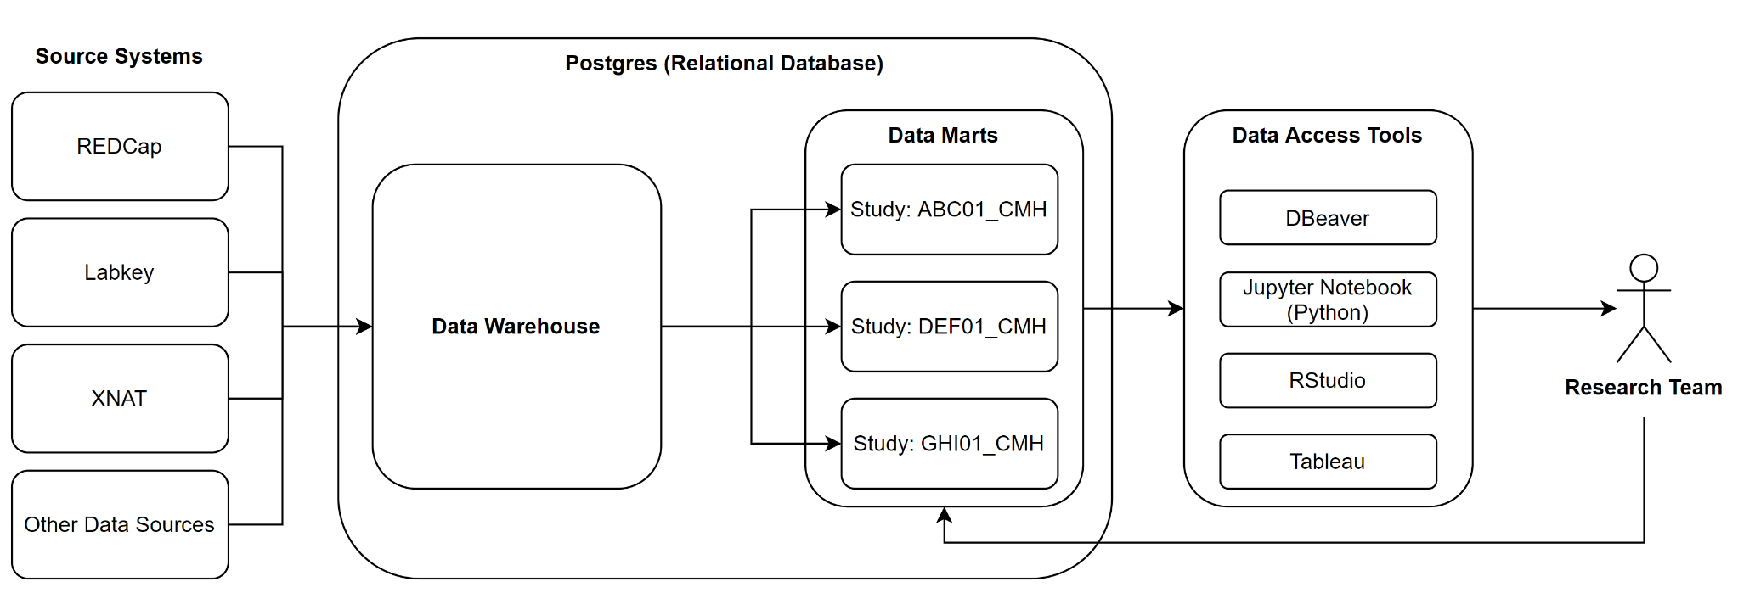



Data Flows In From Multiple Sources

Slide 5
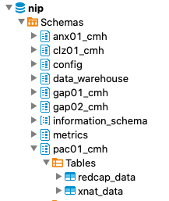
What Does A DataMart Look Like?
Features:
Provides users with integrated data from all data collection systems
Stores data in a set of tables (PostgreSQL relational database)
Easy to organize and access
Data Mart Structure:
Name: same as Project ID (ABC01_CMH)
Tables: redcap_data, xnat_data, labkey data
Access permissions: specific to the project/research group

Slide 6
What’s in a Data Storage Format?
Wide Format
Long Format
Subject ID | Study ID | Field Name | Field Value
TST_CMH_01 | TST_CMH | Measure 1 | Value 1
TST_CMH_02 | TST_CMH | Measure 1 | Value 2
TST_CMH_03 | TST_CMH | Measure 1 | Value 3
TST_CMH_01 | TST_CMH | Measure 2 | Value 4
TST_CMH_02 | TST_CMH | Measure 2 | Value 5
TST_CMH_03 | TST_CMH | Measure 2 | Value 6
Subject ID | Study ID | Measure 1 | Measure 2
TST_CMH_01 | TST_CMH | Value 1 | Value 4
TST_CMH_02 | TST_CMH | Value 2 | Value 5
TST_CMH_03 | TST_CMH | Value 3 | Value 6
More intuitive for the average user
Readable for statistical software
Easier for correlation analysis and ML algorithms
More efficient data query and storage
Many analysis methods built for long data
Missing data doesn’t require a row
Easy to add new fields

Slide 7
NIP Datamart Defaults to Long Format
Subject ID | Study ID | Field Name | Field Value
TST_CMH_01 | TST_CMH | Measure 1 | Value 1
TST_CMH_02 | TST_CMH | Measure 1 | Value 2
TST_CMH_03 | TST_CMH | Measre 1 | Value 3
TST_CMH_01 | TST_CMH | Measure 2 | Value 4
TST_CMH_02 | TST_CMH | Measure 2 | Value 5
TST_CMH_03 | TST_CMH | Measure 2 | Value 6
How do we switch it back for dashboards?

Slide 8
How to use a DataMart
2

Slide 9
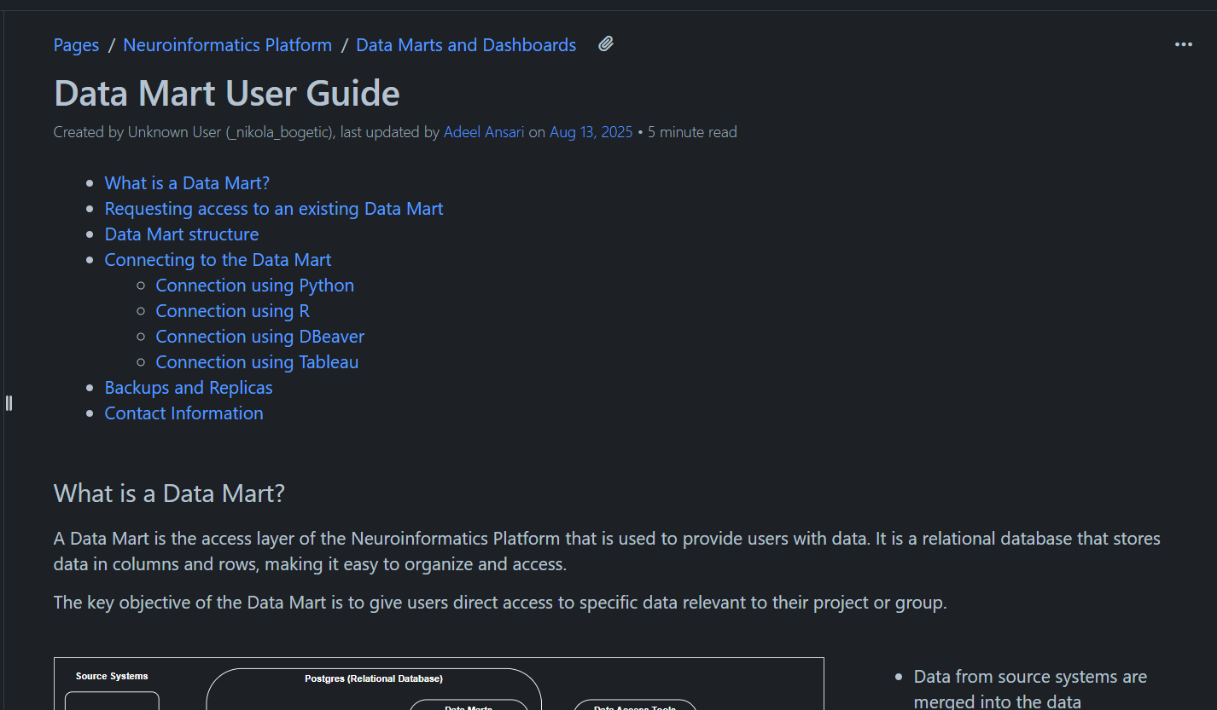
Connecting To The Datamart
Link to DataMart User Guide https://kcniconfluence.camh.ca/x/GYJzAQ

Slide 10
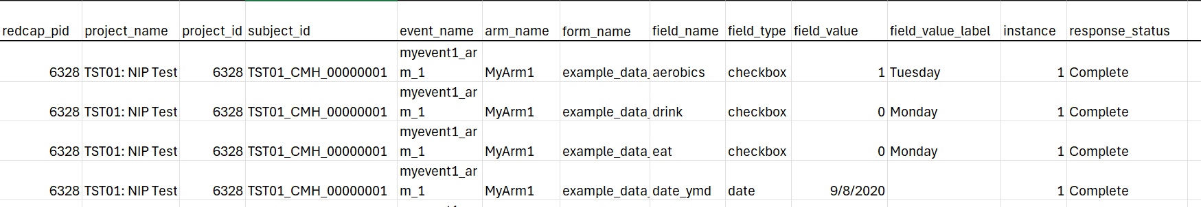
Sample Datamart Redcap Data

Slide 11
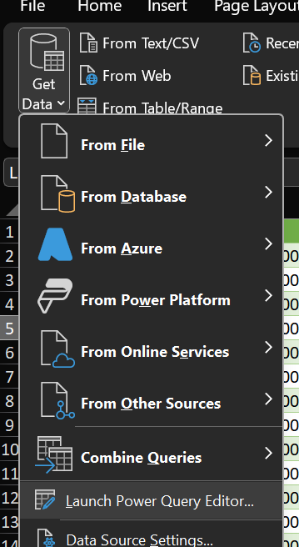
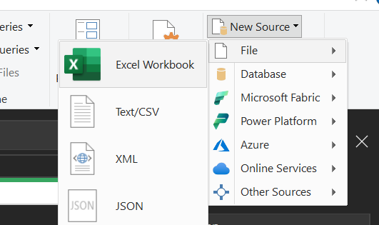
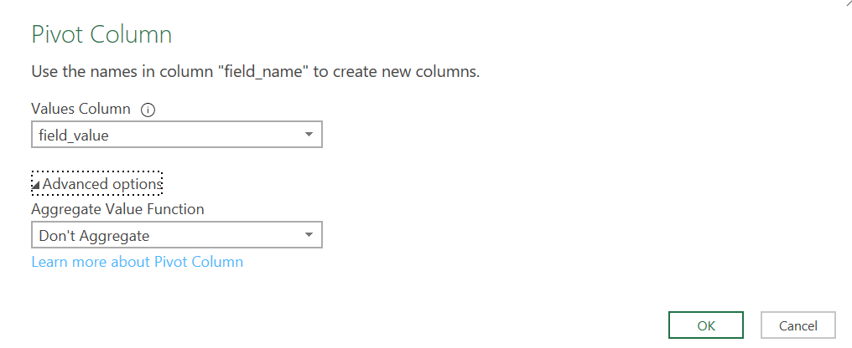
Excel Power Query

Slide 12
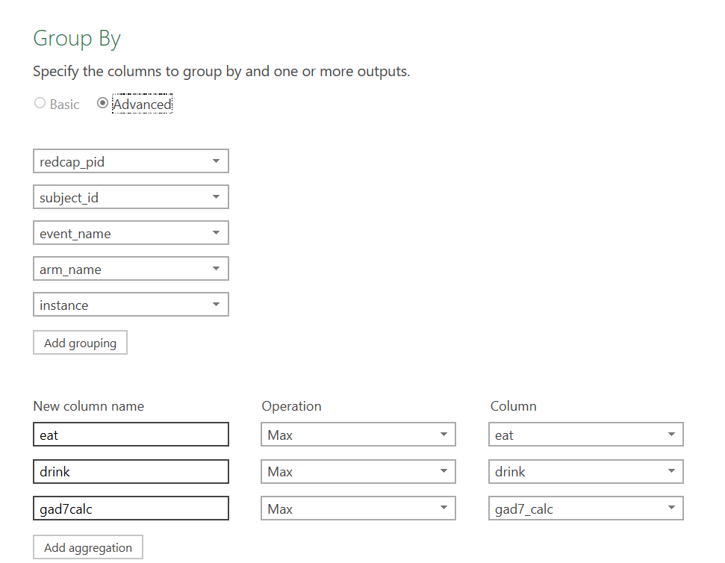
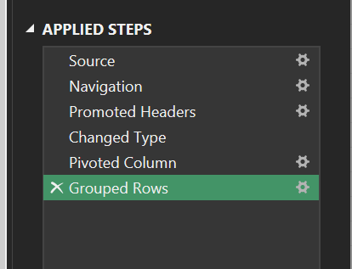
Excel Power Query

Slide 13
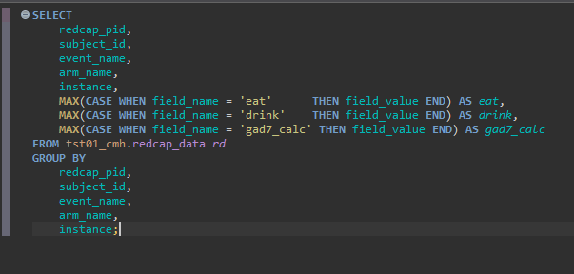

DBeaver / SQL
SQL code for long to wide -> Export
Notes:
SELECT
redcap_pid,
subject_id,
event_name,
arm_name,
instance,
MAX(CASE WHEN field_name = 'eat' THEN field_value END) AS eat,
MAX(CASE WHEN field_name = 'drink' THEN field_value END) AS drink,
MAX(CASE WHEN field_name = 'gad7calc' THEN field_value END) AS gad7calc,
MAX(CASE WHEN field_name = 'phq9_calc' THEN field_value END) AS phq9_calc
FROM tst01_cmh.redcap_data
GROUP BY
redcap_pid,
subject_id,
event_name,
arm_name,
instance;

Slide 14
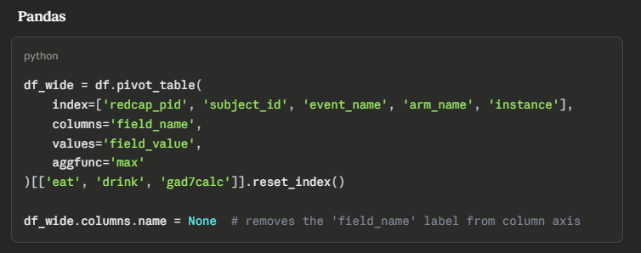
Pandas/Python
Pivot code snippet
Notes:
df_wide = df.pivot_table(
index=['redcap_pid', 'subject_id', 'event_name', 'arm_name', 'instance'],
columns='field_name',
values='field_value',
aggfunc='max'
)[['eat', 'drink', 'gad7calc']].reset_index()
df_wide.columns.name = None # removes the 'field_name' label from column axis

Slide 15
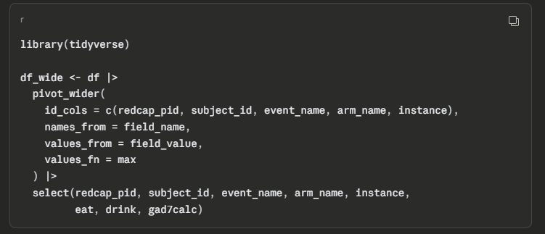
R
Pivot code snippet
Notes:
library(tidyverse)
df_wide <- df |>
pivot_wider(
id_cols = c(redcap_pid, subject_id, event_name, arm_name, instance),
names_from = field_name,
values_from = field_value,
values_fn = max
) |>
select(redcap_pid, subject_id, event_name, arm_name, instance,
eat, drink, gad7calc)

Slide 16
Dashboards
3

Slide 17
Why do we need a dashboard anyway?
Research Uses
Real time tracking of enrollment and journey in the study
  Demographics and distribution of cohorts to guide recruitment
  Easy reporting and display to sponsors and stakeholders
  Protocol adherence
Adverse event surveillance
Reviewing multiple data types at once

Slide 18
Why do we need a dashboard anyway?
Clinical Uses
  Patient monitoring dashboards — Track vitals, lab results, and medication schedules across a ward in real time, flagging deteriorating patients before a crisis occurs
  Hospital operations — Visualize bed occupancy, ED wait times, staff-to-patient ratios, and OR scheduling to reduce bottlenecks
  Chronic disease management — Longitudinal views of a patient's HbA1c, blood pressure, or weight trends over time to guide treatment adjustments
  Infection control — Monitor HAI (hospital-acquired infection) rates by unit, flagging outbreaks early and tracking the impact of interventions

Slide 19
Data Granularity Determines What You Can Chart
Data Granularity — the level of detail in your data (daily, monthly, by patient, etc.)
What does a row in a table represent?
- A single timepoint?
- A single patient?
- A patient across all timepoints, or just at one?
- Is it already aggregated in some way? Or tied to a datetime?
What combination of columns makes a row unique?

Slide 20
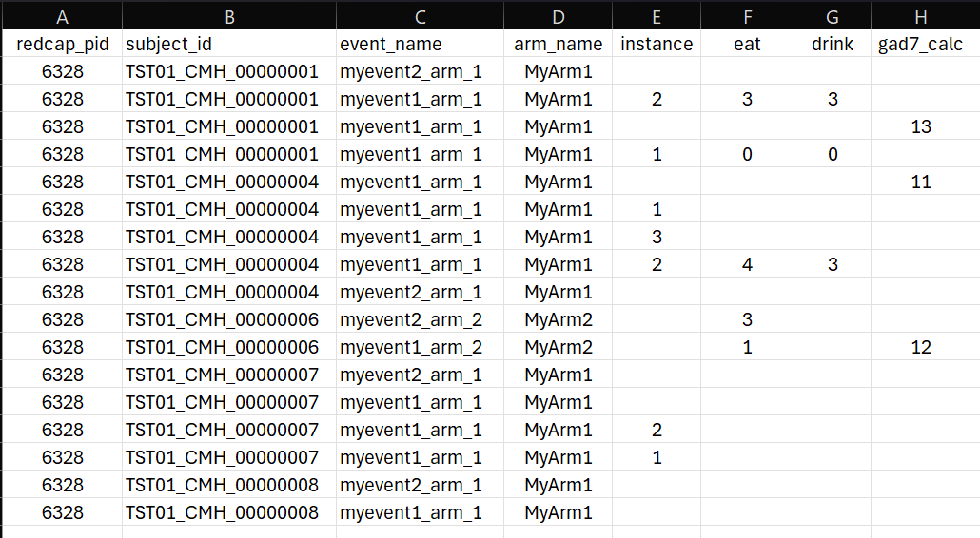
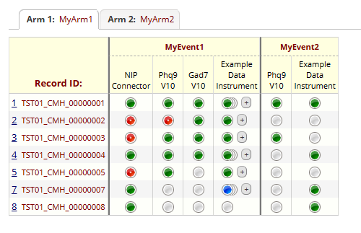
Redcap Export Format
pid, subject_id, event_name, arm_name, and instance combination is unique in Redcap data
Notes:
Charting Redcap data, will likely require a separation of repeatable data from non-repeatable data.

Slide 21
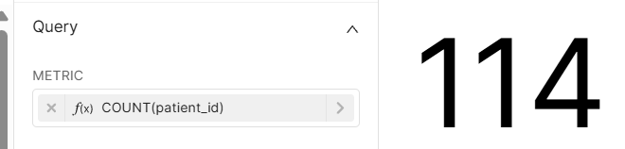
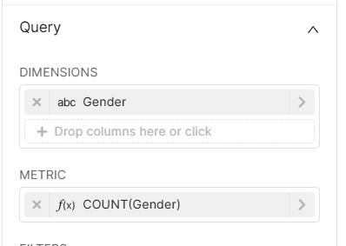
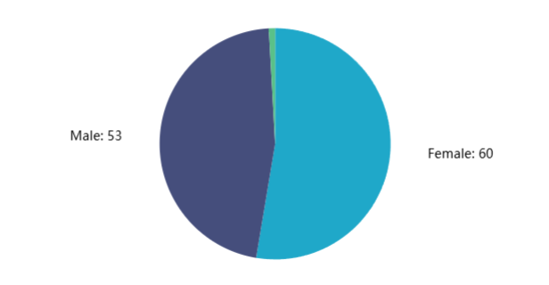
Dashboarding: Metrics vs Dimensions
What’s the difference?
Metrics:
What are we counting?
Dimensions:
What are we comparing?

Slide 22
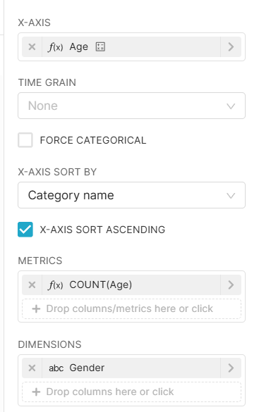
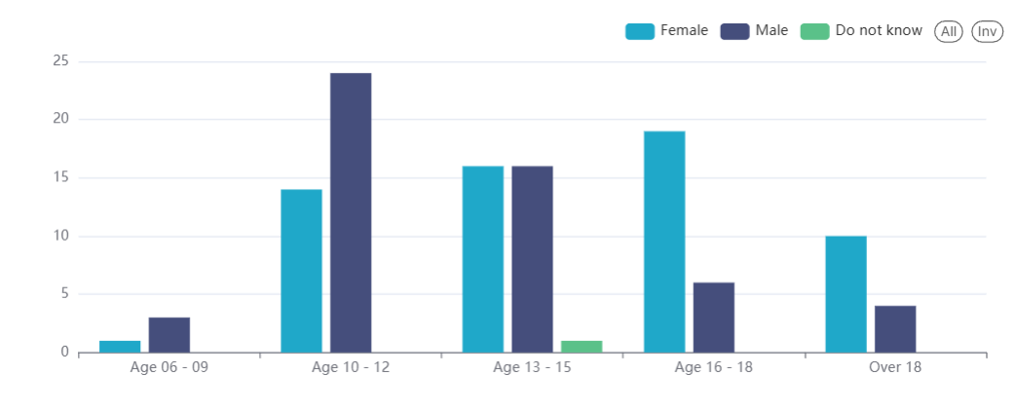
Putting It All Together

Slide 23
Design
Audience-first design — who will use this, and what decisions will they make with it?
Signal vs. noise — fewer, well-chosen charts beat a wall of visuals
Hierarchy — the most important KPIs go top-left (how the eye scans)
Consistency — uniform colors, fonts, and chart styles build trust
Interactivity — filters and drill-downs let users explore rather than just consume

Slide 24
Demonstration
4

Slide 25
Demo Steps
Open Superset, show completed Dashboard for context
Show Datasets
Create Big Number
Create Bar Chart Trend from long data
Create Chart Filters
Create view for wide fields in SQL Lab
  Saving dataset
Create pie chart from wide data
Create table from wide data

Slide 26
Thank You!
NIP Project Request Form: Neuroinformatics Platform - Project Request Form
Datamart User Request Form: Neuroinformatics Platform - User Access Request Form
Questions:
Nicole: Nicole.Schoer@camh.ca
Myself: Daniel.Nichol@camh.ca

