Slide 1

Hands-on tutorial
Vanessa Gonçalves
Clement Zai
Arun Tiwari
Delnaz Roshandel
Wei Deng
Yanyan Zhao

Slide 2
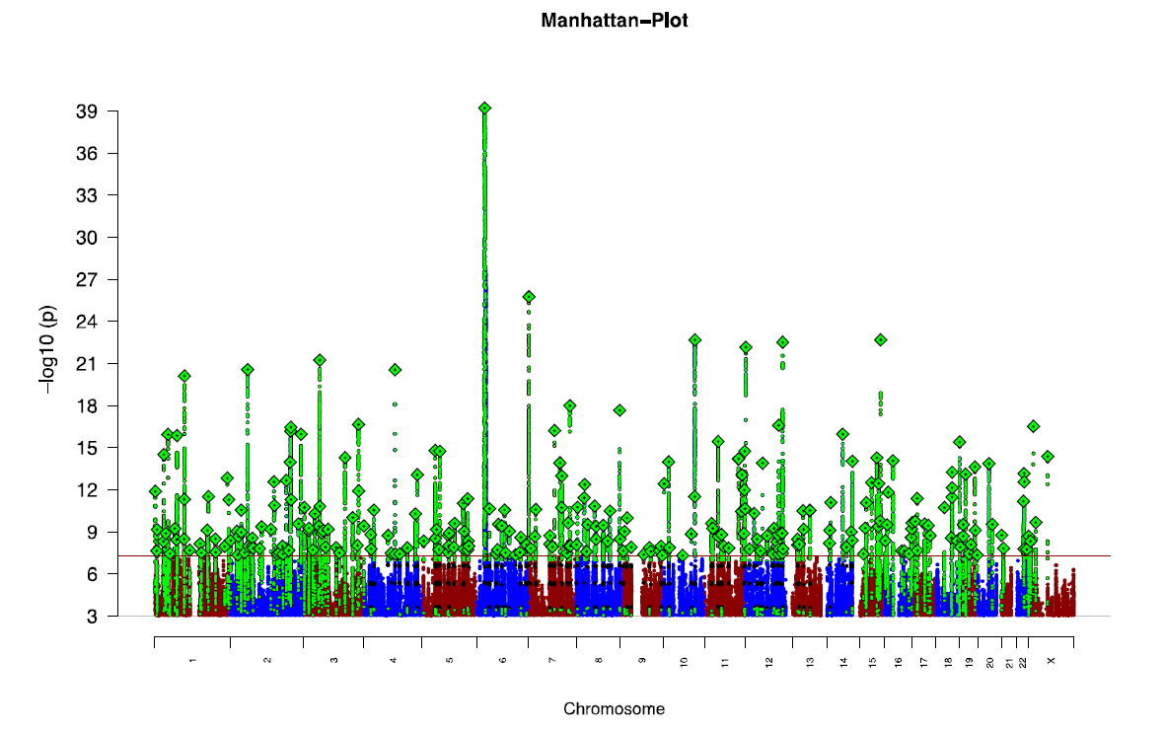
Schizophrenia N=69,369
Controls N=236,642
Schizophrenia Working Group of the Psychiatric Genomics Consortium 2020

Slide 3
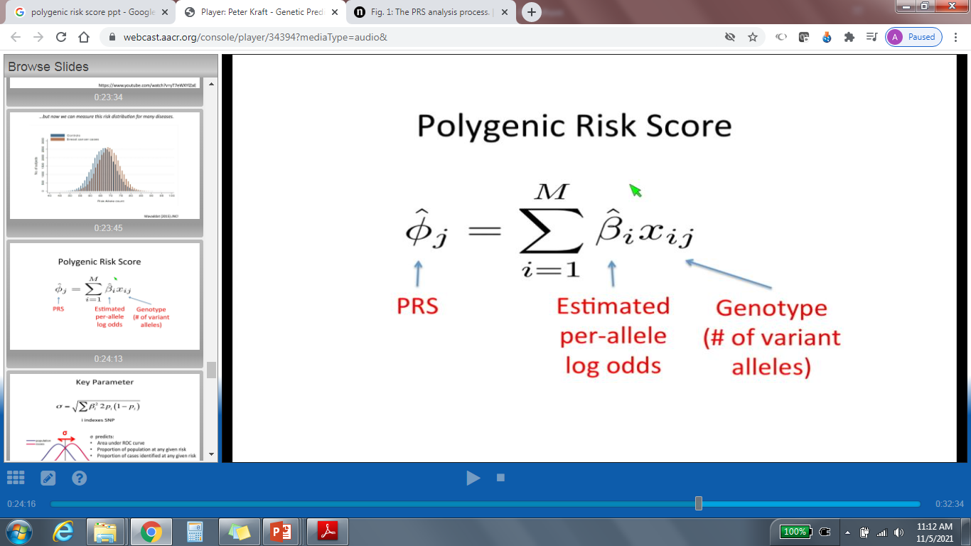
©Peter Kraft
PRS are calculated for individuals in the target data as a sum of `risk alleles' across SNPs with P-values below a given P-value threshold, weighted by the effect sizes estimated by a GWAS
https://www.illumina.com/content/dam/illumina-marketing/images/amrdigital/PRS/Polygenic%20Risk%20Score%20-%20Infographic-digital-Illumina.pdf

Slide 4
PRS Method
P-value based clumping and thresholding (PC+T)
  Uses the GWAS effect size estimates as SNP weights and
  includes independent SNPs (defined by an LD r2 filter for a given chromosomal window distance)
  with association p values lower than a threshold (chosen after application in a tuning sample)

Slide 5
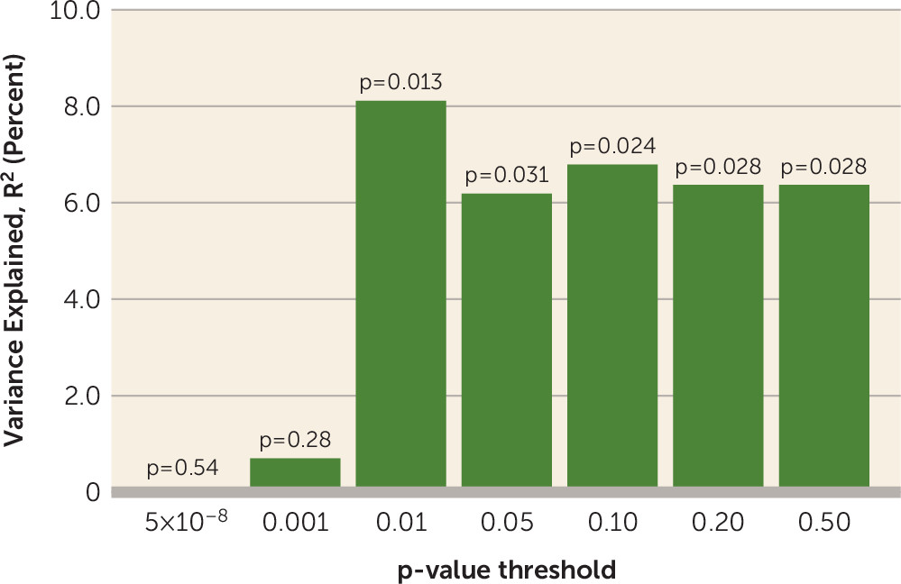
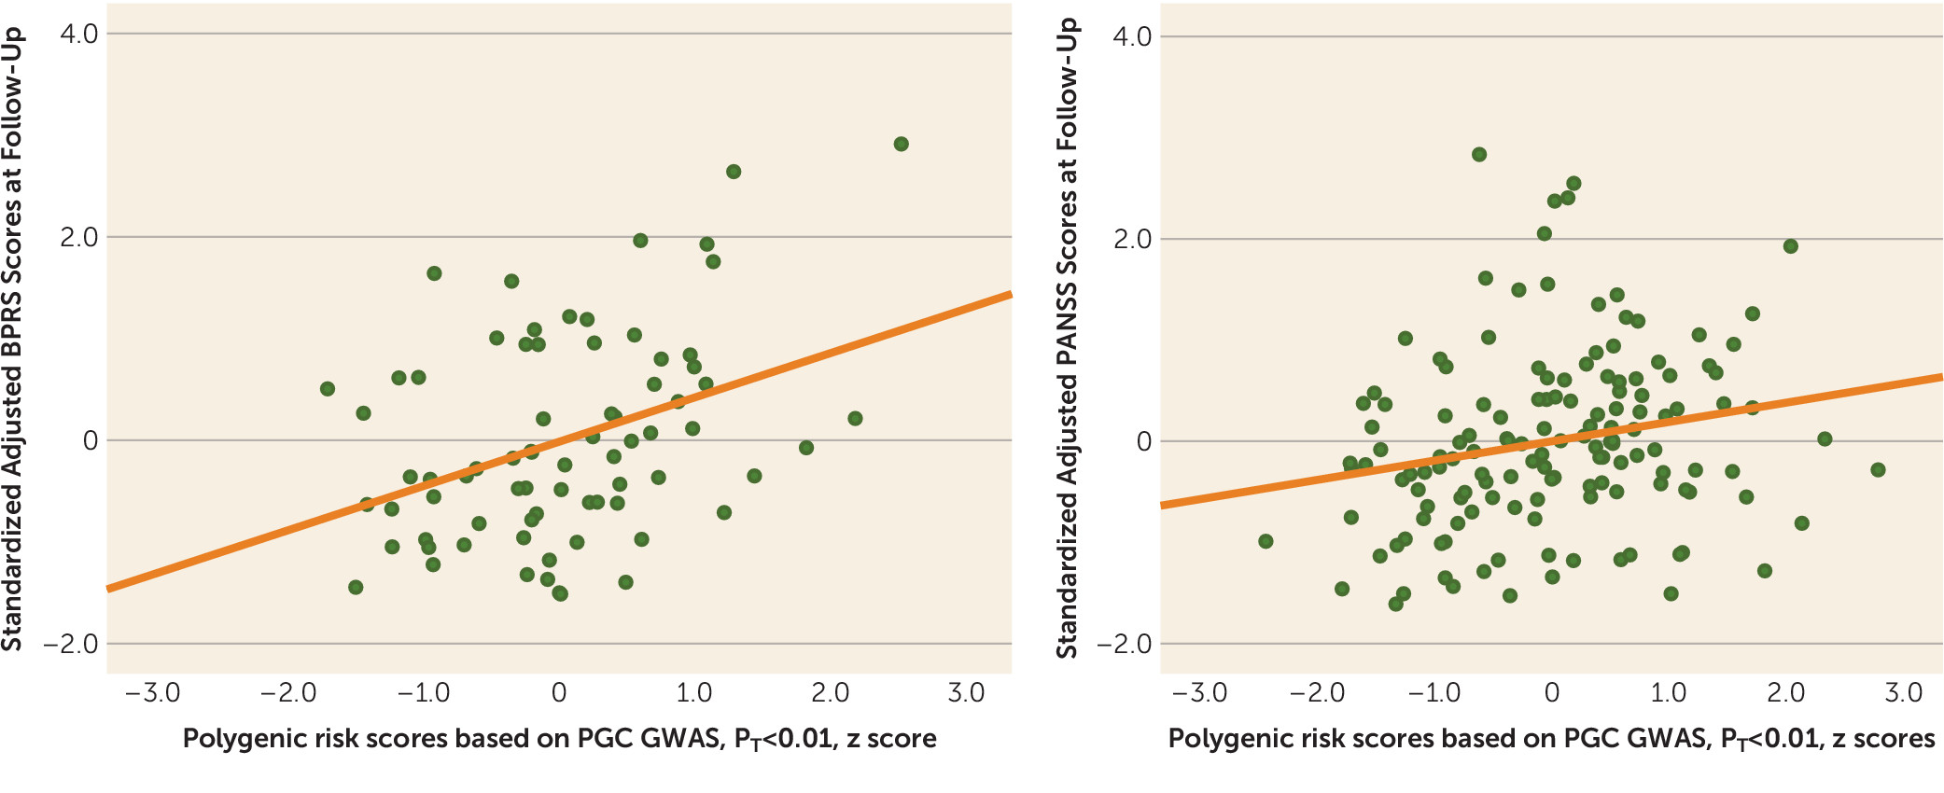
Schizophrenia Polygenic Risk Score as a Predictor of Antipsychotic Efficacy in First-Episode Psychosis
Zhang et al., Am J Psychiatry 176:1, January 2019

Slide 6
Analytical Workflow
Base Data
Target Data
QC
Summary Stats
h²snp > 0.05
Effect allele
Standard GWAS
Alleles/Strand QC
Mismatch Sex info
Sample overlap w Base
Build and Ancestry match
>100 individuals
Overlapping SNPs
PRS Calculation (C + T method)
Clumping
Thresholding
Generating Scores
Applications of PRS
Measuring association between PRS and trait(s)

Slide 7
Base data
Target data
.txt file
.bim file
bmikg
A1= Allele1 in source/summary stat data
A2= Allele2 in source/summary stat data
V5= Allele1 in the target sample
V6= Allele2 in the target sample
Ambiguous SNPs (A/T; C/G) out
bmikg1
Perfect allele matches
A1=A V5=A
A2=C V6=C
allele matches but flipped strand
A1=A V5=T
A2=C V6=G
Allele switches
A1=A V5=C
A2=C V6=A
Allele switches and flipped strand
A1=A V5=G
A2=C V6=T
bmikg1aa
Bmikg1ab… ai
bmikg1ba
Bmikg1bb… bi
bmikg1a
bmikg1b
bmikg2
Mismatched/unresolved SNPs and ambiguous SNPs were
removed

Slide 8
https://kcniconfluence.camh.ca/display/GEN/Tutorial+for+Polygenic+Risk+Score

Slide 9
Biol Psychiatry. 2021 Nov 1;90(9):611-620.
PLoS Genet 17(5): e1009021. https://doi.org/10.1371/journal.pgen.1009021

