Slide 1
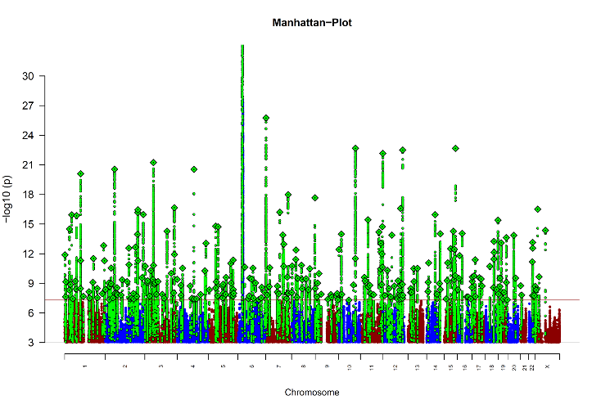


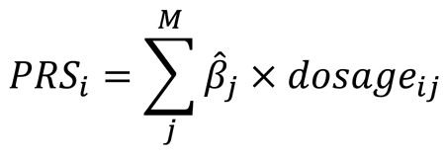
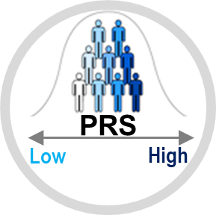
Polygenic Risk Scores
Sample A
GWAS
Sample B
cases
controls
With risk allele
Without risk allele
Sample B
Trubetskoy et al, 2022; Ahanghari et al, 2022; ASHG, 2018; Wikipedia; Ebrahimi et al. 2024
Notes:
Identify SNPs from source GWAS (Base Data e.g., SCZ) surpassing a p-value threshold and their effect sizes
Score each participant in target GWAS data (e.g., neuroticism) by summing the risk alleles they possess for SNPs weighted by their corresponding effect sizes

Slide 2
Polygenic Risk Scores
GWAS
SNP | CHR | POS | A1 | A2 | BETA | SE | P | NEFF
rs1198591 | 1 | 98541836 | C | G | -0.1 | 0.0108 | 3.54E-20 | 58749.13
rs13195636 | 6 | 27509493 | A | C | 0.2 | 0.0159 | 6.55E-40 | 58749.13
rs10883760 | 10 | 104419465 | G | T | 0.1 | 0.0152 | 3.91E-11 | 58749.13
rs12628185 | 22 | 39248549 | G | A | -0.2 | 0.0351 | 4.54E-08 | 57150.34
Summary Statistics
Sample B
ID | rs119… | rs131… | rs108… | rs126…
1 | CC | AC | GT | AA
2 | GG | AA | GG | GG
3 | CG | CC | TT | GA
4 | GG | AC | GG | AA
5 | GG | CC | TT | AA
ID | #A1_rs119… | #A1_rs131… | #A1_rs108… | #A1_rs126…
1 | 2 | 1 | 1 | 0
2
3
4
5
ID | SCORE_rs119… | SCORE_rs131… | SCORE_rs108… | SCORE_rs126… | PRS_4SNPs
1
2
3
4
5
Trubetskoy et al, 2022; Ahanghari et al, 2022; ASHG, 2018; Wikipedia; Ebrahimi et al. 2024
Notes:
Identify SNPs from source GWAS (Base Data e.g., SCZ) surpassing a p-value threshold and their effect sizes
Score each participant in target GWAS data (e.g., neuroticism) by summing the risk alleles they possess for SNPs weighted by their corresponding effect sizes

Slide 3
Polygenic Risk Scores
GWAS
SNP | CHR | POS | A1 | A2 | BETA | SE | P | NEFF
rs1198591 | 1 | 98541836 | C | G | -0.1 | 0.0108 | 3.54E-20 | 58749.13
rs13195636 | 6 | 27509493 | A | C | 0.2 | 0.0159 | 6.55E-40 | 58749.13
rs10883760 | 10 | 104419465 | G | T | 0.1 | 0.0152 | 3.91E-11 | 58749.13
rs12628185 | 22 | 39248549 | G | A | -0.2 | 0.0351 | 4.54E-08 | 57150.34
Summary Statistics
Sample B
ID | rs119… | rs131… | rs108… | rs126…
1 | CC | AC | GT | AA
2 | GG | AA | GG | GG
3 | CG | CC | TT | GA
4 | GG | AC | GG | AA
5 | GG | CC | TT | AA
ID | #A1_rs119… | #A1_rs131… | #A1_rs108… | #A1_rs126…
1 | 2 | 1 | 1 | 0
2 | 0 | 2 | 2 | 2
3 | 1 | 0 | 0 | 1
4 | 0 | 1 | 2 | 1
5 | 0 | 0 | 0 | 0
ID | SCORE_rs119… | SCORE_rs131… | SCORE_rs108… | SCORE_rs126… | PRS_4SNPs
1
2
3
4
5
Trubetskoy et al, 2022; Ahanghari et al, 2022; ASHG, 2018; Wikipedia; Ebrahimi et al. 2024
Notes:
Identify SNPs from source GWAS (Base Data e.g., SCZ) surpassing a p-value threshold and their effect sizes
Score each participant in target GWAS data (e.g., neuroticism) by summing the risk alleles they possess for SNPs weighted by their corresponding effect sizes

Slide 4
Polygenic Risk Scores
GWAS
SNP | CHR | POS | A1 | A2 | BETA | SE | P | NEFF
rs1198591 | 1 | 98541836 | C | G | -0.1 | 0.0108 | 3.54E-20 | 58749.13
rs13195636 | 6 | 27509493 | A | C | 0.2 | 0.0159 | 6.55E-40 | 58749.13
rs10883760 | 10 | 104419465 | G | T | 0.1 | 0.0152 | 3.91E-11 | 58749.13
rs12628185 | 22 | 39248549 | G | A | -0.2 | 0.0351 | 4.54E-08 | 57150.34
Summary Statistics
Sample B
ID | rs119… | rs131… | rs108… | rs126…
1 | CC | AC | GT | AA
2 | GG | AA | GG | GG
3 | CG | CC | TT | GA
4 | GG | AC | GG | AA
5 | GG | CC | TT | AA
ID | #A1_rs119… | #A1_rs131… | #A1_rs108… | #A1_rs126…
1 | 2 | 1 | 1 | 0
2 | 0 | 2 | 2 | 2
3 | 1 | 0 | 0 | 1
4 | 0 | 1 | 2 | 1
5 | 0 | 0 | 0 | 0
ID | SCORE_rs119… | SCORE_rs131… | SCORE_rs108… | SCORE_rs126… | PRS_4SNPs
1 | -0.2 | 0.2 | 0.1 | 0 | 0.1
2
3
4
5
Trubetskoy et al, 2022; Ahanghari et al, 2022; ASHG, 2018; Wikipedia; Ebrahimi et al. 2024
Notes:
Identify SNPs from source GWAS (Base Data e.g., SCZ) surpassing a p-value threshold and their effect sizes
Score each participant in target GWAS data (e.g., neuroticism) by summing the risk alleles they possess for SNPs weighted by their corresponding effect sizes

Slide 5
Polygenic Risk Scores
GWAS
SNP | CHR | POS | A1 | A2 | BETA | SE | P | NEFF
rs1198591 | 1 | 98541836 | C | G | -0.1 | 0.0108 | 3.54E-20 | 58749.13
rs13195636 | 6 | 27509493 | A | C | 0.2 | 0.0159 | 6.55E-40 | 58749.13
rs10883760 | 10 | 104419465 | G | T | 0.1 | 0.0152 | 3.91E-11 | 58749.13
rs12628185 | 22 | 39248549 | G | A | -0.2 | 0.0351 | 4.54E-08 | 57150.34
Summary Statistics
Sample B
ID | rs119… | rs131… | rs108… | rs126…
1 | CC | AC | GT | AA
2 | GG | AA | GG | GG
3 | CG | CC | TT | GA
4 | GG | AC | GG | AA
5 | GG | CC | TT | AA
ID | #A1_rs119… | #A1_rs131… | #A1_rs108… | #A1_rs126…
1 | 2 | 1 | 1 | 0
2 | 0 | 2 | 2 | 2
3 | 1 | 0 | 0 | 1
4 | 0 | 1 | 2 | 1
5 | 0 | 0 | 0 | 0
ID | SCORE_rs119… | SCORE_rs131… | SCORE_rs108… | SCORE_rs126… | PRS_4SNPs
1 | -0.2 | 0.2 | 0.1 | 0 | 0.1
2 | 0 | 0.4 | 0.4 | -0.4 | 0.4
3 | -0.1 | 0 | 0 | -0.2 | -0.3
4 | 0 | 0.2 | 0.4 | 0 | 0.6
5 | 0 | 0 | 0 | 0 | 0
Trubetskoy et al, 2022; Ahanghari et al, 2022; ASHG, 2018; Wikipedia; Ebrahimi et al. 2024
Notes:
Identify SNPs from source GWAS (Base Data e.g., SCZ) surpassing a p-value threshold and their effect sizes
Score each participant in target GWAS data (e.g., neuroticism) by summing the risk alleles they possess for SNPs weighted by their corresponding effect sizes

Slide 6
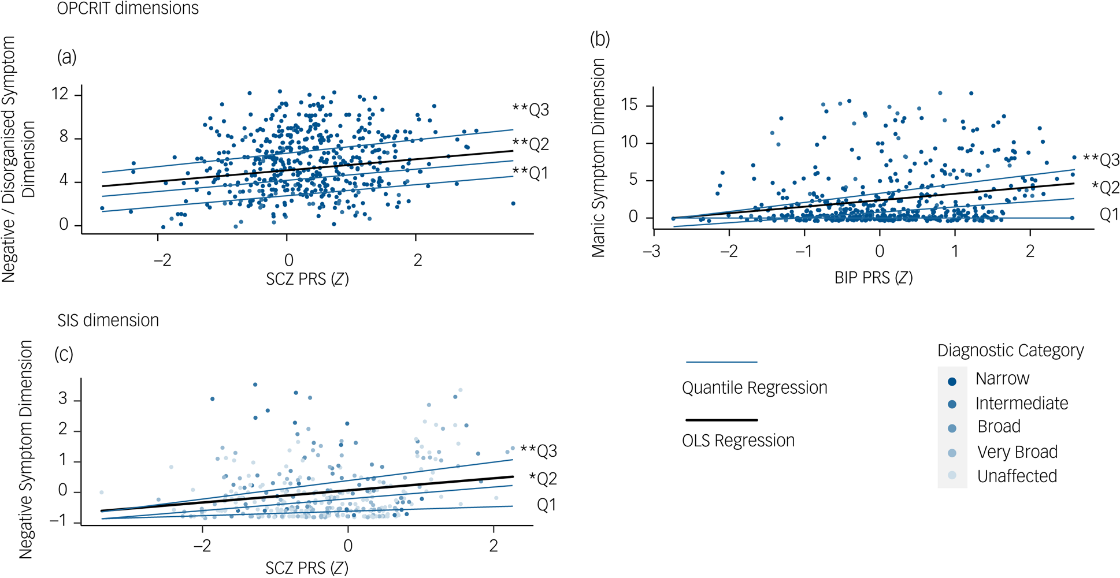
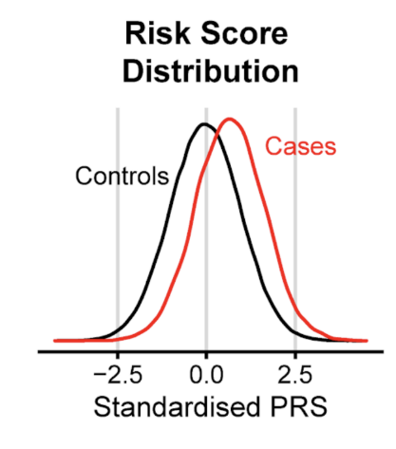
Polygenic Risk Scores
Sample A
GWAS
Sample B
cases
controls
With risk allele
Without risk allele
Sample B
Non-
TRS
TRS
Negative symptom severity
Std SCZ-PRS
Std SCZ-PRS
Trubetskoy et al, 2022; Ahanghari et al, 2022; ASHG, 2018; Wikipedia; Ebrahimi et al. 2024
Notes:
Identify SNPs from source GWAS (Base Data e.g., SCZ) surpassing a p-value threshold and their effect sizes
Score each participant in target GWAS data (e.g., neuroticism) by summing the risk alleles they possess for SNPs weighted by their corresponding effect sizes

