Slide 1
Statistical Inference
Super Short Introduction to Statistical Tests and P-values

Slide 2
We hypothesize a signal, then use the data to CONFIRM it.
Statistical Tests & the Scientific Method
Research Question
hypothesis:
Having a pet improves depression
Sample Data
(Trial, other data)
Descriptive Analysis
Statistical Test
(Test the hypothesis)
Theory
(EBM)

Slide 3
We SEARCH for a not pre-defined signal in the EXSISTING data
Hypothesis Search
Descriptive Analysis
Data driven Question
(hypothesis)
Sample Data
Statistical Test
(Test the hypothesis)
Correct Path
Statistical Reporting (Estimation, not conclusion, not theory)
Sample NEW Data
Theory

Slide 4
Take away
Statistical tests are only valid when hypothesis is stated before looking at the data.
Once you look at the data:
  Tests are not very meaningful
  Estimating effects and their precision is better.

Slide 5
Sample & Population
Research Question
hypothesis:
Having a pet improves depression
Sample Data
25 participants get a pet
25 participants get no pet
There are “infinite” sets of 50 participants. Each will give you different results. Your sample is one of those possible sets.
At first, your results are only valid for your specific set of 50 participants.
What can you tell about all participants? What part of your results will replicate if you look at a different set of 50 partiicpants>?
Statistical Inference!
(testing and estimation)

Slide 6
Statistical Inference: Testing and Estimating
Decision framework: you need good evidence to make an important decision about whether the effect exist.
P-value < 0.05
(evidence)
Decision:
Yes, pets improves depression
Statistical Tests
Learning framework: you don’t need to make a decision, you just want to present your findings.
Statistical Estimation
Pets improves depression score by 5 points (95% CI: 4-6)
Effect Size, Precision, Confidence Interval
Note: In both cases we are looking for evidence that what we see in our sample is valid outside our sample too.

Slide 7
But…
Statistical Test: Decision can be incorrect!
→ Replication Crisis
Estimation: You are just presenting the effect size and how precise it is. You are not making a decision, so you cannot be incorrect.
Question: Do you need to make a decision?!
I would argue most times you don’t.

Slide 8
Testing Framework
Diagnosis | Men odds ratio (BD vs control) | Women odds ratio (BD vs control) | p-value
Coronary artery disease | 1.64 [1.15, 2.34] | 4.23 [3.09, 5.79] | <0.001*
Myocardial infarction | 1.51 [0.80, 2.85] | 1.93 [0.86, 4.35] | 0.6404
Angina | 2.16 [1.38, 3.38] | 3.56 [2.37, 5.36] | 0.1060
Atrial fib./flutter | 2.54 [1.71, 3.77] | 3.00 [1.98, 4.54] | 0.5692
Heart failure | 2.54 [1.55, 4.16] | 6.81 [4.59, 10.12] | 0.0022*
Stroke | 3.70 [2.14, 6.40] | 3.89 [2.12, 7.16] | 0.9046
Essential hypertension | 1.68 [1.25, 2.25] | 3.65 [2.89, 4.61] | <0.001*

Slide 9
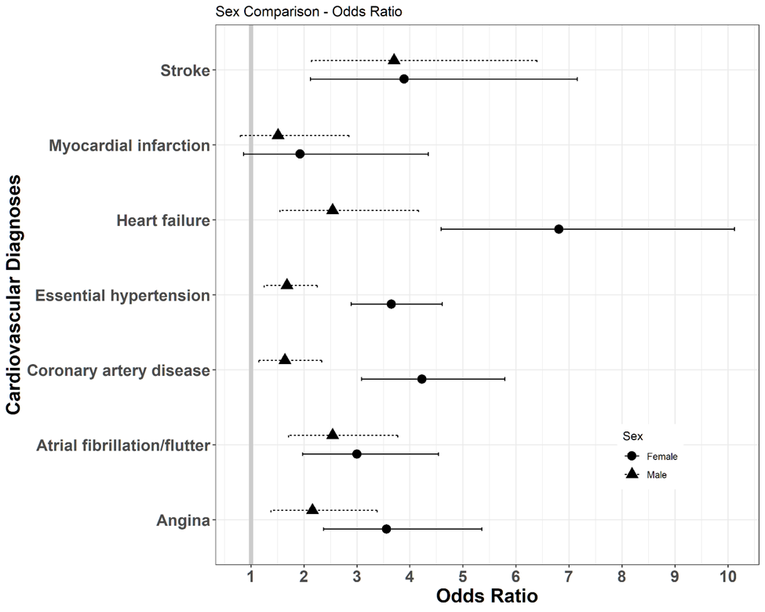
Estimation Framework

Slide 10
A measure of evidence
P-value
I found that pets improves depression score by 5 points relative to no Pet.
Question: How likely is it that this 5 points are just noise and if I collect new data, I will not find it again?
P-value = 0.02
P-value is the probability that the effect I found in the data is just usual noise. Low p-value is evidence that is it not just noise, it is a real effect in the population.

Slide 11
0.05 is arbitrary, but should depend on costs of mistake.
The 0.05 threshold
Would you fly if the probability that the airplane will fall out of the sky was 0.0001? I am pretty sure you would not! This would not be low enough because there is too much at stake (your life)!
Would you leave your umbrella at home if the probability of rain was 0.20? I would. It is low enough to me!
Same for the pets, what is at stake? If lots, then maybe you should use a threshold < 0.05. If not a lot, maybe it should be larger. But these are not always easy questions.

Slide 12
Significant = Enough Evidence.
Interpretation: Significant/Not Significant
If p-value <= Threshold (Significant p-value)
“I have enough evidence that pets improve depression”
If p-value > Threshold (non-significant p-value)
“I don’t have enough evidence that pets improve depression”
Incorrect:
“Pets don’t improve depression”
“We found evidence that pets don’t improve depression”
“Pets are not associated with depression”
You either have or don’t have enough evidence. Think about a court trial: you either have evidence enough to convict someone or you don’t. If you don’t, that is not evidence the defendant is innocent.

Slide 13
Example p-value
Scenario 1 – Incorrect calculation of p-value (look at the data first)
You are casually flipping coins and you flip it many tiems
At some point you notice that you got head 4 consecutive times.
You hypothesize that the coin is biased.
P-value = 0.06
Scenario 2 – Correct calculation of p-value (looking at the data last)
You notice that a coin always turns up head when flipped.
You find that a paper studied that same coin and found that it was highly biased towards head when flipped.
You plan an experiment: flip the coin only 4 times
You got 4 heads.
P-value = 0.06.
Scenario 1: Just a large noise that you will get if you keep flipping coins.
Scenario 2: Smoking gun.

Slide 14
Key take-ways
The 0.05 threshold for p-values is arbitrary.
P-value is the probability that I would find my effect in random data (data with no effect).
The smaller the p-value the larger the evidence – this is always valid.
P-value < 0.05 is good evidence only when scientific method is followed: hypothesis -> sample -> p-value.
You use p-values when you want to make a decision.
Confidence intervals are alternatives to p-values. Instead of deciding if the effect exist or not, you estimate the effect and its precision.

Slide 15
Let’s do some Inference!

