Slide 1
“Insight” as a Keyword for the ED
Peter Muirhead, KCNI
Apr. 14/2023

Slide 2
Interesting (and Debateable!) Properties
Assumes a pre-existing problem or gap
Temporality: Both a process and an event (you have it or you don’t)
  BUT: it can emerge at once from a discrete event, OR build up over time in relation to multiple factors (think food allergy vs. psychotherapy)
Metaphysics: fundamentally phenomenological (emerges through human experience), but might be tacet/second nature/subliminal/imponderable/implicit
Semantic overlap: Inspiration, the uncanny, calling, creativity, illumination, religious experience, enlightenment, aha!, eureka!

Slide 3
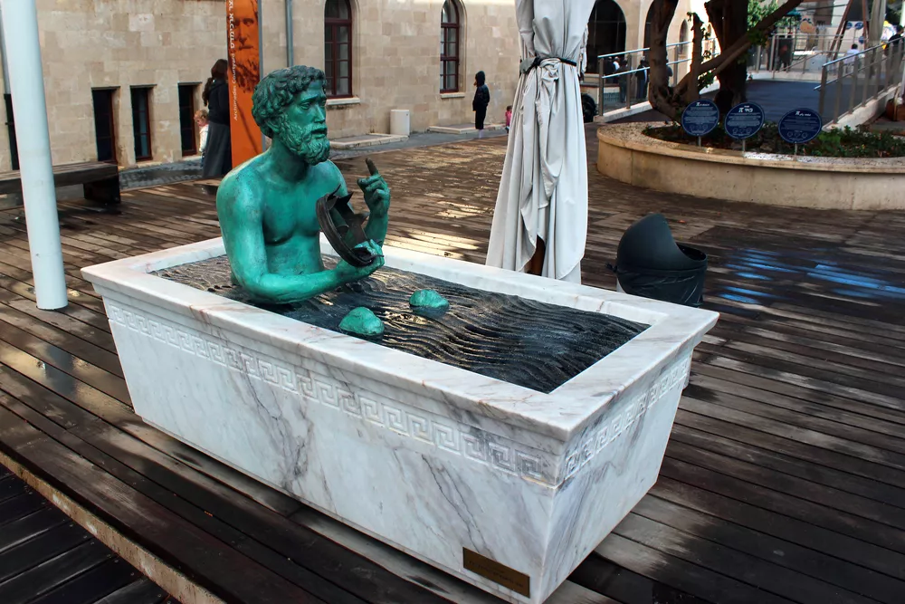
Madatech, Israel's National Museum of Science, Technology and Space, Haifa. (Image credit: Andrii Zhezhera/Shutterstock))

Slide 4
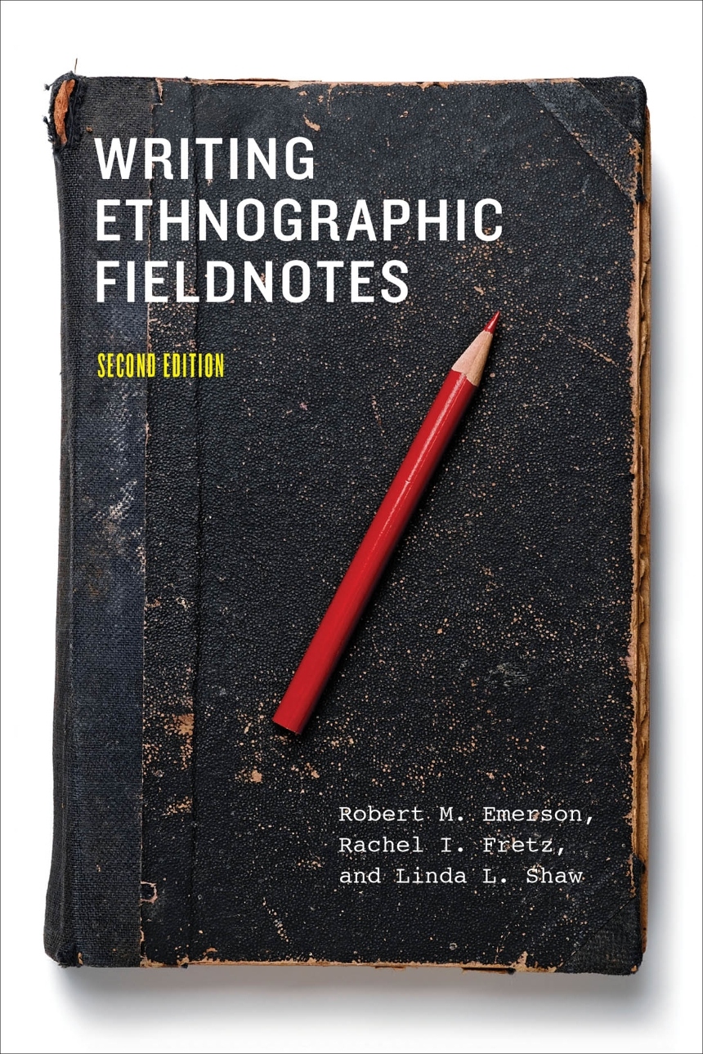

Not pictured: ED Downtime Computer

Slide 5
Insight as a “Keyword”
Per Raymond Williams (1976), culture studies
Insight: Big deal in 1990s and 2000s in cognitive science
Association with the idea of genius or discovery – pop psych, retrospective diagnosis, drugs
Paradoxical association with/exotification of the figure of the schizophrenic, bipolar person, autistic person, etc.
Tension with full rational personhood in Judeo-Christianity/Western philosophy: e.g. Matthew 21:6, “from the mouths of babies”/ “kids say the darndest things”, Locke’s ideas about madness
Tension with empathy: we need to wait for them to “get” it

Slide 6
What does “Insight” mean clinically?
Reflexive Note: “Insight” is black-boxed, but not meaningless
Specialized term, but semantic overlaps remain, BCIS
Clinicians interested in extent to which patient has insight (usually about diagnosis, behaviour, possible futures)
Clinicians identify necessary insight through their expertise, patients access insight through psychoeducation, experience, and intuition
Presence or absence of a particular thought process, of acceptance, remorse, psychosis
A useful variable for gatekeeping (housing, treatment programs), measuring recovery
A shorthand for a variety of otherwise implicit power relationships

Slide 7
Clinical Meaning, cont.
Good fit with recovery discourse (think AA)
Individualistic (in this form), bootstrappy, mindful
Cause and effect/self-discipline – insight as risk-management
Insight into one’s environment – “what’s best for me”
Grounds/code for compliance, rationality, safety (to self/others)
Psychiatrically relevant experiences: learning the right lessons
Anything else?

Slide 8
Why does Insight matter in the ED?
  When “insight” is invoked, say/do distinction is visible
  Maps to the functional impairment aspect of diagnosis/formulation/DSM
  Reveals the boundary (in psychiatric causation) between nature and culture
  Technically, not all insights are clinically desirable, BUT only good patient insights get named as such (epistemic + ethical judgement)

Slide 9
An aside: Anosignosia (per Babinski 1914)
(“without-disease-knowledge”)
Sometimes identified as a feature of psych/neuro disorders: can’t recognize – symptom of an underlying illness
Socially relevant, clear connection with stigma: not recognizing that one is marked
Cartesian distinction between anosignosia and rejecting the premise of treatment (anatomical, not psychological)

Slide 10
“Insight” in Social Science
Good for anthropology: medicine/religion nexus, “grand” but ultimately grounded in experience and practice
Medico-legal boundary work
Latour/Asad: a leftover in modernity, incomplete secularization
Hutchinson (1941): Insight (in creativity) has stages, is complex, has a build-up, relationality (see Estroff 2014 commentary)
Estroff: typically, we assume compliance = awareness, resignation = agreement, completely different theorization of insight between psychology of creativity and psychiatry, leaves out sociality

Slide 11
Critiques
Epistemic Injustice (quality of arguments varies, see Kidd et al. 2022, canonically Fricker 2007): Injustice toward a knower
Insight as a lost cause/impossibility (criminal culpability, some severe mental illness, dementia)
Very enlightenment-y, modernist
By same token: colonial logic of West and rest, built on an “othering” framework
Chronicity: (Real or perceived) immutability of psychiatric disorder
“Making up People“ (Hacking 2006) – human kinds defined through their relationship to insight, a feedback loop

Slide 12
Critiques, cont.
Rosen (2022) talk (see Confluence, invite email): “insight” in the implicit curriculum
Rosen: “Insight” masks the move from “how can I help to this person?” to “does this person have a psych disorder?”
Patient needs to be convinced that they need a particular treatment, even if they don’t want it (on some level)
Profoundly individualistic
Is it always best to know?

