Slide 1
“At the doctor’s office, it [sex] doesn’t exist”: Identity and insight in emergency psychiatric care
Monthly Team Meeting: April 14, 2023
Theme: Insight
Presenter: Laura Sikstrom

Slide 2
INSIGHT
in-sight (noun)
“A deep understanding of a person or thing.”
-Oxford
“New understanding by a mentally ill person of the [biological/situational] causes of their disorder”
Oxford Dictionary
“Awareness of understanding of one’s mental or emotional state or condition”
- Merriam Webster
L. Sikstrom, April 14, 2023
Data Integration Team Meeting
Notes:
It often involves seeing connections or patterns that are not immediately apparent, and it can come from experience, observation, or intuition.

Slide 3
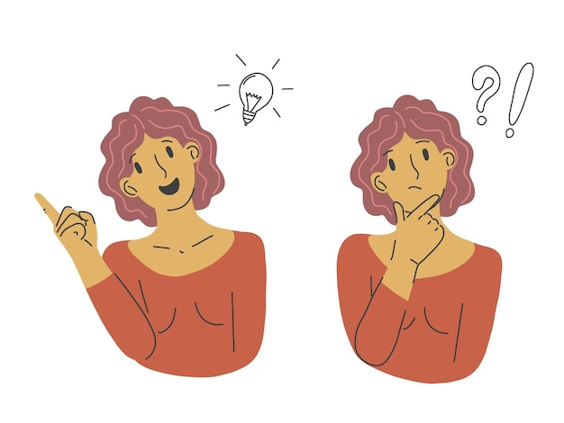
PENETRATION
(discernment, perception, acumen)
The power or act of seeing into a situation;
A power to see what is not evident to the “average mind”;
- Merriam Webster

Slide 4

Penetrations/Limitations
Because Bourdieu’s habitus left little room for agency;
It is through penetrations that working-class youth recognize capitalism’s false promise of advancement via education.
But penetrations are partial and disorganized (rarely result in social change or upheaval at scale).
Willis describes this partiality as limitations. The limitations in this case are a form of racialized masculinity. (e.g., racist misogyny). Racialized masculinity gives these youth a sense of empowerment, identity and agency.
  eg., “I chose this [factory] job; I’m not some f** who sits at a desk all day”
  Eg., the feminization of office or white collar work;

Slide 5
Penetrations (my take)
A deep understanding of a person or thing (e.g., ‘the system’)
Not necessarily an “insight” I agree with (e.g., believe to be ‘true,’ or at least fully true in the objectivist sense);
Moments where our interlocutors* do the interpretive work for us;
  In our study, clinicians are also research participants;
    They do interpretative work for us all the time – but we may find it much harder to disagree with them (e.g., authoritative knowledge);
    *Interlocutor: someone we engage in conversation with.
    Clinicians (informal)
    Patients (formalized)

Slide 6
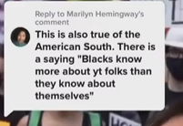
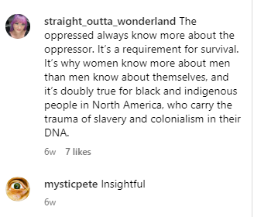
Psychology of oppression = increased access to ‘truth’?
“Equality keeps us honest. Our peers tell us who we are and how we are doing…. Inequality creates liars and delusion. The powerless need to dissemble—that’s how slaves, servants, and women got the reputation of being liars… This is why I always pair privilege with obliviousness; obliviousness is privilege’s form of deprivation. When you don’t hear others, you don’t imagine them, they become unreal, and you are left in the wasteland of a world with only yourself in it, and that surely makes you starving, though you know not for what, if you have ceased to imagine others exist in any true deep way that matters. This is about a need for which we hardly have language or at least not a familiar conversation.”
Solnit on the Ignorance of Privilege
https://www.instagram.com/reel/Co2QLvBr7L5/?igshid=YmMyMTA2M2Y%3D

Slide 7
KNOWLEDGE
(Insight/Penetration)
IDENTITY

Slide 8
IDENTITY
“Who we are in relation to others”
Gender
Ethnicity
Sexual identity
Diagnosis (bio citizenship, Petryna)
Profession
Class
Personality-type (e.g., extro vs introverted)
Parent, spouse, child
Astrological sign
KNOWLEDGE
“knower and knowledge generation can never be fully separated”

Slide 9
Q. Tell me a little about yourself and how you came to CAMH?
(First question, deliberately open ended)
Would like to calculate the mean length of time someone takes to answer (e.g., 10min+ I bet)
Q. Are there aspects of your identity that impacted your experience in the ED?
(Near the end, one of our best questions)

Slide 10
A note on transcription
… means words have been omitted (including fillers, discourse markers or repeats);
…. Means whole sentences are missing;
[xxx] means a word was added for clarity;
In anthropology we use pseudonyms; in medicine participants are often given ID numbers (e.g. P05).
[sic] means the transcription is imperfect.

Slide 11
“At the doctor’s office, it [sex] doesn’t exist” (P03)
LS: Are you comfortable describing for me a little bit how that felt and what you were hoping, like, what you were trying to express through that very visceral reaction?
Ellis (P03): I…. tried communicating in… a more calm way…. But I felt like they didn't think I was… crazy enough, or I don't fucking know, you know? But in that moment, like, I don't know, I just felt… I don't know, they just weren't seeing how much I was actually struggling. And I don't know. Like, I don't know.
LS: What do you think it is? That made it hard for them to see? Like, how much you were struggling?
Ellis: …. I just never felt like, my feelings were validated by them. You know, like, I don't know, just I yeah, I feel like they weren't getting the full picture. Because, like, I feel like there's definitely questions that they should be asking that they're not like, I feel like… sexual health and… they don't talk about it at all. Like, it's like, there's so many indicators that, you know, like, show themselves to make someone's sexual behavior that could point to like, their mental illness and stuff. And it's not asked about at all and I understand that, like, maybe they don't want to make patients feel uncomfortable or anything, but that's only because, like, there's so much stigma around it already. And like, it's because people aren't talking about it and like doctors are acting like it doesn't exist, you know?
….Like, I'm, I'm a sex worker, you know? Like, it's not only my job, it's like, it's a lot, you know? I don't know. I feel like, yeah, at the doctor's office, like it doesn't exist. [Ends with growing confidence about their interpretation]
…

Slide 12
“It’s hard to say, I’m no expert”
Ethan: So it seems to be that, from my experience, when there's an immediate health, like mental health concern, the prioritization is quite good. But when there's an addiction concern, I felt a little bit lower on the list…. It’s hard to say… I'm no expert. Right. So I can‘t - I just want to talk from my experience. And when I go to the ER, for my addiction issues, I feel I fall lower on the list. But I'll leave it at that. Yeah….
But it takes time for people like myself to appreciate that the system is trying to help as best as it's capable of doing. It's really not [sic]. It comes down to the matter of funding and a numbers thing. And like, unfortunately, that's just the fact of living in a world like the one we have, no? I'm not making political because I don't want to go there. But if I could somehow get more funding, I think people would be better off. Right?
But you know, I feel like the ER can only do so much. You know?.... So that's no one's fault. The way I see my own personal opinion…. You know, there's only so many beds, there's only so many doctors and nurses, and that the stress that you guys are under is gotta be it's gotta be unbearable at times, especially with the fact that so with mental health and addiction.

Slide 13
“I notice more than others, because I’m a lawyer” (P12)
Alexei: Well, I think what impacts it, first of all, yeah, people have their own pre determinations, pre conceptions. And, for example, I have not noticed any homophobia for example. Right? Okay. So I would not say that that plays any role into any denials, right, permissions, right, or anything else. Otherwise, I would have brought it up there. Right. Or anything else that may have been there. But I think I noticed more than others, because I'm a lawyer. So I'm used to see details and pay attention to details and even more than any other person. Why? Because I highlight them more than ever, in courts. Right. So I'm used to this. I'm used to it.
I'm seeing nurses, that will go a step further. I see nurses that just the bare minimum as required. And I'm seeing nurses who will have their own rules, but the common determinant is that minimum to provide minimum to is allowed. And then that is so why is also [sic] patients need to fight for their own rights. They fight for things that been determined already for them. Small things, for example, like passes. Now, some, some nurses are easier than others who have some illnesses are not. I would love to see a common criteria of leadership that says here We have rights are called the rights. Right? Of a patient. Right. And the patient rights been explained the rights to have Uber delivered to them once a day, four to six unknown errors is to decline delivery of such food to the patient under any circumstances. Unless emergency or something like that. Right. Yeah, that will bring clarity.

Slide 14
“I know what I can get away with” (P04)
LS: You mentioned you thought maybe the nurse thought you look like a trustworthy person. I'm wondering if you can reflect on that. Are there aspects of your identity that you think shaped your experience in the ED?
“Hannah”: That's interesting. That's, I like your question. [Pauses, nods approvingly]. Yeah, um, the reality is, is that I surround myself with a lot of Black people, and that's natural. For me. I have a lot of Black friends. I don't know what it is, [but] in turn, I know I know the visual…. Essentially… essentially, essentially there is there is a level… the way that you proceed outside, it's real in the sense that … people have a natural understanding of what they see as trustworthy.…
But the reality was… here is a middle aged white woman in distress [referring to herself]. She's not yelling, she's not screaming, she's got a backpack, she looks like she's in trouble. She's crying. She wants to get home. And, you know, when you see someone paint a picture like that, versus let's paint a picture of a Black male, or someone that’s mixed, okay. And I met him and I'm giving a good example of somebody who was in the same waiting room as me. He expressed to me he is bipolar. And so he said that he's aggressive. And here is… a teenager.. an older teenager. He is mixed. And he is expressing that he is violent when he is not stable. So he's walking into the hospital unstable, violent yelling, screaming, that's a completely different picture than what I just painted. So you're going to have someone like me, who could walk in with a knife in my, in my in my bag… no problem, because… I don't fit the profile of someone who would bring in a knife and start to do stuff. And so and that's what I'm trying to say here is that, you know. , we know we, we live with these biases, right? And I felt that they didn't really care to see what was in my bag, because he probably thought that I wasn't a threat. But the reality was, is that I was very much in distress mentally…. I think every single person that walks in with a bag should be checked. Even if they are, you know, privileged white women. I'm sorry. And just because you're a white woman, and so I'm trying to be very, I'm very, very open about this area of society, because I see it every day with my friends. And, you know, that for me, I know what I know. I know what I can get away with. No, I can't [lie]. I'm not gonna lie about it, you know?
[Rather than make a] decision [about] whether someone is trustworthy or not… just say, “no one's trustworthy. Everyone gets checked.” Everyone must be safe in this facility. It is my responsibility. And instead, it's a “Oh, no, she looks like she's having a hard time.” … And I think that that's it. That's changed the, the level of safety you feel you're walking into [the ED]… That's the only thing. I think other than that, though, I felt safe.

Slide 15
Identity
“Metis, but you have to be to get a job these days.”

Slide 16
Reflecting on knowledge production
Clinicians and researchers decide implicitly or explicitly what’s ‘true’
Clinicians - what’s clinically significant and/or valid knowledge:
  Nurse re. P03 – I think the nurses did the right thing (not admitting them).
  Nurse re. P05 – it’s not protocol to take a clients bag if they’re not being admitted;
Researchers: what’s worth bringing to light, what isn’t;
  Eg. I feel uncomfortable with P06 claim to being metis.
  Eg. I’m not sure what to make of racialized clients claim that they’ve never faced discrimination.

Slide 17
DISCUSSION
Identities, even marginalized ones, are a resource (source of knowledge), not a deficit.
  What does this mean for the SDOH?
2. Does privilege always equal obliviousness?
  Is the liminal space of the ED a great equalizer? (e.g. in that context all identities are collapsed into archetypes of the good/bad patient?)
3. The confused/psychotic participants are not represented here. They did not provide any quotable “insights.”

Slide 18
RESOURCES
S. Tagliamonte. 2005. So who? Like what? Just who? Discourse markers in Canadian Youth. Journal of Pragmatics. https://doi.org/10.1016/j.pragma.2005.02.017
E. Yates-Doerr. 2020. Reworking the Social Determinants of Health: Responding to Material-Semiotic Indeterminacy in Public Health Interventions. MAQ. https://doi.org/10.1111/maq.12586

