Slide 1
Predictive Care
The False Promise of Fair AI Models in Acute Psychiatry
Marta M. Maslej, Christoffer Dharma, Peter S. Muirhead, Yifan Wang,
Susan J. Bondy, Juveria Zaheer, Laura Sikstrom
October 13, 2023

Slide 2
Disclosure of Financial Support
This program has received financial support from The University of Toronto’s Dalla Lana School of Public Health (DLSPH) in the form of a Data Science Seed Grant, The Social Sciences and Humanities Research Council (SSHRC) in the form of an Insight Development Grant, and Google Research in the form of an Award for Inclusion Research.
This program has received in-kind support from The Krembil Centre for Neuroinformatics (KCNI), The Krembil Foundation and Office of Education at The Centre for Addiction and Mental Health (CAMH) in the form of computational and administrative support.
Potential for conflict(s) of interest:
  N/A
Notes:
This slide must be visually presented to the audience AND verbalized by the speaker.
Where a program has received no external financial or in-kind support, indicate No External Support

Slide 3
Presenter Disclosure
Presenters: Marta Maslej & Laura Sikstrom
Relationships with financial sponsors:
  Grants/Research Support: Dalla Lana School of Public Health, Social Sciences & Humanities Research Council, Google Research, AMS Healthcare
  Speakers Bureau/Honoraria: N/A
  Consulting Fees: N/A
  Patents: N/A
  Other: Employees of The Centre for Addiction and Mental Health (CAMH)
Notes:
This slide must be visually presented to the audience AND verbalized by the speaker.
Where a faculty/speaker has no relationships to disclose, indicate Not Applicable under relationships with Financial Sponosrs

Slide 4
Mitigating Potential Bias
The Dalla Lana School of Public Health and Social Sciences and Humanities Research Council have no influence on any aspect of the research studies being discussed in this presentation
Financial support from Google Research is in the form of an unrestricted gift
Notes:
This slide must be visually presented to the audience AND verbalized by the speaker.
When speaker/facilitator has no relationships that might pose a potential conflict of interest AND the program has been developed without external support, this slide may be omitted.

Slide 5
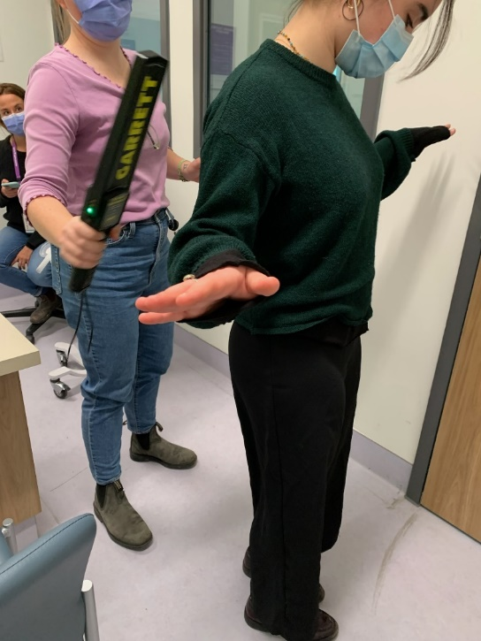
The Clinical Challenge
“The moment we touch a patient, we have failed.”
Violence has adverse outcomes for patients & providers when it happens.
Opportunity to enhance risk assessments with machine learning.
But BIAS ∵ Extreme Caution
Team Nurse Z Findlay holds a mock triage in the CAMH Emergency Department with the research team
Notes:
In this presentation, we investigate an emergent medical and technical innovation we call ‘predictive care’. Predictive care is an approach to medicine driven by advances in artificial intelligence, which enhance our ability to identify patterns and predict outcomes or behaviours. While in psychiatry, few predictive care tools are in use, risk assessments for suicide, patient readmission and inpatient aggression or violence are in high demand.
In particular, the prevention and management of violence and aggression in acute psychiatric settings is a priority. While enhancing clinical risk assessments with ML might be a solution - we also know that predictive care models are capable of amplifying existing inequities, such as racial bias, often because these tools are trained on biased datasets.

Slide 6

Study aim
examine how systemic factors bias EHRs for racialized patients, with implications for training ML models to predict risks of violence or aggression
Photo credits: OpenAI, Dall-E
Notes:
given this, our study examines how systemic factors might bias data in EHRs for certain kinds of patients (e.g., racialized patients), with implications for training ML models on these data to predict violence/aggression

Slide 7

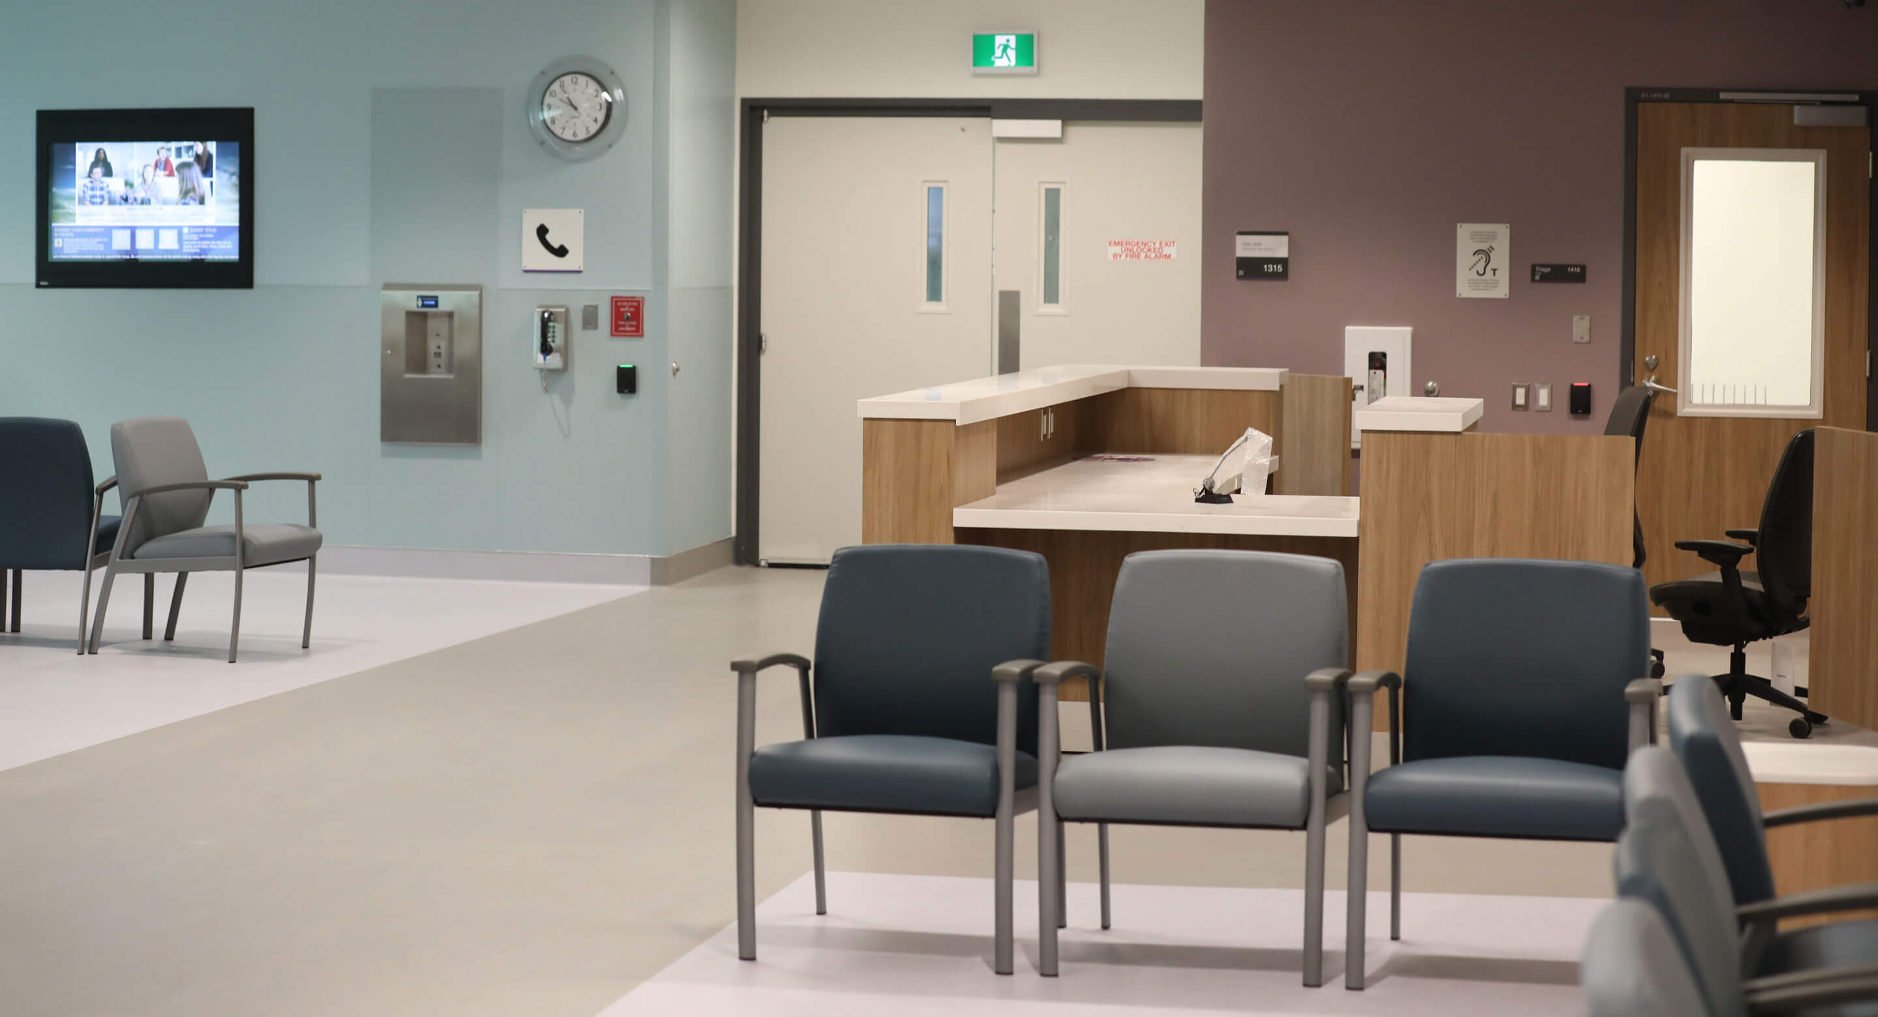
The CAMH ED
Peter
Muirhead
REB #053-2021
Sikstrom, Maslej, et al. 2023. Predictive Care Protocol
Notes:
Our study involved both ethnographic and computational methods. In our case, the ethnography included 250 hours of participant observation of the Emergency Dept at CAMH, and shadowing providers as they went about their work. In addition, we conducted 37 semi-structured interviews with patients, providers and key informants. Our goal was to understand how risk of violence/aggression is documented and managed in this context.

Slide 8
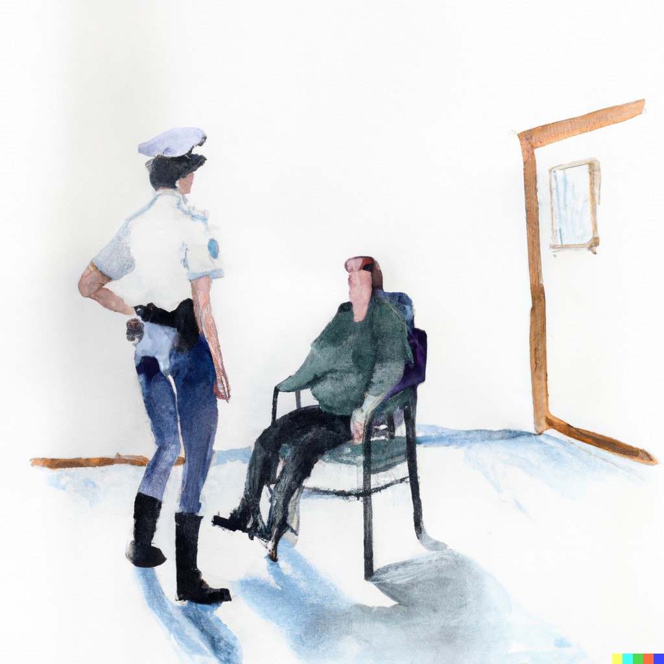

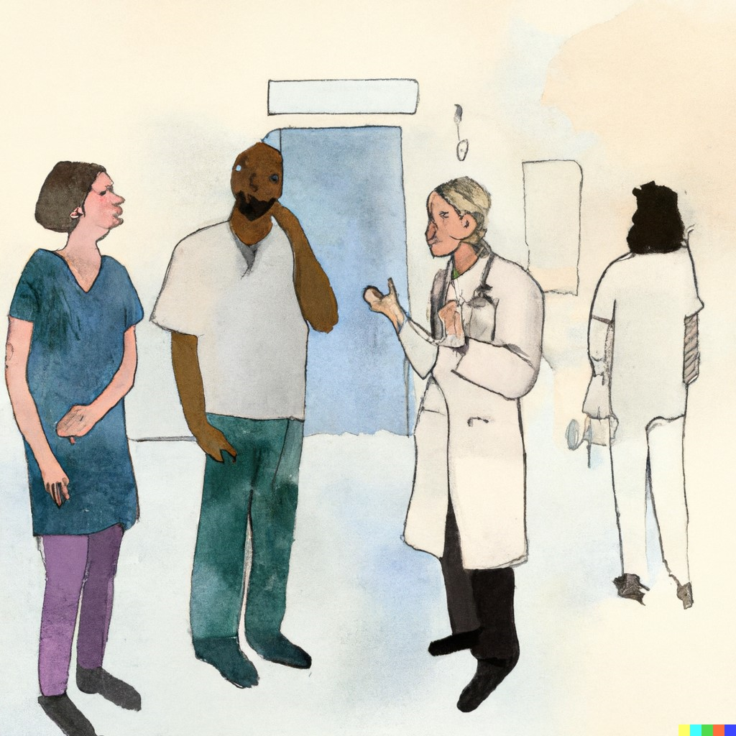
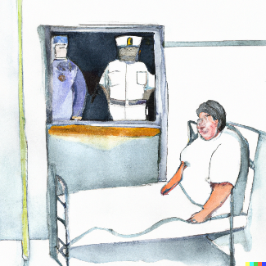
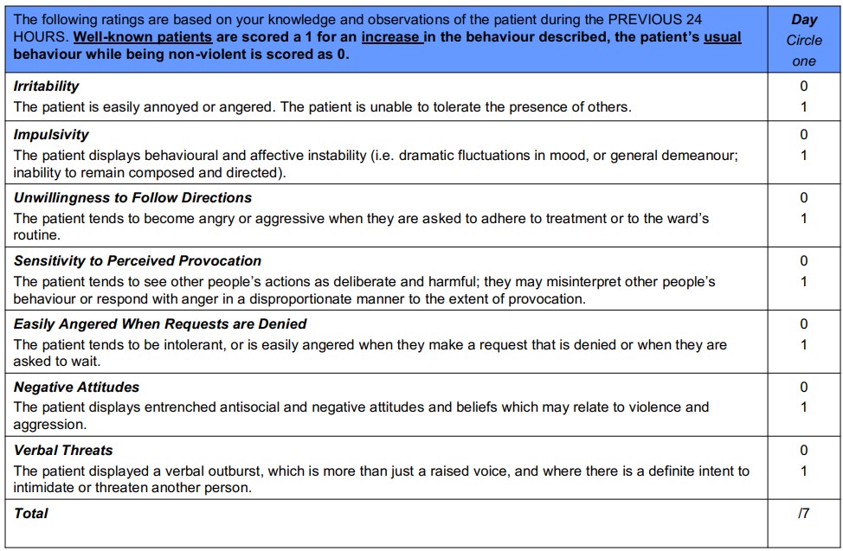
Results
“Client managed to bite a police officer, even while handcuffed.”
“Sir! Please stay seated on the bed! Sir!”
Documented in the EHR (structured and unstructured)
Information used to manage staff and patient safety
Generate a daily “DASA” score
Reshared verbally
Shared verbally
Photo credits: OpenAI, Dall-E
Ling et al., 2015
Notes:
Our findings demonstrate that admission by police is one of the key factors shaping documentation + management of risk in this context.
To give you an ethnographic example of what we mean by this, when a client is brought into the ED by police, the police verbally share info about the context surrounding the encounter, for eg, managed to bite me even while handcuffed. This info is then documented in the EHR. After the first 24 hours, nurses review this narrative data to generate a daily numerical score called the DASA, which is a structured clinical risk assessment that nurses use to rate patients on 7 behavioural indicators of violence or aggression, eg irritability, verbal threats. This score is then used in combination with other clinical observations to guide risk management strategies. In particular, staff share and re-share information verbally about previous police encounters at routine meetings like rounds and team huddles. This information is often discussed and used to develop a range of interventions meant to keep everyone safe –this may include small things like reminders to put your hair in a ponytail or frequent verbal instructions to reinforce the boundary between patients and staff. For example, “stay seated” or “stand back from the door.”

Slide 9





Computational Analyses
Analysis 1. Role of social and systemic bias in
false positive assessment on the DASA
7,424 clients, 12,650 acute care stays (2016-2022)
(from the
first day only)
Generalized estimated equations (correlated data)
Modified Poisson regressions (prevalence ratios or PRs)
Chris
Dharma
Dharma et al., in prep
Notes:
Methods. Ethnographic findings useful for illuminating key factors that could impact risk assessment, such as police presence at admission. So the goal of our computational analysis was to test how these factors, when recorded in EHRs, might impact violence risk prediction, both when it is done by clinicians but also by machine learning algorithms.
We compiled EHRs across acute care stays for patients at CAMH (from May 2016 to May 2022) which were available for two main analyses:
1) to understand whether certain patients may be unfairly assessed with the DASA, with a focus on false positive assessments (i.e., being rated as high risk but not going on to become violent/aggressive)
-first, we examined whether racialized patients are more likely to receive these false positive assessments (univariate regressions examining association of race and false positive assessment)
-then we controlled for other factors, like whether someone was admitted to the ED by police, to see if they accounted for any observed associations between race and false positive assessments
MARTA

Slide 10
Results (Analysis 1, FPA)
 | Unadjusted PR (95% CI) | Adjusted** PR (95% CI)
Race/Ethnicity (REF: White)* | 1.00 | 1.00
Asian | 1.07 (0.92, 1.24) | 1.01 (0.89, 1.16)
Black | 1.32 (1.19, 1.47) | 1.06 (0.96, 1.17)
Indian | 1.07 (0.92, 1.25) | 0.99 (0.85, 1.14)
Indigenous | 1.30 (1.07, 1.58) | 1.21 (1.01, 1.44)
Latin-American | 0.91 (0.72, 1.15) | 0.88 (0.72, 1.09)
Middle Eastern | 1.37 (1.14, 1.64) | 1.22 (1.03, 1.44)
Mixed | 1.01 (0.80, 1.28) | 1.02 (0.80, 1.30)
Note. * reference group, **adjusted for age, gender, diagnosis, housing status, admission mode
Notes:
Results. Findings from this analyses do suggest that some racialized patients are at higher risk of false positive assessments relative to white patients; however, associations are attenuated or not significant in the adjusted or multivariable regression, suggesting that other factors may be accounting for the association between race and false positive assessment (Figure 1).
MARTA

Slide 11

 | Adjusted** PR (95% CI)
Admission Mode (REF: By self)* | 1.00
Police | 2.14 (1.92, 2.40)
Case worker / nurse | 1.53 (1.30, 1.81)
Housing (REF: Own)* | 1.00
Supportive Housing | 1.37 (1.17, 1.61)
Unstable housing/unhoused | 1.45 (1.26, 1.68)
Note. Factors with sig. associations are depicted. *reference group, **additionally adjusted for race, age, gender, and diagnosis
housing insecurity
policing & racial profiling
Maura & Weisman de Mamani, 2017; Kim, 2019;
Huey, Ferguson & Vaughan, 2021; Cotter, 2023
Notes:
Results. What are the other factors?
Admission by police in particular, and this is consistent with evidence of racial profiling in Canada, there’s research in this space suggesting that Black and Indigenous Canadians are more likely to report negative perceptions of police and have more frequent contacts with the police.³⁵ Experiences of criminalization can also fuel distrust between police and racialized individuals, which can alter interactions and lead to escalation and admission to the ED.
But another key predictor of FPA is certain housing situations, like being in supportive housing or unstable/unhoused – This makes sense – poor living conditions may exacerbate illness and impair functioning, which could lead to atypical behaviours that are considered high-risk on the DASA (e.g., agitation, noncompliance with directions). Patients with unstable housing may also spend more time in public spaces or police-surveilled spaces, making them more likely to encounter police.³⁰
So it’s not really a matter of interpersonal bias in the ED that is leading to unfair assessment by clinicians, but rather, structural inequities that start even before the patient comes into the ED
MARTA

Slide 12





Analysis 2. Impact of training data bias on machine learning (ML) prediction of violence
n^{train} 29,879 (3% incident), n^{test} 12,840
(first 3 days of acute care stay per client, 2016-2022)
Evaluate best-performing model on test set
Optimize for F1 across models
with 5-fold CV
in train set
FP
FP+TN
incident (1) or
no incident (0)
Yifan
Wang
Wang et al., in prep
Notes:
Methods. So given there are systemic factors that could bias risk assessment data, our second computational analysis examined the impact of training ML models on these data.
-to examine this, we trained ML models on a range of sociodemographic, clinical and admission related features from EHRs, including DASA ratings, to predict whether a patient would become violent or aggressive on a given day -won’t go into details of model development to save time but essentially, we split our data 70/30 into train and test sets, optimized for F1 across various models with 5 fold cv on train set, and evaluated the best-performing model on the test set – key part of this analysis was a fairness assessment, in which we examined compared model predictions between demographic groups with a focus on false positive rates ( whether stratified model predictions by patient demographics (like race and gender) group, focusing on race, gender, housing, citizenship and mode of admission – the key metric was false positive rate which is calculated as FP/FP+TN (total # neg cases)

Slide 13
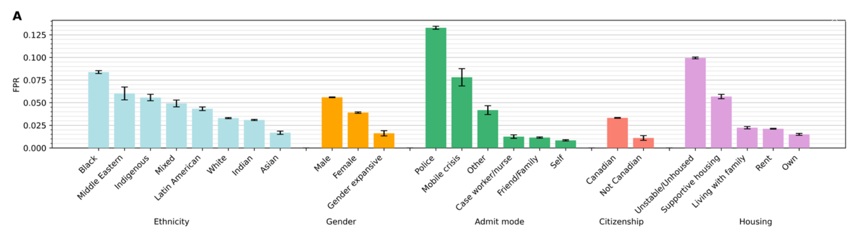
Results (Analysis 2, ML)
Best model (random forest): AUC 0.81, SENS 0.33, SPEC 0.95
False positive rate
(FP/FP+TN)
Suchting et al., 2018; Menger et al., 2018
Notes:
And in our second analysis, which examined the impact of training ML models on this EHR data to predict violent/aggressive incidents, our best-performing model achieved results on the test set similar to what others have reported in the lit - but the key findings here are the false positive rates, which show that among all race/ethnic groups, these are highest in racialized groups (black, ME, IND). But also in patients brought in by police or those in unstable housing/unhoused.
So not surprisingly, training models on EHR data which contain these embedded structural inequities can lead to biased model performance.
MARTA
(n_estimators = 200, min_samples_split = 20, min_samples_leaf = 4, max_features = log2, max_depth = 20, class_weight = balanced_subsample, bootstrap = True)

Slide 14
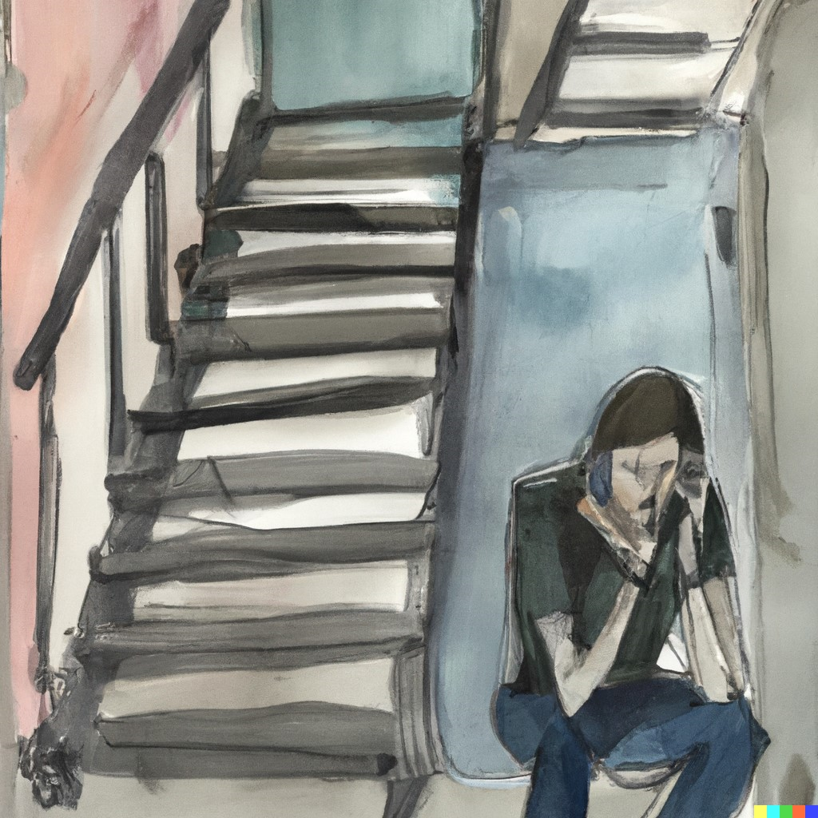
Results
“…. I'm not making things political because I don't want to go there. But if we could somehow get more funding, I think people would be better off. Right?…. So it's not about the individuals or even the police themselves, but about, like the system in general, the bigger system. You know, there's only so many beds, there's only so many doctors and nurses, and that the stress that you guys are under is gotta be unbearable at times…”
Interview with former client in the grungy stairwell of a shelter
Notes:
Results. To return to the ethnographic findings, in qualitative interviews with patients who have had encounters with the law and in unstable housing situations, such as this person I interviewed in the stairwell of a shelter, his experiences echoed these findings, for him, this was not about bad cops and bad doctors, it’s about larger systemic issues, … in his words ….

Slide 15

Conclusions
fixing models ≠
fixing systemic problems
Notes:
Discussion/Conclusion. Systemic factors may contribute to unfair assessment of risk for racialized patients, which can lead to unfair machine learning predictions when models are trained on EHRs. Current approaches to mitigating bias in training data or modelling do not address the underlying social and political realities leading to unfair assessment (e.g., more frequent apprehension by police) – fixing models != systemic problems
LAURA

Slide 16





Conclusions
Offer client a meal.
<
OF
VIOLENCE
OF
BIAS
Stand back!
Notes:
Using machine learning to identify patients at risk of biased assessment may be a more promising approach to supporting risk assessment – because if we can identify who is at risk of being unfairly assessed and why, we can build tools to provide more targeted solutions, like offering meals to patients who may be hungry, rather than using coercive boundary setting strategies – which may offer a more compassionate and equitable way to use AI in this space.
MARTA

Slide 17














Thank you
Our
Team
Our Collaborators
Our Funders
Dr. Juveria Zaheer
Dr. Sean Hill
Dr. Daniel Buchman
Dr. Susan Bondy
Dr. Katrina Hui
Dr. Gillian Strudwick
Valeria Khudiakova
Chris
Dharma
Yifan
Wang
Renee
Rosenmann
Peter
Muirhead
Igor
Sokolov
Patrycja
Szkudlarek
Sitra Adill
Mohammed
Notes:
THANK YOU OUR TEAM AND FUNDERS

Slide 18
Additional Slides

Slide 19
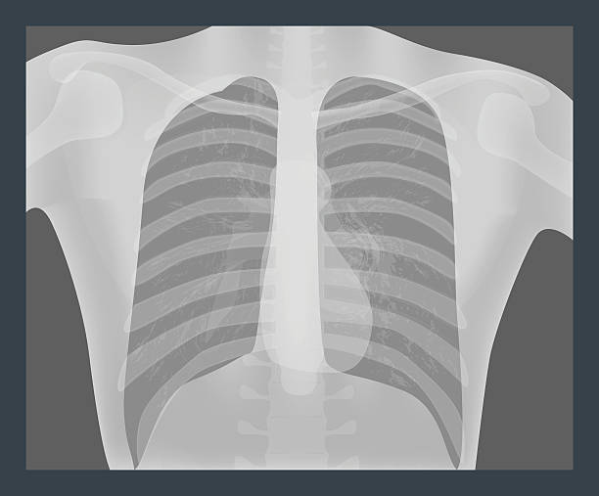

Biased data, biased predictions
Seyyed-Kalantari, Zhang, McDermott, Chen & Ghassemi, 2021
Photo credits: OpenAI, Dall-E
Notes:
Increasing awareness that training ML models on biased datasets can lead to biased predictions, such as more inaccurate predictions for already disadvantaged groups. Lots of examples of this in different high-stakes domains, such as in oncology (eg underdiagnosis chest x ray study and not always clear why this happens, though in many cases, could be lack of representation in training data
Not a ton of research into this in mental health, but particularly a concern in psychiatry, since biases can creep into datasets in various ways in this context – bc of lack of representation, but also because assessment relies on subjective observation of symptoms and behaviours
-these observations are recorded in EHRs, but they have embedded assumptions, social and diagnostic stereotypes, and are impacted by overlapping systemic inequities
-so you can see how assessment is different for psychiatry vs something like oncology, and how the data used in ML in these two contexts has different limitations/challenges
MARTA

Slide 20
Data
Data:
  EHR containing DASA risk assessment across inpatient care units at CAMH, since 2016
Features
  DASA: Location, scores
  Demographic features: Age, gender, sexual orientation, citizenship, housing, marital status, income, birth country, race, language, education
  Admission-related features: admission mode
  Diagnosis: Prior aggression, diagnosis, substance-induced
Outcome:
  Aggressive incidents including staff reporting and documented restraints

Slide 21
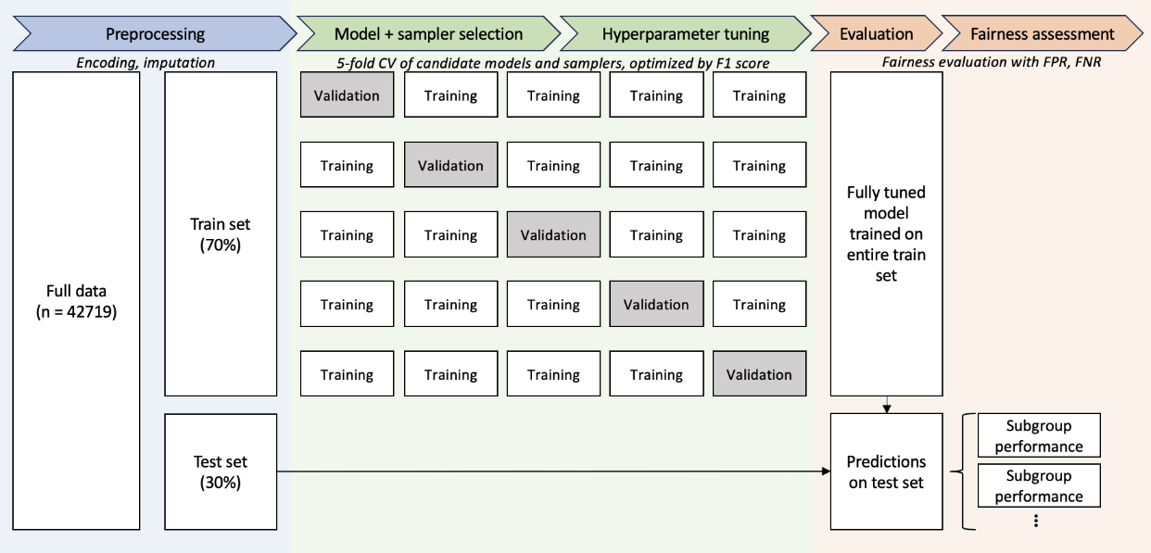
ML Pipeline
Models
Logistic Reg
Naïve Bayes
RF | SVM
Decision Tree
ANN | SGB
Sampling
No sampling
Random undersampling
Near miss
Smote
Notes:
Methods. Our second computational aim was to examine how these data could impact machine learning predictions of violence or aggression
-to examine this, we built an ML model trained on some additional sociodemographic and admission related factors (additional ones were sexual orientation, citizenship, marital status, income, education, whether diagnosis was substance induced, prior aggression) as well as the DASA scores – the aim was to use this data to predict whether a patient would become violent or aggressive on a given day, and we included data from the first 3 days or until violent/aggressive incident, as research suggests most incidents happen then
Missing <20% imputed by mode, >20% added as missing
Models were Logistic regression, Naïve Bayes, RF, SVM, Decision tree, ANN, SGB
Samplers were no resampling, random undersampling, nearmiss, smote
-top 3 models were subject to hyperparameter tuning with 5-fold CV (50 iteration random grid search across tunable parameters)
-best fully tuned model trained on entire train set applied to test set
-KEY ANALYSIS: Fairness assessment - FPR
MARTA

Slide 22
Model selection
F1 score by model and sampling algorithm | No resampling | Random undersampler | Nearmiss (undersampler) | SMOTE (oversampler)
Logistic regression | 0.002 | 0.152 | 0.067 | 0.091
Naïve Bayes | 0.091 | 0.099 | 0.046 | 0.078
Random Forest | 0.200 | 0.147 | 0.073 | 0.160
Gradient boosting | 0.022 | 0.144 | 0.070 | 0.176
Support vector machine | 0.077 | 0.198 | 0.112 | 0.091
Decision tree | 0.074 | 0.103 | 0.068 | 0.081
Neural network | 0.066 | 0.113 | 0.060 | 0.070

Slide 23
Hyperparameter tuning
Model (sampling strategy) | F1 score (sd) | ROC-AUC (sd) | Sens | Spec | Optimized hyperparameters
Random forest (none) | 0.215 (0.033) | 0.802 (0.020) | 0.308 | 0.949 | n_estimators = 200 min_samples_split = 20 min_samples_leaf = 4 max_features = log2 max_depth = 20 class_weight = balanced_subsample bootstrap = True
Gradient boosting (SMOTE) | 0.207 (0.016) | 0.798 (0.024) | 0.236 | 0.965 | smote__sampling_strategy = 0.75 smote__k_neighbors = 3 gbc__subsample = 0.8 gbc__n_estimators = 50 gbc__min_samples_split = 3 gbc__min_samples_leaf = 2 gbc__max_features = log2 gbc__max_depth = 4 gbc__learning_rate = 0.01
Support vector machine (random undersampling) | 0.210 (0.031) | 0.804 (0.020) | 0.332 | 0.945 | undersampler__sampling_strategy = 0.5 Undersampler__replacement = False svc__kernel = poly svc_gamma = 0.01 svc__degree = 3 svc__class_weight = balanced svc__C = 0.1

