Slide 1
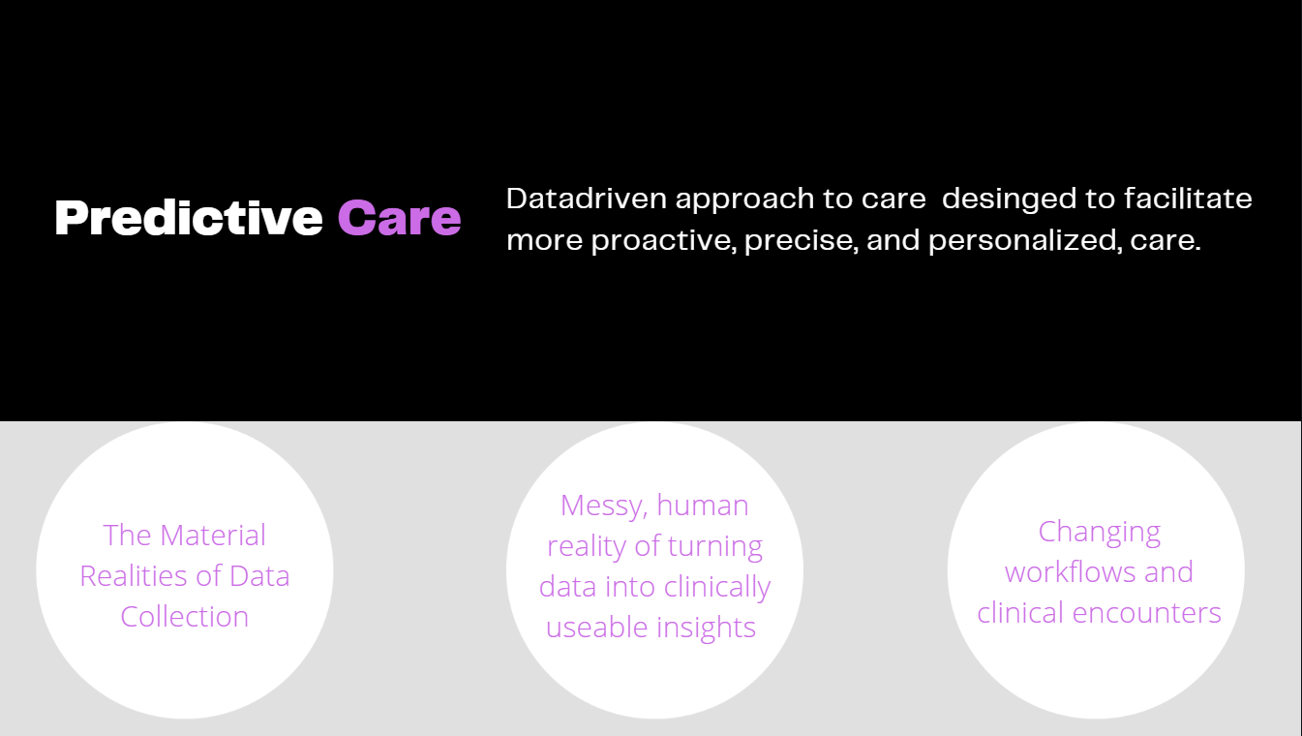

Dr. Laura Sikstrom, Medical Anthropologist
Project Scientist, KCNI, CAMH
Assistant Professor (Anthropology, UofT)
AMS Fellow in Compassion & AI
Dr. Marta Maslej, Experimental Psychologist
Project Scientist, KCNI, CAMH
Fairness & Health Equity
DATA
PREDICTION
+ CARE
Notes:
Our team examines an emergent medical and technological innovation we call "Predictive Care." Most of my ongoing research examines new healthcare opportunities and risks that emerge alongside these innovations.
We combine Prediction with “care” deliberately to illustrate that we are not just interested in the accuracy or usefulness of a specific predictive algorithm –
RATHER we are interested in both how these tools are made, and ask questions about how these advances are transforming care more broadly.
In particular, we are both very interested in how these tools could be used effectively to advance health equity.
Marta and I work independently and collaboratively. Today, we’ll talk about 2 projects that we work on together.

Slide 2

Hybrid Computational Ethnography
We are an interdisciplinary research team that develops novel methodological approaches designed to transform data* into compassionate and equitable health care experiences and outcomes.
*Data: Computational (BigData) + Ethnographic (ThickData)
Sikstrom, Maslej, et al. 2023. Predictive Care Protocol
Notes:
LAURA
Not typically that two scientists lead, but we have complementary strengths and skill sets, and are interested in answering similar questions about AI (2 coins)
-so our approach is interdisciplinary – for example, the study we will talk about first relies on computational-ethnography (link BMJ Protocol).
- Computational Ethnography
LAURA

Slide 3
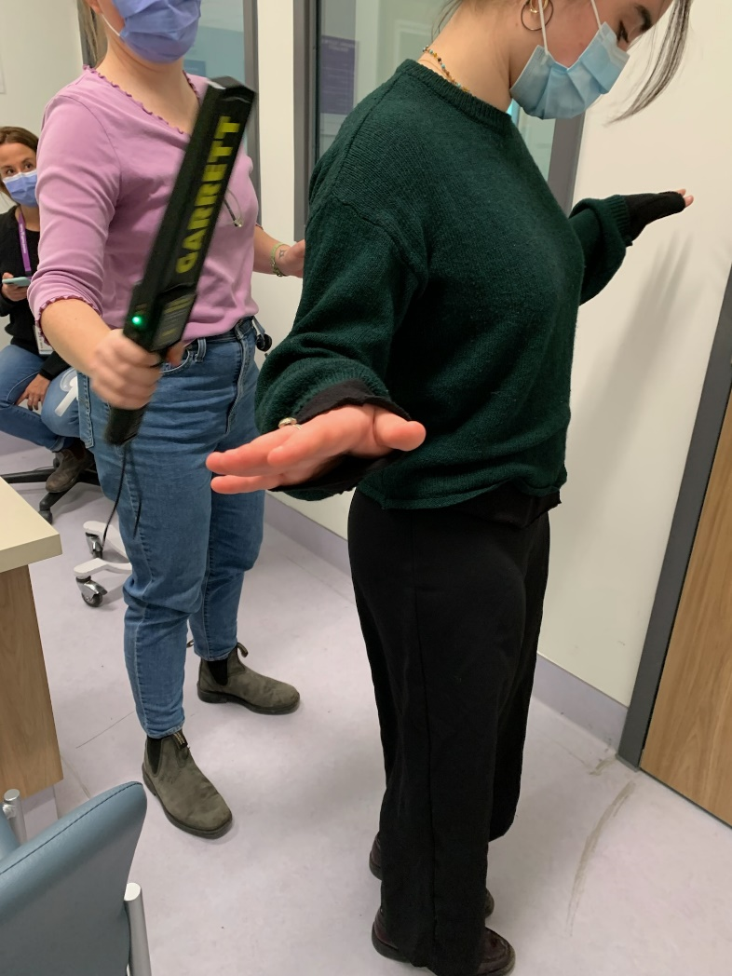
The Clinical Challenge
“The moment we touch a patient, we have failed.”
Violence is rare, but has adverse outcomes for patients & providers when it happens.
Opportunity to enhance risk assessments with machine learning.
But BIAS ∵ Extreme Caution
Team Nurse Z Findlay holds a mock triage in the CAMH Emergency Department with the research team
Notes:
Violence is rare but has adverse outcomes when it happens
-outline the challenge – the ‘moment we have touched a patient we have failed’
-efforts to automate or enhance with ML
Currently clinicians use structured rating scale to identify early warning signs to prevent coercive measures – so for example for providers the use of restraints is a last resort – or ‘the moment we touch a patient, we have failed.”
Efforts to automate or enhance this process with ML, but of course we know that biases in training datasets are a problem. So the main focus of this project is to examine how the increasing use of machine learning to enhance risk assessments might impact care in acute psychiatry.
LAURA

Slide 4










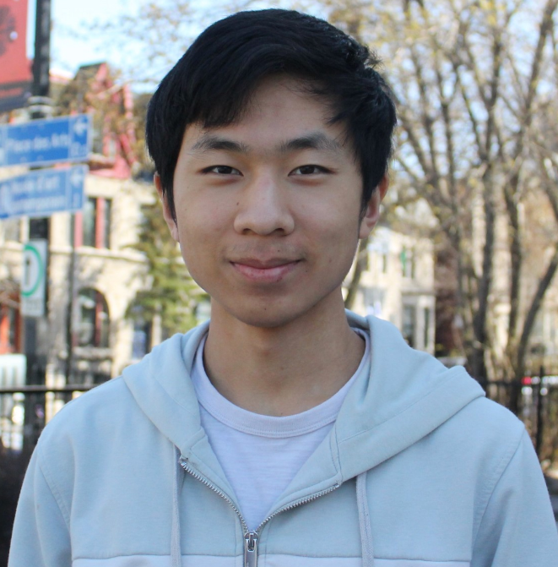

Machine Learning Modelling
10,236 clients across 17,703 acute care stays at CAMH
Demographics
Diagnosis
0 (no incident)
Admission
1 (incident)
Risk ratings
Clinical notes (soon!)
Robert Xiao
Yifan Wang
Notes:
To understand how this automation may impact risk assessment, we are building an ML model using sociodemographic, clinical and risk assessment data from over 10,000 clients across almost 18,000 acute care stays
-preliminary modelling carried out by our student, Robert Xiao, shows that our models can predict incidents of violence or aggression with performance similar to what other researchers are finding (AUC~.70)
-however, one of our other students, Yifan Wang, has been exploring the feature space our models are using to make predictions – one key takeaway from his analyses has been that although there are certain features characterizing patients who are not likely to commit a violent incident (for example, older patients who follow instructions and are not verbally threatening), there is no feature representation that can be used to reliably characterize who will commit such an incident, which may be why sensitivity in our models tends to be poor while specificity is high
-we think this means that any patient can become violent or aggressive, with these behaviours being more related to conditions or interactions in the care setting, rather than patient factors
-our next step will be to add information from clinical notes into the feature space, which we hope will provide this additional context/info and improve sensitivity

Slide 5

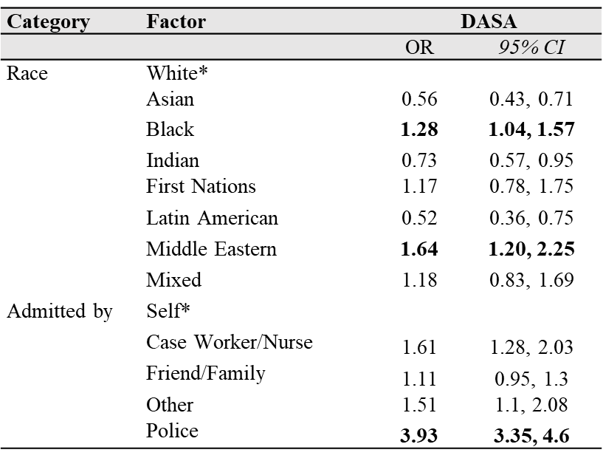
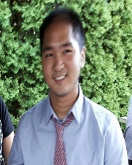
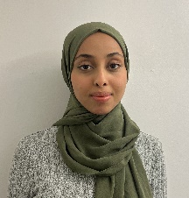
Potential for Bias
Biased features (e.g., risk assessments) Biased outcomes
Note. * denotes the reference category; ORs adjusted for age, gender, housing, and diagnosis.
Chris Dharma
Sitra Adill Mohammed
Notes:
-but our focus is bias - we are relying on clinician derived risk assessments to train our models (both structured and unstructured in the form of clinical notes), but it is possible that this assessment is biased for some patients
-one of our other students, Chris Dharma, is focusing on cases where patients are identified as being at high risk but do not go on to become violent/aggressive, and potential social or systemic factors contributing to these sort of false positive assessments using epidemiological approaches – he has already found that clinicians’ perceptions of risk are higher for racialized patients, as well as for patients admitted into the ED by police (which makes sense since police presence at admission could signal aggression) - for example, we hypothesize we suspect police presence at ED admission
-our other student, Sitra Adill Mohammed , is examining social and systemic factors contributing to bias in a qualitative way – we have consulted with key organizations or members for ME finding
(MODIFY)

Slide 6

The CAMH Emergency Department
Notes:
-CAMH ED is a complicated, dynamic and acute setting, police presence
-almost 15K visits / year
-care is coordinated by interproffesional health teams - In addition, care is also coordinated by interprofessional health teams that include social workers, pharmacists, addictions specialists, nurses, psychiatrists and unregulated health professionals like program assistants or PAs. Significantly, this means that risk is often managed collectively – raising questions about how an AI-derived prediction would or could be used effectively in this context. For example, most approaches to date might produce a risk flag in the EHR for clinicians – but in this context PAs – who do not have access to a computer – are the staff members that spend the majority of their time
-value shared decision making – nurses, social workers, dynamic

Slide 7
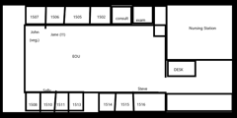
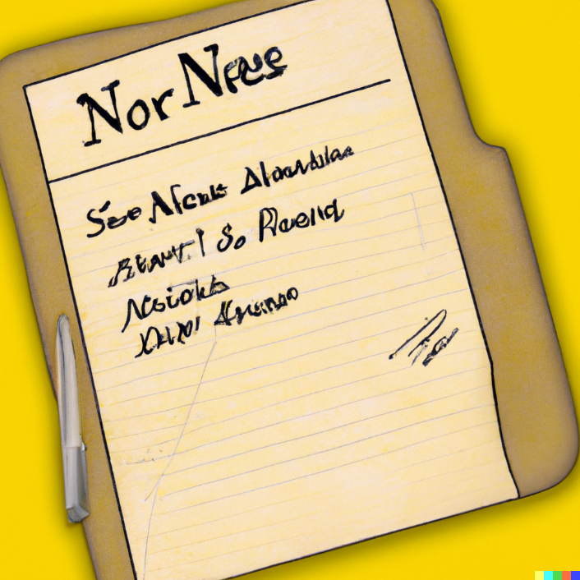
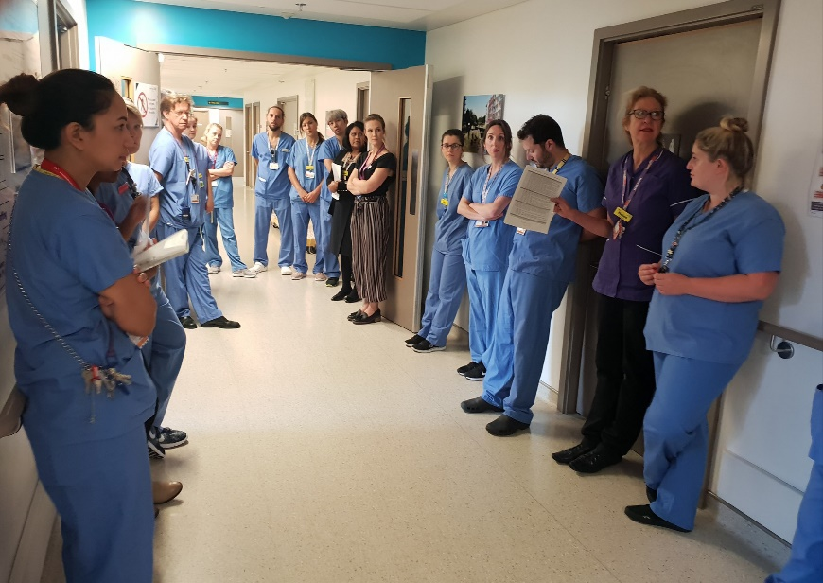


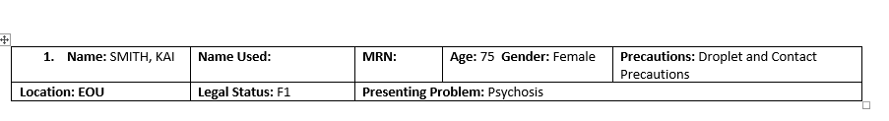
THE CLINICAL CONTEXT
How is risk assessment data generated and instrumentalized in everyday clinical scenarios?
8:30am: Rounds (25+ppl)
7am: Nurse Handover (1:1)
9am: Huddle (50ppl)
Peter Muirhead
Notes:
LAURA
To give you an ethnographic example, 3 key moments when different providers share info about safety ….

Slide 8
OH COMPUTER
WHERE ART THOU?
Notes:
Of PARTICULAR NOTE – the medium by which most predictive tools are delivered is through a computer interface – yet in each of these instances where risk is being managed – the COMPUTERS ARE NOT PRESENT during these key encounters – so any integration of any AI model would require changes to workflows and the built infrastructure of the ED itself.
This raises a lot of questions about how a tool might be successfully integrated into care in acute psychiatric contexts supported by interprofessional health teams.

Slide 9
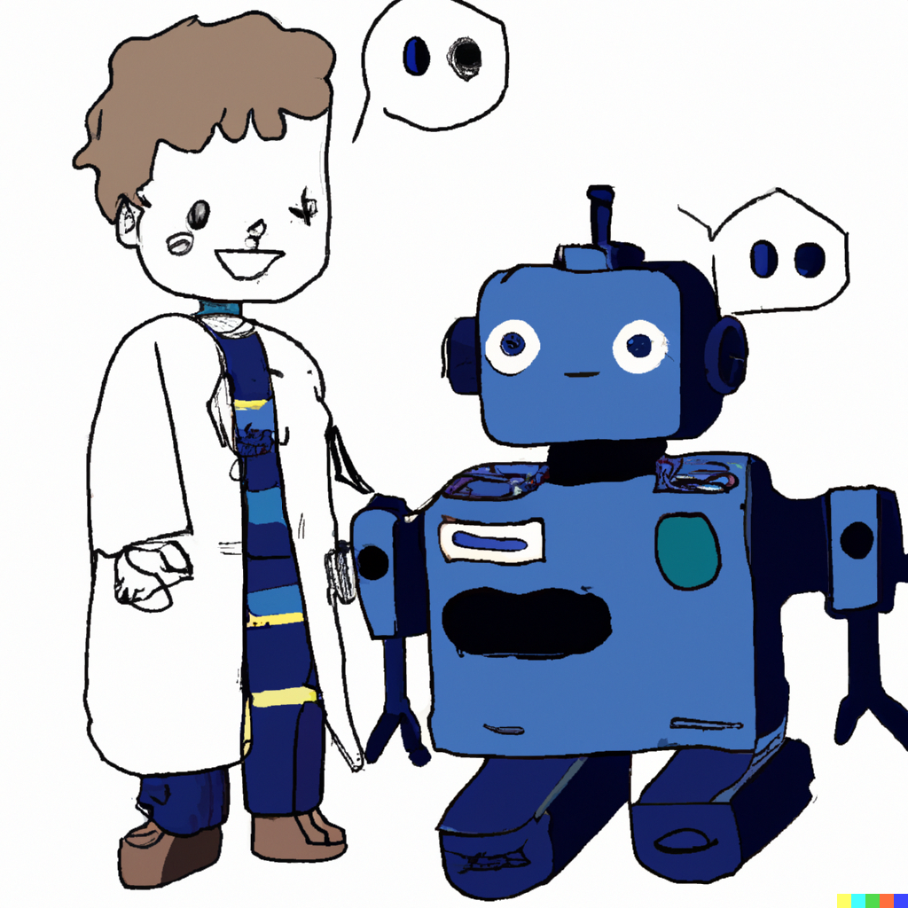





Human-AI Teaming
Perceptions
of AI
(Maslej et al., accepted,
Transl. Psychiatry)
Peer
endorsement
Emotional
state
Workflow integration
Role of AI in mental health is supportive, not prescriptive
Cognitive
forcing
Attentional demands
Notes:
MARTA
The topic of interprofessional health teams leads us to the next challenge, which is that the anticipated role of AI in mental health care will be in the form of Human-AI Teaming – in that AI should not be used to automate or prescribe decision making, but rather to support it, by offering additional insights or perspectives or facilitating the review of patient data
-therefore, successful teaming is thought to rely on users critically engaging with AI information
-however, this engagement can be impacted by a host of factors, not just relating to its technical performance
-for example, can include negative perceptions about AI (in fact, a preference for human derived clinical decision support has emerged in one experiment we completed with CAMH psychiatrist, as compared to AI derived decision support)
-but others also include peer endorsement of AI -how seamlessly or easily AI can be integrated into clinical workflows or care
-the emotional, attentional and cognitive demands of the care setting
-there are also technical strategies that can be implemented to promote critical engagement with AI information, called cognitive forcing (many exist but example is to delay the presentation of AI info until after a clinician has made an initial decision or assessment)
-in light of all these potentially influential factors, our future work examines how we can achieve successful human AI teaming in mental health care

Slide 10

Hybrid Approach
Tightly-controlled online experiments
large N’s
Ecologically valid qualitative studies
small N’s
identify factors promoting teaming in mental health
evaluate identified factors in realistic clinical settings
Notes:
MARTA
To answer this question, Laura and I have adapted our interdisciplinary approach to involve the integration of qunatively findings derived from a series of tightly controlled experiments with large sets of participants testing many factors, with a simulation study involving a smaller numbers of care providers carrying out clinical tasks in more realistic settings
-in this way, our research leverages the strengths of both experimentation and ethnographic investigation to better understand how we can promote successful human-AI teaming in complex mental health care settings, such as those at CAMH

Slide 11


Teaming: Experimental Context
Cognitive forcing
View
delayed AI
View AI
on demand
Update decision after viewing AI
N=2600
7 experiments
Randomized to
factor manipulations
Assessment performance
Risk assessment task
Aim: to identify factors promoting teaming in mental health
Notes:
MARTA
In our first experiments, we will test how manipulations of various factors, such as attitudes about AI, induced emotion, or different types of cognitive forcing techniques impact engagement with AI information when making decisions relevant to a mental health scenario, using the example of inpatient violence risk assessment, drawing on our prior work
-because this design allows for randomization of large numbers of participants to different manipulations of factors in this online decision-making scenario, our findings can help us establish causality, identifying which factors to focus on in more involved and ecologically valid investigations

Slide 12

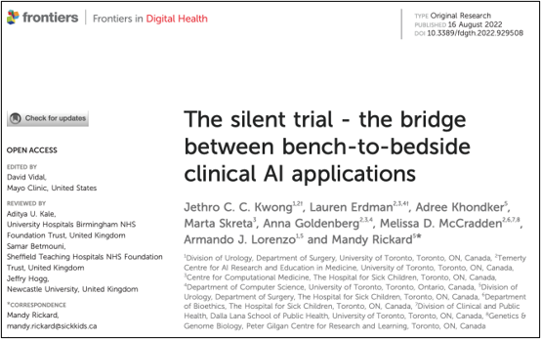
A Role for Simulation?
The CAMH Simulation Centre
Notes:
A consensus is emerging around the standards and practices required to support the successful integration of AI into sociotechnical systems.77–79 These frameworks propose a phased approach,80 which includes first establishing performance of machine learning models on historical data – which we have done – and then conducting a “silent trial” of predictions in a “minimal risk environment”, where only researchers access predictions to speculate about impacts on care,77 and concluding with a prospective
trial to evaluate impacts on real patient outcomes.78
However the inability of clinicians to engage with AI information results in a translational gap between AI-predictions and the actual clinical context. In addition, as we’ve described – the acute psychiatric context presents unique challenges to the adoption of clinical-AI applications. For example, there is a really big difference between using machine vision to enhance cancer detection and a psychiatric context that emphasizes shared decision-making in care.
As a result, we have designed a series of experiments to be conducted in collaboration with the Simulation centre to test the candidate features most likely to enhance teaming identified in previous phases of this study. In particular, this will include real-time observations of decision-making processes to identify social and contextual cues that may override technical features of the user interface – like cognitive forcing.

Slide 13
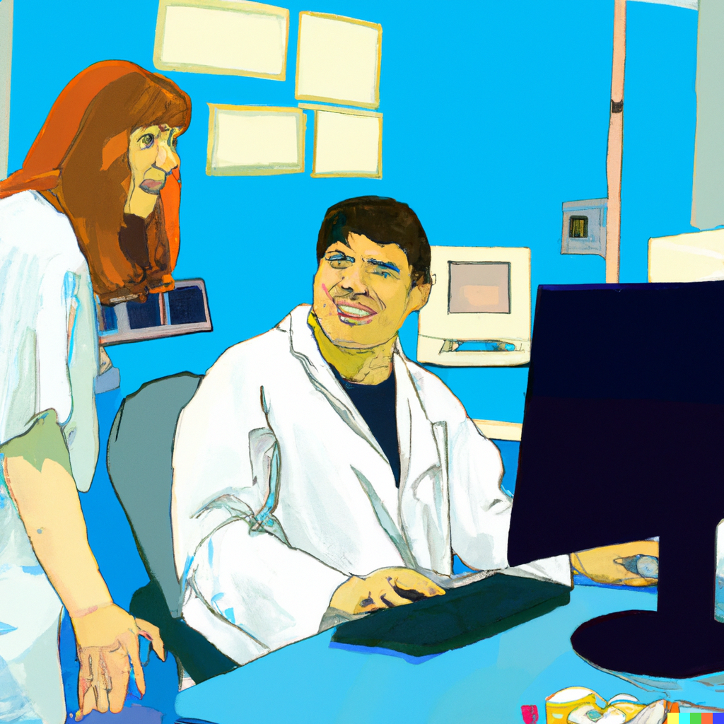
Teaming in Clinical Context
Right Information
Right Way
Right Time
Right Person
(Excuse the gender stereotypes, Dall-E cannot help itself)
Notes:
Laura
As Marta mentioned one of the interface features we are interested in cognitive forcing. As an example, a provider might be asked to make an initial assessment and then wait for the AI information. That time is meant is to meant to allow the provider to reflect on their assessment and anticipate what the AI might propose. However, in practice, the provider might just use this time to check their email, or catch up a with a colleague.
In this way, our proposed study aims to identify the range of factors that might impact teaming in real-world psychiatric settings.

Slide 14



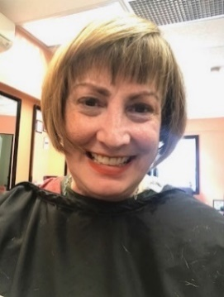
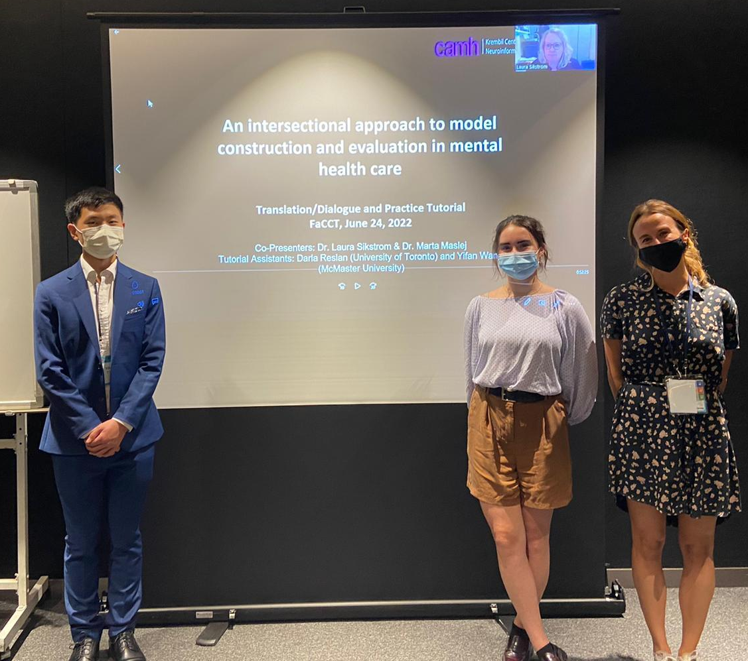












The Predictive Care Team
Dr. Laura Sikstrom
Dr. Marta Maslej
Collaborators (CAMH):
Dr. Sean Hill
Dr. Gillian Strudwick
Dr. Daniel Buchman
Dr. Juveria Zaheer
Simulation Centre
Health Intelligence
Dr. Sanjeev Sockalingam
Dr. Matt Ratto
Dr. Stefan Kloiber
V Khudiakova
Chris Dharma
Yifan Wang
Renee Rosenmann
P Muirhead
Igor Sokolov
P Skudlarek
Sitra Adill Mohammed
The team presenting at FAccT ’22
Notes:
BOTH
Thank you to our team (LAURA TO SEND) – just collaborators on projects – funders

