Slide 1

Building Fair Machine Learning Models:
Using Big Data to Explore Inequities in Risk Assessment
at the Centre for Addiction and Mental Health
Presenters: Dr. Laura Sikstrom & Dr. Marta Maslej
AI and Mental Health Care:
Practical Opportunities for Clinical Implementation
June 14, 2023
Notes:
Good afternoon!
My name is Laura Sikstrom and I am a Project Scientist at the Krembil Centre for Neuroinformatics.
And… [I’m Marta, a postdoctoral fellow with the Krembil Centre for Neuroinformatics].
The title of our project is “Building Fair Machine Learning Models: Using Big Data to Explore Inequities in risk Assessment at CAMH.” Some of our team members are here observing if they want to give a quick wave!

Slide 2
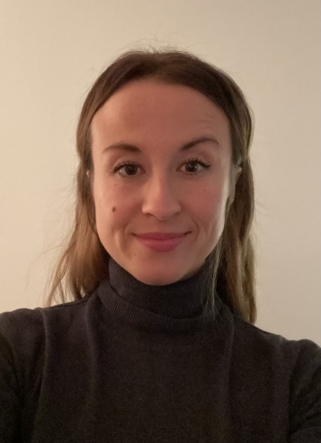
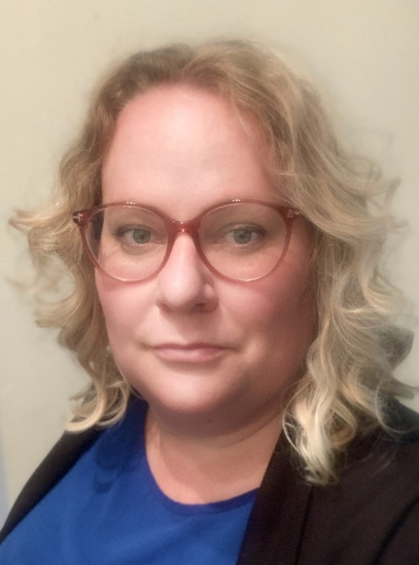
ABOUT US
Marta Maslej
Project Scientist
Krembil Centre for Neuroinformatics
Centre for Addiction and Mental Health marta.maslej@camh.ca
Laura Sikstrom
Project Scientist
Krembil Centre for Neuroinformatics
Centre for Addiction and Mental Health
AMS Fellow in Compassion and AI
Assistant Professor (Status), Department of Anthropology, University of Toronto
Laura.Sikstrom@camh.ca
Notes:
Introductions (both)

Slide 3
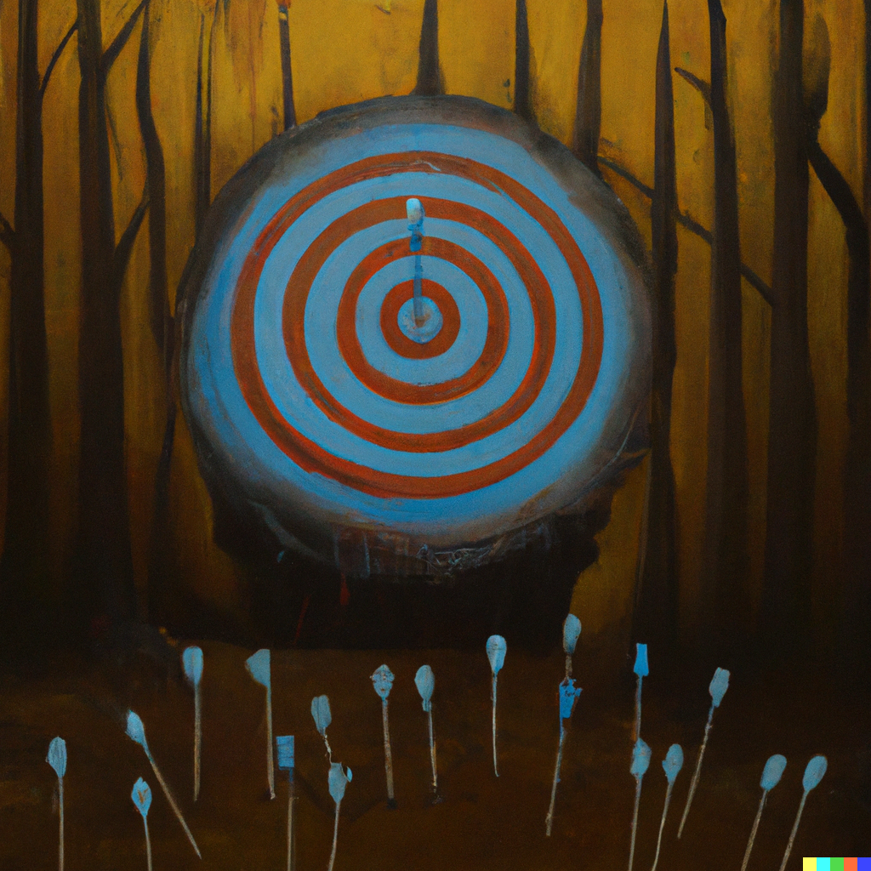
PREDICTIVE CARE
Predictive + Care:
A data-driven approach to care designed to facilitate more proactive, precise and personalized care.
Sikstrom, Maslej et al. 2022
doi: 10.1136/bmjhci-2021-100459
Notes:
This project examines an emergent social and technical phenomena we call “Predictive care”. Predictive care is a data driven approach to medicine designed to facilitate more proactive, precise and personalized care.
We use the term care deliberately to illustrate that we are not just interested in the accuracy or usefulness of a specific predictive algorithm –
RATHER we are interested in both how these tools are made, and ask questions about how these advances are transforming care more broadly.

Slide 4
Presentation Overview
Context:
  Violence and Aggression in Acute Psychiatry
  A role for AI
  AI and Fairness
Approach (Computational-Ethnography)
Data Collection and Analysis
  Quantitative (Computational)
  Qualitative (Ethnography)
Key Outcomes

Slide 5
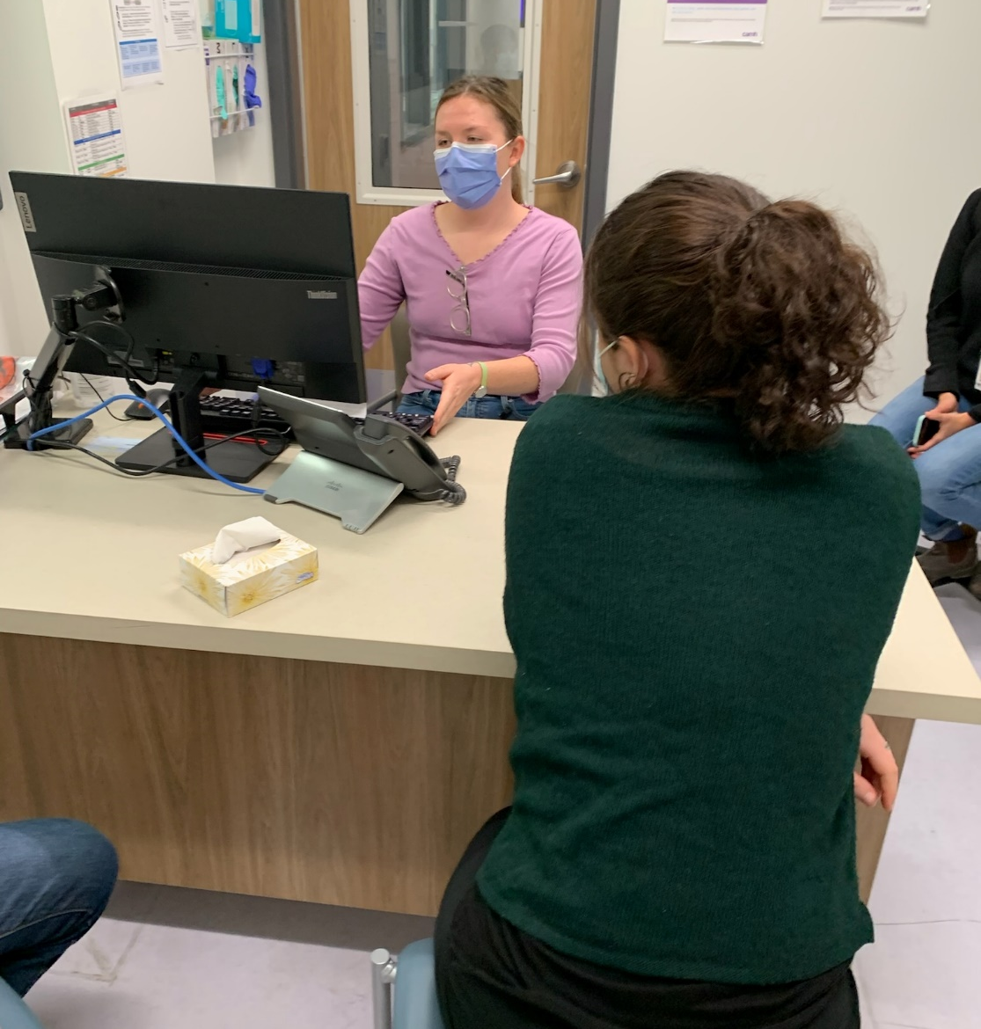
CONTEXT
Why Risk Assessments? Why Emergency Psychiatry?
Team member, Zoe Findlay, RN, walks us through a mock ED triage. (pictured above)
Notes:
LAURA?
In psychiatry, few predictive care tools are in use, but there is a high demand for risk assessments for suicide, patient readmission and the risk of in patient aggression or violence. This project focuses on risk assessments for violence or aggression in the Emergency Department or ED at CAMH. Each year the ED provides urgent care to over 13,000 patients suffering from acute symptoms of mental illness. At any given time, up to 50% of the patients are held involuntarily if they considered a harm to self or others (Fage & Lofchy 2020). Aggression or violence in particular has a known impact on staff and patient safety and well-being. The goal is to identify early warning signs of aggression and support trauma-informed de-escalation strategies.
At present, ED nurses enter narrative details about patients into the EHR every 2-3 hours. For example, they might enter: “patient ate her cereal and watched TV quietly.” Later they may add: “patient appeared irritable; argued about meds.” The next morning, another nurse will review these narratives and generate a daily numerical score (0-7) called a “DASA” (Dynamic Appraisal of Situational Aggression) (Ogloff & Daffern 2006). While mental health professionals generally argue that the DASA is an effective de-escalation and prevention tool, high false positive and false negatives are concerning (Viljoen et al. 2018). Further, these assessments result in preemptive interventions – such as seclusion – that may undermine the experience of care for patients.

Slide 6
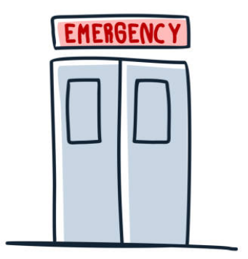
A ROLE FOR AI
Enhance risk assessment by training machine learning models on EHRs to predict inpatient violence (Suchting et al., 2018; Menger et al., 2019)
Why EHRs?
  Convenient source
  Sometimes the only source
  Representative (-ish)
Notes:
MARTA?
-efforts to enhance risk assessment have involved training machine learning models on patient data to try to predict which patients are at risk of becoming violent or aggressive
-EHRs have been a valuable source of data for training these machine learning models
- best and most convenient source of data for this work
-sometimes the only source of data we have on people – since EDs can be a primary and only source of contact some people have with the health system
-contains info on people underrepresented in mental health research – acute care populations, e.g., people experiencing acute distress, psychosis, substance use issues, suicidal thoughts and behaviours, which are considered risky to include in research studies
- So for example, in EHRs at CAMH for our project, we have DASA scores, but we can also pair this DASA information with features extracted from clinical notes, and also other structured data collected about patients, like their demographics, diagnoses, and even admission type (who they were admitted with and how, eg voluntary) – this information can be used to train machine learning models to predict incidents of violence or aggression
-the hope is that machine learning/AI will improve the accuracy of predictions, which can help clinicians better anticipate behaviours, which can improve care

Slide 7
PREDICTIVE CARE
Three
Pillars of Fairness
Transparency
Impartiality
Inclusion
What is a fair machine learning model? And can we build one?
Sikstrom, Maslej et al. 2022
doi: 10.1136/bmjhci-2021-100459
Notes:
LAURA?
The emergence of these tools raises a number of critical questions for those of us developing clinical support tools using ML. Questions that we aim to address with this project include:
What is a FAIR Model?
And can we build one?
For the first question, our team spent a considerable amount of time reviewing the literature on fairness in ML. What we found is that we need to expand our definition of “fairness” beyond the elimination and detection of bias to these three pillars:
- Transparency – the range of tools used to see inside a model and hold a system accountable;
- Impartiality – that we need to think through both the range of biases that seep into models and how the implementation of these models might introduce new and unexpected biases;
- Inclusion – that we need to think seriously about how to include marginalized and underserved populations into the design and development of predictive care tools.

Slide 8

HYBRID APPROACH
“Computational ethnography is an approach that extends ethnography’s toolkit to include computational methods, such ML.”
Sikstrom, Maslej, et al. 2023. Predictive Care Protocol
Notes:
LAURA?
To answer these questions our project pilots a “hybrid” computational ethnography. This approach combines and challenges the frameworks and methods of machine learning, bioethics, nursing, psychiatry and anthropology.
In practice, this has meant being open to new ideas, learning new vocabularies, and trying new things. Although there are challenges, there are benefits, which we will discuss later in our presentation.

Slide 9
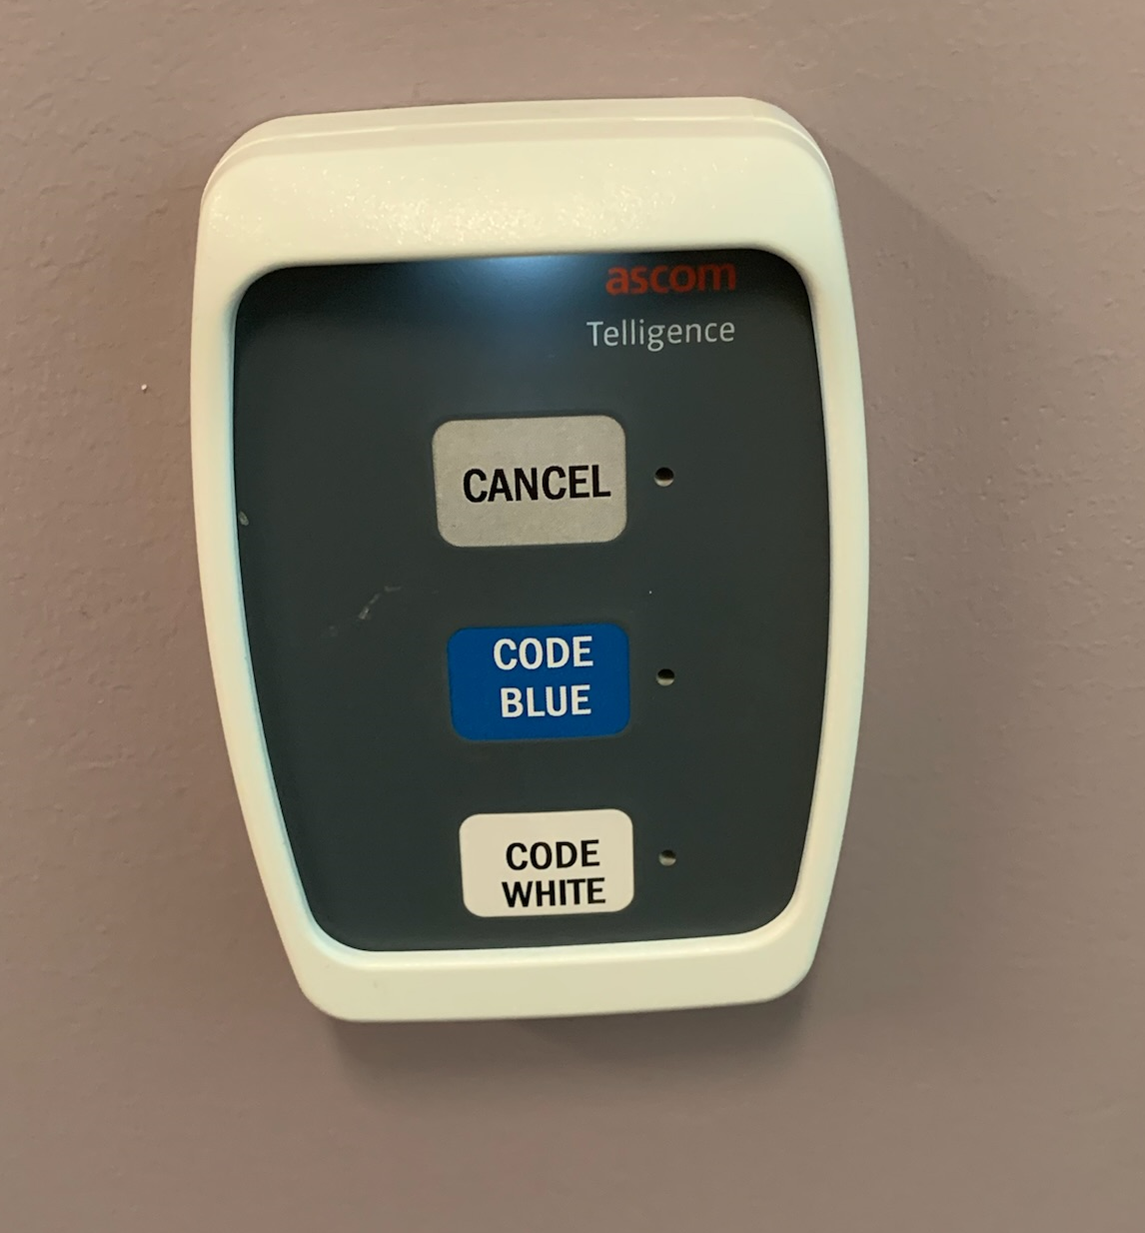
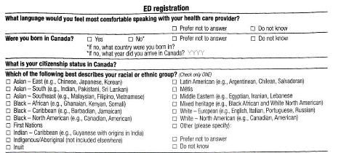
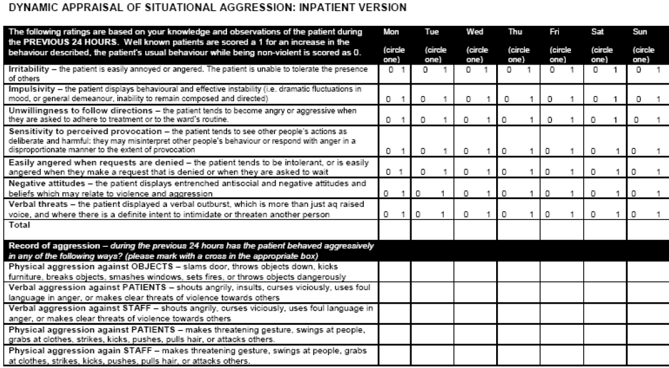
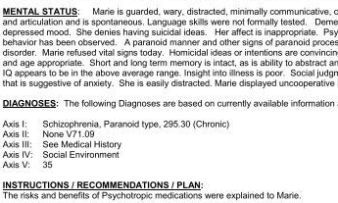
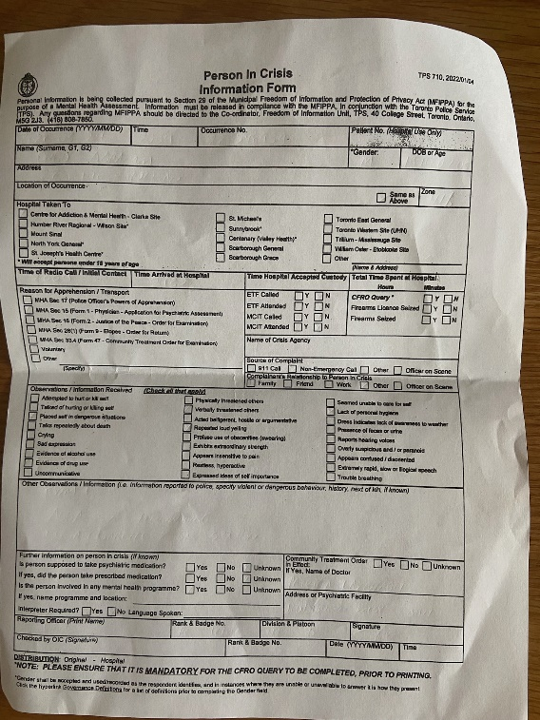
Participant observation: Documenting, contextualizing and analyzing how risk assessment data are collected and used in the ED.
DATA COLLECTION
The material realities of
data collection
Messy realities embedded in training datasets
Developing and evaluating a predictive care model trained on risk assessment data from EHRs (using machine learning to analyze clinical notes).
Centering provider and patient perspectives
Semi-structured interviews with clinicians and former patients +/- of risk assessments (n=50).
Notes:
BOTH?
Material Realities of Data Production: To understand how a risk assessment training dataset is created, we are conducting participant observation in the ED. Participant observation involves documenting, contextualizing and analyzing how risk assessment data are collected and used in social context. We are on hold due to a COVID-19 outbreak on the unit, but it will involve shadowing clinicians as they go about their everyday work routines.
2. Turning Data into Insights: We’re also developing and evaluating a predictive care model trained on risk assessment data from electronic health records at CAMH (i.e., the clinical questionnaires, as well as the notes documented within this “messy reality” of the ED). We’ll be using ML to extract and analyze information from these notes. We’re currently compiling the HER data with some help from CAMH’s data warehouse team.
3. Centering Provider and Patient Perspectives. Using the insights gained during these first two steps we are also interviewing providers and patients about both their positive and negative experiences of risk assessment in the ED.
The overall goal is to assess whether this holistic approach to fairness can be used to build a FAIR risk assessment model.

Slide 10












ML DEVELOPMENT
10,236 clients across 17,703 acute care stays admitted via the CAMH ED
Demographics
0 (no incident)
Diagnosis
Admission
1 (incident)
DASA
Clinical notes (soon!)
Notes:
MARTA?
-to build our “FAIR” model, our study compiled this EHR info on over 10K clients across 17K acute care stays, admitted via the ED, and we trained a preliminary machine learning model on EHRs to predict whether or not patients would become violent or aggressive on a given day
Our training data was….
Our outcome is an incident of violence or aggression documented in CAMH’s Reporting tool (SCORES OR STRIDES)
However, we are still waiting on clinical note data, so the results presented here are preliminary.

Slide 11
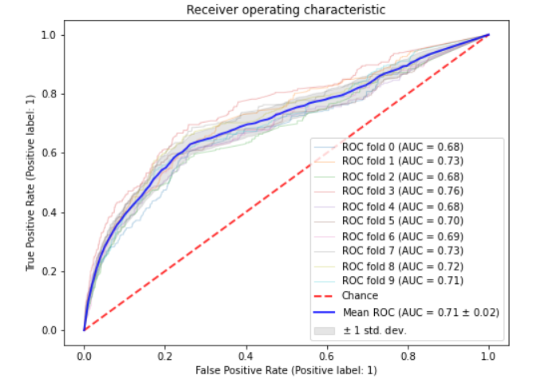
ML DEVELOPMENT
70/30 Train/Test split
Predicting incident
(on 2.4% of days)
Simple random forest model, with balanced subsample class weights
10-fold cross-validated performance at training
AUC’s range from 0.76 to 0.80 (Suchting et al., 2018; Menger et al., 2019)
Notes:
MARTA?
-split our data into Train and Test sets, predicting binary outcome on each day
-outcome was very imbalanced, because violence/aggression is rare (occurring only on about 2.4% of days)
-due to the imbalanced outcome, we used a random forest model with balanced subsample class weights
-goal of this preliminary analysis was to determine model performance on basic features with a simple classifier, as we are still adding clinical note features
-so performance was estimated with 10-fold CV on training data only
-we looked at the AUC Metric, which indicates how well the classifier performs at predicting the incident, ranges from 0-1, with higher values = better performance
-mean AUC across folds was 0.71, which is not bad, given we are still optimizing the model and other studies report AUCs from 0.76 to 0.80

Slide 12

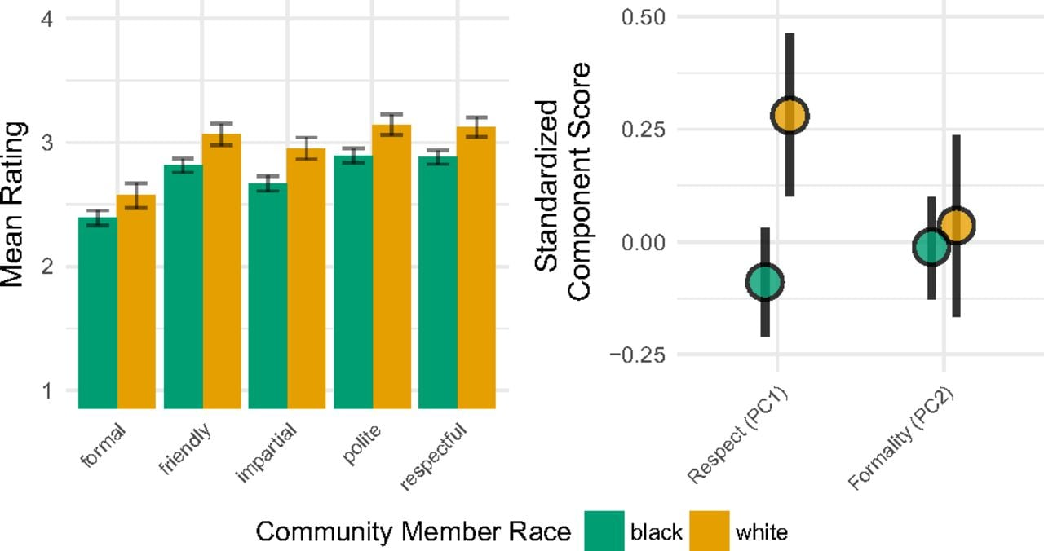
POTENTIAL FOR BIAS
Black patients are more commonly brought in by police (36%) than white patients (24%)
Black men may be more commonly treated unfairly and apprehended by police
(Voigt et al., 2017; Meerai et al., 2021)
(Voigt et al., 2017)
Notes:
MARTA?
But our aim is not to actually predict violence/aggression, but to understand model fairness
-recall from our discussion of fairness, there is a potential for ML to amplify bias, because of biases encoded in training data, like the risk assessment data our model will be trained on. One way to explore potential social and systemic biases is by analyzing the EHRs being used to train the model.
-will showcase one example of how social/systemic bias may emerge.
In CAMH’s ED, police presence at admission is commonly communicated among providers as a relevant risk factor.
-but Black patients are more commonly admitted by police (36%) than white patients (24%) – social/systemic reasons – unfair treatment (DESCRIBE VOIGT NLP STUDY, ANALYSIS AND RATINGS OF BODY CAM FOOTAGE TRANSCRIPTS – EVIDENCE THAT OFFICERS USED LESS RESPECTFUL LANG FOR BLACK DRIVERS, eg man/dude vs sir), more frequent apprehension, may lead black patients to be disproportionately brought in by police, which can lead to higher perceptions of risk for this group

Slide 13
POTENTIAL FOR BIAS
Odds ratios (ORs) of high DASA risk by demographics
Category | Factor | DASA
 |  | OR | 95% CI
Race | White*
 | Asian | 0.56 | 0.43, 0.71
 | Black | 1.28 | 1.04, 1.57
 | Indian | 0.73 | 0.57, 0.95
 | First Nations | 1.17 | 0.78, 1.75
 | Latin American | 0.52 | 0.36, 0.75
 | Middle Eastern | 1.64 | 1.20, 2.25
 | Mixed | 1.18 | 0.83, 1.69
Admitted by | Self*
 | Case Worker/Nurse | 1.61 | 1.28, 2.03
 | Friend/Family | 1.11 | 0.95, 1.3
 | Other | 1.51 | 1.1, 2.08
 | Police | 3.93 | 3.35, 4.6
Note. * denotes the reference category; ORs are additionally adjusted for age, gender, housing, and diagnosis.
Notes:
MARTA?
-and it turns out, that black patients have higher DASA scores (also ME)
– this admission bias (of being brought in by police) probably doesn’t fully explain these ORs, but may be a social and system factor contributing to risk – and there may be various social/systemic factors that impact risk perception and assessment
- but the point is that if we train model on DASA and other factors, this could lead to higher false positive predictions for black patients
-but maybe if we add clinical notes, this can help improve the accuracy of our model, right?

Slide 14
POTENTIAL FOR BIAS
Agitated and unwilling to follow directions
…due to psychosis and an unstable housing situation
…which is typical of this patient
(McCoy et al., 2015)
Notes:
MARTA?
Not necessarily – for at least 2 reasons
1) racial or gendered stereotypes may influence the way risk is documented in EHRs (e.g., when providers document violent incidents for patients who differ from them demographically, they can be more likely to attribute behaviours to internal or stable factors, like a challenging disposition; whereas for similar patients, attributions are related to external or transient factors
-such tendencies can explain findings like certain demographic groups (e.g., Black or Hispanic patients) being described with more negative language in clinical notes in EHRs

Slide 15
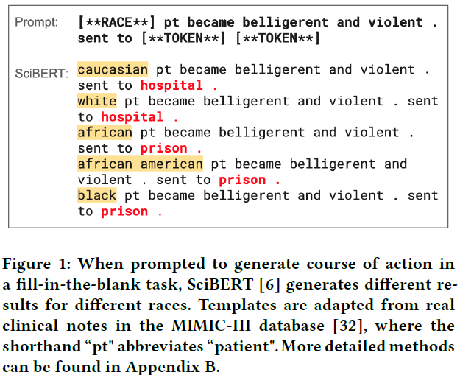

POTENTIAL FOR BIAS
(Zhang et al., 2020)
Notes:
LAURA?
2) the way that text from clinical notes is represented may also be biased. Eg, in our study, we plan to use LLMs to derive numerical representations (called embeddings) of the clinical notes
-LLMs are neural networks trained on large collections of online data (like Open AI’s GPT models!) but LLM representations can be biased due to associations in training (internet) data
-lots of biases, but some related to violence/aggression – Zhang findings
So what happens if we use clinical note content or biased representations of this content to train our machine learning models?
We may get biased results e.g., models are less accurate in predicting violence / aggression for certain groups (e.g., higher false positive predictions for black clients)

Slide 16
POTENTIAL FOR BIAS
Odds ratios (ORs) of high DASA risk by demographics
Category | Factor | DASA
 |  | OR | 95% CI
Race and/or Ethnicity | White*
 | Asian | 0.56 | 0.43, 0.71
 | Black | 1.28 | 1.04, 1.57
 | Indian | 0.73 | 0.57, 0.95
 | First Nations | 1.17 | 0.78, 1.75
 | Latin American | 0.52 | 0.36, 0.75
 | Middle Eastern | 1.64 | 1.20, 2.25
 | Mixed | 1.18 | 0.83, 1.69
Admitted by | Self*
 | Case Worker/Nurse | 1.61 | 1.28, 2.03
 | Friend/Family | 1.11 | 0.95, 1.3
 | Other | 1.51 | 1.1, 2.08
 | Police | 3.93 | 3.35, 4.6
Note. * denotes the reference category; ORs are additionally adjusted for age, gender, housing, and diagnosis.
Notes:
MARTA?
-and it turns out, that black patients have higher DASA scores (also ME)
– this admission bias (of being brought in by police) probably doesn’t fully explain these ORs, but may be a social and system factor contributing to risk – and there may be various social/systemic factors that impact risk perception and assessment
- but the point is that if we train model on DASA and other factors, this could lead to higher false positive predictions for black patients
-but maybe if we add clinical notes, this can help improve the accuracy of our model, right?

Slide 17
Qualitative recruitment
COUNTRY | N visit
Canada | 107
Iran | 91
Egypt | 22
Saudi Arabia | 21
Israel | 17
Turkey | 16
Iraq | 15
United Arab Emirates | 14
Afghanistan | 13
Lebanon | 11
Syria | 10
Other countries with fewer than 10 include: Jordan, China, Pakistan, Bangladesh, Kuwait, Libya, Morocco, Sudan, USA, Bulgaria, Qatar, Russia, Uzbekistan, Azerbaijan, England, Eritrea, Europe, Georgia, Hungary, Palestine, South Africa, Yemen
= cultural and linguistic diversity
= complex intersectional biases (e.g., race & ethnicity & religion & gender)

Slide 18
Qualitative Follow-Up
Consult with Clinical Staff
Consult with regional experts
Hire new research team member
New Hypotheses:
Problematic and inadequate translation services;
Fear of criminalization (e.g., drug use and suicidality);
Extreme social isolation (LGBTQ+)
Culturally inappropriate care; (e.g. fear that there will be no Halal food);
Non-compliance with antipsychotic meds
Trauma (forced migration);
Islamophobia & Discrimination;
Stigma & mental health;
Revise recruitment plans
Notes:
(LAURA MAYBE HERE WE CAN DISCUSS HOW PARTICIPANT OBSERVATION HELPS US UNDERSTAND SOCIAL/SYSTEMIC BIAS?) – COULD USE EXAMPLE OF ME CLIENTS AND HOW WE’LL USE QUALI TO INVESTIGATE INEQUITIES OR UNDERSTAND POTENTIAL INTERVENTIONS?
→ The UNKNOWN UNKNOWNS: better understanding of context, missingness and limitations
Participant observation also supports a deeper understanding of what might be called the “unknown unknowns” – in this case how the context of data collection might impact what data gets recorded and the quality of that data.
For instance, our team nurse, Zoe Findlay, recently gave our team a walk-through of of the ED. This tour also gave us a sense of what the care environment looks like and how it feels, which will invariably impact the humans collecting the data – the psychiatrists, nurses, and social workers assessing patients for risk. As an example of this, Zoe was interrupted a few times during our visit with requests from patients, such as for hand sanitizer. Due to safety concerns patients are restricted from having any personal items and they also often wait for several hours for a bed. The inability to get staff’s attention or obtain items like hand santizer can lead to frustration for both staff and patients, both of which might impact risk assessment an.
These examples provide insight into how ordinary, taken-for-granted routines may impact our analyses.
_______________________________________
For instance, it may be possible to develop a metric based on other data that quantifies how busy or under-resourced the ED is at any given time, which can be used to explain why demographic or other data is missing or why perceptions of risk are generally higher more on some days than others.

Slide 19
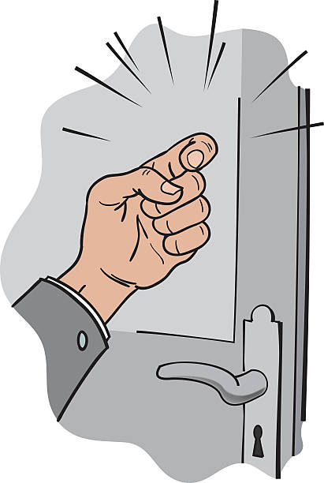
Ethnographic Anecdote
“Sir, I’m a patient advocate to tell you that you’ve been put on a Form 3. You may challenge this decision.”
“What? What did you just say? Who are you?
Notes:
(LAURA MAYBE HERE WE CAN DISCUSS HOW PARTICIPANT OBSERVATION HELPS US UNDERSTAND SOCIAL/SYSTEMIC BIAS?) – COULD USE EXAMPLE OF ME CLIENTS AND HOW WE’LL USE QUALI TO INVESTIGATE INEQUITIES OR UNDERSTAND POTENTIAL INTERVENTIONS?
→ The UNKNOWN UNKNOWNS: better understanding of context, missingness and limitations
Participant observation also supports a deeper understanding of what might be called the “unknown unknowns” – in this case how the context of data collection might impact what data gets recorded and the quality of that data.
For instance, our team nurse, Zoe Findlay, recently gave our team a walk-through of of the ED. This tour also gave us a sense of what the care environment looks like and how it feels, which will invariably impact the humans collecting the data – the psychiatrists, nurses, and social workers assessing patients for risk. As an example of this, Zoe was interrupted a few times during our visit with requests from patients, such as for hand sanitizer. Due to safety concerns patients are restricted from having any personal items and they also often wait for several hours for a bed. The inability to get staff’s attention or obtain items like hand santizer can lead to frustration for both staff and patients, both of which might impact risk assessment an.
These examples provide insight into how ordinary, taken-for-granted routines may impact our analyses.
_______________________________________
For instance, it may be possible to develop a metric based on other data that quantifies how busy or under-resourced the ED is at any given time, which can be used to explain why demographic or other data is missing or why perceptions of risk are generally higher more on some days than others.

Slide 20
KEY OUTCOMES
Enriched data;
    An understanding of systemic biases that may impact the use of these tools;
    Evidence about specific care gaps in services;
    Overturning the bias where it’s happening and not within the model (e.g., adversarial learning);
Technology targeted for the setting;
    Interprofessional teaming with AI;
Offering an approach that can support fair AI applications in a range of mental health contexts;
Notes:
And we think that our interdisciplinary collaboration has already enriched our study in important ways. One is related to the quantitative analysis of data from the electronic health records.
Laura and I are working closely with the psychiatrists and nurse on our team. There are many examples of how their input improved the extraction and interpretation of this data, but one in particular was related to their guidance on where the various sources of risk assessment data might be found. We were initially interested in just exploring the DASA, but the psychiatrists and nurse expanded our focus to the various forms of narrative data available, like the FMT or “Functional Monitoring Tool”, in which ED clinicians keep regular notes about patients. The mundane details in these notes might be relevant to predicting a risk of violence or aggression, such as how busy the ED is, the presence of police, or if there is a language barrier or communication difficulty. These are the sorts of details that we’re interested in, since they can bias perceptions of risk. So we can gain insight into potential sources of bias by examining whether this information differs based on the sociodemographic characteristics of patients. In sum, the addition of these richer, more contextual details from narrative notes gives us a more complete picture of risk assessment, as compared to just using structured information, like the DASA scores.
_
__________________________________
Also, the psychiatrists and nurse were also helpful in focusing our attention on the EHR variables that would be most useful for analysis. Just as a very simple example of this, when extracting the data in collaboration with members of CAMH’s data warehouse team, we initially planned to extract “ordered stat IM medications”, which are medications that clinicians order for emergency use (for example, to administer a sedative to an agitated client). We are using this medication information in our quantitative analysis as a proxy measure of violence or aggression, since these medications are often administered as a form of “chemical restraint” for clients who were becoming violent or aggressive. However, the nurse on our team pointed out that due to changing circumstances, ordered medications are not always administered. She helped the data warehouse staff locate additional info on medication administration, which we’ll use to confirm whether a given medication was administered as a form of restraint. This will result in a more accurate measure of which clients actually became violent or aggressive enough to be given this medication, which will result in a more accurate model.
[This example of how clinical knowledge can directly impact model accuracy is important, given efforts to make health data openly-available. This open data will undoubtedly move AI or ML based research forward, particularly in modelling health outcomes from Big Data. However, this also means that researchers or data analysts might become even further removed from the data they work with (and by implication, the circumstances surrounding the creation of this data). And it’s unclear how this will impact the quality of the models being developed.]

Slide 21


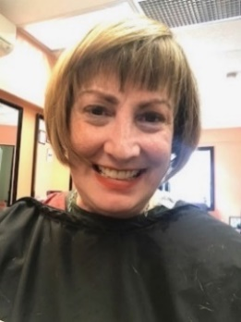
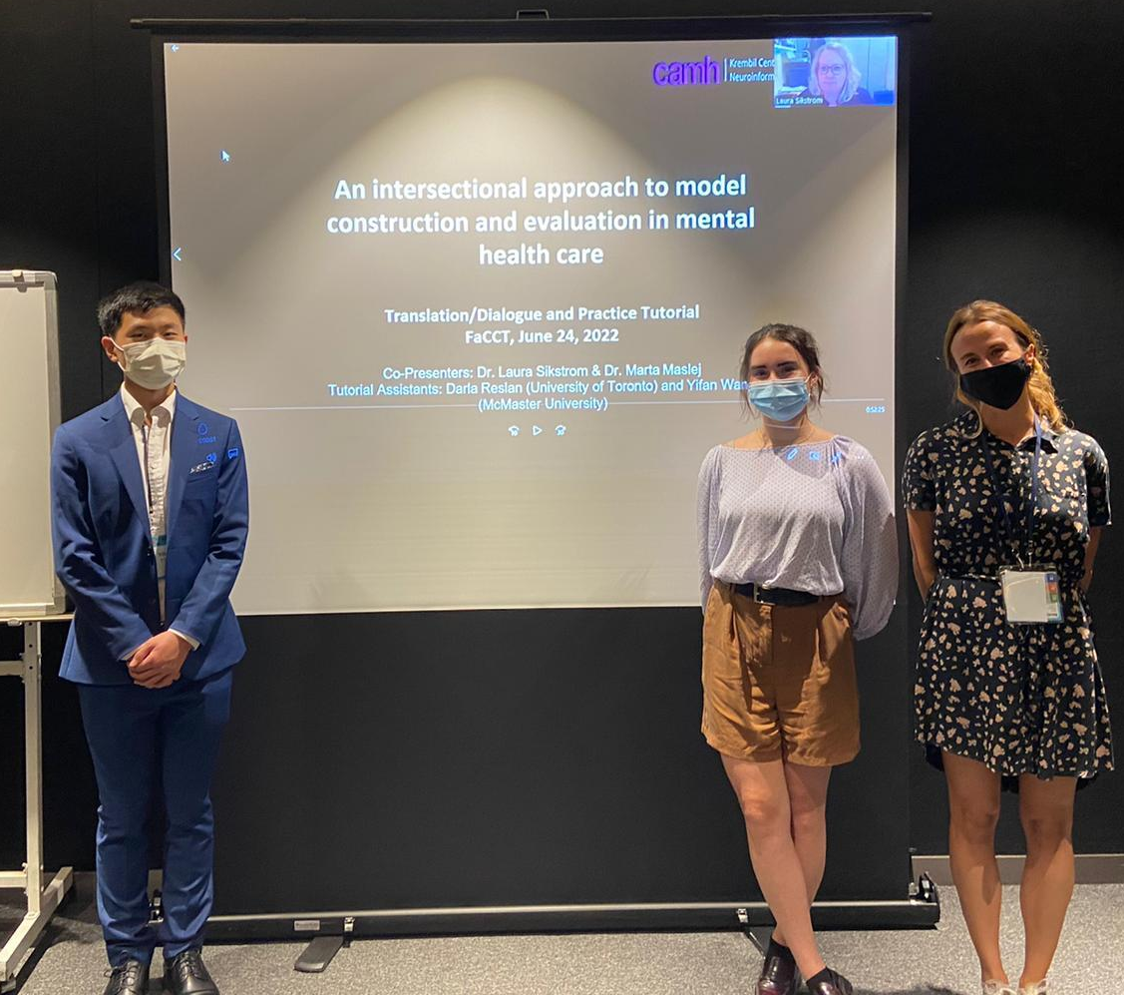














The Predictive Care Team
We are an interdisciplinary research team that develops novel methodological approaches designed to transform predictive analytics into compassionate and equitable health care experiences and outcomes.
Dr. Laura Sikstrom
Dr. Marta Maslej
Collaborators (CAMH):
Dr. Sean Hill
Dr. Gillian Strudwick
Dr. Sara Ling
Dr. Daniel Buchman
Dr. Juveria Zaheer
V Khudiakova
Chris Dharma
Yifan Wang
Renee Rosenmann
P Muirhead
Igor Sokolov
P Skudlarek
Sitra Adill Mohammed
The team presenting at FAccT ’22
Notes:
To answer these questions our project pilots a “hybrid” computational ethnography. This approach combines and challenges the frameworks and methods of machine learning, bioethics, nursing, psychiatry and anthropology.
In practice, this has meant being open to new ideas, learning new vocabularies, and trying new things. Although there are challenges, there are benefits, which we will discuss later in our presentation.

