Slide 1
THRESHOLDS
Data Integration Meeting: June 16, 2023
Presenter: Laura Sikstrom

Slide 2


A narrow barrier between two other spaces
Easily transgressed. Both fun and dangerous. Boundary flirting.
Dall-E prompt: A threshold, feminist art

Slide 3
OBJECT
Entrance
Gate
Doorway
Door
Edge
Verge
Brink
Starting point
Border
Borderline
Edge
Boundary
Brink
TIPPING POINT
Magnitude
Intensity
Climax
Milestone
Endpoint
Point of no return

Slide 4
“It looks like a margin, both spatial and social, but… it acts as the core…. [This is the place] where political authority is perpetually remade, its legitimacy renewed.”
- Jusiontye (2018): Threshold: Emergency Responders on the US-Mexico Border

Slide 5
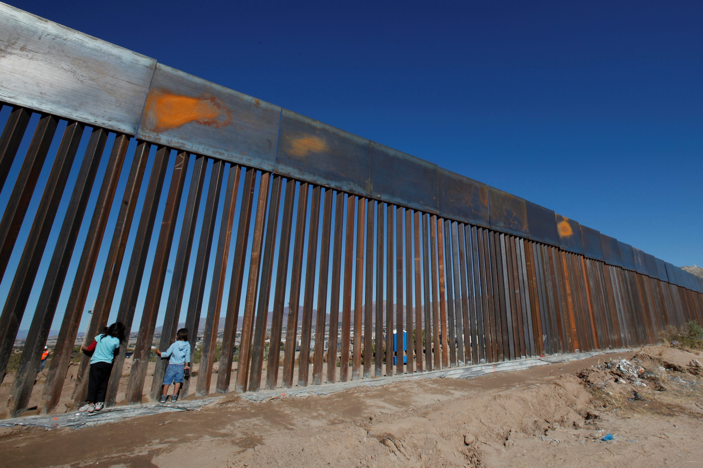
Tactical Infrastructure
Fences
Roads
Bridges
Drainage structures & grates
Observation zones
Lighting
Remote video surveillance (e.g., drones)
Algorithms (border calculus)
Surveillance towers (sensors, radar, motion detection)
Checkpoints

Slide 6
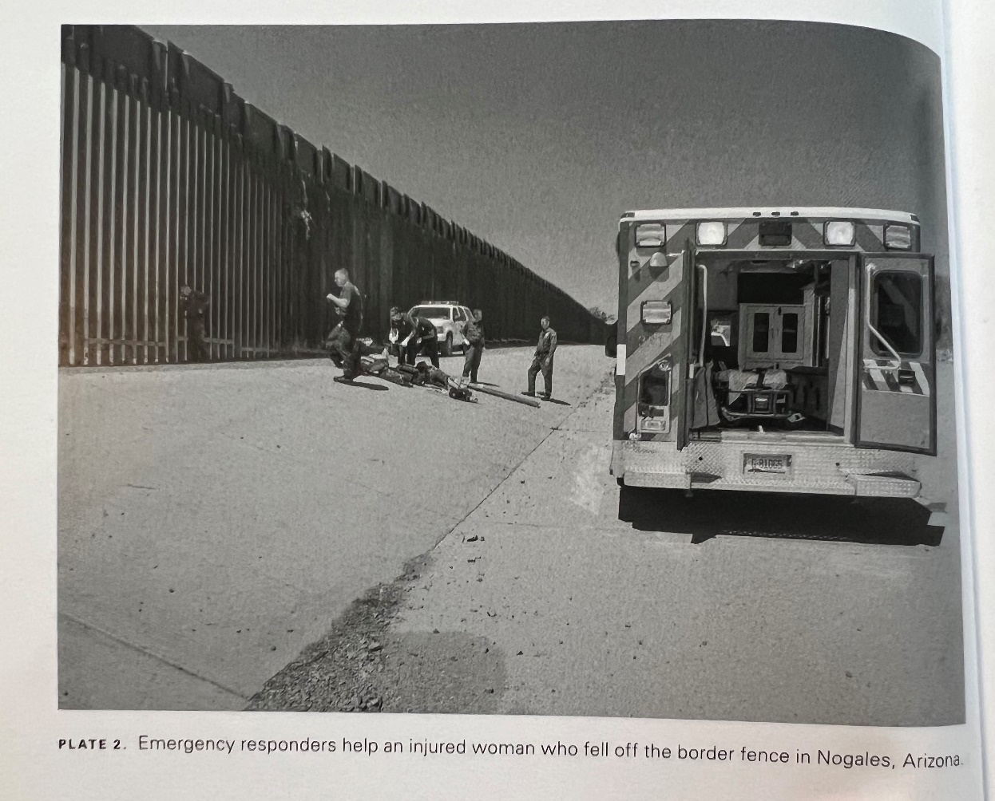
BODIES: Ankle Alley, Dehydration, Drowning
4.1 Miles: The Mediterranean
Full Doc

Slide 7

BODIES: Ankle Alley, Dehydration, Drowning
Hybrid Collectif [like sociotechnical?]
Agency is an emergent property created by the interaction of many heterogeneous components known as actants, sources of action that may be human or nonhuman.
- Heat
- Pathogens
- Sonoran desert
- Wild animals

Slide 8
Environmental Design Features as Actants?
Video surveillance
Secure triage
Windows
Soundproofed care station
How are the logics aligned?
How do they differ?
What is the relationship between psychiatric care and carcerality?
How do these nonhuman actants enact specific kinds of interpersonal interactions?

Slide 9
Boundaries/rubber bands

