Slide 1
INTERFACES
July 12, 2023
Laura Sikstrom & Peter Muirhead

Slide 2
Technology: A hazardous concept (Leo Marx)
A branch of learning related to the mechanistic arts (up until mid-1900s)
Keywords (and the emergence of their common useage) are markers for far-reaching changes in society and culture.
Hazardous = assign tools an ostensibly discrete entity – one capable of becoming a virtually autonomous, all-encompassing agent of change (p. 564)

Slide 3

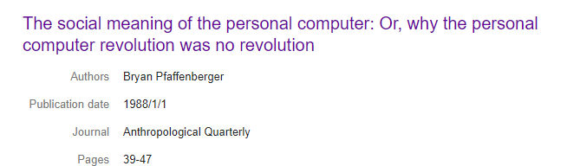

Slide 4

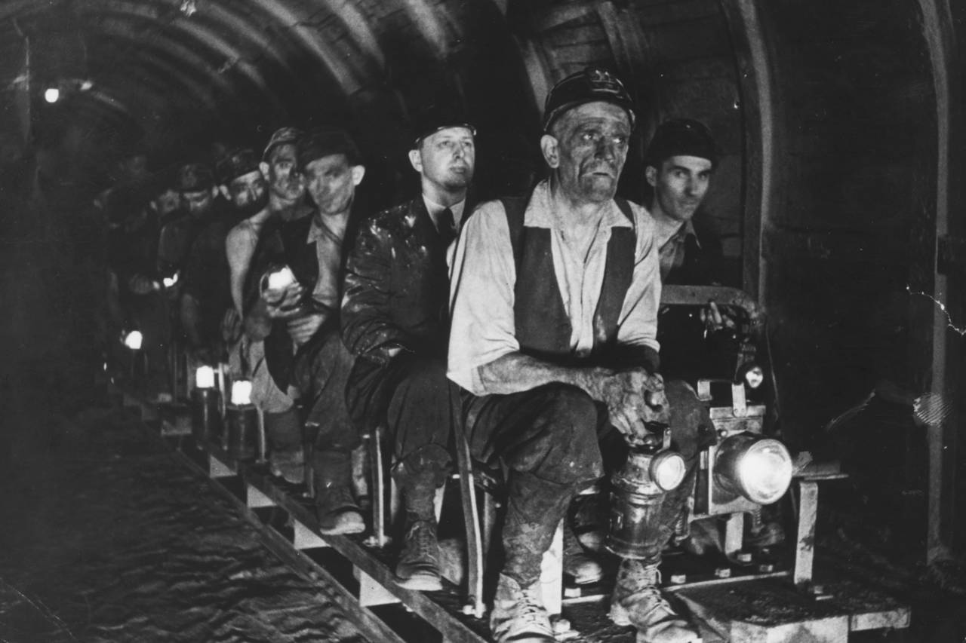
Sociotechnical Systems
Technical does not primarily mean material technology. In other words, it also means the policies, procedures knowledge etc., that shapes how workers should interact with material technologies.

Slide 5
Interface (definition):
“A device [AND] or system that unrelated entities use to interact.”
“A device or program enabling a user to communicate with a compute”
A point where two systems, subjects, orgs, meet and interact.
Interact with; connect with.
Institutional ethnography: the coordination of work within institutions via ‘texts’

Slide 6

Interface (definition):
“System” (people in spaces)
Canada, Ontario, Toronto, CAMH (the ‘health system’)
Emergency Care
Care station
Conference room
Huddle, rounds, handovers
Device(s):
Electronic Health Records
  FMTs
  Interdisciplinary notes
(Desktop) Computers
White boards
Tablets (n/a)
Laptops (residents/learners in back room)
Other (post its, legal pad, docx, stretcher placement tool)
Pharm dispensing thing (supposed to use to enter meds)

Slide 7
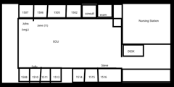
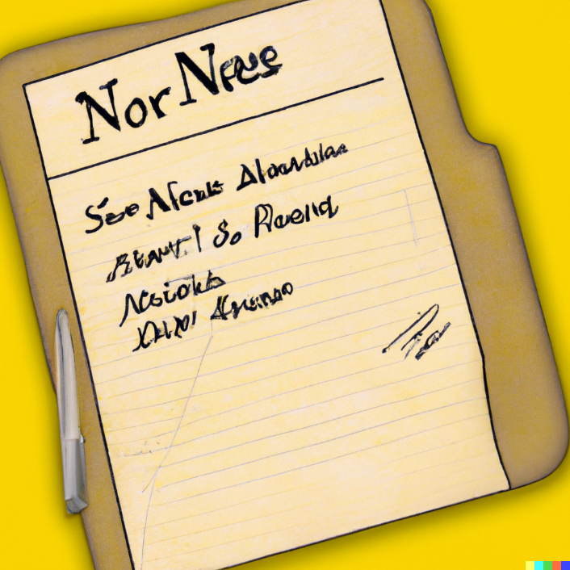
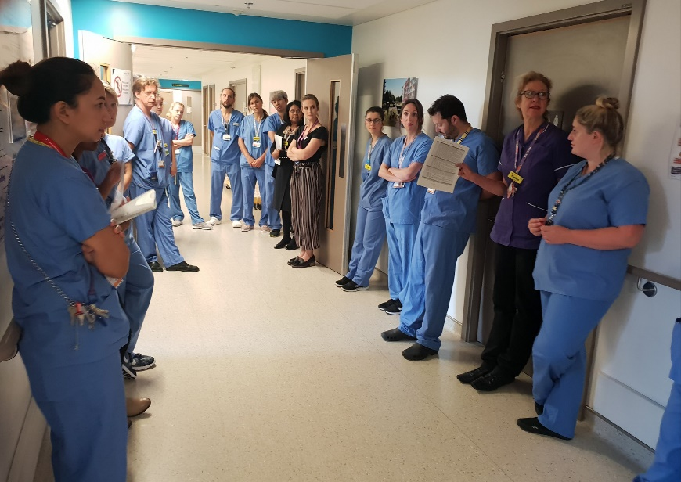

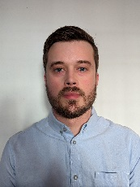
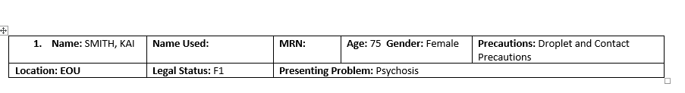
THE CLINICAL CONTEXT
How is risk assessment data generated and instrumentalized in everyday clinical scenarios?
8:30am: Rounds (25+ppl)
7am: Nurse Handover (1:1)
9am: Huddle (50ppl)
Peter Muirhead
Notes:
LAURA
To give you an ethnographic example, 3 key moments when different providers share info about safety ….

Slide 8
OH COMPUTER
WHERE ART THOU?
Notes:
Of PARTICULAR NOTE – the medium by which most predictive tools are delivered is through a computer interface – yet in each of these instances where risk is being managed – the COMPUTERS ARE NOT PRESENT during these key encounters – so any integration of any AI model would require changes to workflows and the built infrastructure of the ED itself.
This raises a lot of questions about how a tool might be successfully integrated into care in acute psychiatric contexts supported by interprofessional health teams.

Slide 9
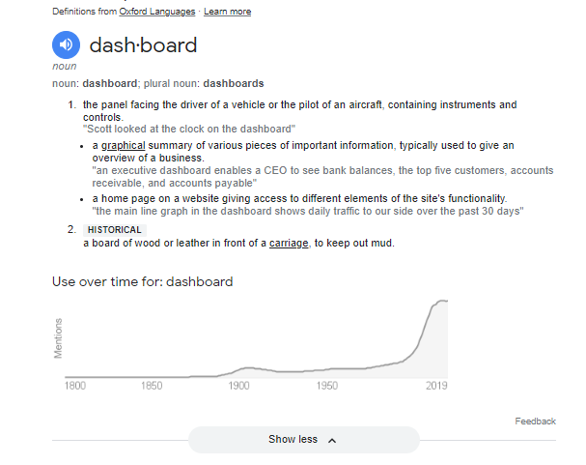
“Dashboards”

Slide 10
These are estimates;
Data retrieval primarily occurs early in a shift;
Nurses actively transform useful features into other formats (copy and paste from FMT, interdisciplinary notes into .docx, task lists, reminders;
Documentation increases with acuity;
Notes:
Of PARTICULAR NOTE – the medium by which most predictive tools are delivered is through a computer interface – yet in each of these instances where risk is being managed – the COMPUTERS ARE NOT PRESENT during these key encounters – so any integration of any AI model would require changes to workflows and the built infrastructure of the ED itself.
This raises a lot of questions about how a tool might be successfully integrated into care in acute psychiatric contexts supported by interprofessional health teams.

Slide 11



Shadowing Nurse Data Use in ED/EOU
Nurse shadowing reveals basic barriers to good interface in current FMT (but use varies!)
Pasting over SOAP format (per-incident) while charting, one continuous narrative
Corroborated: DASA reflects a very specific moment in time, limited utility in EOU
SN1: Word doc titled “CHART HERE” open separately
Copy/Pasting different parts of the chart into Word so that the useful parts are visible during shift
Volume of text in FMT is a burden once multidisciplinary notes are reviewed at start of shift
Retrieval
Documentation
FMT

Slide 12
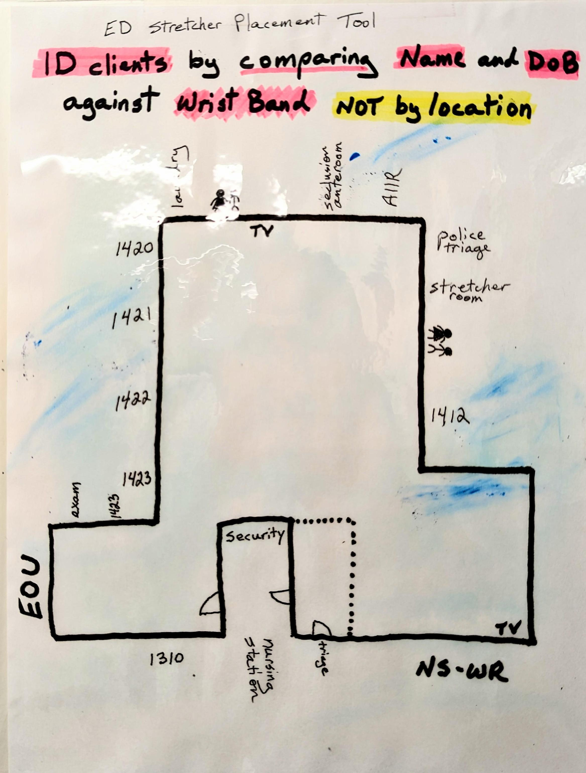
Interfacing Space + Basic Patient Info
Conceived/implemented/Iterated by PAs and nurse ed. (?) beginning in ~May, 2023 → Where is each patient sleeping?
Interfaces space + patient records
Communication between night + day shifts
Adaptation to the space not being used as-designed, lack of equivalent digital tool, stretcher location on white board, or consistent PA computer access
On wall between the security booth and the ED outpost, opposite PA perch
Caveat: Identity still needs to be verified independently, not a magic solution (see layers)
Laminated: Wiped/filled only as needed
ED stretcher placement tool, June 2023

Slide 13
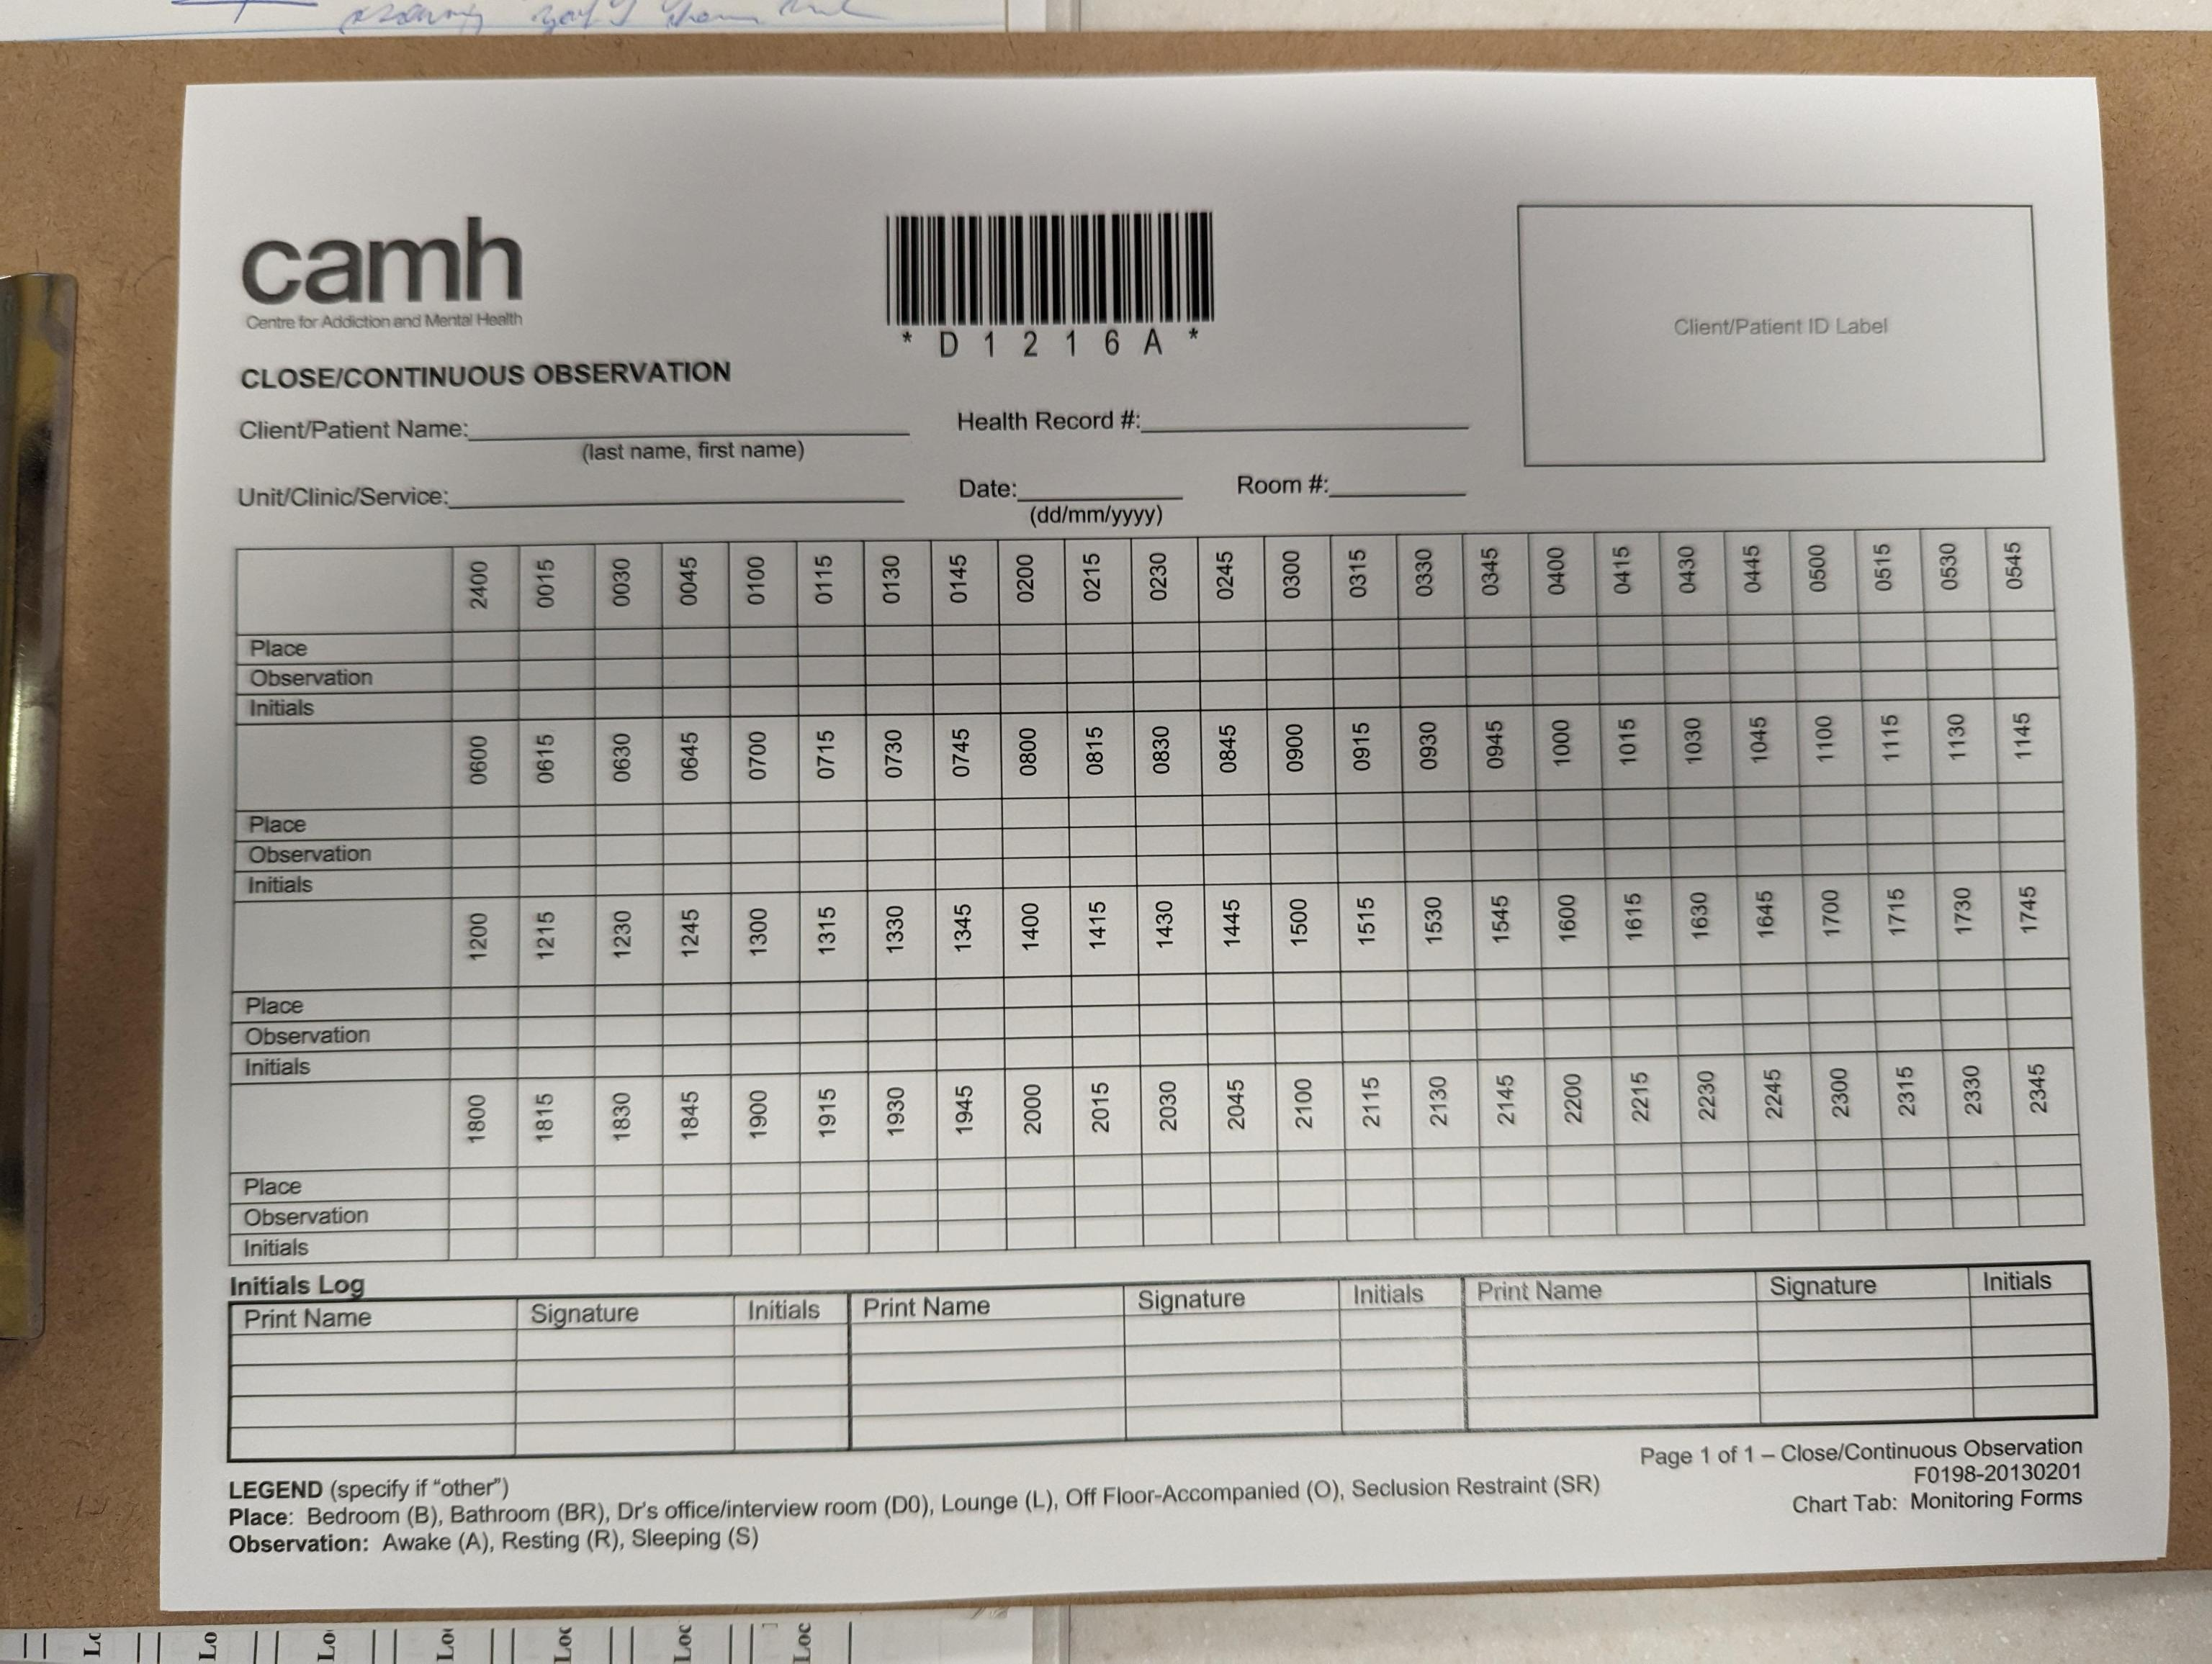
Compare with Continuous Observation Form (for example; also in FMT)
1 per patient, per day, every 15 minutes), ensures observation compliance, clear retrospective and medico-legal functions
Stretcher Placement Tool: Captures everyone’s location at one moment, helps with safety and finding people
Less exhaustive than Form, but more useful for PAs
COF and SPT somewhat analogous to FMT and Word Doc

Slide 14
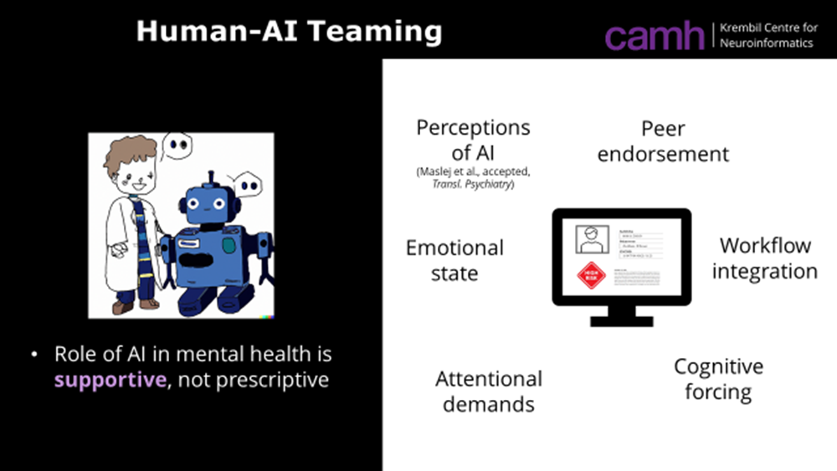

Slide 15
BRAINSTORM
How, where and when should humans interface with the data provided by DASA+?

