Slide 1
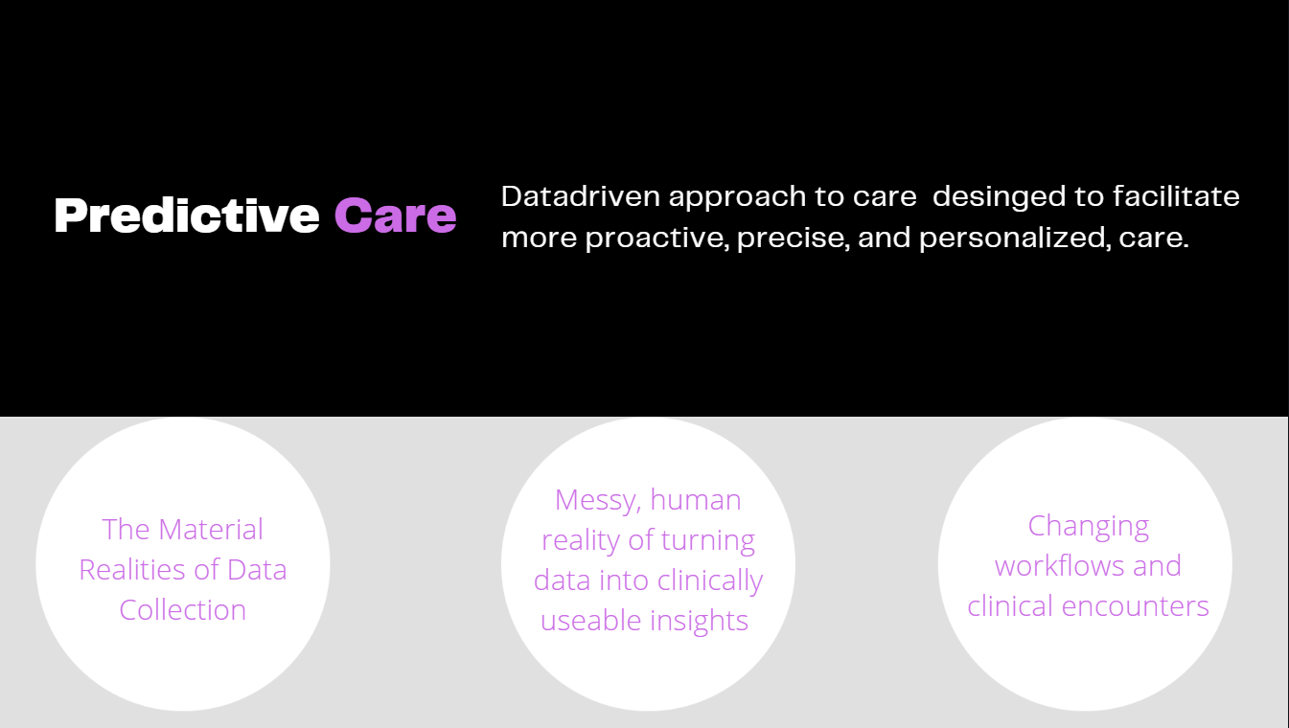

Dr. Laura Sikstrom, Medical Anthropologist
Project Scientist, KCNI, CAMH
Assistant Professor (Anthropology, UofT)
AMS Fellow in Compassion & AI
Dr. Marta Maslej, Experimental Psychologist
Project Scientist, KCNI, CAMH
Fairness & Health Equity
DATA
PREDICTION
+ CARE
Notes:
Our team examines an emergent medical and technological innovation we call "Predictive Care." Most of my ongoing research examines new healthcare opportunities and risks that emerge alongside these innovations.
We combine Prediction with “care” deliberately to illustrate that we are not just interested in the accuracy or usefulness of a specific predictive algorithm –
RATHER we are interested in both how these tools are made, and ask questions about how these advances are transforming care more broadly.
In particular, we are both very interested in how these tools could be used effectively to advance health equity.
Marta and I work independently and collaboratively. Today, we’ll talk about 2 projects that we work on together.

Slide 2

Hybrid Computational Ethnography
Computational (BigData)
+
Ethnographic (ThickData)
Sikstrom, Maslej, et al. 2023. Predictive Care Protocol
Notes:
LAURA
Not typically that two scientists lead, but we have complementary strengths and skill sets, and are interested in answering similar questions about AI (2 coins)
-so our approach is interdisciplinary – for example, the study we will talk about first relies on computational-ethnography (link BMJ Protocol).
- Computational Ethnography
LAURA

Slide 3









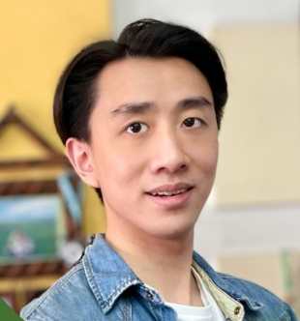
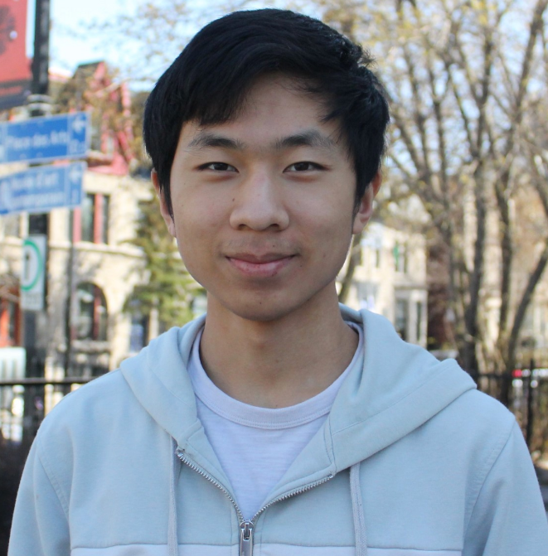

Machine Learning Modelling
10,236 clients across 17,703 acute care stays at CAMH
Demographics
Diagnosis
0 (no incident)
Admission
1 (incident)
Risk ratings
Clinical notes (soon!)
Robert Xiao
Yifan Wang
Notes:
To understand how this automation may impact risk assessment, we are building an ML model using sociodemographic, clinical and risk assessment data from over 10,000 clients across almost 18,000 acute care stays
-preliminary modelling carried out by our student, Robert Xiao, shows that our models can predict incidents of violence or aggression with performance similar to what other researchers are finding (AUC~.70)
-however, one of our other students, Yifan Wang, has been exploring the feature space our models are using to make predictions – one key takeaway from his analyses has been that although there are certain features characterizing patients who are not likely to commit a violent incident (for example, older patients who follow instructions and are not verbally threatening), there is no feature representation that can be used to reliably characterize who will commit such an incident, which may be why sensitivity in our models tends to be poor while specificity is high
-we think this means that any patient can become violent or aggressive, with these behaviours being more related to conditions or interactions in the care setting, rather than patient factors
-our next step will be to add information from clinical notes into the feature space, which we hope will provide this additional context/info and improve sensitivity

Slide 4
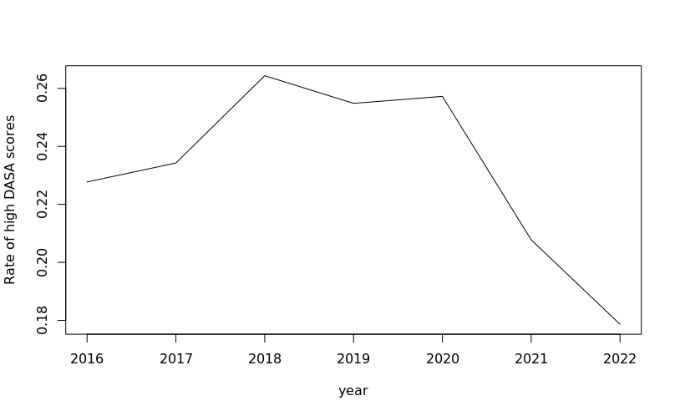
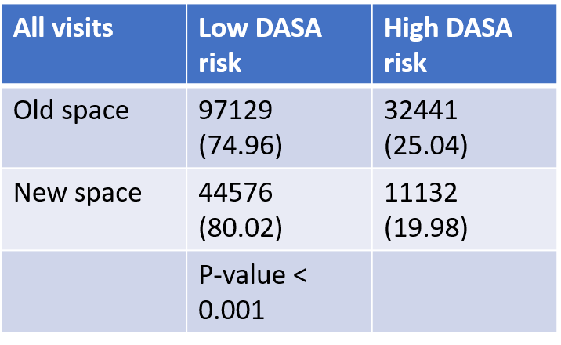
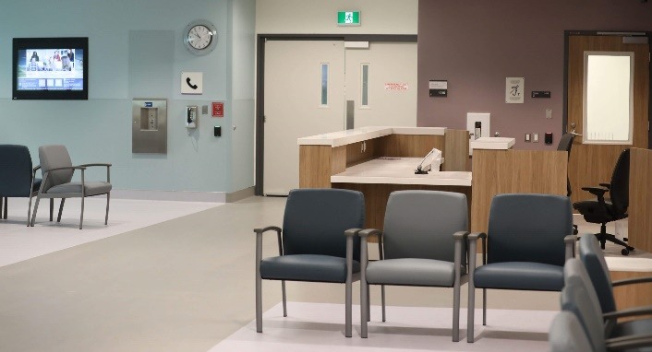
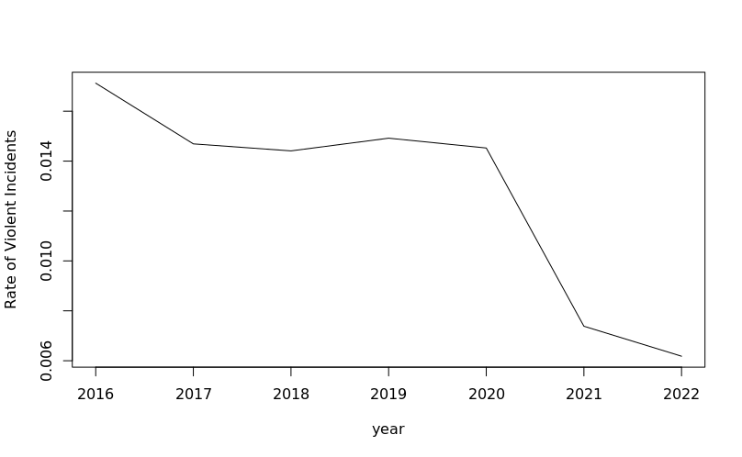
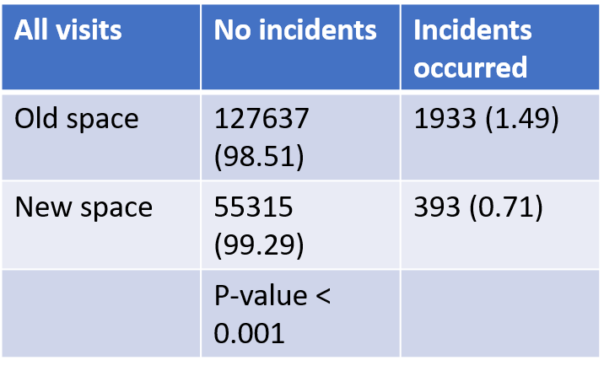
The New ED: Good News
Ready for Change

Slide 5
Thresholds are Dangerous
Table 1. Categories of topics, their numbers, labels and terms
Table 1. Categories of topics, their numbers, labels and terms
Category | Number | Label | Terms
Client space | 19 | Entering or exiting a room | room, went, came, hallway, client came, client went, went room, got, came room, ran, staff, sudden, close, back, told, took, hall, later, hand, reason
 | 74 | Entering or searching a room | room, enter, bed, room client, client room, enter room, found, stand, remov, room secur, search, instruct, lie, quick, left, outsid, client, round, staff, room writer
 | 34 | Searching personal belongings | remov, found, room, bathroom, cloth, search, chang, shower, item, safeti, check, pant, gown, shoe, time, belong, smoke, multipl, pull, contain
 | 79 | Washroom and harassment | use, washroom, floor, threaten, piec, urin, bedroom, racial, slur, spit, around, request, racial slur, client use, neck, pick, remov, lay, clean, rip
Staff space | 88 | Interview room | room, interview, interview room, stay, stay room, go room, room staff, staff, anoth, room client, cooper, seen, quiet, move, chair, escort room, talk, agre, ask, calm
 | 61 | Nursing station and harassment | station, nurs, nurs station, station door, nurs station door, door, window, station window, bang nurs, nurs station window, bang nurs station, came nurs, came nurs station, bang, approach nurs, glass, picu, stare, jump, demand
Common space | 42 | Lounge | loung, area, sit, chair, loung area, client sit, comput, sat, sit loung, heard, stand, tabl, stood, got, watch, sudden, away, quiet, seat, move
 | 9 | Objects thrown | threw, water, food, floor, cup, throw, tray, coffe, tabl, took, lunch, eat, breakfast, dinner, loung, pick, across, proceed, offer, remain
 | 15 | Banging | bang, door, window, head, glass, wall, bang door, bang head, start bang, start, forc, broke, break, began bang, piec, hard, broken, rip, jump, pick

Slide 6
Thresholds are:
1. Physical Spaces
  e.g., Nursing station)
2. Interpersonal
e.g., personal ‘bubbles’)
3. Moral (transgressions)
e.g. sexual harrassment

Slide 7
Main Questions:
1. Entrances and Exits:
  A. design choices to manage risk in these transitional zones;
2. Access to and sight lines into care station;
  A. “Outposts”
3. Interpersonal relationships:
  A. Therapeutic alliance
  B. Interprofessional team work

Slide 8

“Outposts”
Ready for Change

