Slide 1
Everyday....
We believe there are mental health resources available for everyone who needs them.
One day…
It was noted that people accessing care for depression were younger on average as compared to the general population.
Because of this... concerns were raised about mental health care access in older populations

Slide 2
Because of that...
Until Finally...
And ever since then...

Slide 3
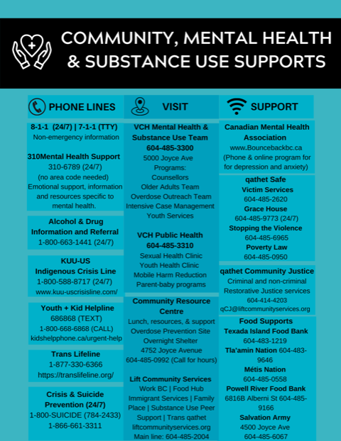
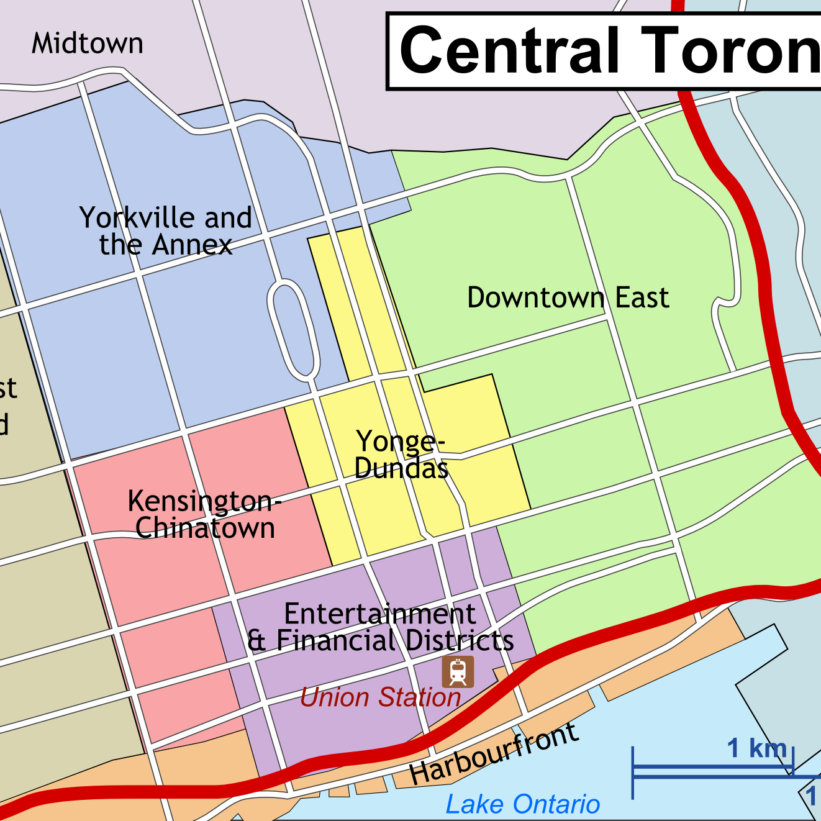
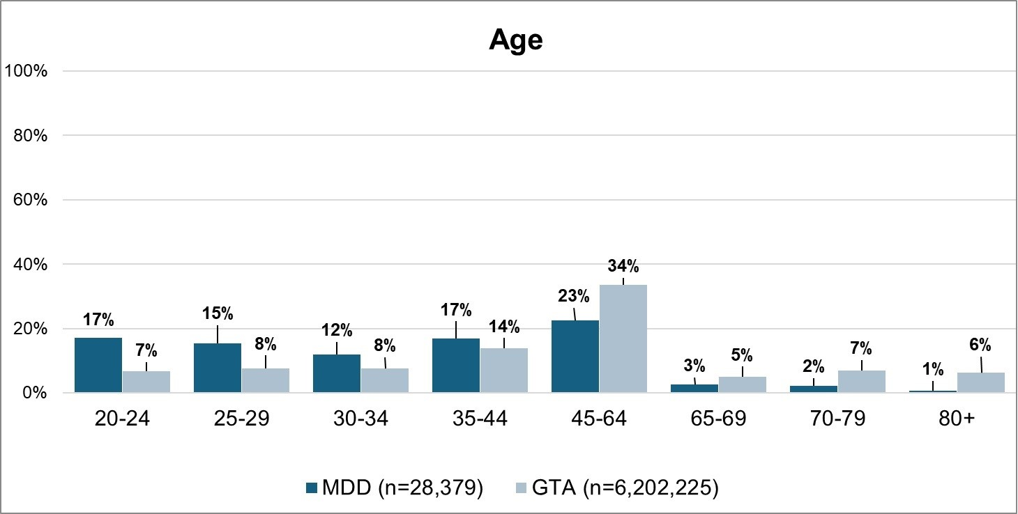
Everyday.... clinicians working in outpatient clinics at CAMH support clients in finding community supports and services (beyond mental health care services - social supports, etc.)
One day… the manager of the outpatient clinic wanted to put together a list of community-based resources to help clinicians in supporting their clients in wayfinding community supports.
Because of this… the manager wanted to understand the age and income makeup of the clients that they care for at the clinic.

Slide 4
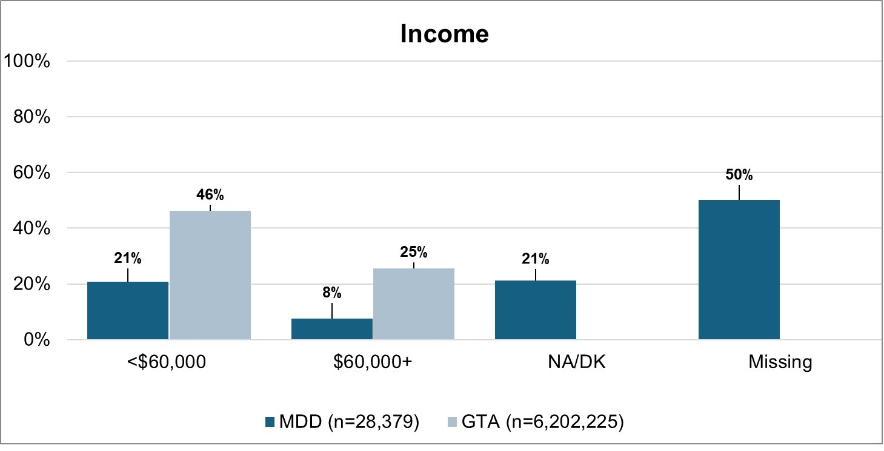

Because of that... The manager used this fairness dashboard to understand which types of services and supports they should include in their list - based on the age and income skew of their client population.
Until Finally...the manager was able to put together a list of community based resources and supports that aligned with their client population demographics and needs.
And ever since then… the dashboard has been used as tool to refine and update the list of available community based resources and services for clients receiving care at the outpatient clinic

Slide 5
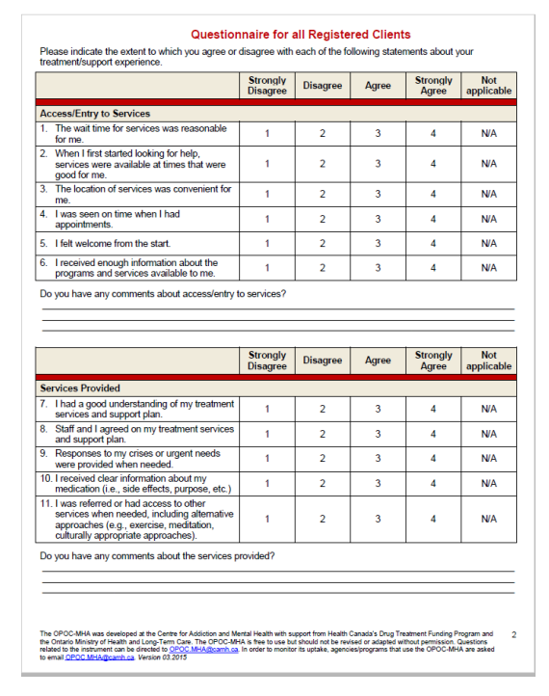
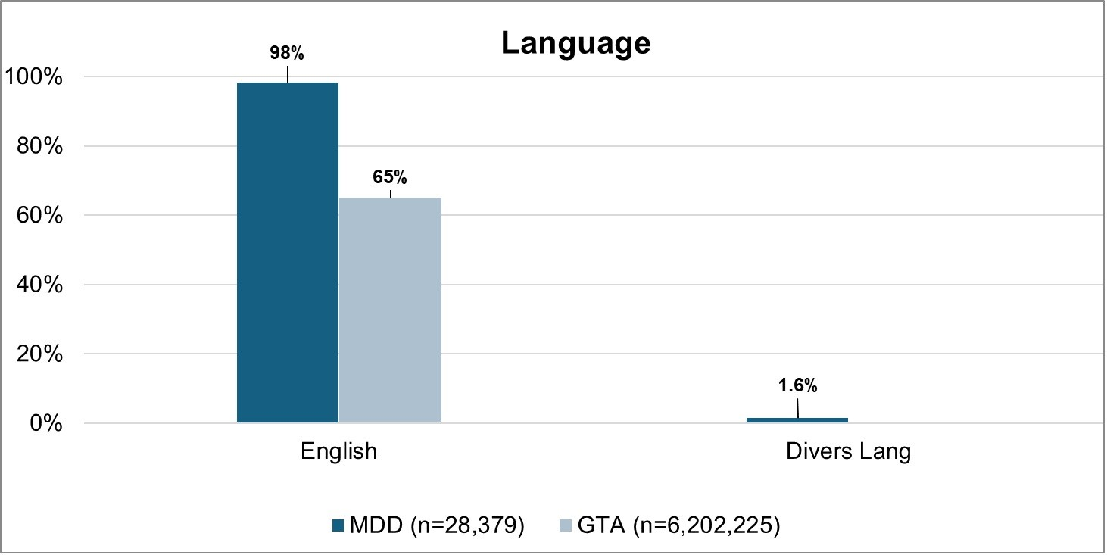

Everyday.... the Ontario Perception of Care (OPOC) research assistants use our dashboard to access linguistic-related health data.
One day... they noticed that more people in the GTA do not speak english than what was being shown on the dashboard.
Because of this… they pondered whether those who do not speak English were accessing services at CAMH or were receiving translation support for their visit.

Slide 6
Because of that... we were able to add a question if the patient/client had received help filling out their demographic/intake forms.
Until Finally... the necessary interpretation services were implemented so all language speakers had similar access to care.
And ever since then… all multilingual speakers were able to have the same access of care at CAMH.

