Slide 1

Fairness Dashboard:
Mockup Exploration

Slide 2







Icebreaker: If you could invent a new holiday, what would that holiday be and how would you celebrate it?

Slide 3

About Today's Meeting
Independent review of the Fairness Dashboard mockup. Make sure to take note of any questions/commentary!
Guided walkthrough with Q&A and feedback collection.
Reflection on feedback and suggest improvements to questions for future focus groups.

Slide 4

Questions to Consider
What are your first reactions or thoughts?
What do you like or dislike about the dashboard pages?
What do you think the dashboard is trying to communicate?

Slide 5


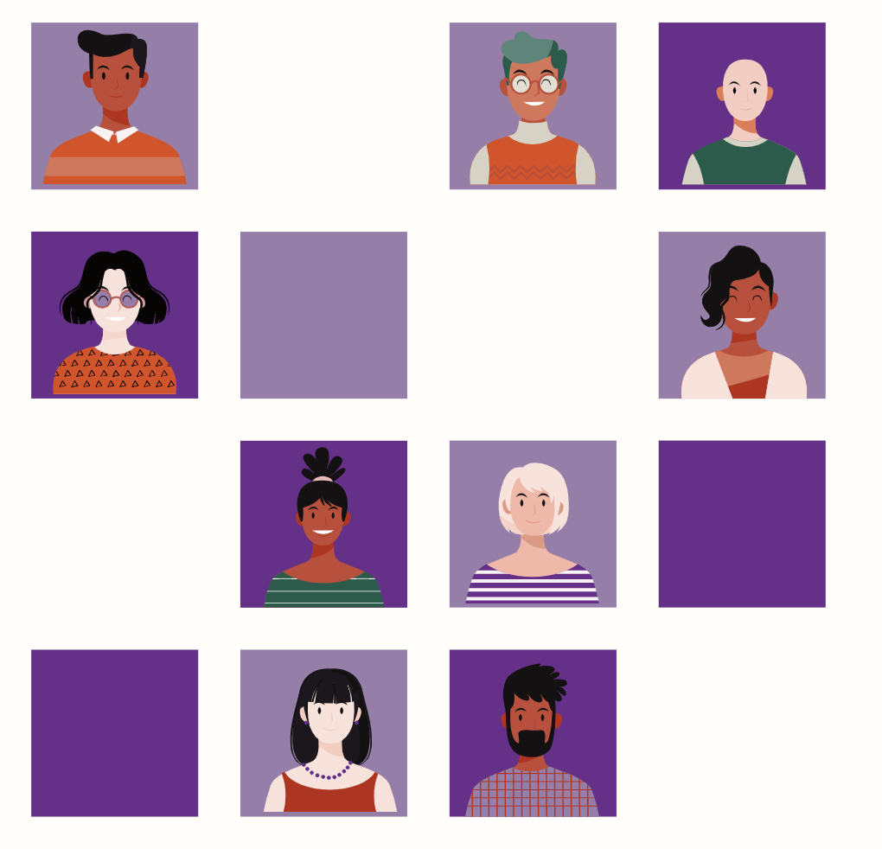
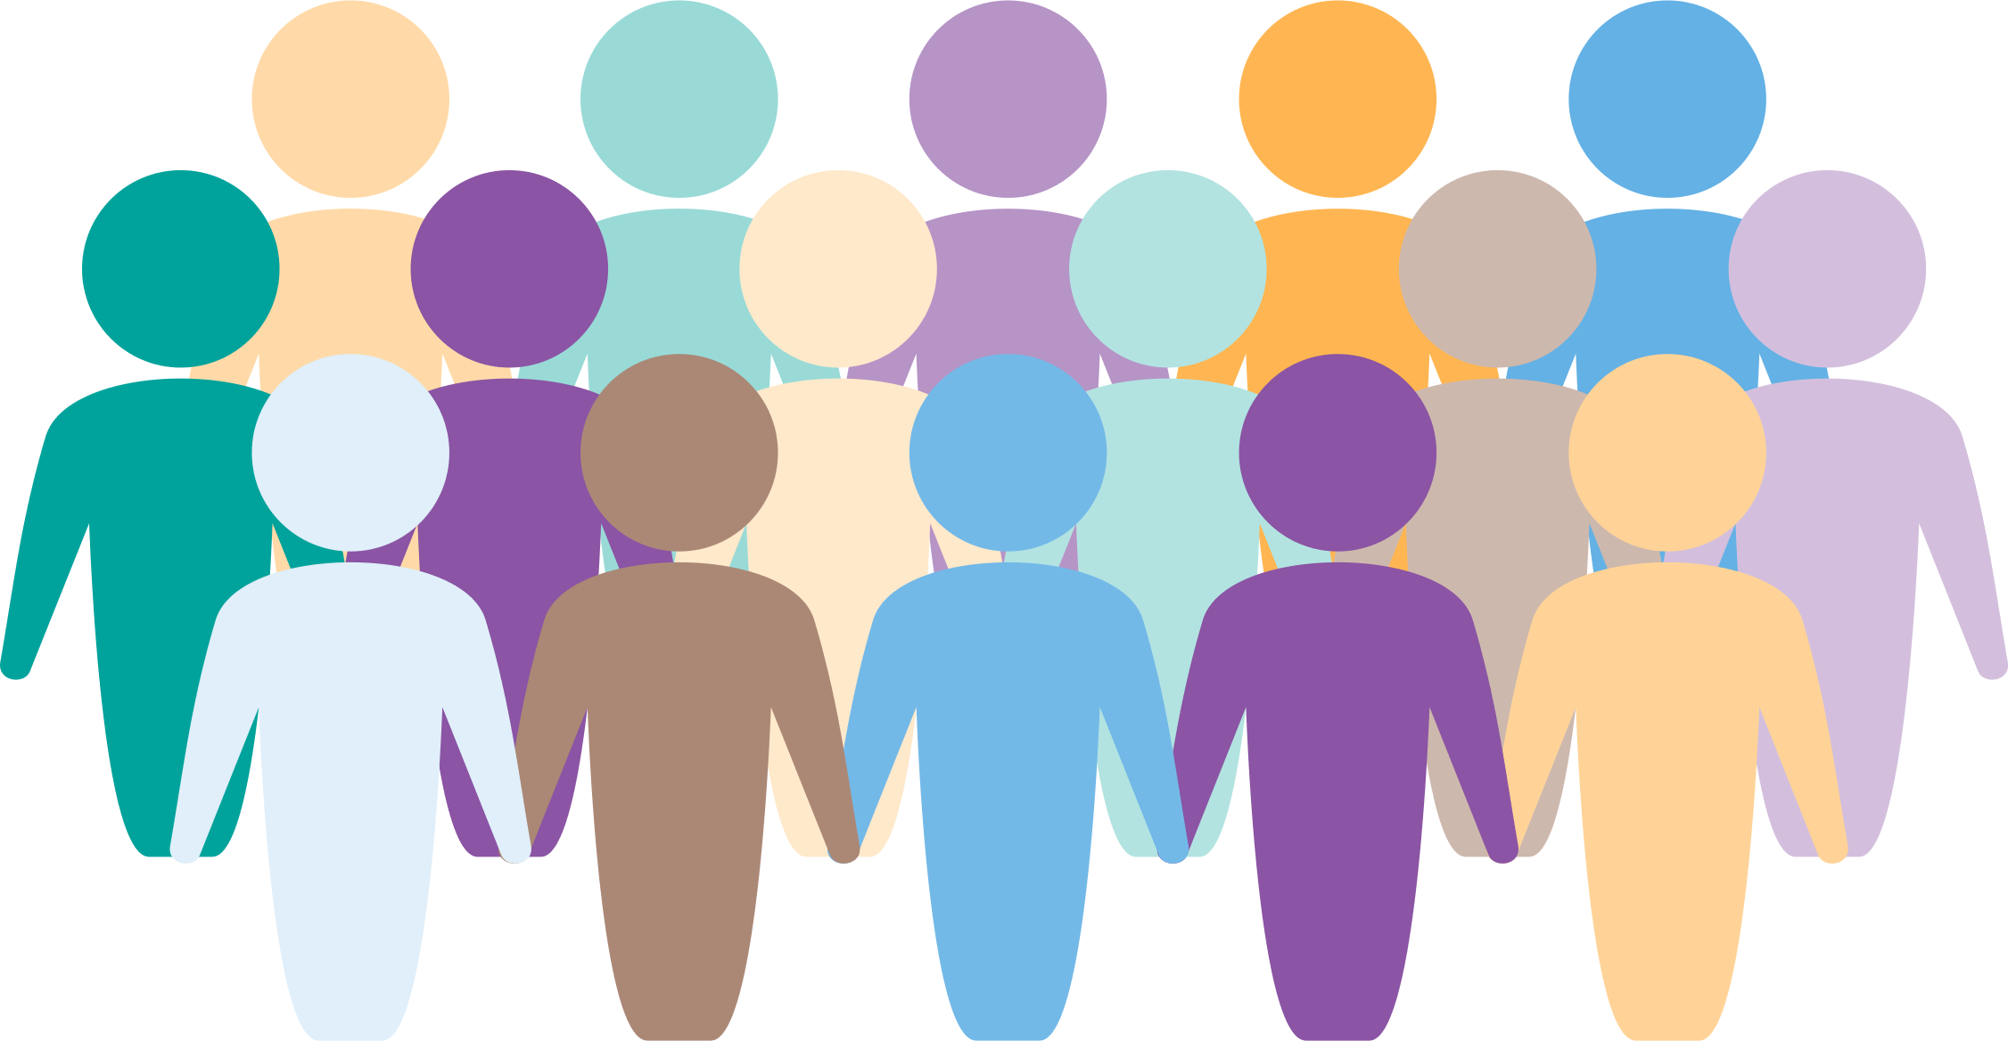




The Fairness Dashboard
Client Sociodemographic Data
Why do we need this dashboard?
This dashboard, developed collaboratively with lived experience advisors, is designed to reflect the multi-faceted realities of mental health care and encourage meaningful action toward health equity. The dashboard allows you to navigate client demographic data and explore critical questions which shape our understanding of health equity.
Where does the data come from?
While reviewing the data, consider the following:
Who is accessing care and who is not?
How do care outcomes differ and what factors influence the care services?
Fair use data framework
Who created this dashboard?
Share Your Feedback
Emergency and Acute Care Services
Depression Care Services
Schizophrenia Care Services

Slide 6

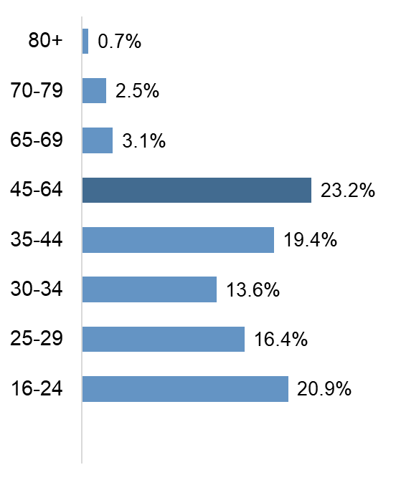
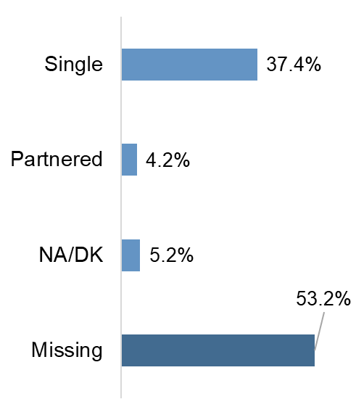
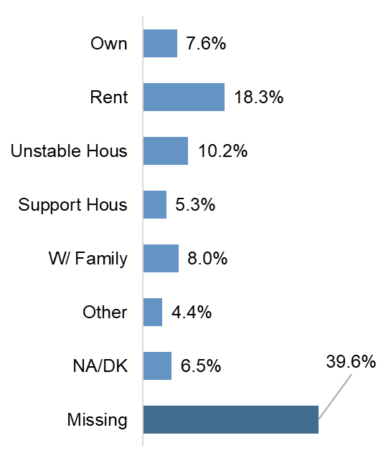
Overview of SSD Client Population
2. SSD Clients Compared to Canadian Census
3. Clinical Outcomes Stratified by Demographics
Total clients diagnosed with SSD
Percent of clients with a disability
Percent of clients who speak English
Why do we need this dashboard?
13,799
30.5%
97.0%
Note: On Tableau, these percentages will be visible when you hover over each bar.
Where does the data come from?
Age Distribution
Marital Status
Housing Type
Fair use data framework
Who created this dashboard?
Share Your Feedback
Notes:
https://healthdata.dshs.texas.gov/dashboard/mental-health/mental-health
https://www.dhs.wisconsin.gov/crisis/988-data-dashboard.htm
https://www.aihw.gov.au/mental-health/overview/prevalence-and-impact-of-mental-illness

Slide 7



CLINICAL OUTCOMES STRATIFIED BY DEMOGRAPHICS
Schizophrenia Spectrum Disorder health outcome measures of clients that had services at CAMH from Jan 1, 2016 to June 30, 2023 by demographic group.
Demographic Group 1
Demographic Group 2
1. Overview of SSD Client Population
Gender Identity
Housing
[Embedded highlights]
Symptom Severity by Status
Overall Functioning by Status
Marital Status
2. SSD Clients Compared to Canadian Census
BRPS
CGI
WHODAS
SOFAS
3. Clinical Outcomes Stratified by Demographics
Symptom Severity by Housing
Overall Functioning by Housing
Housing
BRPS
CGI
WHODAS
SOFAS
Share Your Feedback
Notes:
https://healthdata.dshs.texas.gov/dashboard/mental-health/mental-health
https://www.dhs.wisconsin.gov/crisis/988-data-dashboard.htm
https://www.aihw.gov.au/mental-health/overview/prevalence-and-impact-of-mental-illness

Slide 8
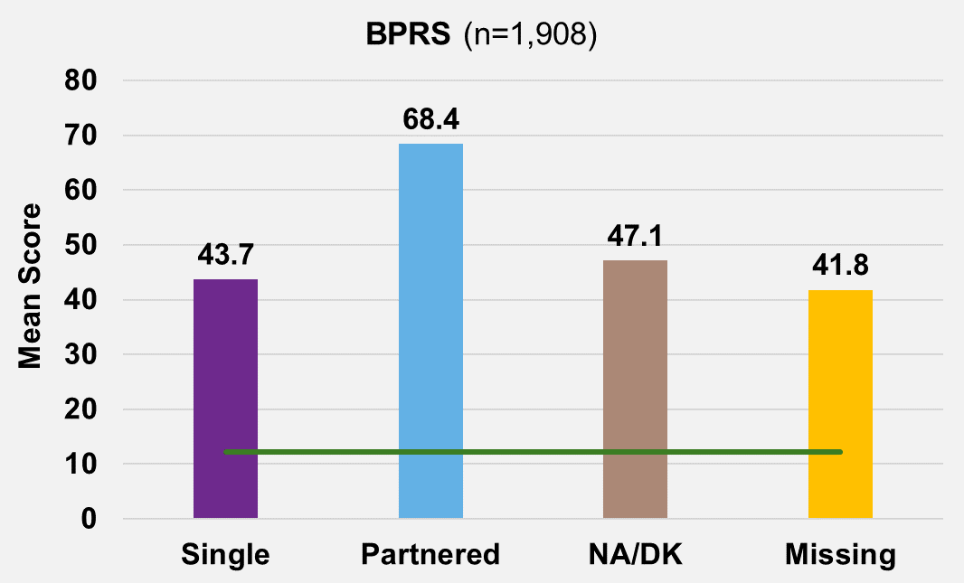
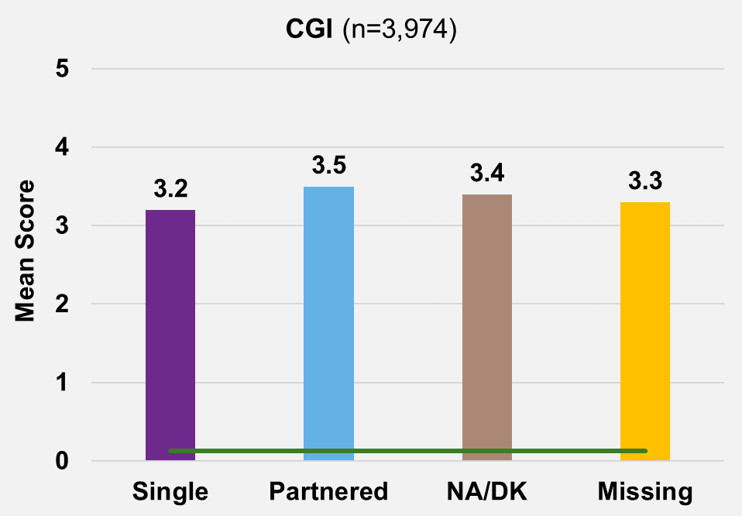


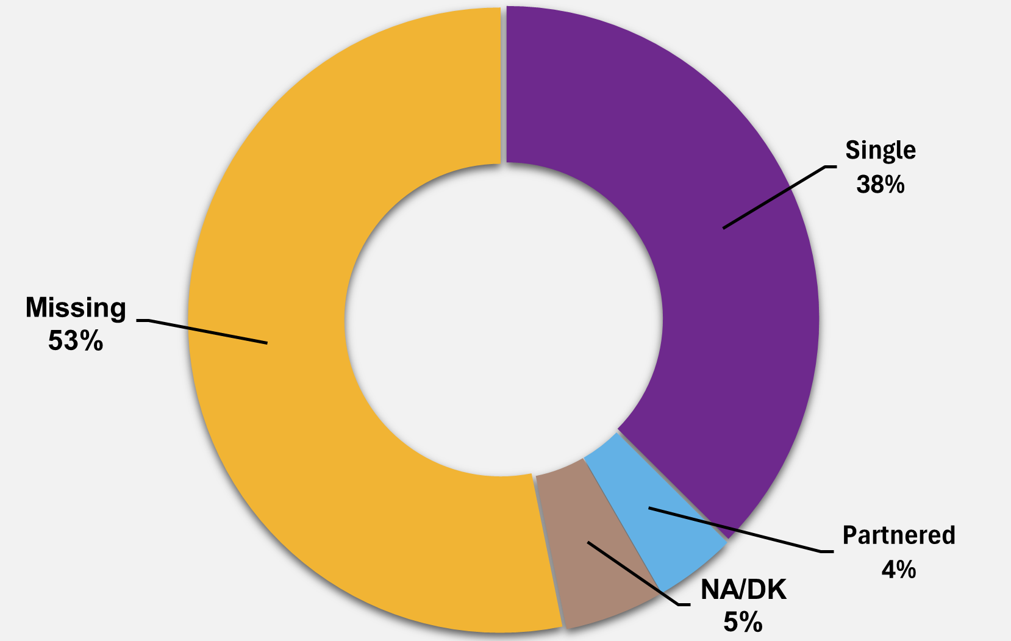
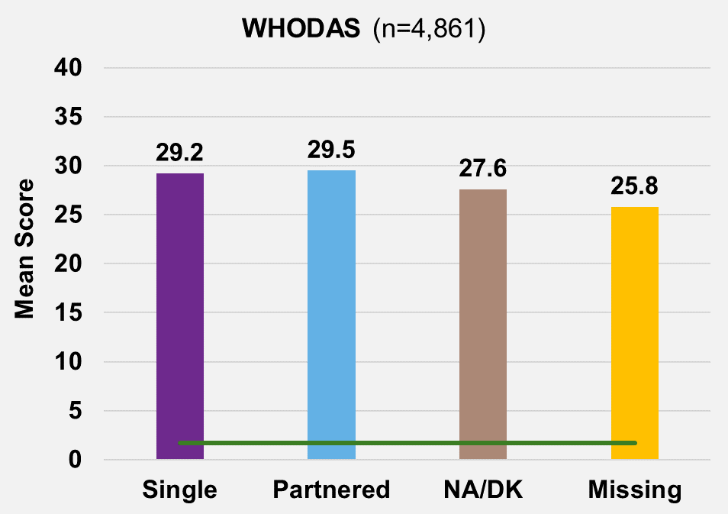
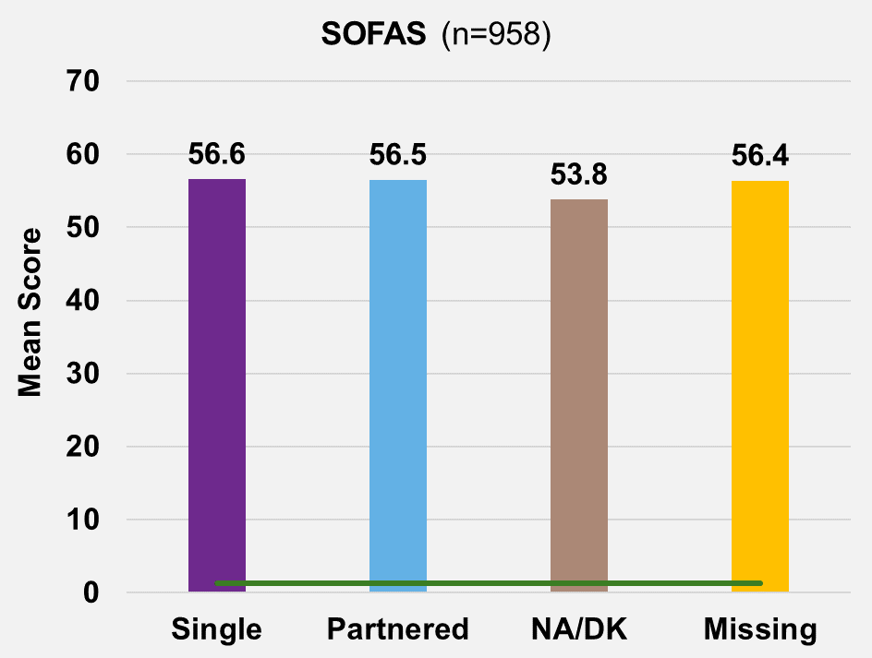
[Example of visualizations for possible layout featured in slide 7]
SSD CLINICAL OUTCOMES STRATIFIED BY MARITAL STATUS
Green line (standard deviation) – measures how much the numbers in a group vary from the mean (average)
Symptom Severity
RANGE REPORTED
1 - 126
MEAN
50.2
RANGE REPORTED
1 - 7
MEAN
3.4
Collapsed navigation
Key Highlights
Partnered clients display the highest scores in BPRS, CGI and WHODAS, indicating most significant symptom severity and functional impairment.
Single clients display highest score in SOFAS, indicating the highest social and occupational functioning, with moderate difficulty.
Overall Functioning
RANGE REPORTED
12 - 60
MEAN
28
RANGE REPORTED
0 - 100
MEAN
55.8
SSD Marital Status
(n=13,799)
Notes:
https://healthdata.dshs.texas.gov/dashboard/mental-health/mental-health
https://www.dhs.wisconsin.gov/crisis/988-data-dashboard.htm
https://www.aihw.gov.au/mental-health/overview/prevalence-and-impact-of-mental-illness

Slide 9
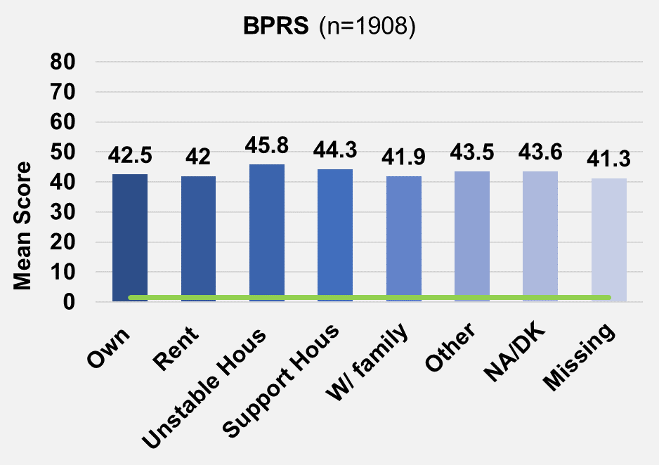
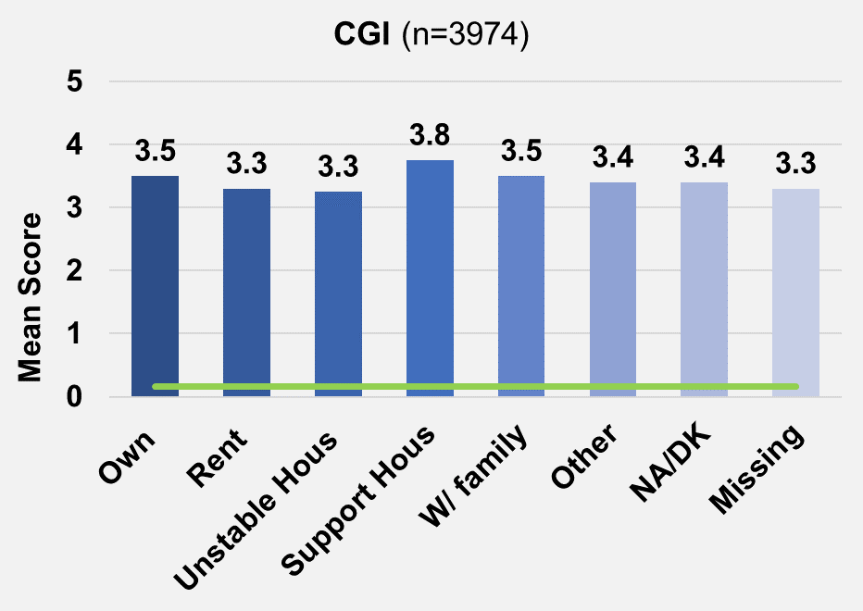
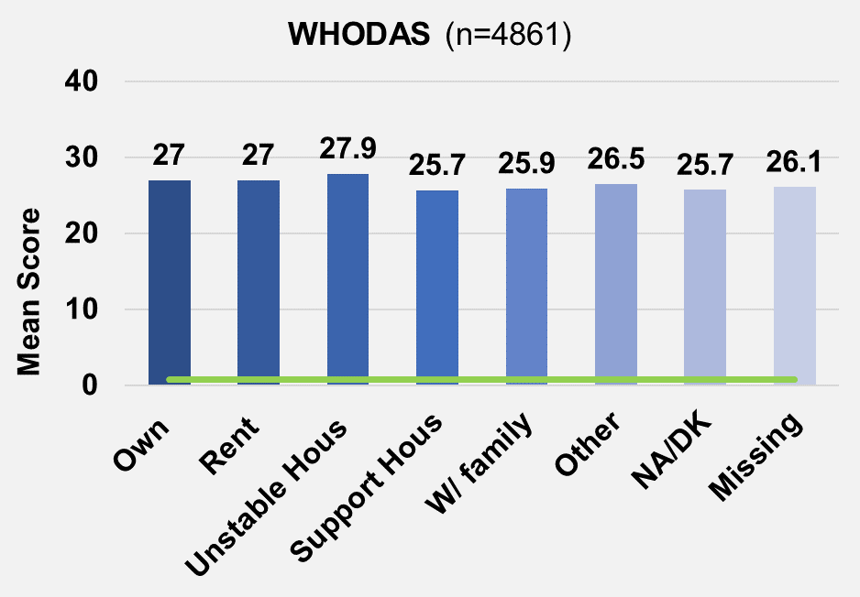
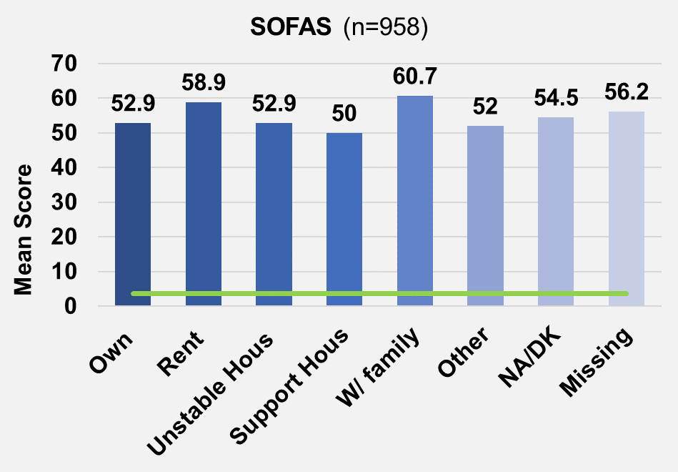
Green line (standard deviation) – measures how much the numbers in a group vary from the mean (average)
SSD CLINICAL OUTCOMES STRATIFIED BY HOUSING
Note: On Tableau, these scores will be visible when you hover over each bar.
Key Highlights
Symptom Severity
RANGE REPORTED
18 - 126
MEAN
43.5
RANGE REPORTED
1 - 7
MEAN
3.5
Clients living in unstable housing display the highest scores in BRPS and WHODAS, indicating most significant symptom severity and functional impairment.
Clients living with family display highest scores in SOFAS, indicating the highest social and occupational functioning amongst housing types, however the score (60.7) is still considered "moderate difficulty" in social, occupational, or school functioning.
Overall Functioning
RANGE REPORTED
12 - 60
MEAN
26.3
RANGE REPORTED
0 - 100
MEAN
53.4
SSD Housing (n=13,799)
Notes:
https://healthdata.dshs.texas.gov/dashboard/mental-health/mental-health
https://www.dhs.wisconsin.gov/crisis/988-data-dashboard.htm
https://www.aihw.gov.au/mental-health/overview/prevalence-and-impact-of-mental-illness

Slide 10


What should be highlighted about the importance of this dashboard? Do you have suggestions?
Why do we need this dashboard?
The Fairness Dashboard is intended to provide researchers, scientists and clinicians with a clear and accessible way to ...
[insert importance of the dashboard as 3 key bullet points]
Click one of the icons below to learn more about health equity, fair AI and potential ways you can use this data to inform or improve care.
Why do we need this dashboard?
Where does the data come from?
Is there anything we are missing here? What information would you like to see in these categories?
Fair use data framework
Who created this dashboard?
What is Health Equity?
What is Fair AI?
How can this data be used?
Share Your Feedback
Notes:
Health equity, informed by socio-demographic data, is essential for addressing disparities in health outcomes among different population groups. Utilizing socio-demographic data allows for targeted interventions to address these disparities. It helps identify at-risk populations, ensuring that resources and policies are directed where they are most needed. Overall, leveraging socio-demographic data ensures that health equity efforts are precise, impactful, and lead to healthier, more equitable communities.

Slide 11
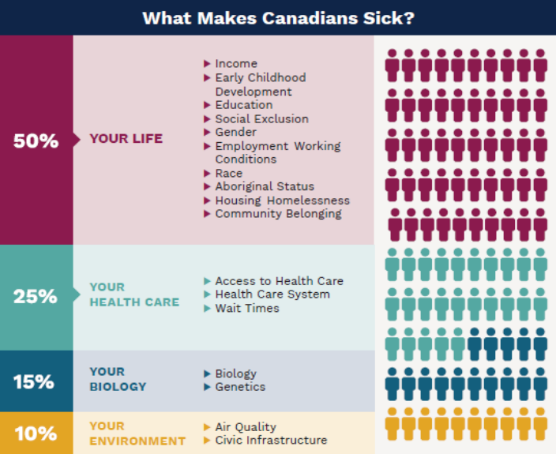
Why do we need this dashboard?
X
The Fairness Dashboard is intended to provide researchers, scientists and clinicians with a clear and accessible way to ...
[insert importance of the dashboard as 3 key bullet points]
Click one of the icons below to learn more about health equity, fair AI and potential ways you can use this data to inform or improve care.
Why do we need this dashboard?
What is Health Equity?
Health equity means that all people have fair access to, and can act on, opportunities to reach their full health potential and are not disadvantaged by social, economic and environmental conditions, including socially constructed factors such as race, gender, and sexuality.
Where does the data come from?
Fair use data framework
Source: National Collaborating Centre for Determinants of Health. (2023). Let’s Talk: Health equity (2nd ed.).
Source: Canadian Medical Association (2013). Health care in Canada: What makes us sick?: Canadian Medical Association Town Hall Report.
Who created this dashboard?
What is Health Equity?
What is Fair AI?
How can this data be used?
Share Your Feedback
Notes:
Health equity, informed by socio-demographic data, is essential for addressing disparities in health outcomes among different population groups. Utilizing socio-demographic data allows for targeted interventions to address these disparities. It helps identify at-risk populations, ensuring that resources and policies are directed where they are most needed. Overall, leveraging socio-demographic data ensures that health equity efforts are precise, impactful, and lead to healthier, more equitable communities.

Slide 12
Why do we need this dashboard?
X
The Fairness Dashboard is intended to provide researchers, scientists and clinicians with a clear and accessible way to ...
[insert importance of the dashboard as 3 key bullet points]
Click one of the icons below to learn more about health equity, fair AI and potential ways you can use this data to inform or improve care.
Why do we need this dashboard?
How can this data be used?
The data presented in this dashboard can be used in numerous ways to inform research, clinical care, and clinical outcomes. View the examples below to explore how this data might be used.
Where does the data come from?
Use Case 1: Identifying the need for translation services
Fair use data framework
How should we present these use cases? As a video? Infographic? Workflow diagram? As text/a list?
Who created this dashboard?
What is Health Equity?
What is Fair AI?
How can this data be used?
Share Your Feedback
Notes:
Health equity, informed by socio-demographic data, is essential for addressing disparities in health outcomes among different population groups. Utilizing socio-demographic data allows for targeted interventions to address these disparities. It helps identify at-risk populations, ensuring that resources and policies are directed where they are most needed. Overall, leveraging socio-demographic data ensures that health equity efforts are precise, impactful, and lead to healthier, more equitable communities.

Slide 13
Where does the data come from?
Primary Data Sources
Why do we need this dashboard?
Patient Population of Focus
Where does the data come from?
Demographic Variables
Clinical Outcome Measures
Fair use data framework
Who created this dashboard?
Share Your Feedback

Slide 14
Where does the data come from?
Primary Data Sources
Why do we need this dashboard?
The data presented in this dashboard is derived from two primary sources.
The first source is the Centre for Addiction and Mental Health’s (CAMH) electronic health record, I-CARE. Specifically, patient data was gathered from the CAMH health equity or demographic registration forms and clinical self-assessments (i.e., GAD-7, PHQ-9, etc.).
The second source is the Statistics Canada 2021 Canadian Census data. Data was captured for individuals residing the Greater Toronto Area, the CAMH patient catchment area.
Where does the data come from?
Fair use data framework
Patient Population of Focus
Who created this dashboard?
Demographic Variables
Clinical Outcome Measures
Share Your Feedback

Slide 15
Where does the data come from?
Primary Data Sources
Why do we need this dashboard?
Patient Population of Focus
Where does the data come from?
Within I-CARE, data from patients aged 18 or older were gathered from three categories of services at CAMH:
People diagnosed with major depressive disorder (MDD) or another unipolar depressive order from 2016 to present (n=21,000).
People diagnosed with schizophrenia spectrum disorder (SSD) from 2016 to present (n=10,000).
People admitted to acute care units via CAMH’s emergency department, excluding forensic units, since 2016 (n=12,000).
Fair use data framework
Who created this dashboard?
Demographic Variables
Clinical Outcome Measures
Share Your Feedback

Slide 16
Where does the data come from?
Primary Data Sources
Why do we need this dashboard?
Patient Population of Focus
Where does the data come from?
Demographic Variables
[Insert Demographic Variables]
An indicator library will be presented here. This library will include information about the demographic variables, what they mean and information about data quality (missingness, etc.)
Fair use data framework
Who created this dashboard?
Clinical Outcome Measures
Share Your Feedback

Slide 17
Where does the data come from?
Primary Data Sources
Why do we need this dashboard?
Patient Population of Focus
Where does the data come from?
Demographic Variables
Clinical Outcome Measures
Fair use data framework
[Insert Outcome Measures]
An indicator library will be presented here. This library will include information about the clinical outcome measures (i.e., PHQ-9), what they mean, how scores are captured, how the assessments are conducted, and information about data quality (missingness, etc.)
Who created this dashboard?
Share Your Feedback

Slide 18

Below is an example of questions for users to consider in the analyze stage of the research process. Do you have suggestions for questions in other stages?
Fair Use Data Framework
Our goal is to promote health equity by ensuring the effective, accountable, and ethical use of these data presented in the Fairness Dashboard. The questions below are guidelines* to help users conduct equitable analyses, target audiences effectively, and ultimately improve mental health outcomes by considering all relevant sociodemographic factors and their intersections.
Why do we need this dashboard?
ANALYZE
DESIGN
DEVELOP
IMPLEMENT
EVALUATE
Where does the data come from?
How do the social determinants in this dataset influence mental health outcomes?
What are the mental health impacts of holding multiple marginalized identities?
Intersectionality & Social Determinants of Health
Fair use data framework
Where are there gaps in these data? Who might be underrepresented or missing from the dataset?
What additional types of data would help provide a complete picture of the mental health outcomes in this dataset?
Identifying Data Gaps
Who created this dashboard?
What do the results of your analysis mean for your community, clients, or target population?
What can be done with these results to promote actionable change in mental health disparities?
Results
Share Your Feedback
*Adapted from the ADDIE model of instructional design
Agic, B., Fruitman, H., Maharaj, A., Taylor, J., Ashraf, A., Henderson, J., Ronda, N., McKenzie, K., Soklaridis, S., & Sockalingam, S. 2023). Advancing Curriculum Development and Design in Health Professions Education: A Health Equity and Inclusion Framework for Education Programs. The Journal of Continuing Education in the Health Professions, 43(4S), S4-S8

Slide 19

Who created this dashboard?
The Fairness Dashboard was developed with the valued guidance of our lived-experience research advisory team. Their combined experiences and backgrounds have shaped this tool into a resource hub for exploring health equity data in a thoughtful, accessible, and impactful way.
Below, you can watch their messages to users like yourself and learn more about each advisor.
Why do we need this dashboard?
[Embedded video]
Where does the data come from?
1-3 minute long video
300 word script
  Advisors - What do you want the dashboard users to know?
Fair use data framework
Who created this dashboard?
Meet the Research Advisory Committee
Share Your Feedback
Meet the Predictive Care Research Team

Slide 20
Who created this dashboard?
Meet the Research Advisory Committee
Why do we need this dashboard?
Advisors - How would you like to be identified on this page, if at all? We want to ensure that this page reflects your preferences. Below are some elements we've considered including:
Names
Photos/avatars
Short descriptions/blurbs to introduce advisors
Where does the data come from?
Fair use data framework
Who created this dashboard?
Share Your Feedback

Slide 21
Who created this dashboard?
Meet the Predictive Care Research Team
Why do we need this dashboard?
Dr. Laura Sikstrom, PhD
Project Scientist | Predictive Care Lab
AMS Fellow in Compassion and AI
Krembil Centre for Neuroinformatics | Office of Education
Centre for Addiction and Mental Health
Patrycja Szkudlarek, BSc
Research Analyst | Predictive Care Lab
Krembil Centre for Neuroinformatics
Centre for Addiction and Mental Health
Dr. Marta Maslej, PhD
Staff Scientist | Predictive Care Lab
AMS Fellow in Compassion and AI
Krembil Centre for Neuroinformatics
Centre for Addiction and Mental Health
Iman Kassam, BSc, MHI
Program Officer | Digital Mental Health Lab
Krembil Centre for Neuroinformatics
Centre for Addiction and Mental Health
Where does the data come from?
Fair use data framework
Who created this dashboard?
Learn more about us:
predictivecarecollab.com
Share Your Feedback
Our Collaborators

Slide 22



Fair-AI Toolkit
Why Fair-AI Matters
Fair-AI emphasizes the importance of developing and deploying AI systems that are unbiased, transparent, and respect diverse human experiences. By adhering to these principles, we can develop technologies and forms of care that are trustworthy and beneficial for everyone.
Why do we need this dashboard?
Explore Our Resources
To support users in their fair use of this dashboard, we have curated a range of guides and resources. Select one of the options below to get started:
Where does the data come from?
Fair use data framework
Who created this dashboard?
Dashboard How-to Guides
Fair-AI Resource Library
Fair-AI Community Resource Hub
Share Your Feedback

Slide 23
Fair-AI Toolkit
X
Why Fair-AI Matters
Access detailed tutorials and guides to maximize your use of the Fairness Dashboard below.
Fair-AI emphasizes the importance of developing and deploying AI systems that are unbiased, transparent, and respect diverse human experiences. By adhering to these principles, we can develop technologies and forms of care that are trustworthy and beneficial for everyone.
Why do we need this dashboard?
Dashboard Navigation
Advanced Analytics
Model Evaluation/Interpretation
Explore Our Resources
To support users in their fair use of this dashboard, we have curated a range of guides and resources. Select one of the options below to get started:
Where does the data come from?
[Embedded video]
Fair use data framework
Who created this dashboard?
Dashboard How-to Guides
Fair-AI Resource Library
Fair-AI Community Resource Hub
Share Your Feedback

Slide 24




Fair-AI Toolkit
[Example of possible embedded resource list from Airtable]
X
Why Fair-AI Matters
This resource library includes articles, frameworks, and tools essential for comprehending and applying Fair-AI principles, curated by the Fairness Dashboard team.
Fair-AI emphasizes the importance of developing and deploying AI systems that are unbiased, transparent, and respect diverse human experiences. By adhering to these principles, we can develop technologies and forms of care that are trustworthy and beneficial for everyone.
Why do we need this dashboard?
Views
Filter
Sort
Explore Our Resources
Conceptualising fairness: three pillars for medical algorithms and health equity
Intersectionality in Mental Health Care
Race and Racialization in Mental Health Research and Implications for Developing and Evaluating Machine Learning Models
To support users in their fair use of this dashboard, we have curated a range of guides and resources. Select one of the options below to get started:
Where does the data come from?
RESOURCE TYPE
RESOURCE TYPE
RESOURCE TYPE
Fair use data framework
Article
Tutorial
Article
TAGS
TAGS
TAGS
Machine learning
Machine learning
Machine learning
Patient-centered care
Intersectionality
Continental populations
LINK
LINK
LINK
Who created this dashboard?
https://pubmed.ncbi.nlm.nih.gov/35012941/
https://fairlearn.org/v0.10/auto_examples/plot_intersectional_bias.html#references
https://pubmed.ncbi.nlm.nih.gov/35673219/
Users will have the option to contribute to a similar resource list here.
Dashboard How-to Guides
Fair-AI Resource Library
Fair-AI Community Resource Hub
Share Your Feedback

Slide 25
Share Your Feedback
[Example of possible embedded feedback form]
User Information
Name:
Tope
Why do we need this dashboard?
Email:
Role/Position:
Example Answers
Research
Clinical Practice
Educational
Other (please specify)
Where does the data come from?
Department Type:
Usage Context
Example Answers
Daily
Weekly
Monthly
Rarely
First time
Purpose of Use:
How can you use this data?
Frequency of Use:
ff
Usability & Customization
Example Answers
Very easy
Somewhat easy
Neutral
Somewhat difficult
Very difficult
Who created this dashboard?
How easy is it to navigate the dashboard?
Additional pages for questions on visualizations, insights, suggestions, etc.
Share Your Feedback
1
2
3
4
Notes:
Text box entry?
Survey monkey?
What questions should be asked? Should it just be an open-text option? Should there be an evaluation component?

Slide 26

Reflection
Some of the questions we asked you today will be used in future focus group sessions. We'd like you to take a few moments to reflect and provide feedback by answering the following questions:
What are your first reactions or thoughts to the questions we asked you today?
Are there any questions that you would change or add to?

