Slide 1

Fairness Dashboard:
Visualizing Missingness

Slide 2




Icebreaker: What was the most unusual or surprising thing you learned this year?

Slide 3
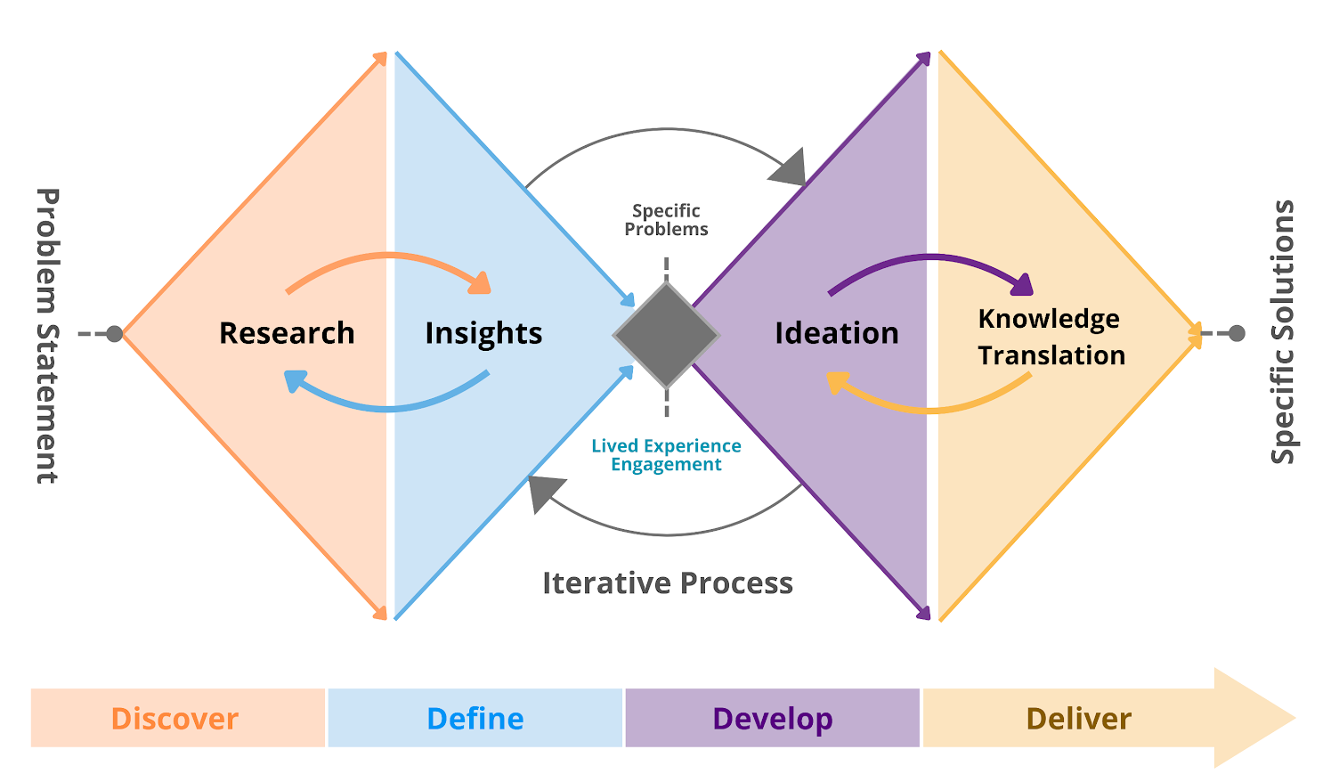
About Today's Meeting
Develop: Co-designing various solutions to address the identified problem
Discuss your perspectives, concerns, and suggestions on how to handle missingness in the Fairness Dashboard.

Slide 4
Ways to deal with missing data
Complete-case analysis
Mark as missing
Statistical imputation
Supplementing with other sources

Slide 5
Complete case analysis
Remove individuals with missing data and only include those with complete data in your analysis.
PROS | CONS
Easy | Bias
Only high-quality data are included | Lack of representation
Not a good solution

Slide 6
Mark as missing
Create a ‘missing’ category and include individuals with missing data in that category.
PROS | CONS
Easy | Only works for categorical data
Representation of individuals with missing data | Not as informative
?
?
?

Slide 7



Statistical imputation
Use statistical modelling or prediction to ‘guess’ values for the missing data, using other data provided by the individual.
PROS | CONS
Variety of techniques available | Only works when there isn’t much missing data (20% or less)
May provide a more ‘complete’ representation of individuals | Requires other high-quality data to be available
?
?
?

Slide 8
Supplementing with other sources
Drawing on other sources of data (e.g., area level indices, clinical notes) to extract missing information.
PROS | CONS
Variety of sources available | Only works if sources contain the correct data
May provide a more ‘complete’ representation of individuals | Data provided by someone else (may be biased)
?
?
?

Slide 9
Questions for Reflection
Which approach is best? Why?
How would you like researchers to handle your missing data?
How would you feel if you learned researchers were using statistical approaches or other sources to ‘fill in’ your missing data?

Slide 10
MDD – Missing Variables
Missing Data Gradient
 | ≥ 80%
 | 60%
 | 40%
 | ≤ 20%
* Gradient colour up for discussion.
Notes:
Colour codes
80% + = C40000
60% = FF2F2F
40% = FF8F8F
20% = FFC91D

Slide 11

MDD – Marital Status
* Hover tooltip *
Some data may be missing or incomplete due to one or more of the following reasons:
Data not collected – Certain data points may not have been collected due to clinical decisions.
Client refusal – The client may have declined to provide certain information or participate in the survey.
Non-response – The client may not have responded to data collection tools.
Please review technical notes for more information.
Missing Data Gradient
 | ≥ 80%
 | 60%
 | 40%
 | ≤ 20%

Slide 12
Missing Data Gradient
MDD – Housing Status
 | ≥ 80%
 | 60%
 | 40%
 | ≤ 20%
Option 1: Presenting “missing” and “PNA/DK” as a grouped category.

Slide 13
Missing Data Gradient
MDD – Housing Status
 | ≥ 80%
 | 60%
 | 40%
 | ≤ 20%
Option 2: Presenting “missing” and
“PNA/DK” as a grouped category, with each category % defined.

Slide 14
Next Steps and Updates
Conferences & Events
Advisor Feedback & Newsletter
University of Toronto – Future of Health Leadership, Informatics and Policy Conference (FHLIP) - Conference Proceeding Accepted
Presenting at the conference: Friday February 21, 2025 – 155 College Street, 8am-5pm
Admission for People w/ Lived Experience is Free!
We've introduced the Advisor Milestone Tracker and email updates before meetings.
Is there anything not included in the tracker and updates that you'd like to see in a newsletter?
Way Point Hospital – 2025 Inspire Conference
Abstract Submissions Due: January 14th
Conference Date: June 2-4th, Blue Mountain
Aiming to submit an abstract (format TBD)
Other News
Iman’s Departure!
Reconvening in the New Year – Jan Advisors Meeting
Teaching for Transformation Co-Facilitation Certificate – Hybrid Course – Jan 13th – 20th 2025
Notes:
https://centreforfacdev.ca/events/?eventtemplate=463-teaching-for-transformation-co-facilitation-certificate
https://event.fourwaves.com/inspire-2025/pages
https://www.eventbrite.ca/e/future-of-health-leadership-informatics-and-policy-fhlip-conference-registration-1088686894809?aff=oddtdtcreator&mc_eid=UNIQID&mc_cid=57f08d60e3

Slide 15
MDD Missing Variables
 | 100%
 | 80%
 | 60%
 | 40%
 | 20%
 | 1%
Notes:
Colour codes
100 - #B80000
90 - #C5151F
80 - #D2293E
70 - #DF3E5C
60 - #EC527B
50 - #F86699
40 - #FA7FA7
30 - #FB97B5
20 - #FDAFC3
10 - #FEC8D1
1 - #FFDDDD

Slide 16
Fairness Dashboard Missing Variables

