Slide 1

Fairness Dashboard:
Missing Data

Slide 2




Icebreaker: What was your first job and what did you like/dislike about it?

Slide 3
About Today's Meeting
Overview of what we know about missing data and its challenges.
Learn about statistical approaches to handling missing data and ethical considerations.
Discuss your perspectives, concerns, and suggestions on how to handle missingness in the Fairness Dashboard.

Slide 4


1
THE MISSINGNESS PROBLEM
Key Question:
How do we improve data quality while ensuring it is easily collected and self-reported by clients?
Notes:
Serious problem with data quality and completeness. This raises a number of questions for the dashboard moving forward.
1) How do we improve data quality while also ensuring the data is easily collected and accurately self-reported by clients?

Slide 5
Fairness Dashboard Missing Variables

Slide 6


03
What kinds of problems does this create?

Slide 7
Interpretation
Accountability (assuming missingness is not at random)
Program evaluation & quality improvement
Lack of statistical power
03

Slide 8


3
Why is so much data missing?
Processes & Refusals
Notes:
- I noticed in the interviews that people could easily “shoot down” the data. In other words, it’s impact and relevance was routinely dismissed both because of the missing features, but also because a dashboard removes the human from the loop. How will individuals know it is reliable? Is there a way, that we could visiaulize the relative reliability of the data? How might we incorporate humans, human analysis, interpretation and checks and balances into this process? This issue was especially important for individuals who are not data experts – they rely on data experts to tell them that the data is realiable. [also important to note that this dashboard would not replace the reports that R&A produces].
-consultaton w/ other experts is important – not meant to exist on its own – incorporate trainings (eg a short webinar before accessing the dashboard)

Slide 9

TIME & EFFORT
13
Staff may lack time to enter the data (e.g., ‘workarounds’)
CLINICAL CONTEXT
Inpatient vs outpatient
PROCESSES
POOR SURVEY DESIGN
‘Housing’ categories are problematic.
RATIONALE
Why the data is being collected is poorly explained
Notes:
With these issues in mind, we approached this issue as an open ended doube-diamond design process. The first phase of this project was designed to collect “user stories” about how a health equity dashboard might be used by various stakeholders at CAMH and what they would need to use it successfully.
So at this stage we are leaving the problem space and moving to the solution space. As a result, today’s presentation will review briefly what we’ve learned today –much of it is covered in the report we circulated previously – and will focus on a few core problems that require solutions.
Focus more on the process
-identify stakeholders
-introduce prototype 1
-gather user stories/requirements
-identify feedback used to inform prototype 2

Slide 10

PREFER NOT TO ANSWER
13
Sensitive information and/or do not fully understand purpose.
CANNOT ANSWER
Reflection of someone’s acuity or the fact that the pre-determined boxes do not ‘fit them’
REFUSALS
FOOT DRAGGING
Not 100% comfortable, so just leave it blank
PRIVILEGE
Do not feel disadvantaged (e.g., questions do not apply to them)
REFUSES TO ANSWER
On principle, they refuse to share their data. People refuse for a number of reasons: earned distrust (data misused in the past); foresee harms; and worry about commodification.
Notes:
With these issues in mind, we approached this issue as an open ended doube-diamond design process. The first phase of this project was designed to collect “user stories” about how a health equity dashboard might be used by various stakeholders at CAMH and what they would need to use it successfully.
So at this stage we are leaving the problem space and moving to the solution space. As a result, today’s presentation will review briefly what we’ve learned today –much of it is covered in the report we circulated previously – and will focus on a few core problems that require solutions.
Focus more on the process
-identify stakeholders
-introduce prototype 1
-gather user stories/requirements
-identify feedback used to inform prototype 2

Slide 11
Data handling examples

Slide 12
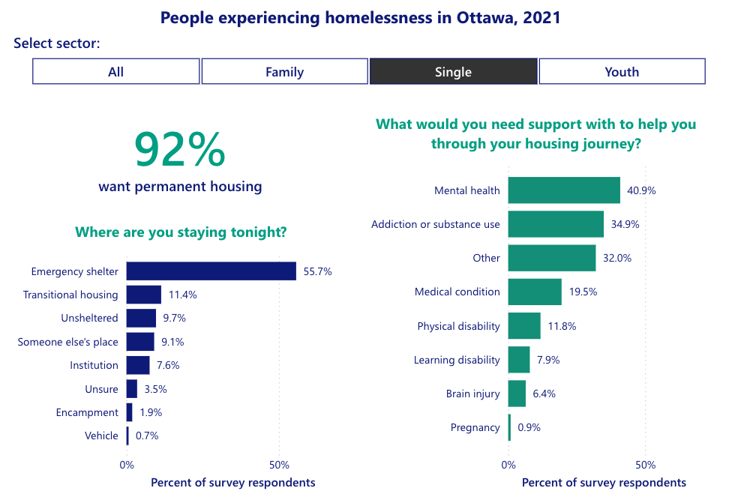
Ottawa Public Health
Mental health, addictions and substance use health in the community dashboard
Missing data were removed from the data dashboard and not visualized.
(per the technical notes)
Notes:
https://www.ottawapublichealth.ca/en/reports-research-and-statistics/mental-health-addictions-and-substance-use-health-in-the-community.aspx

Slide 13
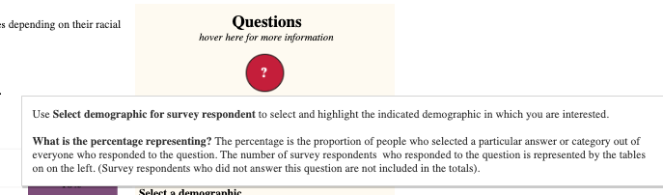
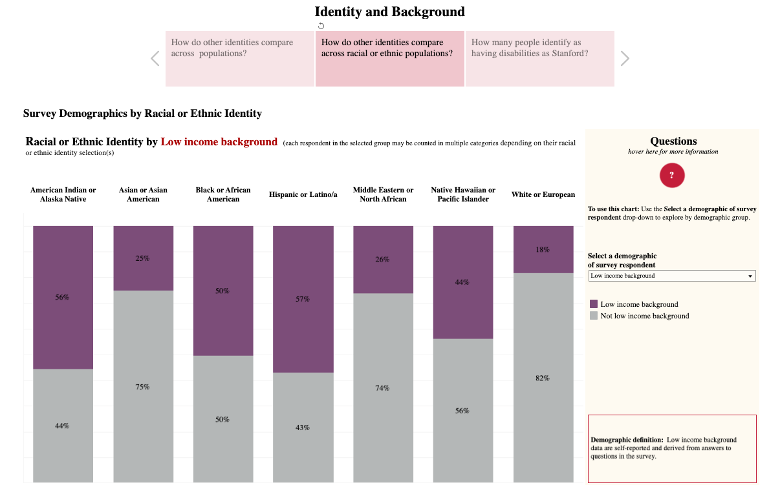
Stanford University
2021 DEI Survey
Individuals who responded 'prefer not to answer' or did not answer regarding the disclosure of their race/ethnic identity were excluded from the visualization.
(per the technical notes)
Notes:
https://tableau.stanford.edu/t/IRDS/views/DEIWorkbook-Demographics/IdentityandBackground?%3Aembed=y

Slide 14
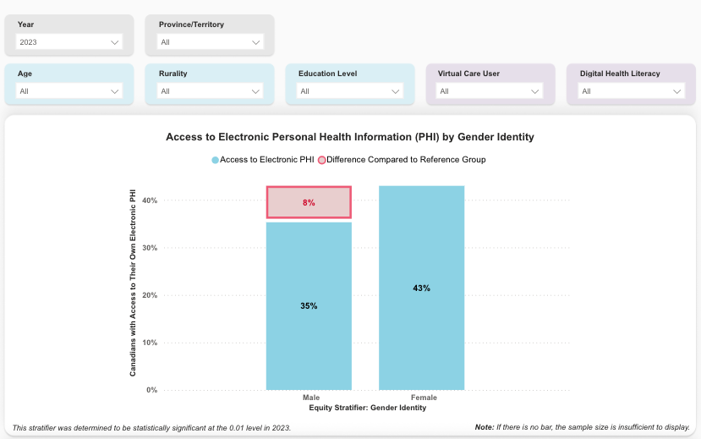
Canada Health Infoway
Digital Health Equity Dashboard
In this graph, only 78% of the data is presented – where 22% is not visualized. They instead include a note: If there is no bar, sample size is insufficient to display
Notes:
https://insights.infoway-inforoute.ca/digital-health-equity-dashboard

Slide 15
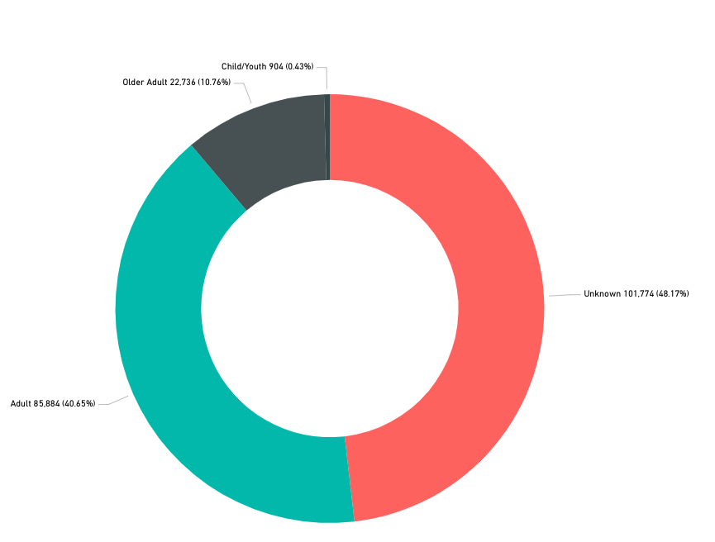
211 Ontario
Business Intelligence Dashboard
Child/Youth 904 (0.4%)
Older Adult 22,736 (10.8%)
Older Adult 22,736 (10.8%)
Missing data is referred to as “unknown” data
Presented with the full data set, despite accounting for nearly half of the sample
Unknown 101,774 (48.2%)
Adult 85,884 (40.7%)
Notes:
https://211ontario.ca/211-data/bi/

Slide 16
Statistical methods & ethical challenges

Slide 17
Ways to deal with missing data
Complete-case analysis
Mark as missing
Statistical imputation
Supplementing with other sources

Slide 18
Complete case analysis
Remove individuals with missing data and only include those with complete data in your analysis.
PROS | CONS
Easy | Bias
Only high-quality data are included | Lack of representation
Not a good solution

Slide 19
Mark as missing
Create a ‘missing’ category and include individuals with missing data in that category.
PROS | CONS
Easy | Only works for categorical data
Representation of individuals with missing data | Not as informative
?
?
?

Slide 20



Statistical imputation
Use statistical modelling or prediction to ‘guess’ values for the missing data, using other data provided by the individual.
PROS | CONS
Variety of techniques available | Only works when there isn’t much missing data (20% or less)
May provide a more ‘complete’ representation of individuals | Requires other high-quality data to be available
?
?
?

Slide 21
Supplementing with other sources
Drawing on other sources of data (e.g., area level indices, clinical notes) to extract missing information.
PROS | CONS
Variety of sources available | Only works if sources contain the correct data
May provide a more ‘complete’ representation of individuals | Data provided by someone else (may be biased)
?
?
?

Slide 22
Questions for Reflection
Which approach is best? Why?
How would you like researchers to handle your missing data?
How would you feel if you learned researchers were using statistical approaches or other sources to ‘fill in’ your missing data?

