Slide 1

Fairness Dashboard:
Advisor Feedback

Slide 2




Icebreaker: When working with a team, what is one thing you appreciate the most ?

Slide 3
About Today's Meeting
Sharing findings and feedback from the Advisor Experience survey.
Brainstorming ideas to improve your advisory experience and our practices.

Slide 4
Advisor Experience Survey Results

Slide 5

Advisor Experience Survey: Purpose
To evaluate your experience as an advisor supporting the Fairness Dashboard project and to gather feedback on ways we can improve your experience.
Notes:
https://revisioncentre.ca/gallery

Slide 6
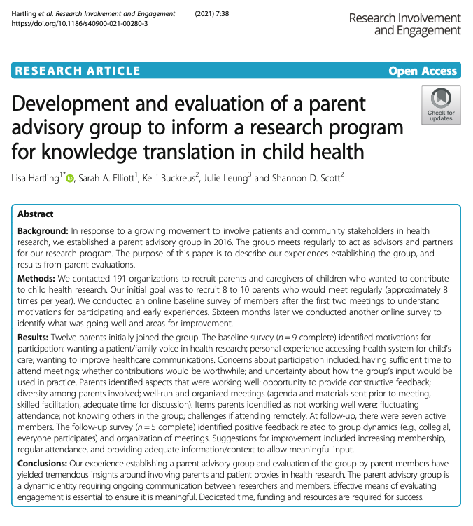
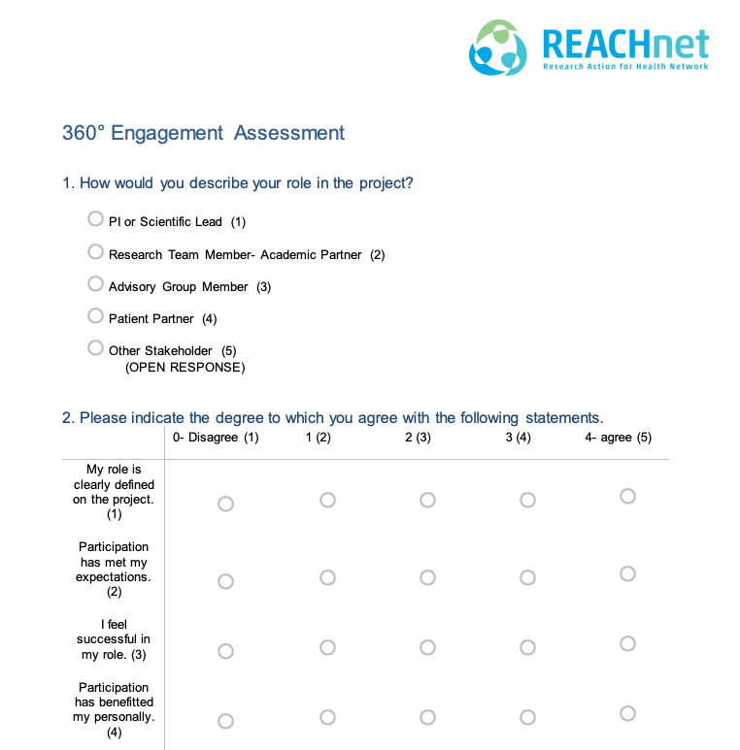
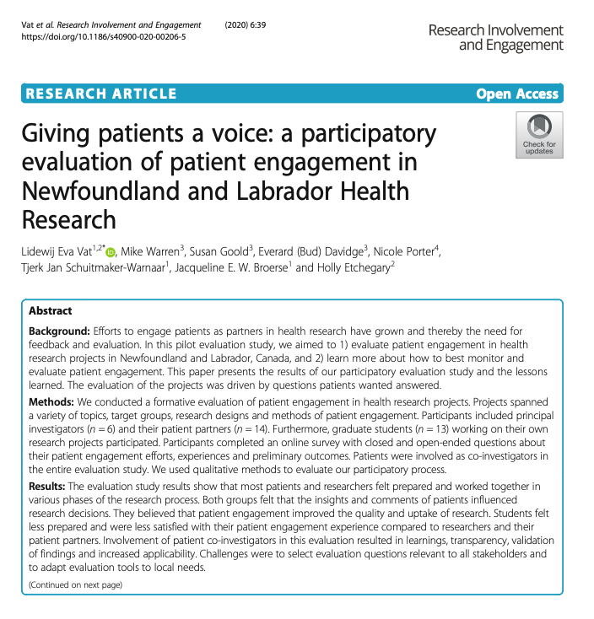
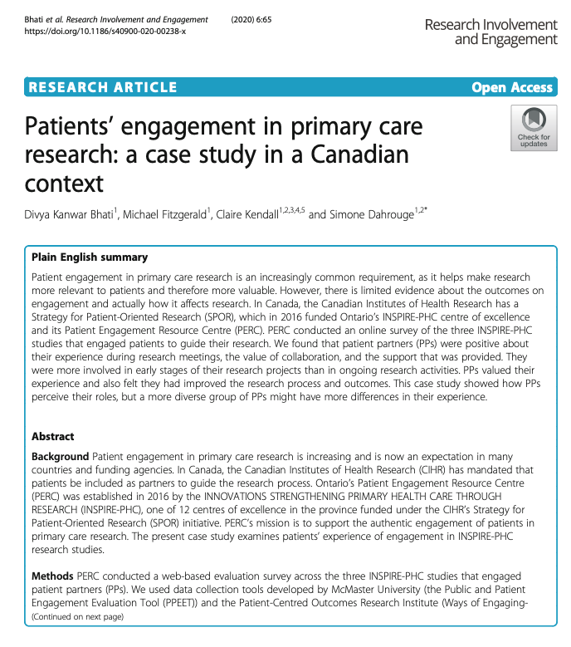
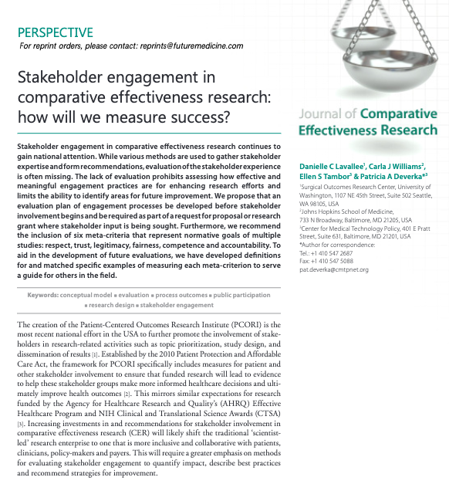
Advisor Experience Survey: Building the Survey
Notes:
https://revisioncentre.ca/gallery

Slide 7
Survey Results: Meeting Facilitation
I had enough information to contribute to the topics discussed during the advisory meetings.
The study and meeting information provided to me has been appropriate and understandable.
The advisory meeting facilitation is compassionate and inclusive.
The purpose of the advisory meetings is clear.
Strongly Agree
Agree
Neutral
Disagree
Strongly Disagree
Notes:
https://revisioncentre.ca/gallery

Slide 8
Survey Results: Meeting Collaboration
A sense of partnership is felt among the research team and the advisors.
I feel comfortable speaking up and contributing during meetings.
All advisors are given equal opportunities to provide their input.
The research team has created a respectful and welcoming environment.
The research team listens to and absorbs my input during the meetings.
The research team encourages the expression of differing viewpoints.
Strongly Agree
Agree
Neutral
Disagree
Strongly Disagree
Notes:
https://revisioncentre.ca/gallery

Slide 9
Survey Results: Meeting Logistics
The size of the advisory committee (i.e., # of advisors) is adequate.
The length/frequency of the meetings allow me to meaningfully contribute to the study.
The team works with me to accommodate any challenges and ensure it is easy for me to participate.
Advisory meetings are scheduled to enable maximum participation.
Strongly Agree
Agree
Neutral
Disagree
Strongly Disagree
Notes:
https://revisioncentre.ca/gallery

Slide 10
Survey Results: Meeting Outputs
The amount of time provided to review communications and materials outside of the advisory meetings is sufficient.
The follow-up and communications after each advisor meeting are sufficient.
The outcomes or outputs of the advisory meetings accurately reflect our discussions.
Strongly Agree
Agree
Neutral
Disagree
Strongly Disagree
Notes:
https://revisioncentre.ca/gallery

Slide 11

Survey Results: Satisfaction
Are you satisfied with your experience as an advisor on the research project?
Yes
Neutral
Felt heard and listened to
Unsure of the bigger picture
Productive use of time
Need more clarity
Contributing to something unique
Notes:
https://revisioncentre.ca/gallery

Slide 12
Advisor Experience Survey: Feedback
Improve the quality of research
Do you believe lived-experience advisors can improve the quality and outcomes of research?
Improve the outcomes of research
General consensus was YES!
Provide nuanced and unique perspectives
Ensure research is grounded in real world experiences
Ensure research is practical, relative and applicable
What can the research team do to improve your overall experience as an advisor on the project?
Provide up-to-date education resources, including inclusive and person-centered language guides.
Conduct 1-on-1 check-ins with advisors pre-or-post advisory meetings to level set.
Continue communicating project updates to the advisors regularly
Notes:
https://revisioncentre.ca/gallery

Slide 13
Brainstorming
Feedback? Recommendations? Concerns?

Slide 14
Update: What's Coming Up
Community of Research Practice (CORP): Patient and Family Engagement Chapter session
Advisory group extension (Spring 2025)
Dashboard video creation company search

