Slide 1

Health Equity: The Impact of Labels

Slide 2
Meeting Goals
Discuss the challenges around demographic labels and their impact.
Review the CAMH Health Equity form and data collection processes.
Explore terminology to better represent diverse groups.
Develop a list of questions and considerations around labels for future reference.

Slide 3
Icebreaker: How do you feel when asked to fill out demographic details on forms, and why?

Slide 4


Slide 5
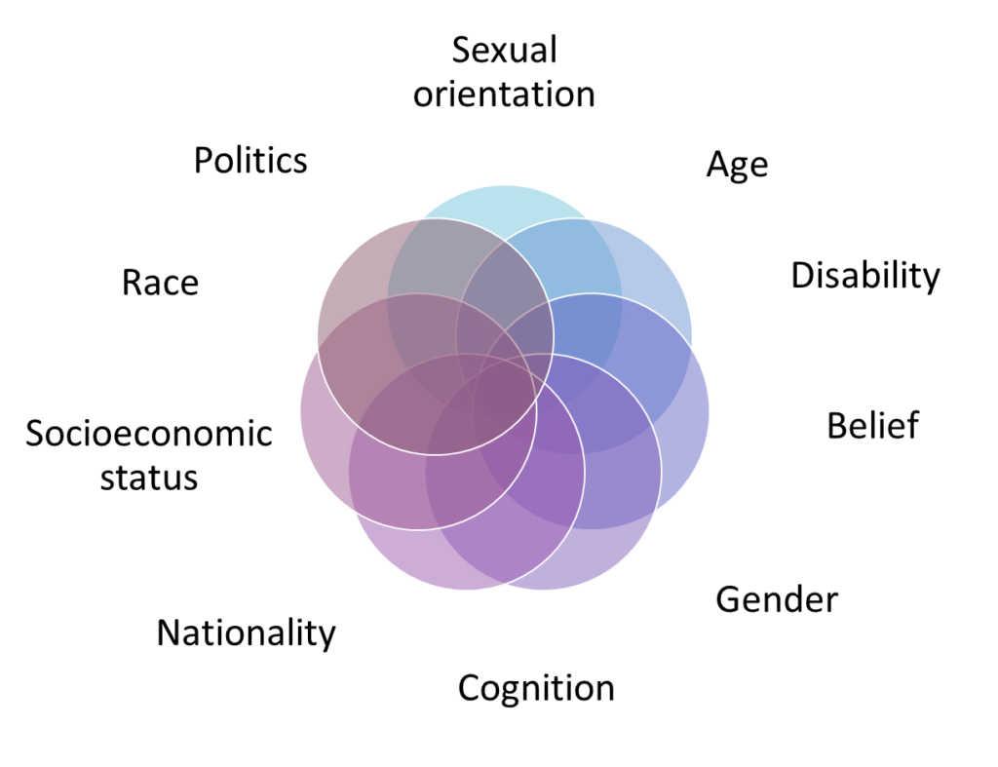
The Implications of Labeling
Labels can shape identities and foster collective voices for groups of people. However, not all labels resonate universally, and many diminish individual experiences.
Managing vast amounts of demographic data daily presents challenges, as data scientists often unintentionally group diverse individuals into overly simplified categories.
Over-generalization risks pushing misaligned strategies and systemic biases forward, ultimately impacting policies and care.

Slide 6
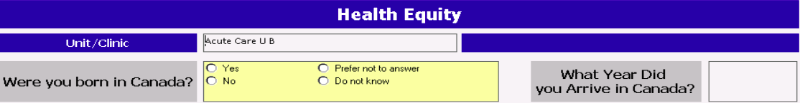
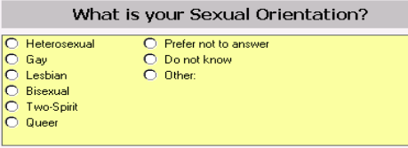
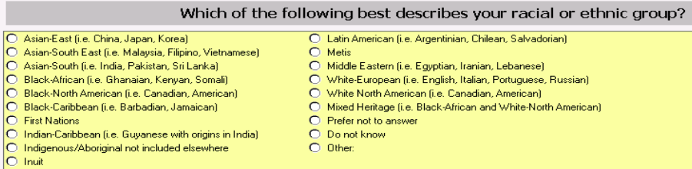
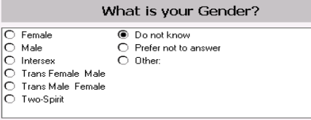
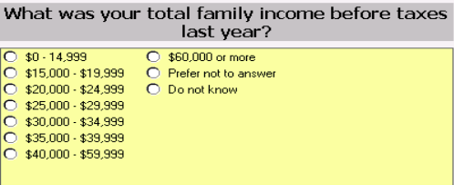
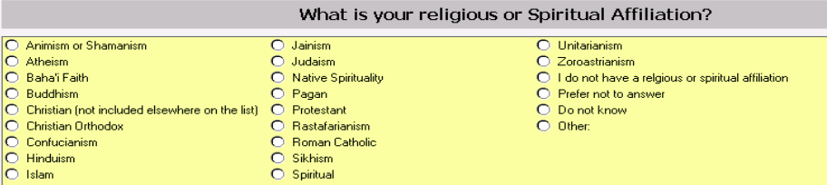
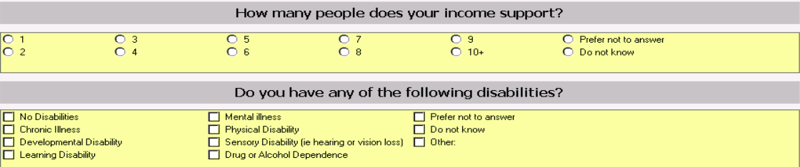
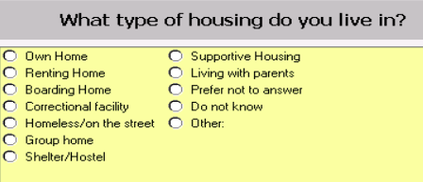

Slide 7
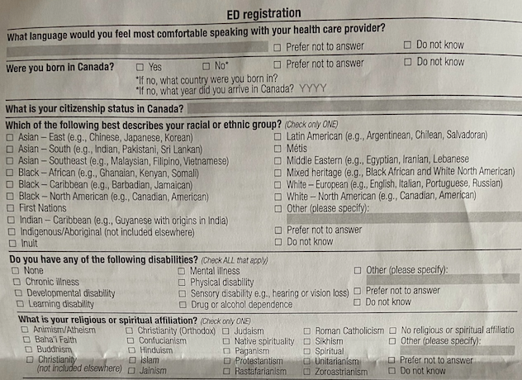
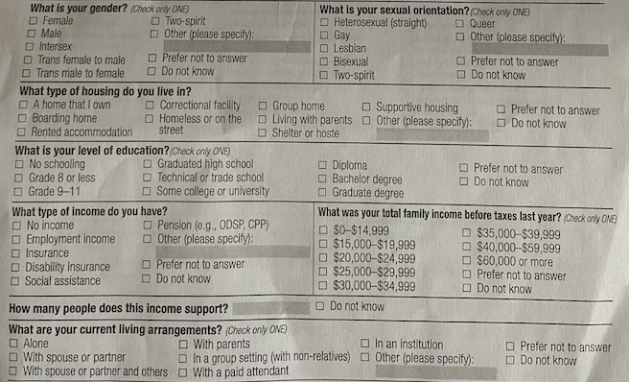

Slide 8
Jamboard Activity: Form Labels
Using Jamboard, we will explore the labels associated with the questions in the Health Equity form.
The third slide is where you can share your own questions, insights, and suggestions around the demographic categories through sticky notes.
Think about these labels’ impact, especially around groups you may identify with.
Do you feel the demographic categories are inclusive and/or unrepresentative?
Are there any gaps that need to be addressed?
https://jamboard.google.com/d/1DWYWjLSw210es5A6aEwDQnACMRDkZBgfB73qsYeWlbc/edit?usp=sharing
Notes:
https://jamboard.google.com/d/1DWYWjLSw210es5A6aEwDQnACMRDkZBgfB73qsYeWlbc/edit?usp=sharing

Slide 9

October Homework Activities
Google Sheet Feedback
Task: Review the registration forms in the Google sheet under the ‘HE form’ and ‘ED form’ tabs. Provide feedback, suggestions, and/or ask questions in the provided sections. Note: Some questions are the same on both forms. Please give feedback on just one sheet for those questions.
Aim: To further reflect on today’s discussion and provide your input on how the forms can better meet health equity goals.
Labelling Reflection
Task: As you review the Google sheets, reflect on designing flyers for our 2024 focus group recruitment. Please add any thoughts you’d like to share to Tab 3 - ‘Labelling Reflection’. We will cover this in our next meeting.
Aim: To consider which client groups we should target and discuss how they might want to be represented in the flyer.
https://docs.google.com/spreadsheets/d/1loukQY3p05RYNb5MbPI-C6pPdWe_hQVgjmH5mIWET2o/edit?usp=sharing

Slide 10
Newsletter Submission
Our team is creating a quarterly newsletter and we’d like you to be featured in it!
Please send:
A photo that represents you (could be an animal, TV character, portrait, etc.)
Your chosen name for the caption
Please submit to patrycja.szkudlarek@camh.ca by Friday, November 3rd

Slide 11
Thank you for joining us this month!
Advisory Team Resources
Check out our team resources here:
https://drive.google.com/drive/folders/18yV2fTT0oIRunWr4voxiSRVt26qM3UOI?usp=drive_link
CAMH Updates
Stay up to date on CAMH news, including projects and findings: https://www.camh.ca/en/camh-news-and-stories

