Slide 1

Examining
Outcome Measures

Slide 2
Icebreaker: If you could make one key change to shape/improve patient-centred outcomes, what would you choose and why?

Slide 3








Where is our data coming from?
Depression care
(outpatient)
Outpatient schizophrenia care
(outpatient, inpatient, peer, community)
Emergency and acute care services
(assessment, inpatient)

Slide 4
Who is in our data?
Aged 18 or older
Demographic and Health Equity data available from 2016 onward
(Prefer NA/DK included)
A diagnosis of a depressive disorder
(codes F33, F32, 296) (n=21K)
A diagnosis of a schizophrenia spectrum disorder
(codes 291, 292, 293…etc.) (n=12K)
Admitted into acute care via the Emergency Department (n=12K)

Slide 5
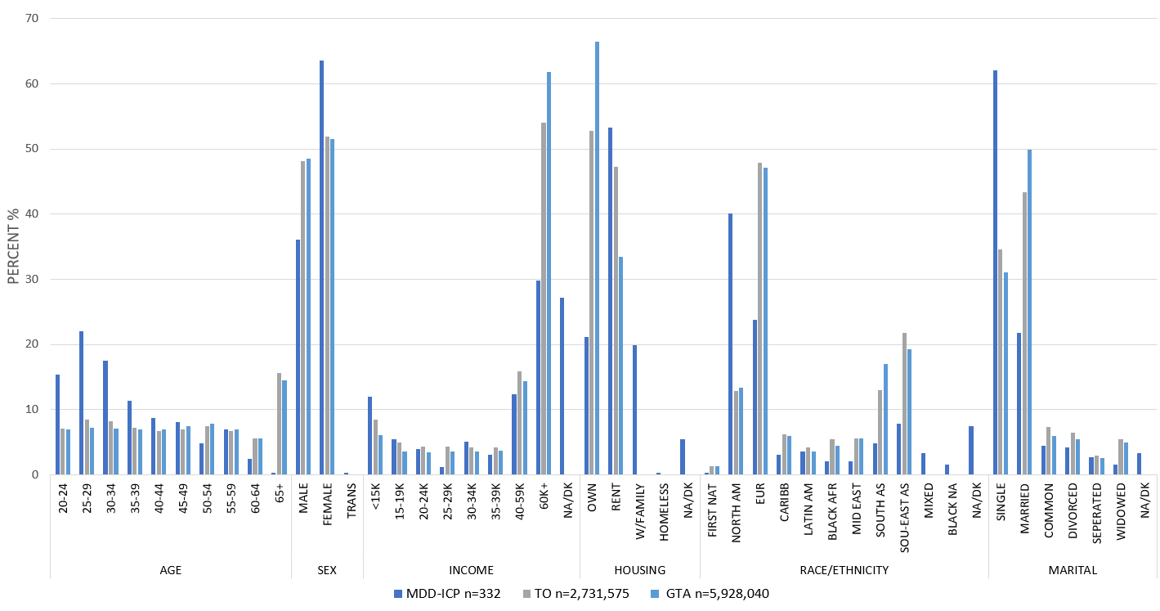
Who is accessing care? (outcomes)

Slide 6
Outcomes of care: Depression
Compare demographic groups on…
RESPONSE 50% reduction in depressive symptoms and anxiety symptoms
REMISSION score of <5 on depression and anxiety measure
RISK frequency of suicidal thinking

Slide 7
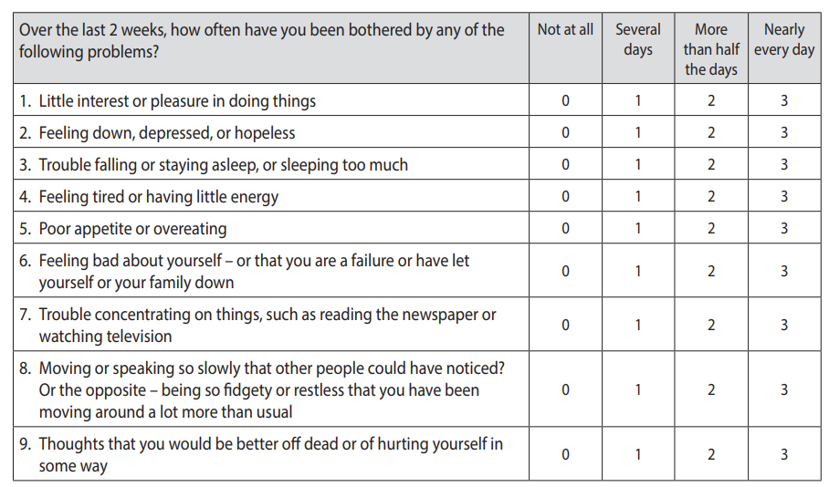
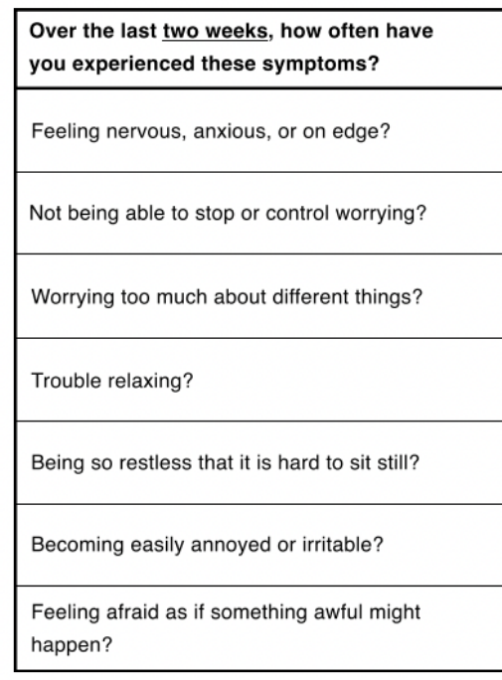
The Generalized Anxiety Disorder
Questionnaire (GAD-7)
The Patient Health Questionnaire (PHQ-9)

Slide 8
Outcomes of care: Schizophrenia
Compare demographic groups on…
Psychiatric SYMPTOM severity (two scales)
Day-to-day, social, and occupational FUNCTIONING (two scales)

Slide 9
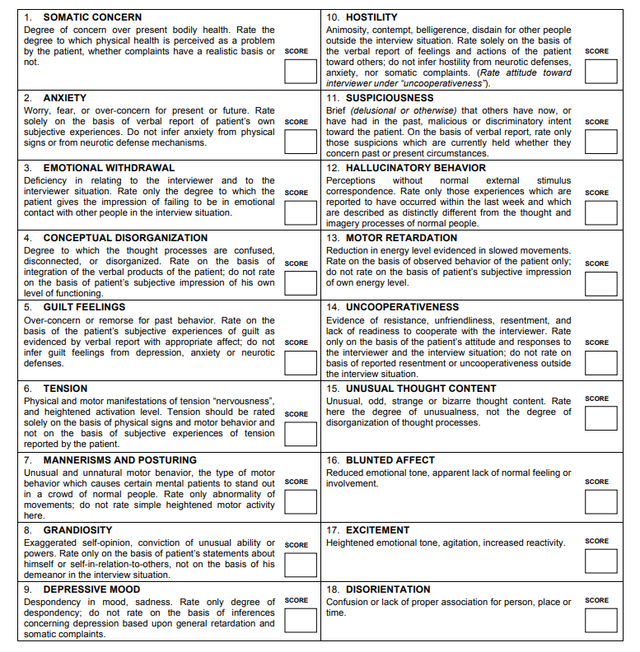
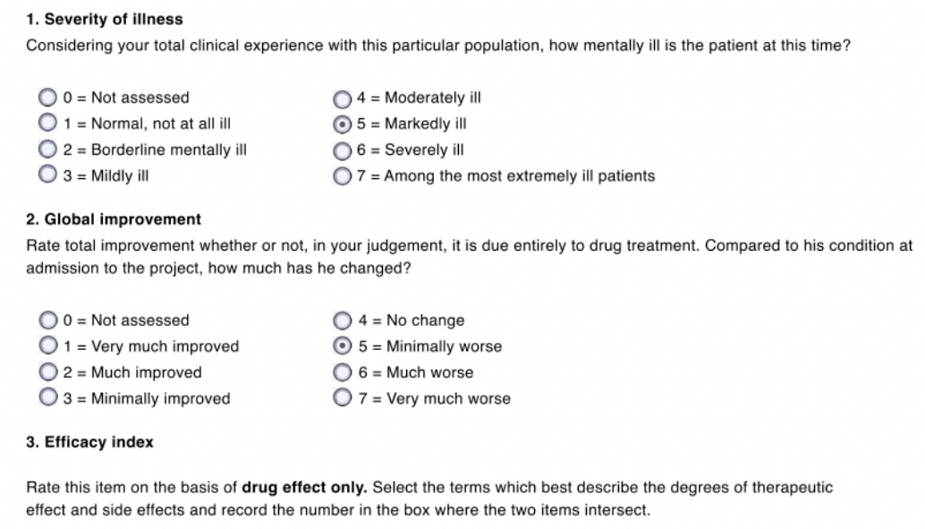
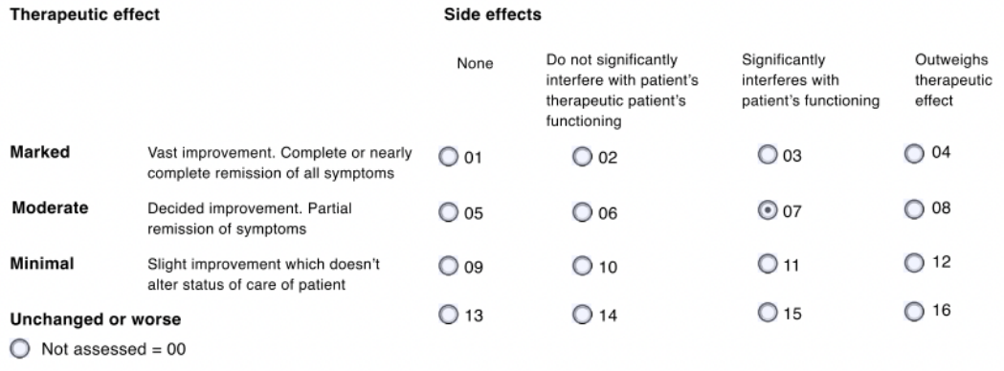
Brief Psychiatric Rating Scale (BPRS)
Clinical Global Impressions (CGI)

Slide 10
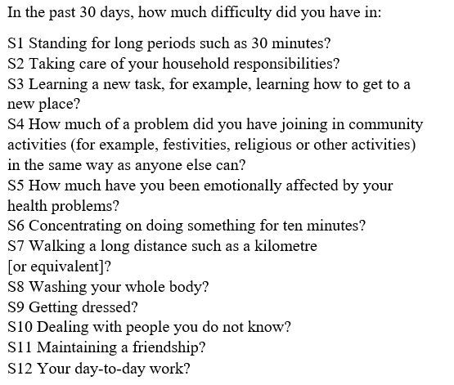
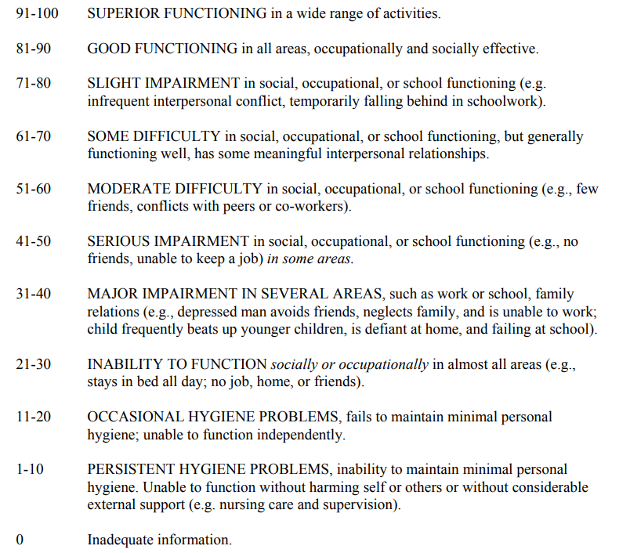
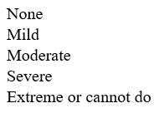
Social and Occupational Functioning Assessment Scale (SOFAS)
WHO-Disability Assessment Schedule (WHODAS)

Slide 11
Outcomes of care: Emergency
Compare demographic groups on…
number of ED visits since first visit (ACUITY or NEED)
number of ED visits within 30 days of first visit (INADEQUATE CARE)
assessment of violence/aggression (average, number of high scores)
number of restraints (mechanical/chemical) and seclusions
(PERCEPTIONS OF VIOLENCE RISK)

Slide 12
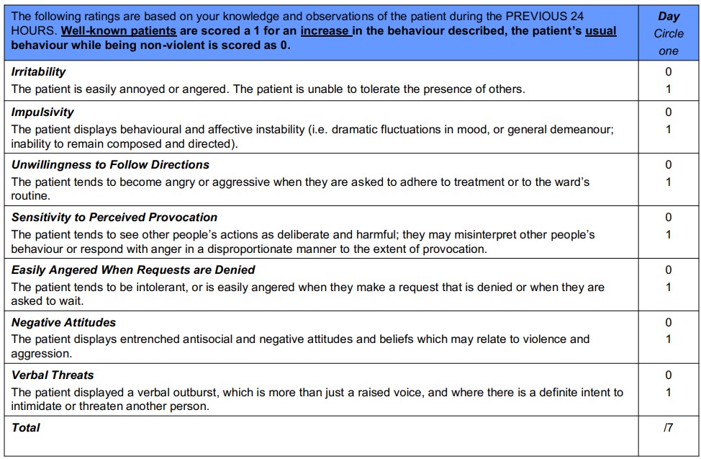
Dynamic Appraisal of Situational Aggression (DASA)

Slide 13




Outcomes of care
What do these outcomes tell us about values?
(What do patients value? What do clinicians value? What does society value?)
What do demographic disparities in outcomes mean?
Which demographic disparities are important to examine?
(i.e., intersectional groups)

