Slide 1

Mapping our Dashboard:
Storyboarding

Slide 2

Icebreaker: What is your favourite kind of story? And why?

Slide 3
The Story Spine
Once upon a time, ___________________.
Every day _______________________.
One day _______________________.
Because of this, _________________.
Because of that, __________________.
Until finally _____________.
And ever since then_____________.
https://www.youtube.com/watch?v=Ay4OChxR4vQ @1min20sec

Slide 4
The Tale of a Fairness Dashboard
An example of a user navigation experience using the story spine template

Slide 5
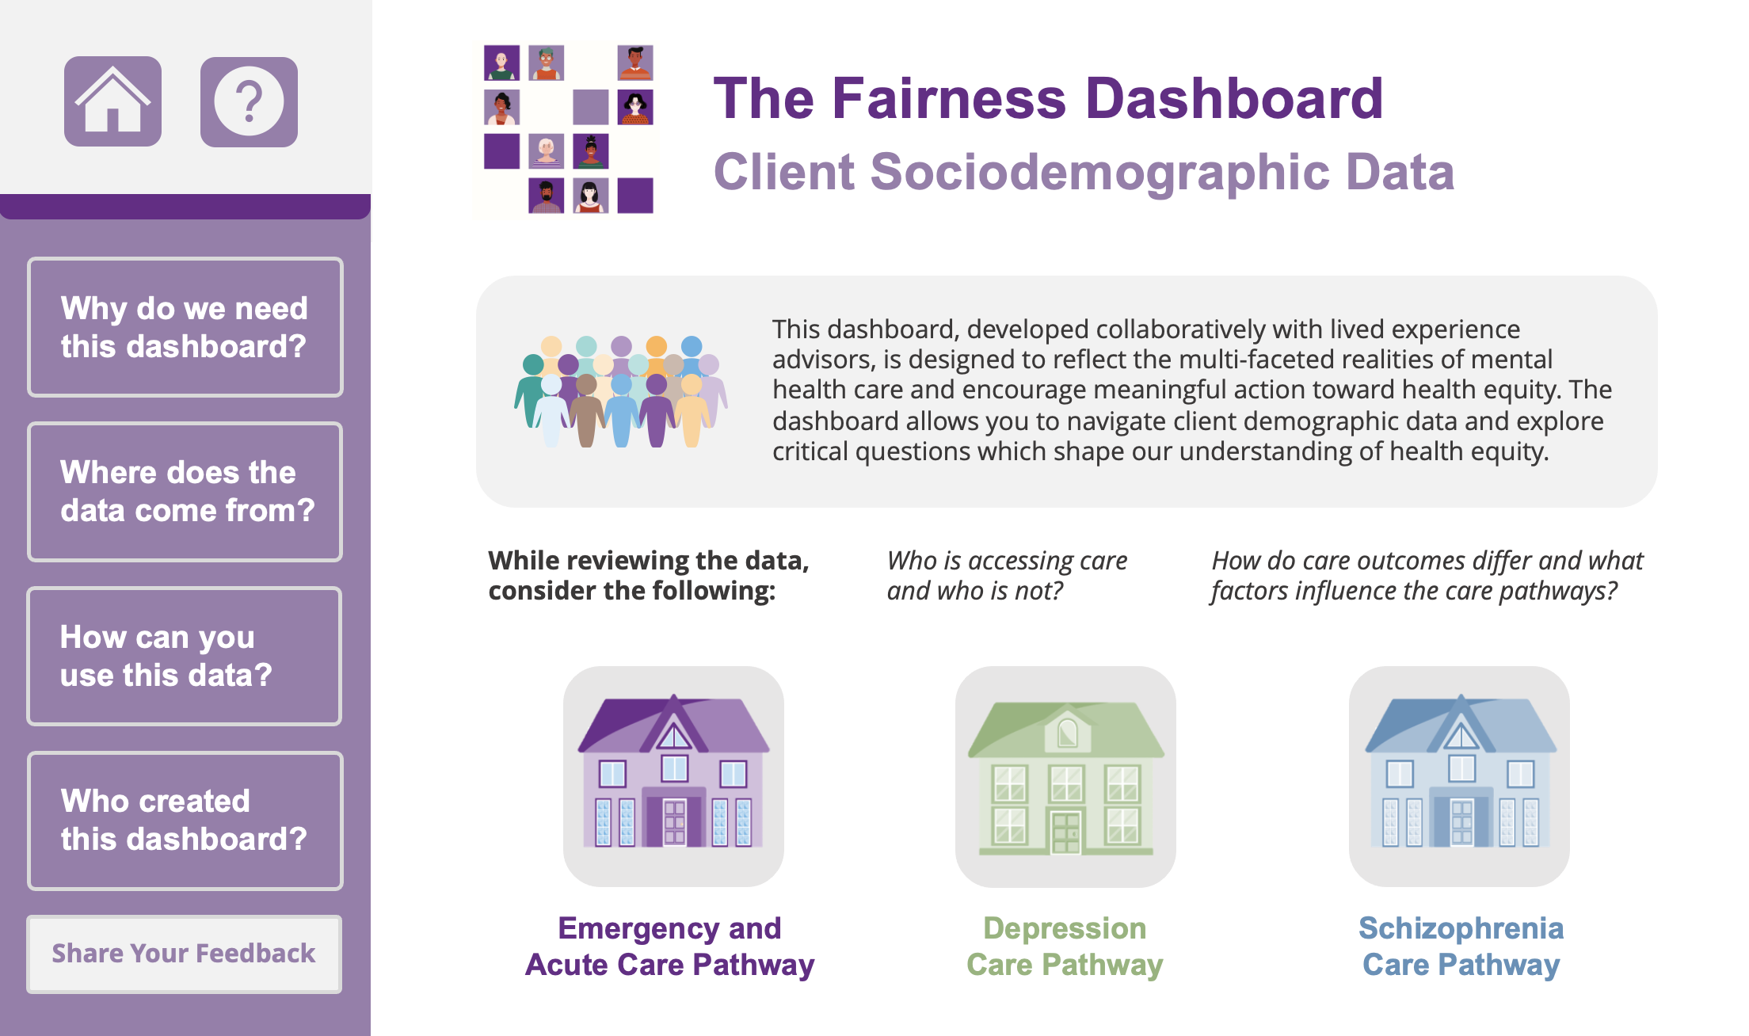
Once upon a time.....

Slide 6

Knowledge User Spotlight
Everyday.....
Nayantara
Data Scientist, Researcher
Values:
High-quality data
Reproducible high-impact science
Clarity (despises uncertainty)
Collaboration
Goal:
Desire for better access to health equity data both as human beings (“I want to live in a better world”) and as scientists (“I want to increase my impact, and I can do that if the data is representative”).
Notes:
Focused on how to use the dashboard, values, goals, impact of the dashboard, etc

Slide 7
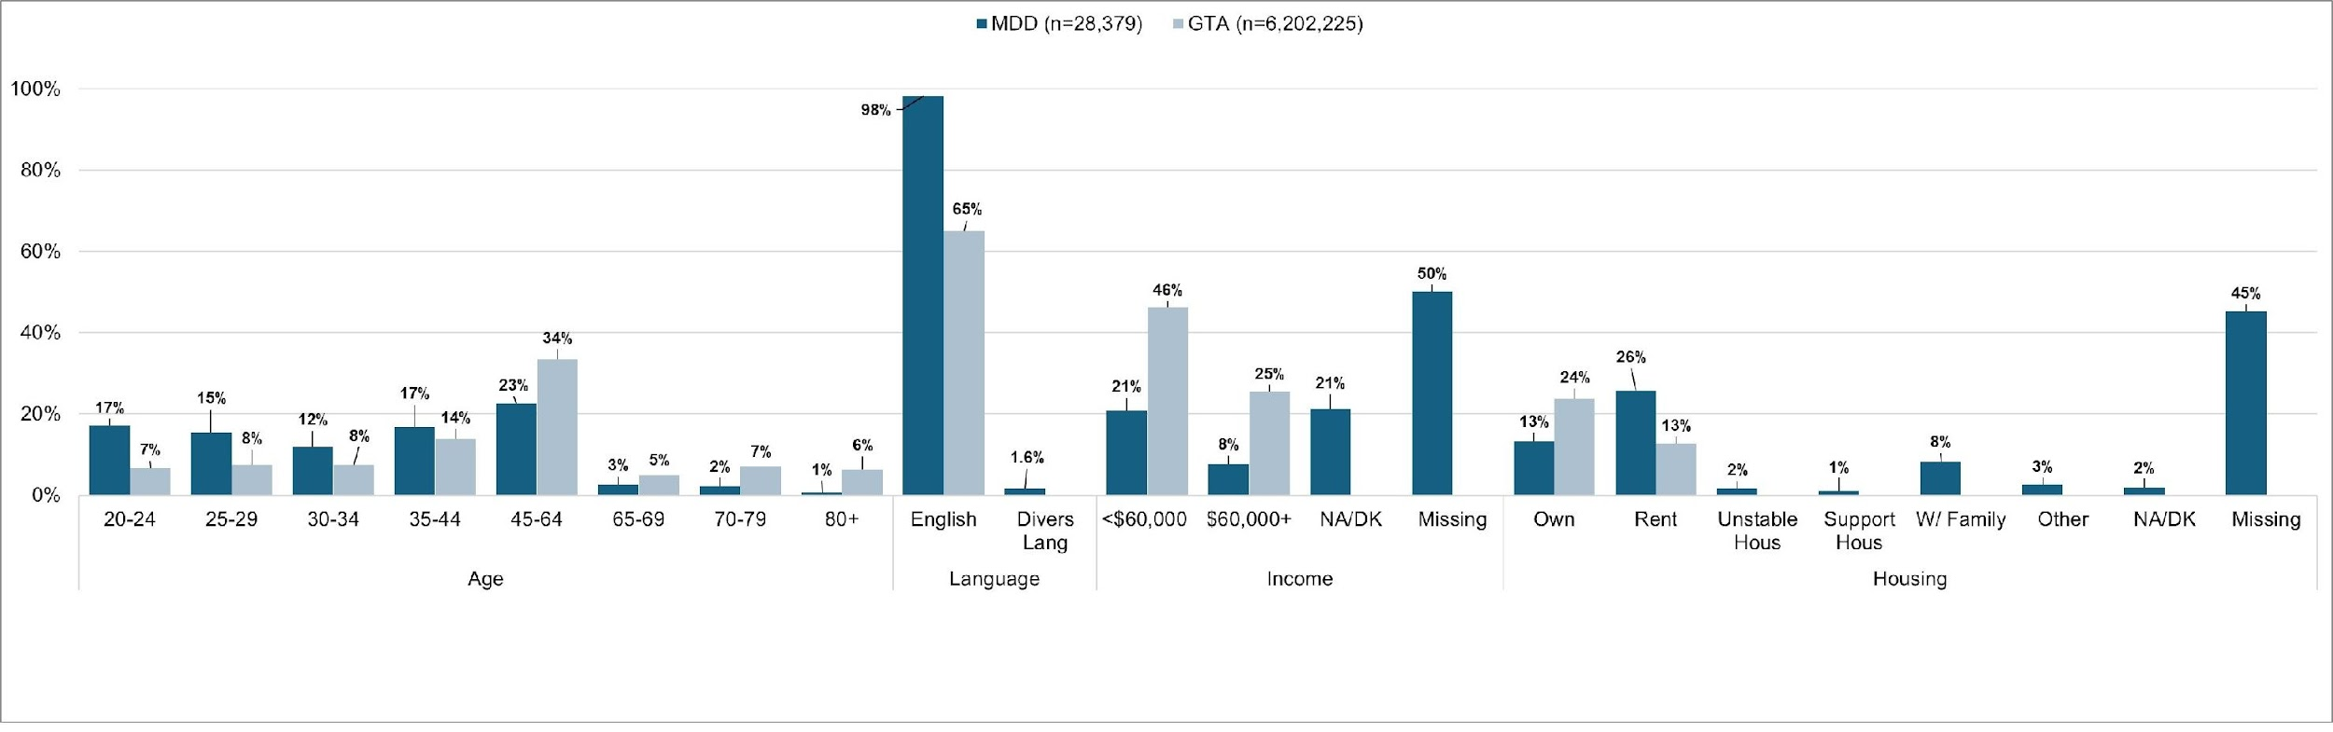
What We Noticed
One day.....
What
WHAT WE NOTICED
LANGUAGE
Notes:
Pull out age, housing, language, gender, income, - a handful for the advisors to work with in the storyboarding
The ultimate goal is to re-visit the objectives of the study – have the use of the dashboard be drive by patient values and perspectives

Slide 8
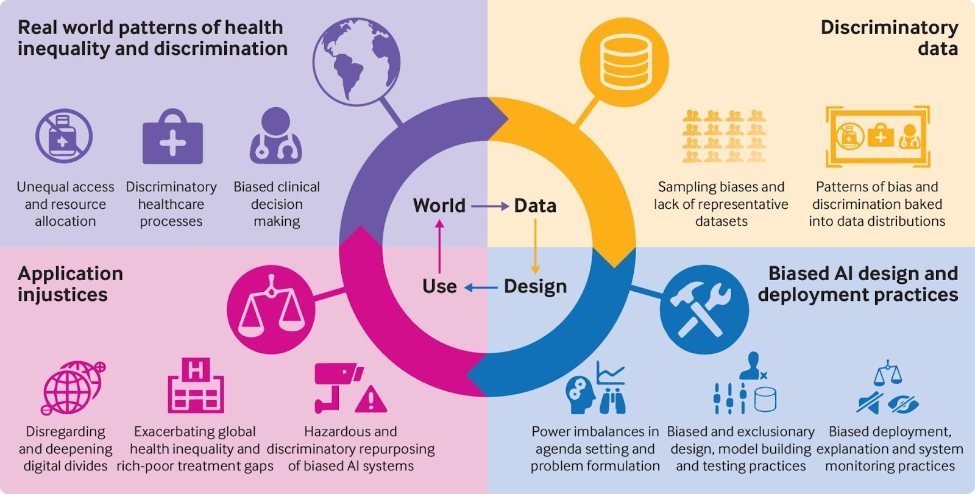
The Consequences
Because of this.....
https://www.lightly.ai/post/bias-in-machine-learning
Notes:
Consequence – people are not accessing care, gaps in access due to language barriers
Need for multi-lingual supports / care / interventions / assessments

Slide 9
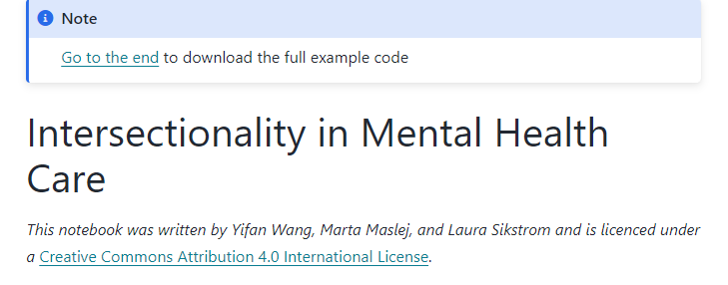
The Recommendations/Mitigations
Because of that.....
How can you use this data?
Notes:
The dashboard would highlight priority areas and disparities in access for select groups.
Research areas – more research looking at improving accessing to care for people who’s first language is not English

Slide 10
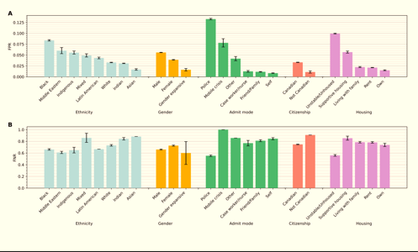
Early Feedback
Until finally.....

Slide 11
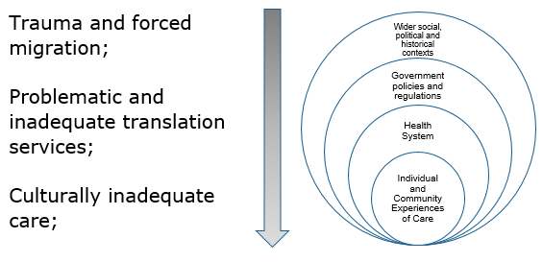
New Research
And ever since then.....

Slide 12

Activity – Storyboarding & What to Do With an Idea
"Yes and... [the heisenberg compensator principle]"
https://youtu.be/pEOz13x3YA4?si=bOGuj0CPhirVBQGp
Notes:
Encourage Analogus thinking
Concept map – workbook page 34
instinctively, howe excited are you about this iea
Innovative fresh does this idea feel
Practical, realistic or feasible

Slide 13
Everyday....
One day...
Because of this...

Slide 14
Because of that...
Until Finally...
And ever since then...

Slide 15
Visualizations - Storyboarding Activity

Slide 16
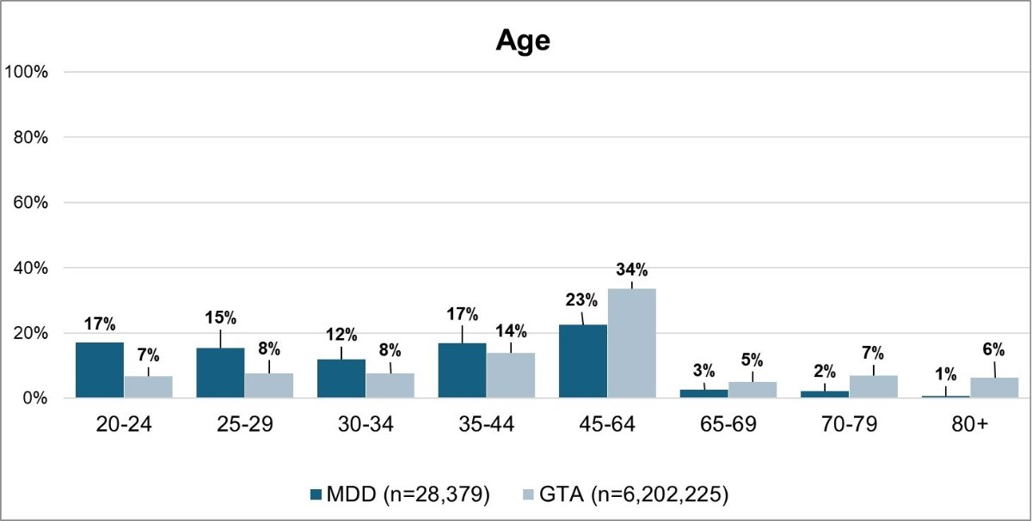
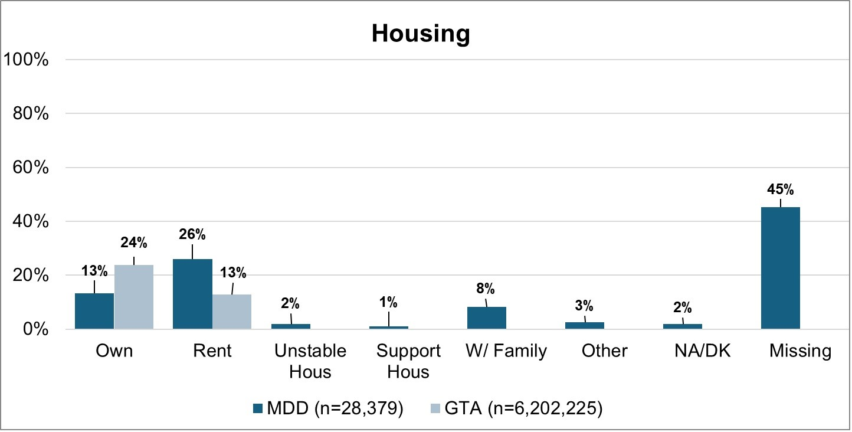
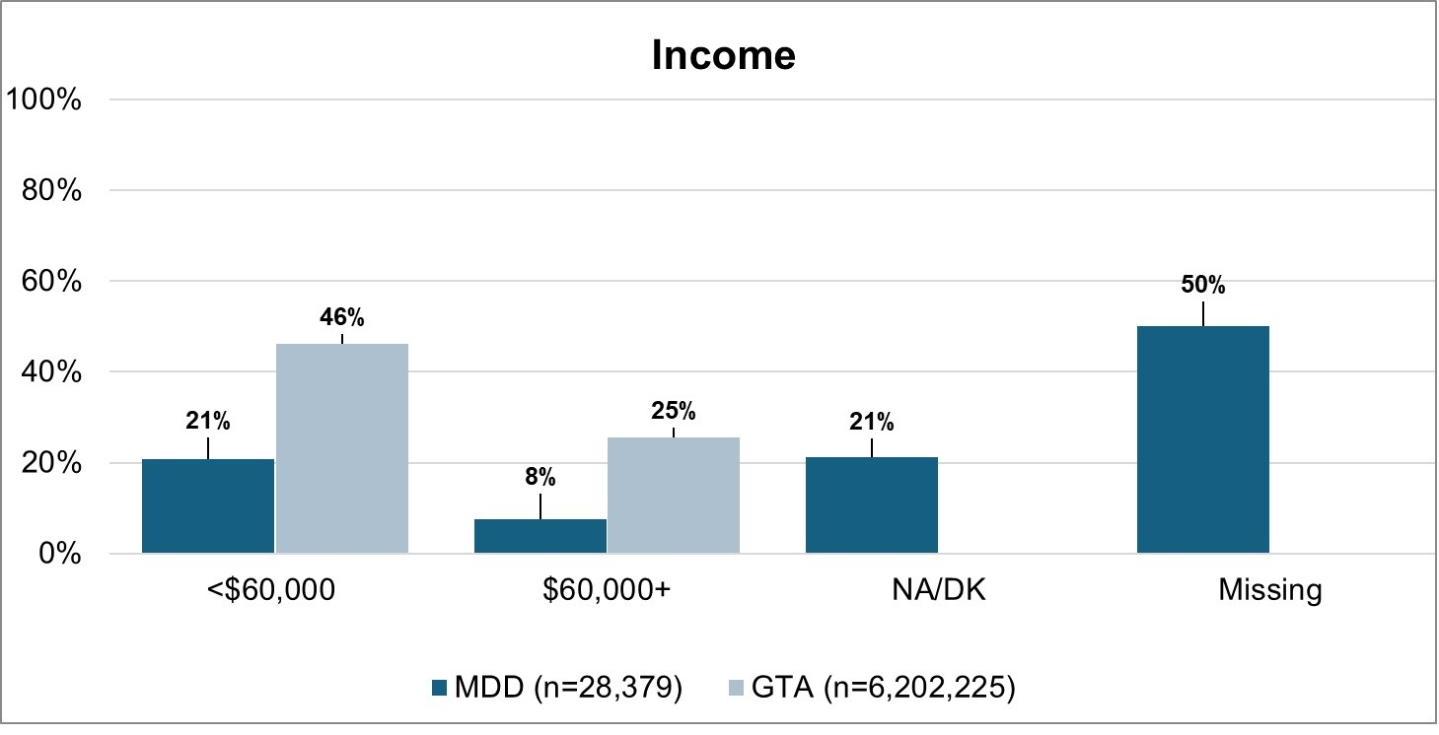
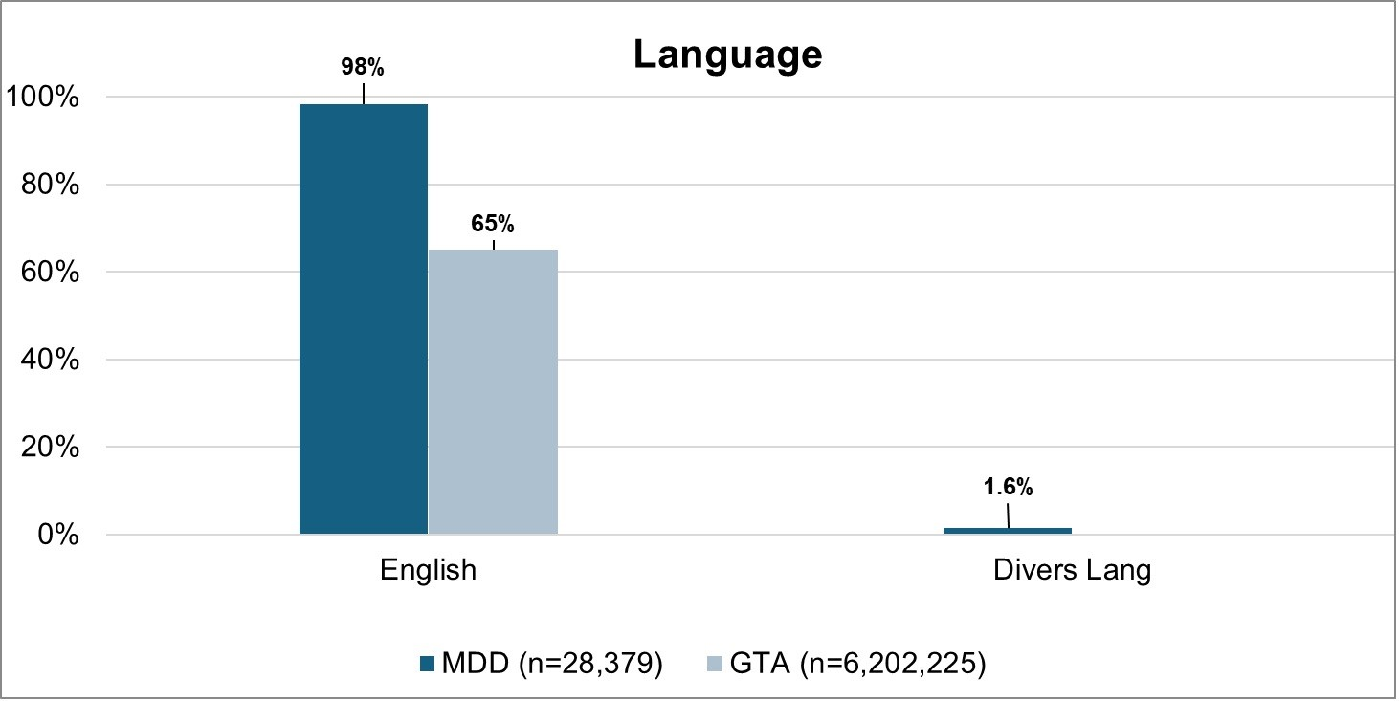
Visualizations - Storyboarding Activity Cont’d

Slide 17
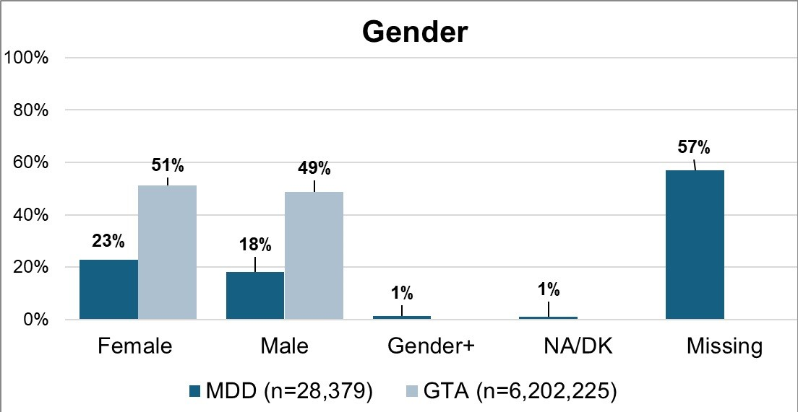

Slide 18
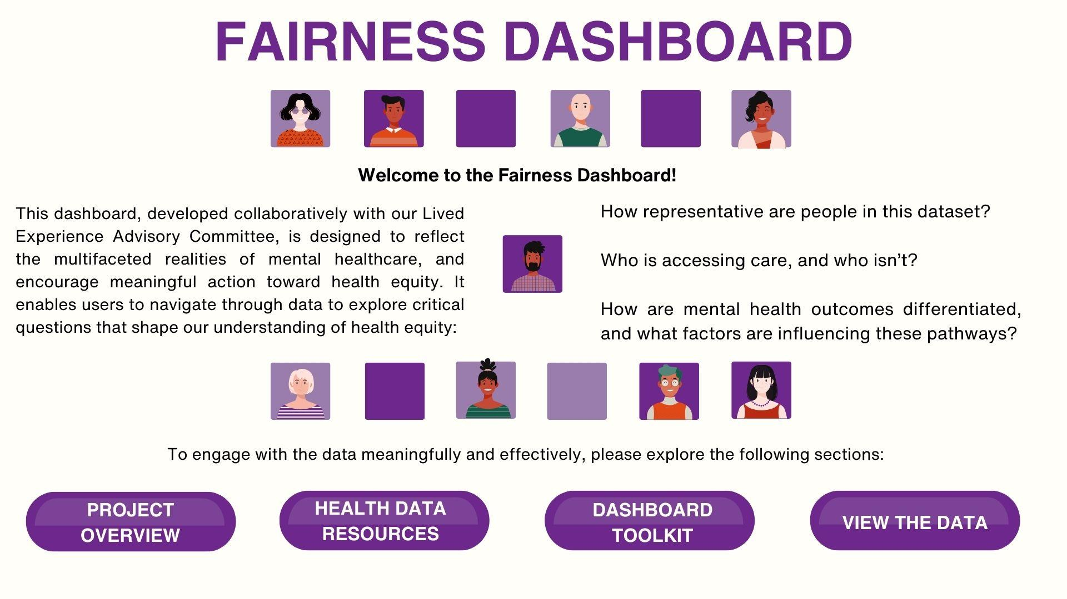

Slide 19







The Fairness Dashboard
Client Sociodemographic Data
How to Navigate this Dashboard
What is healthy equity data and why is it important?
Indicator Library & Definitions
Project Team & Background
Share Your Suggestions for Improvement
Emergency and Acute Care Pathway
Depression Care Pathway
Schizophrenia Care Pathway
Notes:
Not sure what accessibility features are available in tableau or superset

