Slide 1

Exploring
Equity Dashboards

Slide 2
Icebreaker: Numbers to me are…
Numbers and statistics significantly shape our worldview. As we explore data visualizations, we’d like you to reflect on what emotions or thoughts numbers evoke for you.

Slide 3
Storytelling with Dashboards
Responsible Design
Authentic representation
Universal accessibility
Intuitive structure
Clarity and focus
Your Task
Take 15 minutes to explore the dashboards that catch your eye, examining their features and functionalities.
Consider what aspects you find useful, as well as areas for potential improvement.

Slide 4
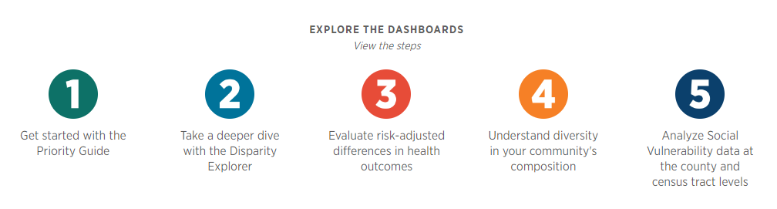
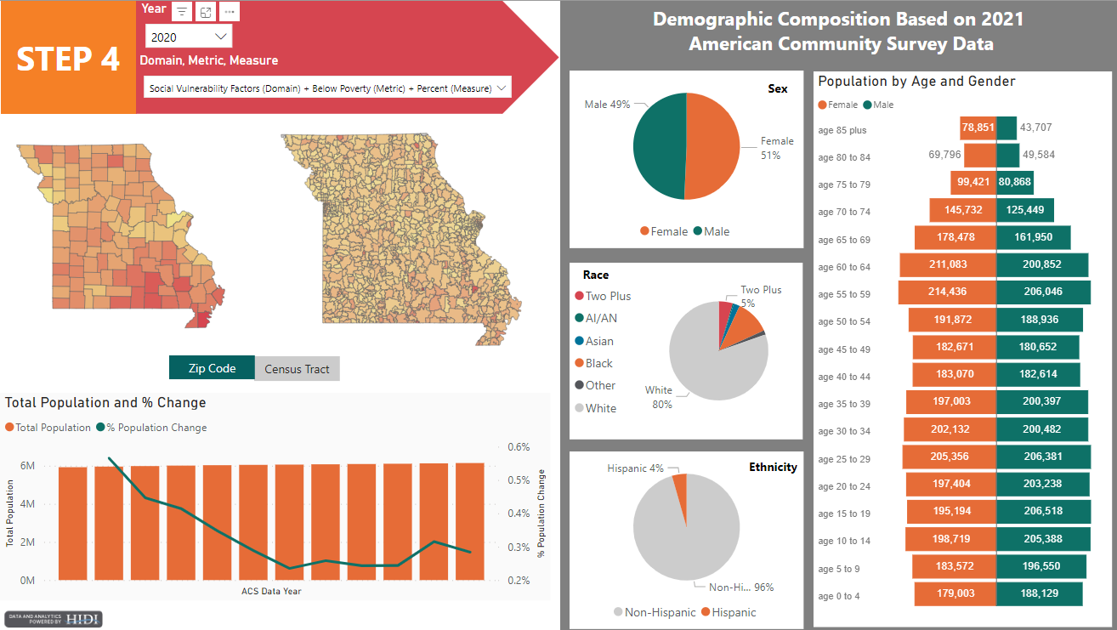
Missouri Hospital Association (MHA): Health Equity Dashboards
Purpose: Provides 5 interconnected dashboards that analyze health disparities and social determinants to support health equity strategies.
Features:
Condition prevalence
Risk-adjusted analysis
Community composition (county, census)
Sociodemographic comparisons
https://web.mhanet.com/health-equity-dashboards/#priority-guide

Slide 5
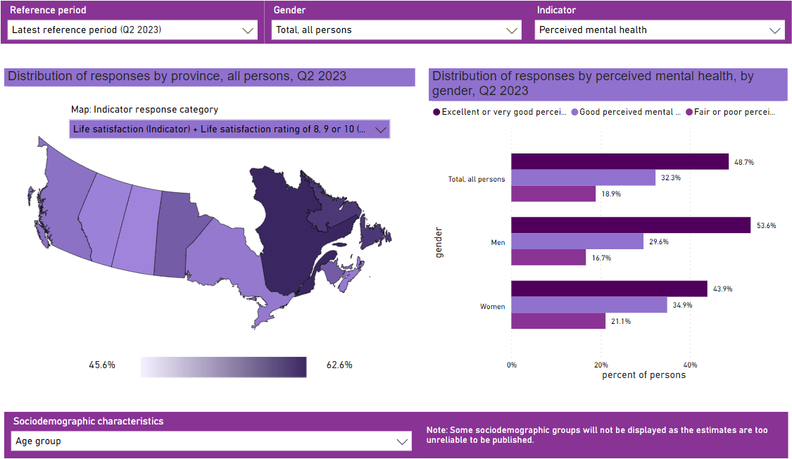
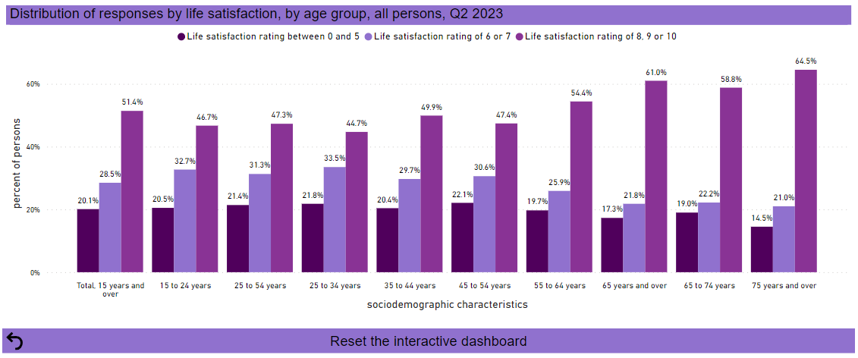
Statistics Canada:
Selected indicators of quality of life in Canada
Purpose: Tracks Canadians’ quality of life through key indicators sourced from the Canadian Social Survey (CSS).
Features:
Geographic distribution by gender
Distribution of responses by indicator and gender, sociodemographic characteristics
https://www150.statcan.gc.ca/n1/pub/71-607-x/71-607-x2022007-eng.htm

Slide 6
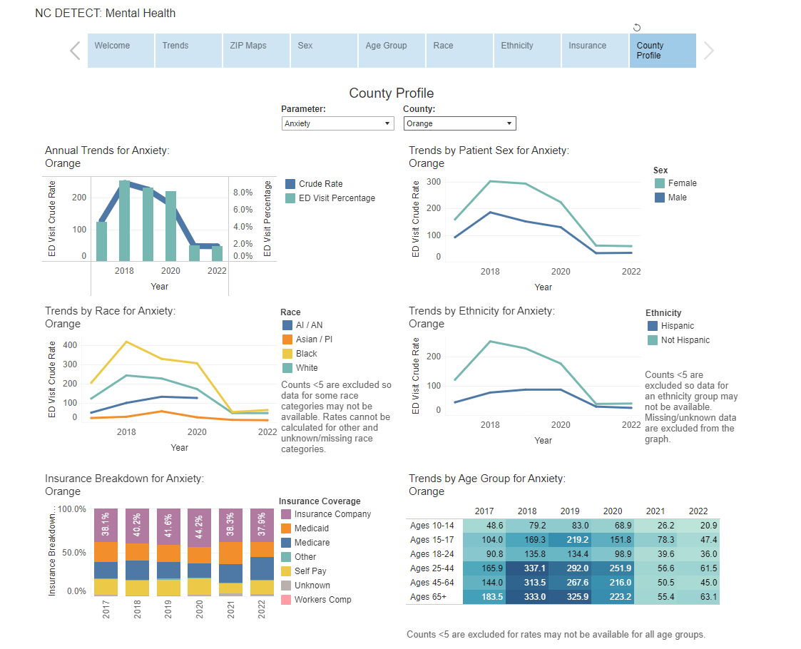
North Carolina (NC) Detect:
Mental Health Dashboard
Purpose: Explores ED visit trend for mental health conditions across NC.
Features:
Trends analysis by sociodemographics, mental health conditions
Geographic breakdown (ZIP/County)
https://ncdetect.org/mental-health-dashboard/

Slide 7
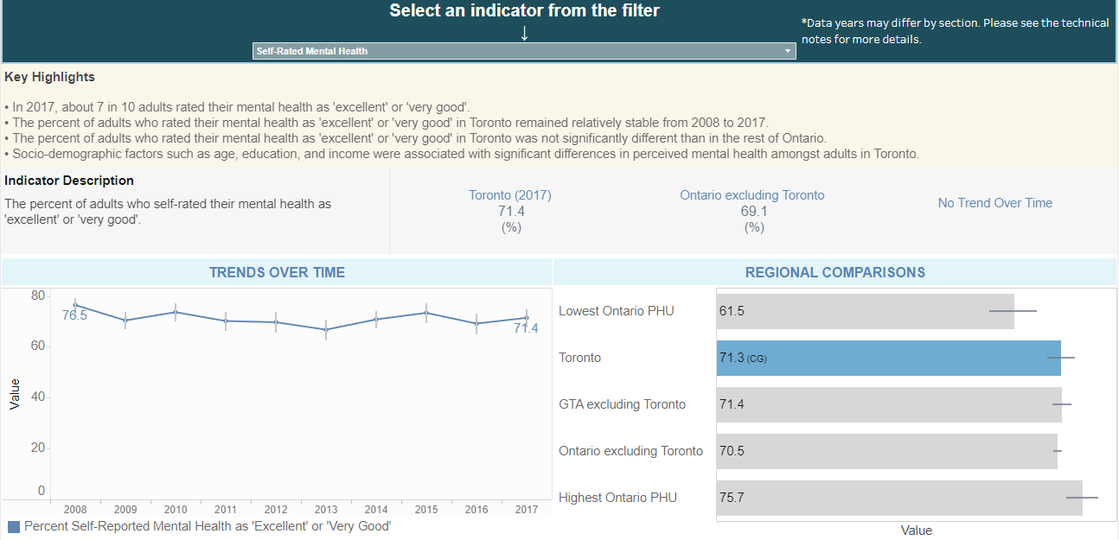
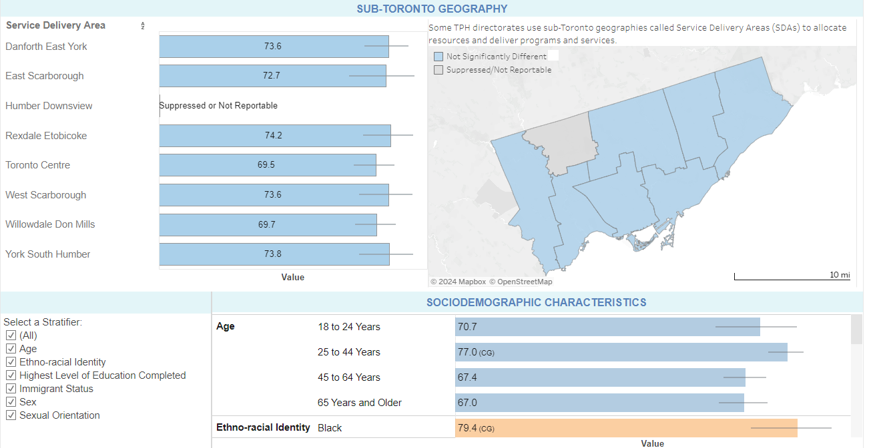
Toronto Public Health:
Population Health Status Indicator (PHSI) Dashboard
Purpose: Provides highlights and key information on population health status indicators from 5 areas of focus for the City of Toronto to reduce inequities.
Features:
Key data highlights and indicator description
Regional and demographic comparisons
Trends analysis
https://www.ontariohealthprofiles.ca/torontohealthstatus/index.php

Slide 8
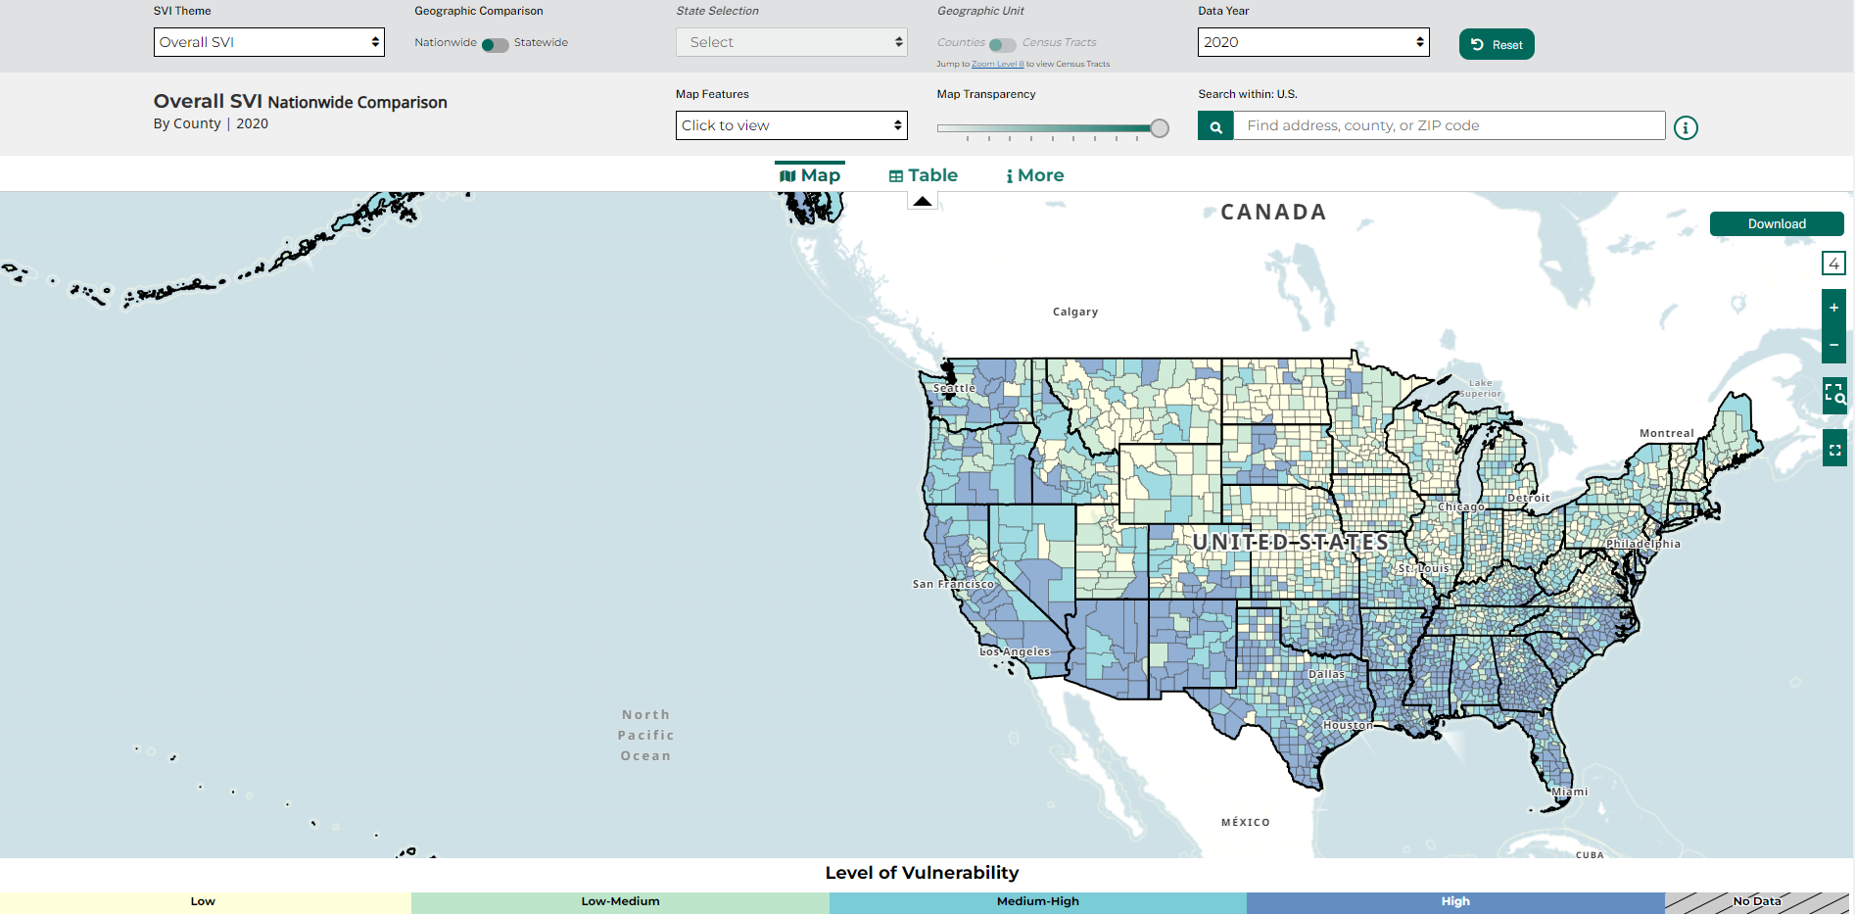
CDC/ATSDR:
Social Vulnerability Index (SVI)
Purpose: Identifies community vulnerability across the U.S. to natural and human-made hazards, using sociodemographic data highlight areas needing support.
Features:
Infrastructure mapping
Sociodemographic insights
Categorizes levels of vulnerability
https://www.atsdr.cdc.gov/placeandhealth/svi/interactive_map.html

Slide 9
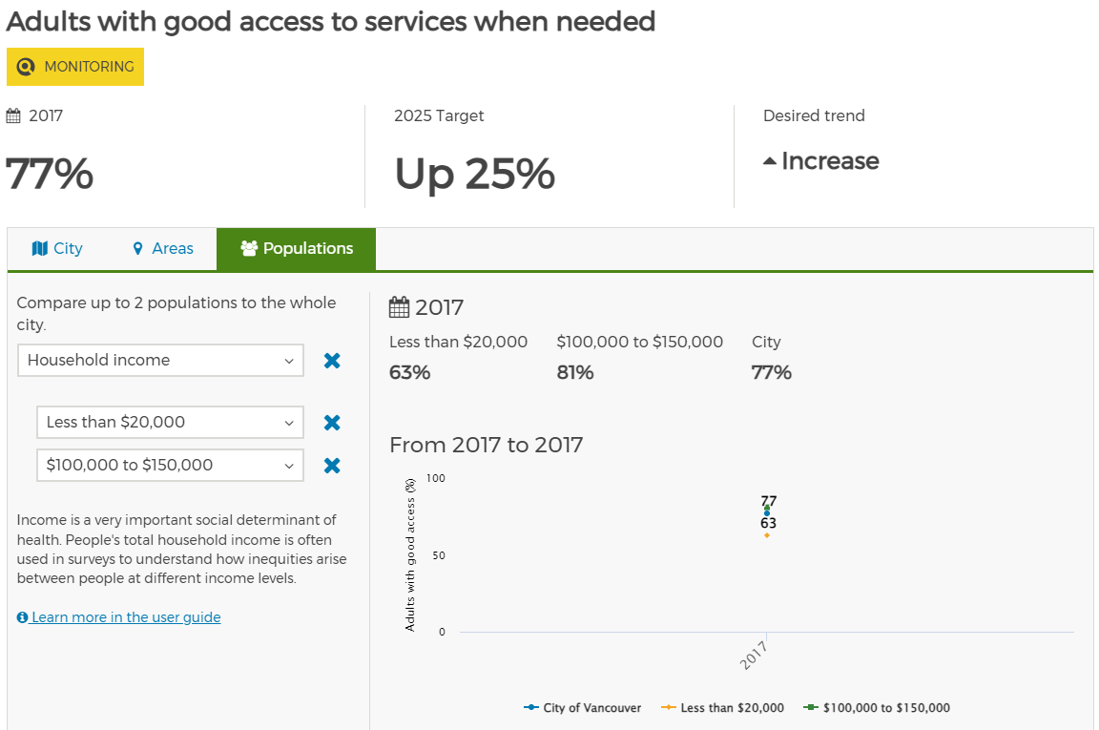
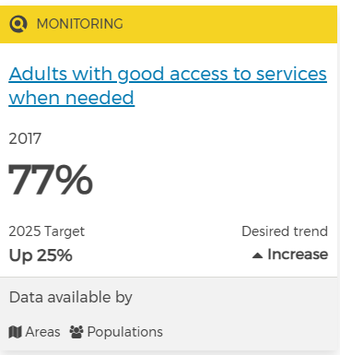
City of Vancouver:
Health City Dashboard
Purpose: Serves as a tool to identify and address inequities in social and economic factors impacting well-being in Vancouver.
Features:
Quick view of indicators
Goal-oriented monitoring
Rationale and analysis for each measure
Sociodemographic comparisons
Indicator quick view
https://opendata.vancouver.ca/pages/healthy-city-dashboard/

